Slide 1
Skeletal System-Histology
BSC2093L-Anatomy & Physiology I Lab

Slide 2
Histology
We will cover tissues that have functions such as holding structures together, separating groups of structures, support, protection and storage.
The 3 tissue types in this section are:
1. Hyaline cartilage
2. Compact Bone
3. Spongy Bone

Slide 3
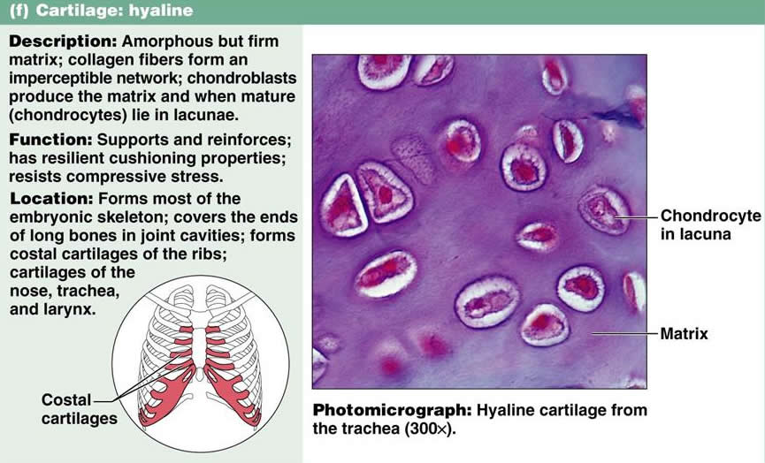
Hyaline Cartilage
This tissue is a connective tissue. It is created by cells called chondrocytes.

Slide 4
Hyaline cartilage

Slide 5
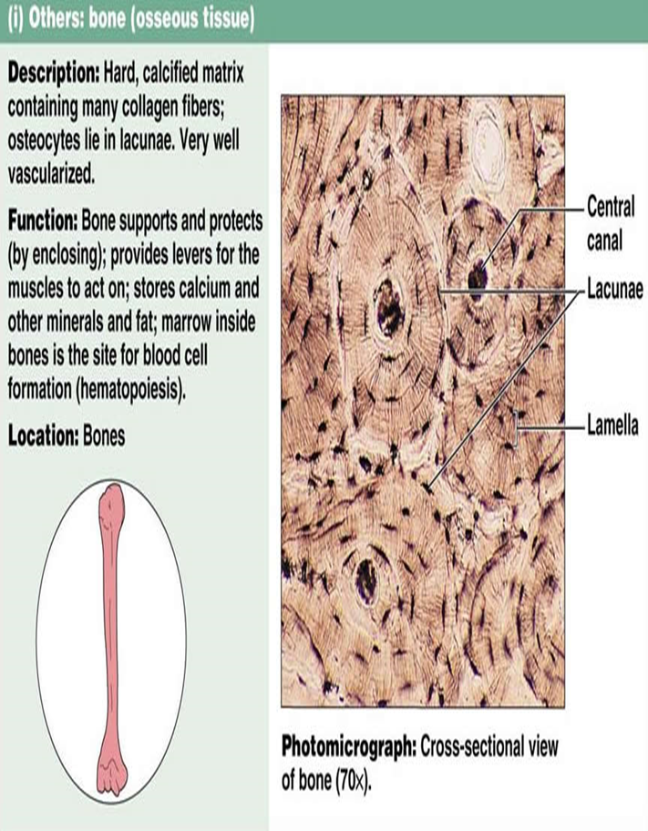
Compact bone
This is a connective tissue. It is made by cells called osteocytes.

Slide 6
Compact Bone

Slide 7
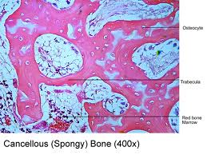
Spongy Bone
This is a connective tissue. It is made by cells called osteocytes.

Slide 8
Structure of a long bone

