Slide 1
RED BLOOD CELLS
INDIAN RIVER STATE COLLEGE
WEEK2

Slide 2
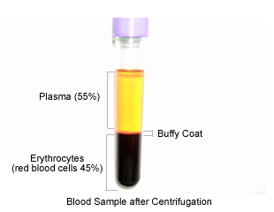
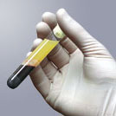
Review: Properties
4 to 6 liters
Plasma
55%
Formed elements
Buffy Coat
1%
Leukocytes and platelets
Erythrocytes
45%

Slide 3
Review: Plasma
Water (92%)
Proteins
Albumin, Globulins, Fibrinogen
Nutrients
Glucose, A.A.’s, Lactic Acid, Lipids, Iron, Trace elements, Vitamins
Electrolytes
Na⁺, Ca⁺⁺, K⁺, Mg⁺⁺, Cl⁻, HCO₃⁻,HPO₄⁻⁻,SO₄⁻⁻
Nitrogenous Wastes
Urea, Uric acid, Creatinine, Creatine, Ammonia, Bilirubin
Others
Dissolved CO2, O2, N2
Enzymes
Hormones

Slide 4
Review: Formed Elements
Erythrocytes
Platelets
Leukocytes (Percentage of total WBC’s)
Granulocytes
Neutrophils (60 to 70%)
Eosinophils (2 to 4%)
Basophils (< 0.5%)
Agranulocytes
Lymphocytes (25 to 33%)
Monocytes (3 to 8%)
“Never Let Monkeys Eat Bananas”

Slide 5
Polycythemia: above normal numbers of RBC’s
Anemia: below normal numbers of RBC’s
These are basic terms of these conditions, they are not what is causing the condition.
Some of the causes of each are listed ahead in the presentation under differential diagnosis.

Slide 6
Hematocrit or Packed Cell Volume (PCV)
The percentage of RBCs in whole blood
In the blood tube it is the lower section of fluid (refer back to the centrifuged blood tube picture or diagram.
Hematocrit %
National Institute of Health (NIH) Values
Male 40.1 - 51.0
Female 34.1 - 44.9

Slide 7
High Hematocrit Values
The following conditions could be the casue of the High values
severe burns
diarrhea
shock
Addison's disease
dehydration
Low Hematocrit Values
The following conditions could be the cause of low values
blood loss
cancers
kidney and liver diseases
malnutrition
vitamin B12 and folic acid deficiencies
iron deficiency
pregnancy
systemic lupus erythematosus
rheumatoid arthritis
peptic ulcer disease

Slide 8
Hemoglobin is a measure of the protein that makes up the oxygen carrying portion of the RBC’s, composed of four globulin proteins.
Abbreviation: Hb or Hgb
NIH Values
Male 13.7 - 17.5 g/dl
Female 11.2 - 15.7 g/dl

Slide 9
High Values of Hemoglobin
Anabolic steroids
Congenital heart disease
COPD
Dehydration
Emphysema
EPO
Heart failure
Kidney cancer
Living at high altitude
Other types of heart disease
Other types of lung disease
Polycythemia vera
Pulmonary fibrosis
Smoking
Low Values of Hemoglobin
Vitamin and iron deficiencies
Acute or chronic bleeding
Hormone deficiencies, such as thyroid hormone or testosterone
Chronic diseases, such as kidney failure, cancer and Crohn's disease
Autoimmune diseases, such as lupus
Side effect of certain medications, such as chemotherapy drugs

Slide 10
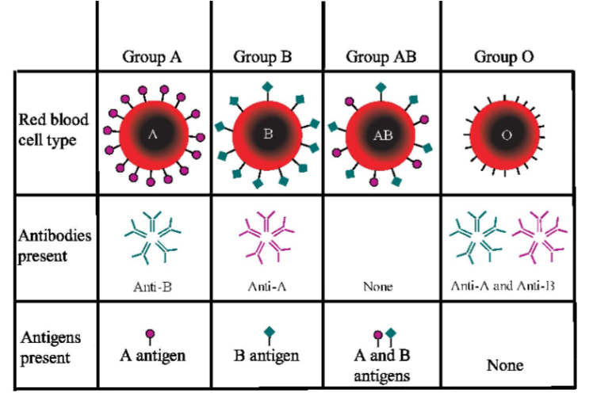

Slide 11
Type O blood is known as the UNIVERSAL DONOR. At the same time because it has both A and B antibodies, individuals with Type O blood can only receive blood from other Type O donors.
Type A blood can be donated to individuals with Type A and Type AB blood. This is because Type A blood will not trigger an antibody reaction in either of these types. Type A can receive blood from Type A or Type O.
Type B blood can be donated to individuals with Type B and Type AB blood. This is because Type B blood will not trigger an antibody reaction in individuals these individuals. Type B individuals can receive blood form Type B and Type O.
Type AB blood can be donated to individuals with Type AB blood only. Due to the dual antigen coat of Type AB blood, it causes an antibody response in all other blood types. Type AB blood on the other hand is known as the “UNIVERSAL RECEIPIENT” because individuals with this blood type have no antibodies that react to the presence of either the A or B blood antigen coat.

