Slide 1
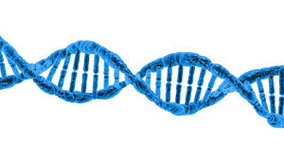
Chapter 3
Biological Macromolecules
General Biology I (BSC 2010)
Caption: DNA Structure (c)Pixabay, Public domain

Slide 2
Introduction: Learning Objectives
Understand how C is used to form macromolecules
How do functional groups play a role?
Contrast isomers with stereoisomers
Know four basic types of macromolecules
Understand how to build and breakdown macromolecules

Slide 3
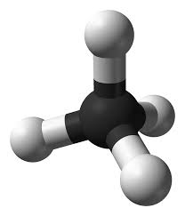
Carbon
Framework of organic compounds consists primarily of C bonded to other C, or N, O, P, S, or H
Forms up to 4 covalent bonds
Methane
(CH₄)
Caption: Ball-and-stick model of the methane molecule (c)Ben Mills, Public domain

Slide 4
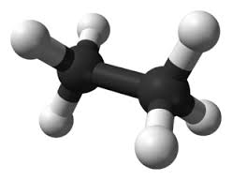
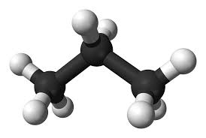
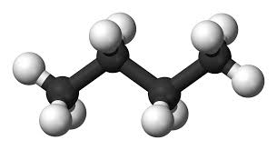
Carbon
Hydrocarbons: molecule consisting only of carbon and hydrogen
Nonpolar - most hydrocarbons (think oil/gas)
Functional groups add chemical properties
Biological molecules are made from hydrocarbon frames, and have functional groups that can make the molecules polar
Ethane Propane Butane
Caption: Ball-and-stick model of the ethane molecule (c)Ben Mills, Public domain
Caption: Ball-and-stick model of the propane molecule (c)Ben Mills, Public domain
Caption: Ball-and-stick model of the butane molecule (c)Ben Mills and Jynto, Public domain

Slide 5
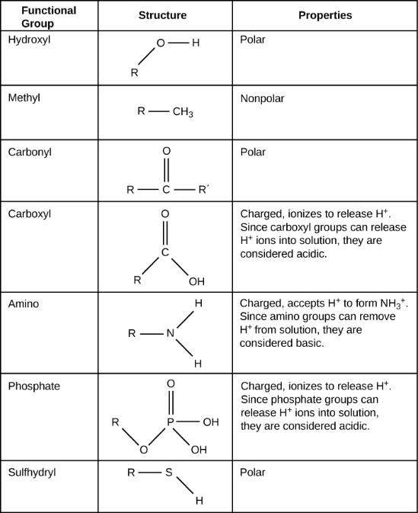
These functional groups can be found in carbohydrates, proteins, lipids, and nucleic acids.
Know all of these functional groups.
Caption: Biology, Functional Groups (c)CNX Openstax, Public domain

Slide 6
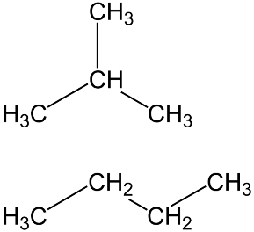
Isomers
Isomer: Molecules with the same molecular or empirical formula
Structural isomers: differences in the structure of the carbon skeleton
Stereoisomers: same carbon skeleton, but different in arrangement
Structural Isomers
Isobutane
Butane
Caption: The structures of isobutane and n-butane – a simple example of isomerism (c)Created with ACD/ChemSketch Freeware by Tsemii, Public domain

Slide 7
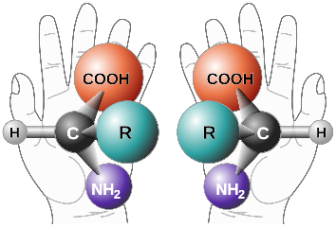
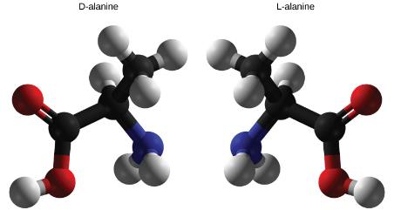
Isomers
Stereoisomers: differ in how groups attached
Enantiomers:
mirror image molecules = chiral
D-sugars (dextro/right) and L-amino acids (levo/left)
Caption: Chirality with hands -modified (c)Perhelion, Public domain
Caption: Biology (c)CNX Openstax, Public domain

Slide 8
Types of Macromolecules
Polymer – built by linking monomers
Monomer – small, similar chemical subunits
Monomers
Polymers

Slide 9
Types of Macromolecules
Macromolecules: large biological molecules
Proteins: monomers = amino acids
Carbohydrates: monomers = monosaccharides
3. Nucleic acids: monomers = nucleotides
4. Lipids: aren’t built of monomers but form large complexes considered macromolecules

Slide 10
Building Macromolecules (Fig 3.2)
Dehydration Synthesis
Formation of large molecules by the removal of water
Monomers are joined to form polymers
Monomers
Polymer
Caption: Dehydration synthesis (c)Openstax College, Public domain

Slide 11
Breaking Macromolecules (Fig 3.3)
Hydrolysis
Breakdown of large molecules by the addition of water (hydro=water, lysis=break)
Polymers are broken down to monomers
Polymer
Monomers
Caption: Hydrolysis (c)Openstax College, Public domain

Slide 12
Macromolecules: Learning Objectives
For the four macromolecules (carbs, nucleic acids, protein, and lipids)
Know what is the monomer
How are polymers made
How are they used in the cell

Slide 13
Figure 3.1
Download for free at http://cnx.org/contents/185cbf87-c72e-48f5-b51e-f14f21b5eabd@10.61
Credit: modification of work by Bengt Nyman
Foods such as bread, fruit, and cheese are rich sources of biological macromolecules.

Slide 14
Carbohydrates
Molecules with a 1:2:1 ratio of carbon, hydrogen, oxygen
Empirical formula (CH₂O)_{n}
C-H covalent bonds hold much energy
Carbohydrates are good energy storage molecules
Examples: Sugars, Starch, Glucose

Slide 15
Carbohydrates
Three Major Groups:
Monosaccharaides
Disaccharides
Polysaccharides
Know definition, example, functions, and how they form for each.
Example: Starch is an energy storage molecule that is formed of glucose molecules linked by covalent bonds through dehydration synthesis.

Slide 16
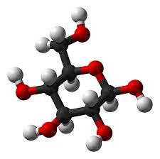
Monosaccharides
Simplest carbohydrate
6 carbon sugars play important roles
Glucose C₆H₁₂O₆
Glucose (C₆H₁₂O₆)
Caption: Alpha–D-glucose (c)Ben Mills, Public domain

Slide 17
Monosaccharides
Examples of Monosaccharides:
Glucose
Fructose is a structural isomer of glucose
Galactose is a stereoisomer of glucose
Enzymes that act on different sugars can distinguish structural and stereoisomers of this basic six-carbon skeleton

Slide 18
Figure 3.4
Monosaccharides are classified based on the position of their carbonyl group and the number of carbons in the backbone.
Aldoses have a carbonyl group (indicated in green) at the end of the carbon chain, and ketoses have a carbonyl group in the middle of the carbon chain.
Trioses, pentoses, and hexoses have three, five, and six carbon backbones, respectively.
Download for free at http://cnx.org/contents/185cbf87-c72e-48f5-b5
1e-f14f21b5eabd@10.61

Slide 19
Figure 3.5
Download for free at http://cnx.org/contents/185cbf87-c72e-48f5-b51e-f14f21b5eab
d@10.61
Glucose, galactose, and fructose are all hexoses. They are structural isomers, meaning they have the same chemical formula (C₆H₁₂O₆) but a different arrangement of atoms.

Slide 20
Figure 3.6
Five and six carbon monosaccharides exist in equilibrium between linear and ring forms. When the ring forms, the side chain it closes on is locked into an α or β position.
Fructose and ribose also form rings, although they form five-membered rings as opposed to the six-membered ring of glucose.
Download for free at http://cnx.org/contents/185cbf87-c72e-48f5-b51e-f14
f21b5eabd@10.61

Slide 21
Disaccharides
2 monosaccharides linked together by dehydration synthesis
Used for sugar transport or energy storage
Examples: sucrose, lactose, maltose
Download for free at http://cnx.org/contents/185cbf87-c72e-48f5-b51e-f14f21b5eabd@10.61

Slide 22
Figure 3.7
Sucrose is formed when a monomer of glucose and a monomer of fructose are joined in a dehydration reaction to form a glycosidic bond. In the process, a water molecule is lost. By convention, the carbon atoms in a monosaccharide are numbered from the terminal carbon closest to the carbonyl group. In sucrose, a glycosidic linkage is formed between carbon 1 in glucose and carbon 2 in fructose.
Download for free at http://cnx.org/contents/185cbf87-c72e-48f5-b51e-f
14f21b5eabd@10.61

Slide 23
Polysaccharides
Long chains of monosaccharides
Linked through dehydration synthesis
Four major classes:
Starch: energy storage in plants (rice, pasta, potatoes)
Glycogen: short term energy storage in animals
Cellulose: structural molecule of plants (dietary fiber: this is why fiber is listed under the carbohydrate section of food label).
Chitin: structural support in insects, arthropods (exoskeleton), fungal cell walls

Slide 24
Figure 3.9
Amylose and amylopectin are two different forms of starch.
Amylose is composed of unbranched chains of glucose monomers connected by α 1,4 glycosidic linkages.
Amylopectin is composed of branched chains of glucose monomers connected by α 1,4 and α 1,6 glycosidic linkages. Because of the way the subunits are joined, the glucose chains have a helical structure.
Glycogen (not shown) is similar in structure to amylopectin but more highly branched.
Download for free at http://cnx.org/contents/185cbf87-c7
2e-48f5-b51e-f14f21b5eabd@10.61

Slide 25
Figure 3.10
Download for free at http://cnx.org/contents/185cbf87-c72e-48f5-b51e-f14f21b5eabd@10.61
In cellulose, glucose monomers are linked in unbranched chains by β 1-4 glycosidic linkages. Because of the way the glucose subunits are joined, every glucose monomer is flipped relative to the next one resulting in a linear, fibrous structure.

Slide 26
Figure 3.11
Download for free at http://cnx.org/contents/185cbf87-c72e-48f5-b
51e-f14f21b5eabd@10.61
Credit: Louise Docker
Insects have a hard outer exoskeleton made of chitin, a type of polysaccharide.

Slide 27
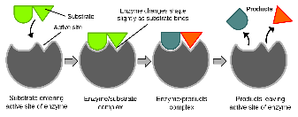
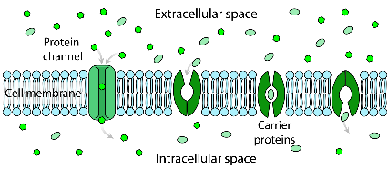
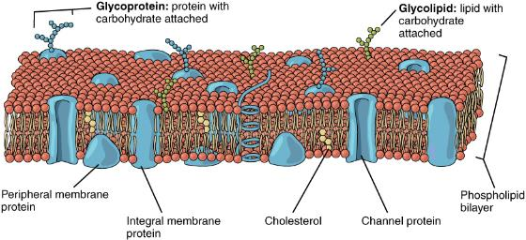
Proteins
Caption: Induced Fit Diagram (c)Mariana Ruiz Villarreal, Public domain
Protein functions include:
1. Enzyme catalysis
2. Defense
3. Transport
4. Support
5. Motion
6. Regulation
7. Storage
Caption: Scheme Facilitated Diffusion In Cell Membrane (c)Mariana Ruiz Villarreal, Public domain
Caption: Lipid Bilayer With Various Components (c)Openstax, Public domain

Slide 28
Figure 3.22
Central carbon atom
Amino group
Carboxyl group
Single hydrogen
Variable R Group (makes each A.A. unique)
4
1
2
3
5
Download for free at http://cnx.org/contents/185cbf87-c72e-48f5-b5
1e-f14f21b5eabd@10.61
Amino acids have a central asymmetric carbon to which an amino group, a carboxyl group, a hydrogen atom, and a side chain (R group) are attached.

Slide 29
Figure 3.23
There are 20 common amino acids commonly found in proteins, each with a different R group (variant group) that determines its chemical nature.
Download for free at http://cnx.org/contents/185cbf87-c72e-48f5-b51e-f14f21b5eab
d@10.61

Slide 30
Figure 3.24
Download for free at http://cnx.org/contents/185cbf87-c72e-48f5-b51e-f14f2
1b5eabd@10.61
Peptide bond formation is a dehydration synthesis reaction. The carboxyl group of one amino acid is linked to the amino group of the incoming amino acid. In the process, a molecule of water is released.

Slide 31
Proteins
Proteins are polymers made of Amino Acid monomers
There are 20 amino acids
Combinations of these 20 AA make up long chains from 2 to over 5,000 or more AA in length
Each chain is a polypeptide
AA link together by a peptide bond to form the long chain polymers of proteins

Slide 32
4 Levels of Protein Structure
Primary structure: sequence of amino acids
Amino acids linked by peptide bonds
Millions of different proteins made from the 20 A.A.
A.A. sequence: amino acids give 3 or 1 letter abbreviation
*Arrows point to the central carbon that has the R group attached.
Caption: Primary Structure of Silk Fibroin (c)Sponk, Public domain

Slide 33
Figure 3.28
Download for free at http://cnx.org/contents/185cbf87-c72e-48f5-b51e-f14f2
1b5eabd@10.61
The α-helix and β-pleated sheet are secondary structures of proteins that form because of hydrogen bonding between carbonyl and amino groups in the peptide backbone. Certain amino acids have a propensity to form an α-helix, while others have a propensity to form a β-pleated sheet.

Slide 34
Figure 3.29
Download for free at http://cnx.org/contents/185cbf87-c72e-48f5-b51e-f14f21b5eabd@10.61
The tertiary structure of proteins is determined by a variety of chemical interactions. These include hydrophobic interactions, ionic bonding, hydrogen bonding and disulfide linkages. The final level of structure for proteins that consists of only a single polypeptide chain.

Slide 35
Quaternary structure: arrangement of individual chains (subunits) in a protein with 2 or more polypeptide chains.
Caption: Main Protein Structure Levels
(c)LadyofHats, Public domain

Slide 36
Figure 3.30
The four levels of protein structure can be observed in these illustrations. (credit: modification of work by National Human Genome Research Institute)
The primary protein structure is usually linear.
Download for free at http://cnx.org/contents/185cbf87-c72e-48f5-b5
1e-f14f21b5eabd@10.61

Slide 37
Figure 3.25
Download for free at http://cnx.org/contents/185cbf87-c72e-48f5-b51e-f14f21b5eabd@10.61
Bovine serum insulin is a protein hormone made of two peptide chains, A (21 amino acids long) and B (30 amino acids long). In each chain, primary structure is indicated by three-letter abbreviations that represent the names of the amino acids in the order they are present.
The amino acid cysteine (cys) has a sulfhydryl (SH) group as a side chain. Two sulfhydryl groups can react in the presence of oxygen to form a disulfide (S-S) bond. Two disulfide bonds connect the A and B chains together, and a third helps the A chain fold into the correct shape. Note that all disulfide bonds are the same length, but are drawn as different sizes for clarity.

Slide 38
Figure 3.26
Download for free at http://cnx.org/contents/185cbf87-c72e-48f5-b51e-f14f21b5eabd@10.61
The beta chain of hemoglobin is 147 residues in length, yet a single amino acid substitution leads to sickle cell anemia. In normal hemoglobin, the amino acid at position seven is glutamate. In sickle cell hemoglobin, this glutamate is replaced by a valine.

Slide 39
Figure 3.27
Download for free at http://cnx.org/contents/185cbf87-c72e-48f5-b51ef14f21b5eabd@10.61
Credit: modification of work by Ed Uthman; scale-bar data from Matt Russell
In this blood smear, visualized at 535x magnification using bright field microscopy, sickle cells are crescent shaped (arrows in dark blue), while normal cells are disc-shaped (arrows in red).

Slide 40
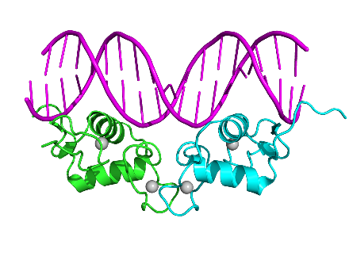
Additional Structural Characteristics
Domains
Functional units within a larger structure
Most proteins made of multiple domains that perform different parts of the protein’s function
Example: DNA binding domain
Domain 1
Domain 2
Caption: Human Progesterone Receptor DNA-Binding Domain Dimer (c)Boghog2, Public domain

Slide 41
Chaperones
Chaperone proteins: help proteins fold correctly
Deficiencies in chaperone proteins implicated in certain diseases
Cystic fibrosis is a hereditary disorder
In some individuals, protein appears to have correct amino acid sequence but fails to fold

Slide 42
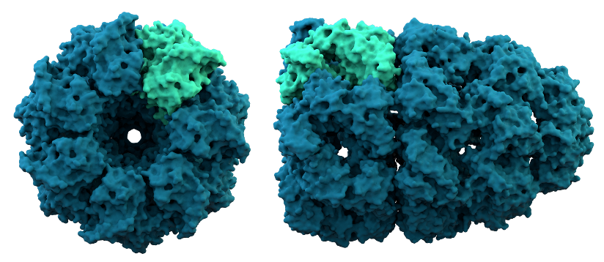
How Chaperones Work
Caption: The Structure of a Chaperonin (c)Thomas Splettstoesser, Public domain
Incorrectly folded protein enters chaperone chamber
Energy from ATP alters the conditions in the chamber (hydrophobic to hydrophilic)
Protein folds correctly (hydrophobic regions align)

Slide 43
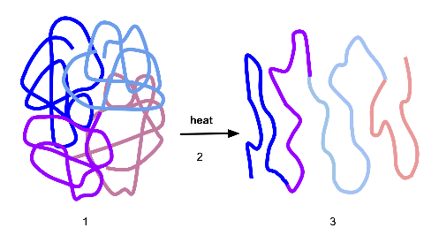
Denaturation
Denature: Protein loses structure and function
Due to environmental conditions
pH
Temperature
Ionic concentration of solution
Sometimes reversible
Denaturation
Properly folded
Denatured protein
Caption: Process of Denaturation (c)Scurran15, Public domain

Slide 44
Dissociation
Subunits may be dissociated without losing their individual tertiary structure
Hemoglobin
Caption: 1904 Hemoglobin (c)OpenStax College, Public domain

Slide 45
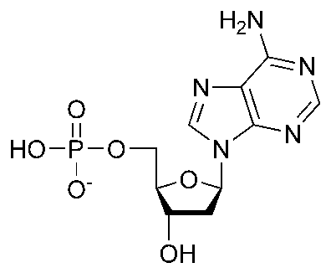
Nucleic Acids
Polymer: nucleic acids
Monomers: nucleotides
Nucleotide: sugar + phosphate + nitrogenous base
Sugar is deoxyribose in DNA or ribose in RNA
Nitrogenous base
Phosphate
Caption: DAMP Chemical Structure (c)Cacycle, Public domain
Sugar

Slide 46
Figure 3.31
A nucleotide is made up of three components: a nitrogenous base, a pentose sugar, and one or more phosphate groups.
Carbon residues in the pentose are numbered 1′ through 5′ (the prime distinguishes these residues from those in the base, which are numbered without using a prime notation). The base is attached to the 1′ position of the ribose, and the phosphate is attached to the 5′ position. When a polynucleotide is formed, the 5′ phosphate of the incoming nucleotide attaches to the 3′ hydroxyl group at the end of the growing chain.
Bases can be divided into two categories: purines and pyrimidines. Purines have a double ring structure, and pyrimidines have a single ring.
Download for free at http://cnx.org/contents/185cbf87-c72e-48f5-b51e-f1
4f21b5eabd@10.61

Slide 47
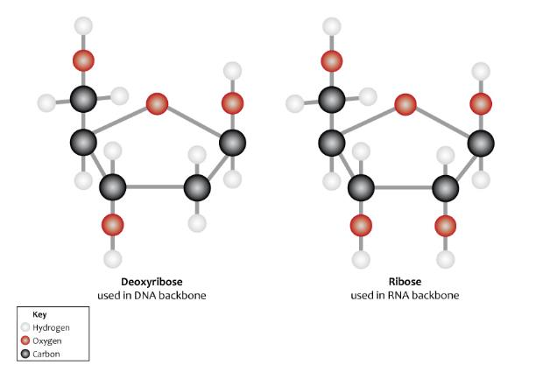
Caption: Chemical Structure of Ribose and Deoxyribose (c)Genomics Education Programme , Public domain
Two types of pentose are found in nucleotides, deoxyribose (found in DNA) and ribose (found in RNA). Deoxyribose is similar in structure to ribose, but it has an H instead of an OH at the 2′ position.

Slide 48
Figure 3.32
Native DNA is an antiparallel double helix. The phosphate backbone (indicated by the curvy lines) is on the outside, and the bases are on the inside. Each base from one strand interacts via hydrogen bonding with a base from the opposing strand.
Download for free at http://cnx.org/contents/185cbf87-c72e-48f5-b51e
-f14f21b5eabd@10.61
Credit: Jerome Walker/Dennis Myts

Slide 49
Figure 3.33
Download for free at http://cnx.org/contents/185cbf87-c72e-48f5-b51e-f14f21b5eabd@10.61
In a double stranded DNA molecule, the two strands run antiparallel to one another so that one strand runs 5′ to 3′ and the other 3′ to 5′.
The phosphate backbone is located on the outside, and the bases are in the middle.
Adenine forms hydrogen bonds (or base pairs) with thymine, and guanine base pairs with cytosine.

Slide 50
Deoxyribonucleic Acid (DNA)
Genes: Encodes information for amino acid sequence of proteins
Sequence of bases (A, T, C, G)
Double helix
Base-pairing rules
A with T (or U in RNA)
C with G
DNA Strand 1: T T A C G G A T C
DNA Strand 2: _ _ _ _ _ _ _ _ _

Slide 51
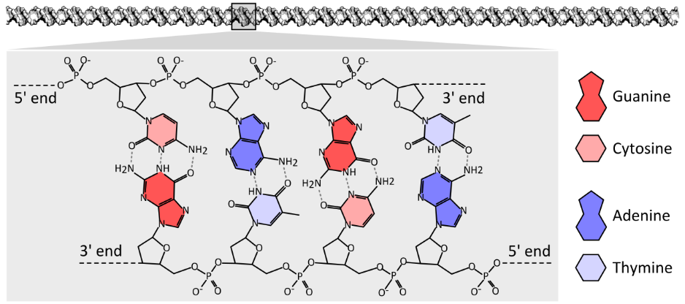
C
T
A
G
G
A
T
C
Caption: The Chemical Structure of a Four Base Pair Fragment of a DNA Double Helix (c)Thomas Shafee, Public domain
Nucleotides: sugar + phosphate + nitrogenous base
Nitrogenous bases include
Purines: adenine and guanine
Pyrimidines: thymine, cytosine, uracil (RNA only)

Slide 52
Ribonucleic Acid (RNA)
RNA similar to DNA except
Contains ribose instead of deoxyribose
Contains uracil instead of thymine
Single stranded
RNA plays many roles in the cell
Messenger RNA (mRNA): DNA encodes the information to make proteins, mRNA relays this info to the structures that make proteins
Ribosomal RNA (rRNA) and Transfer RNA (tRNA)
Notes:
)

Slide 53
Figure 3.34
Download for free at http://cnx.org/contents/185cbf87-c72e-48f5-b51e-f14f21b5eabd@10.61
A ribosome has two parts: a large subunit and a small subunit.
The mRNA sits in between the two subunits.
A tRNA molecule recognizes a codon on the mRNA, binds to it by complementary base pairing, and adds the correct amino acid to the growing peptide chain.

Slide 54
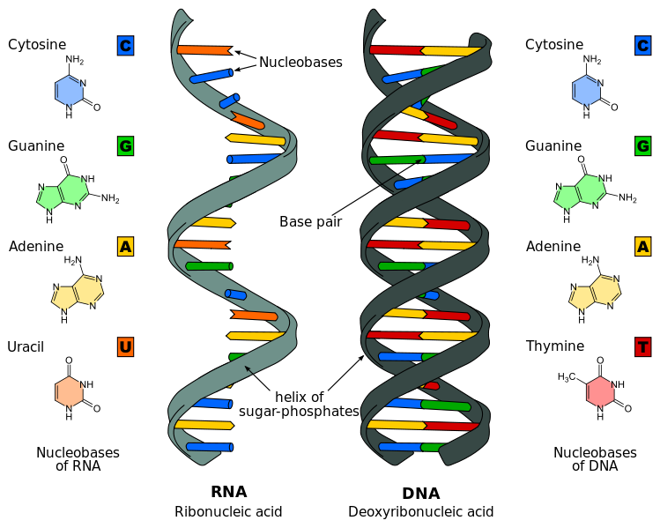
Caption: Diffeence in DNA and RNA (c)Sponk, Public domain

Slide 55
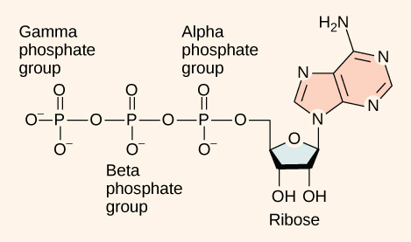
Other nucleotides
ATP Adenosine TriPhosphate
Primary energy currency of the cell
Caption: Figure 06 04 01 – Adenosine Triphosphate (c)CNX Openstax, Public domain
adenosine

Slide 56
Lipids
Group of nonpolar compounds
hydrophobic
insoluble in water
Not polymers
Examples: Fats, oils, waxes, cholesterol, hormones, some vitamins
Excellent for energy storage
Due to high number of C-H bonds

Slide 57
Figure 3.12
Download for free at http://cnx.org/contents/185cbf87-c72e-48f5-b51ef14f21b5eabd@10.61
Credit: Ken Bosma
Hydrophobic lipids in the fur of aquatic mammals, such as this river otter, protect them from the elements.

Slide 58
Lipids: Fats
Fatty acids
Saturated: no double bonds between carbon atoms
Higher melting point, animal origin
Solid at room temperature
Unsaturated: 1 or more double bonds
Low melting point, plant origin
Liquid at room temperature
Trans fats: produced industrially

Slide 59
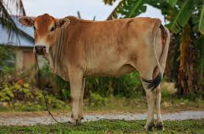
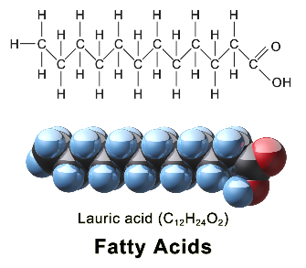
Saturated:
No double bonds
Solid at room temperature
Animal origin
Caption: Langkawi, Malaysia: Cow at Padang Mat Sirat
(c)CEphoto, Public domain
Caption: Saturated Fatty Acid (c)BruceBlaus,
Public domain

Slide 60
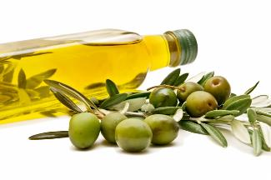
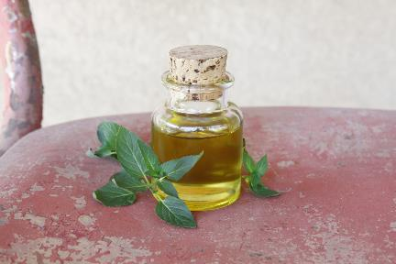
Unsaturated:
1 or more double bonds
Liquid at room temperature
Plant origin
Caption: Extra Virgin Olive Oil (c)USDA, Public
domain
Caption: Homemade Peppermint Infused Oil (c)Kathy Zinn,
Public domain

Slide 61
Figure 3.14
Stearic acid is a common saturated fatty acid.
(No double bonds between carbon atoms)
Download for free at http://cnx.org/contents/185cbf87-c72e-48f5-b51e-f14f21b5eabd@10.61

Slide 62
Figure 3.15
Oleic acid is a common unsaturated fatty acid.
(One or more double bonds between carbon atoms)
Download for free at http://cnx.org/contents/185cbf87-c72e-48f5-b51e-f14f21b5eabd@10.61

Slide 63
Figure 3.16
Saturated fatty acids have hydrocarbon chains connected by single bonds only.
Unsaturated fatty acids have one or more double bonds. Each double bond may be in a cis or trans configuration. In the cis configuration, both hydrogens are on the same side of the hydrocarbon chain. In the trans configuration, the hydrogens are on opposite sides. A cis double bond causes a kink in the chain.
Download for free at http://cnx.org/contents/185cbf87-c72e-48f5-b51e-f14f21
b5eabd@10.61

Slide 64
Figure 3.18
Download for free at http://cnx.org/contents/185cbf87-c72e-48f5-b51ef14f21b5
eabd@10.61
Credit: Roger Griffith
Waxy coverings on some leaves are made of lipids.

Slide 65
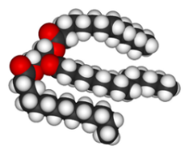
Lipids: Fats
Triglycerides
Composed of 1 glycerol and 3 fatty acids
Caption: Triglycerides (c)OpenStax College, Public domain
Caption: Trimyristin 3D (c)Wikimedia Commons, Public domain

Slide 66
Figure 3.13
Triacylglycerol is formed by the joining of three fatty acids to a glycerol backbone in a dehydration reaction. Three molecules of water are released in the process.
Download for free at http://cnx.org/contents/185cbf87-c72e-48f5-b51
e-f14f21b5eabd@10.61

Slide 67
Figure 3.19
A phospholipid is a molecule with two fatty acids and a modified phosphate group attached to a glycerol backbone. The phosphate may be modified by the addition of charged or polar chemical groups. Two chemical groups that may modify the phosphate, choline and serine, are shown here. Both choline and serine attach to the phosphate group at the position labeled R via the hydroxyl group indicated in green.
Download for free at http://cnx.org/contents/185cbf87-c72e-48f5-b51e
-f14f21b5eabd@10.61

Slide 68
Figure 3.20
Download for free at http://cnx.org/contents/185cbf87-c72e-48f5-b51e-f14f21b5eabd@10.61
The phospholipid bilayer is the major component of all cellular membranes. The hydrophilic head groups of the phospholipids face the aqueous solution. The hydrophobic tails are sequestered in the middle of the bilayer.

Slide 69
Figure 3.21
Steroids such as cholesterol and cortisol are composed of four fused hydrocarbon rings.
Download for free at http://cnx.org/contents/185cbf87-c72e-48
f5-b51e-f14f21b5eabd@10.61

