Slide 1
Medical Terminology/Body Systems
BSC2093L-Anatomy & Physiology 1 Lab

Slide 2
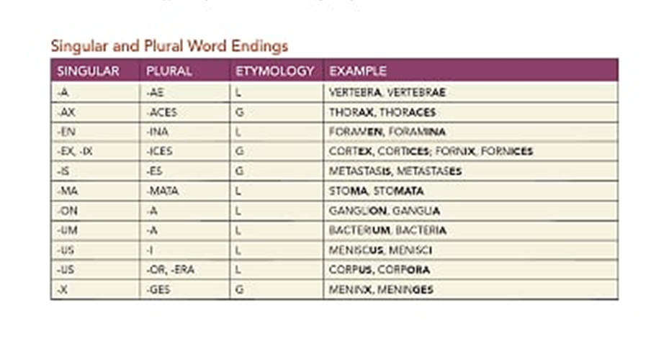
Part A. human Anatomical Terminology-terms that are derived from Latin or Greek origin. These terms allow for doctors to have a common method of communication and avoid confusion.

Slide 3
The elements of medical Terms
A medical word contains all or some of the following:
-Word root
-Suffixes
-Prefixes
-combining form
Ex. Tonsillitis= defined as the inflammation of the tonsils
Inflammation(suffix)
Tonsil (word root)

Slide 4
Word roots-all medical terms have at least 1 word root. The root can be a whole word or part of a word and are usually in Greek or Latin
Cardi/o-heart
Derm/o-skin
Arthr/o-joint
Bucc/o-cheek
The –o at the end of each of the roots is known as a combining vowel. It must be used when joining together two roots.

Slide 5
Prefix- A word component that is put in front of a root/word that will change its meaning
SUFFIX- A WORD COMPONENT ADDED TO THE END OF A ROOT/WORD THAT CHANGES ITS MEANING
Examples- see pg 3 in lab manual
-cyte: cell
-ectomy: surgical removal
-opsy: view
Examples- see pgs 2-3 in lab manual
Ab: away from midline
Tri: three
Hyper: excessive, above
Sub: under, below

Slide 6
Singular and plural word endings: most singular nouns can be made plural with –s at the end. However, in medical terminology we have exceptions to this rule.
Singular Examples
Vertebra
Thorax
foramen
Plural Examples
Vertebrae
Thoraces
foramina
Review pg. 4 in lab manual for more examples

Slide 7
Rules for Putting words together
The prefix is always placed at the beginning of the word.
A suffix is always placed at the end of the word.
When more than 1 root word is used, it is a compound word and requires the use of a combining vowel to separate the words.
When you are defining medical terms, begin with the suffix.
If the word also contains a prefix the order in which you define the word is: Suffix first, prefix second and root word(s) last.

Slide 8
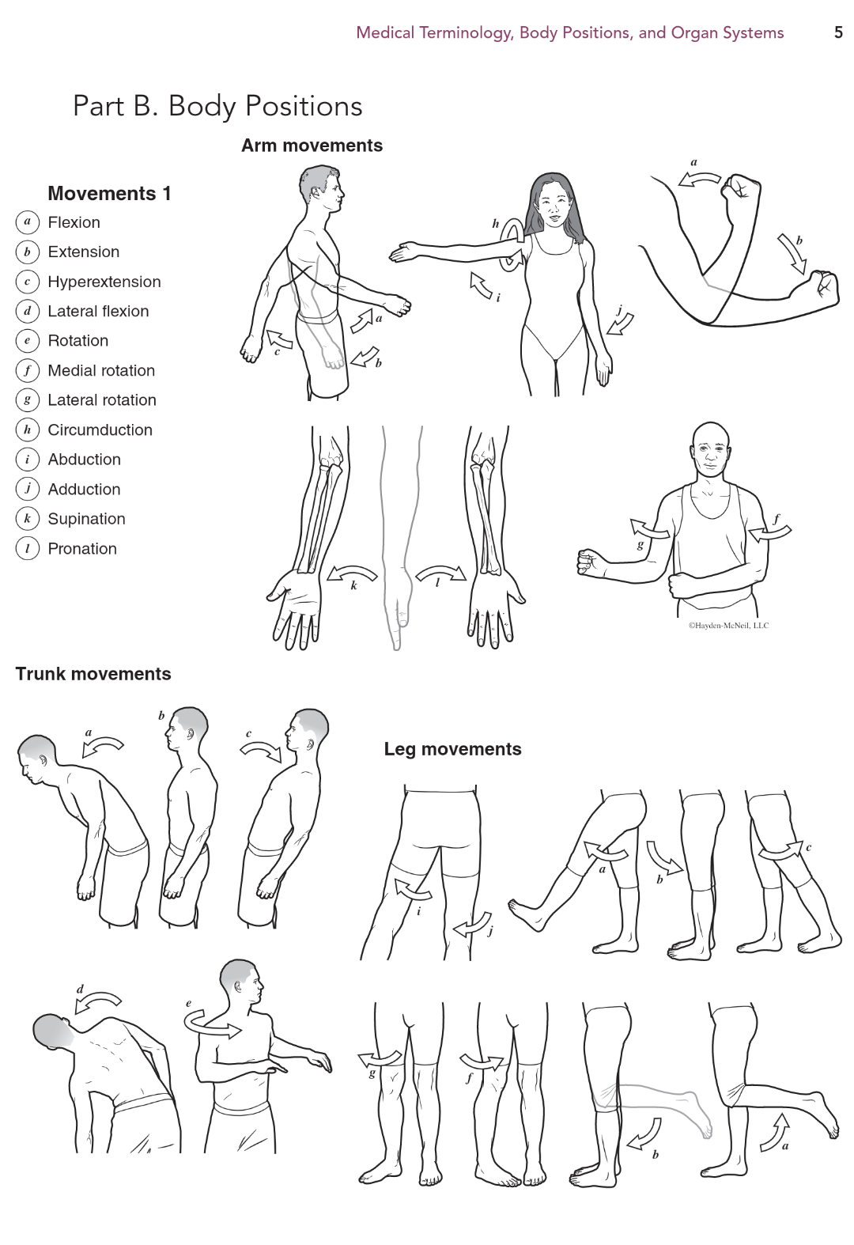
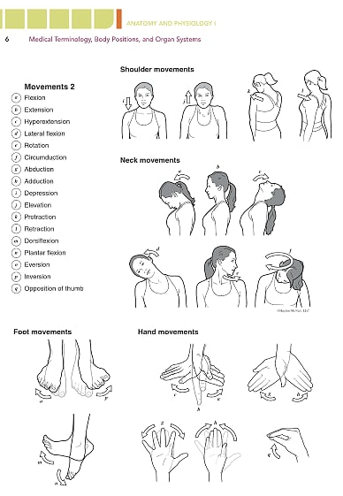
Part B. Body Positions-Movements
These terms are used to describe body movements. *It can be easier to understand if you see these movements in action.* ☺

Slide 9
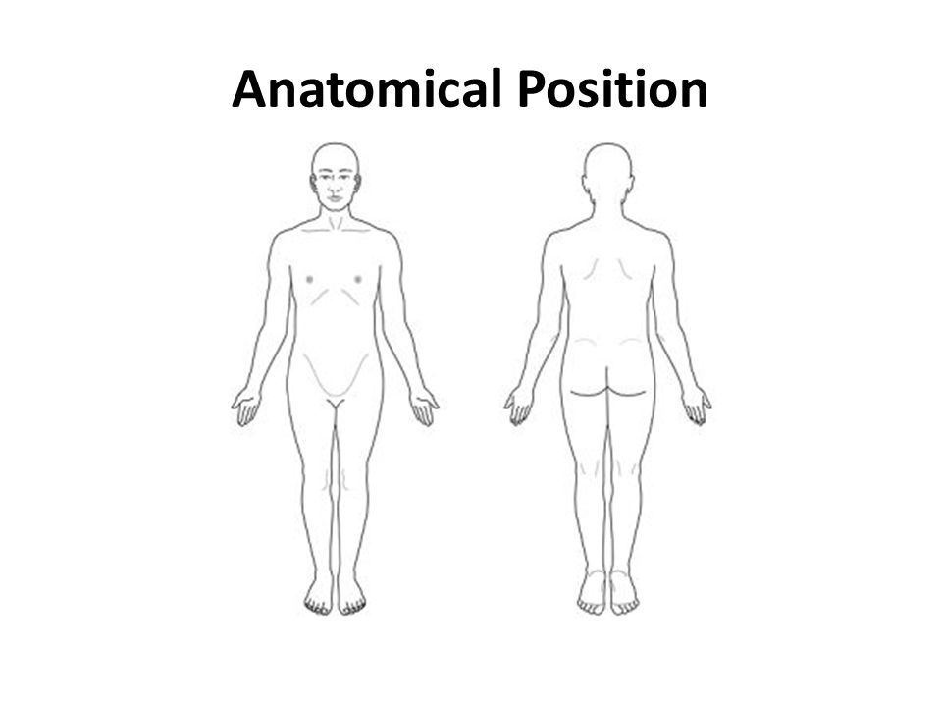
Part c. anatomical position
Anatomical Position of the body-hands are down by the sides with the palms facing forward and the feet are together.

Slide 10
Part c. Relative position of body parts & directional terms

Slide 11
Part c. planes and sections of the human body
A plane is a imaginary flat line that passes through the body/body part. A section is a cut of the body/body part made along a specific plane. The cut can help with understanding relationships between structures that are three dimensional.

Slide 12
Part c. body cavities -these cavities in the body contain, support and protect internal organs. For example, the cranial cavity supports and protects the brain inside the bony skull.

Slide 13
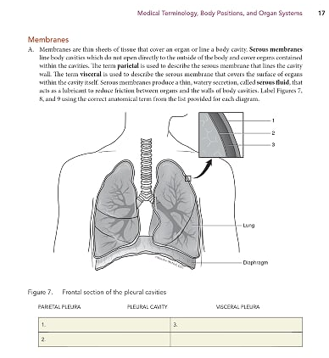
Part c. membranes -organs and body cavities are line with thin sheets of tissue known as membranes.
Serous membranes- this membrane lines the internal body cavities. The membrane that lines the cavity wall is the parietal membrane. The membrane that covers the surface of an organ is the visceral membrane.
Serous fluid is produced by the serous membrane to lubricate and reduce friction between organs and the walls of the body cavity.

Slide 14
Part c. membranes

Slide 15
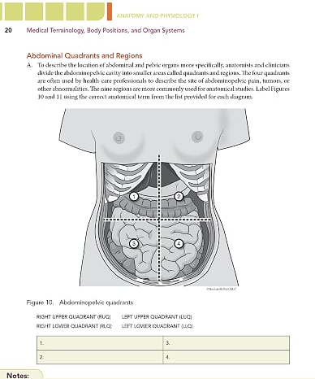
Part C. Abdominal quadrants and regions
The four abdominopelvic quadrants are formed by a pair of imaginary lines running perpendicular and intersecting at the navel.
These quadrants help health care professional when it comes to describing the site of pain, aches and injuries.

Slide 16
Part C. Abdominal quadrants and regions
You will be responsible for knowing the four quadrants and also what structures are found in each quadrant.
Please note that some large organs such as the liver can span more than one quadrant.

Slide 17
Part C. Abdominal quadrants and regions
There are nine abdominopelvic regions. These regions provide a more precise location and tends to be used more often by anatomists.

Slide 18
Part C. Abdominal quadrants and regions
You will be responsible for knowing the nine regions and also what structures are found in each region.
Please note that some large organs such as the liver can span more than one region.

Slide 19
Part C. Major organ systems of the Body
A organ is a structure made up of several tissues that are performing a specific function. Look over the torso model and be able to identify the organs found on pg. 22 in your lab manual.
an organ system consists of organs that interact in a coordinated fashion to perform a specific range of functions.

Slide 20
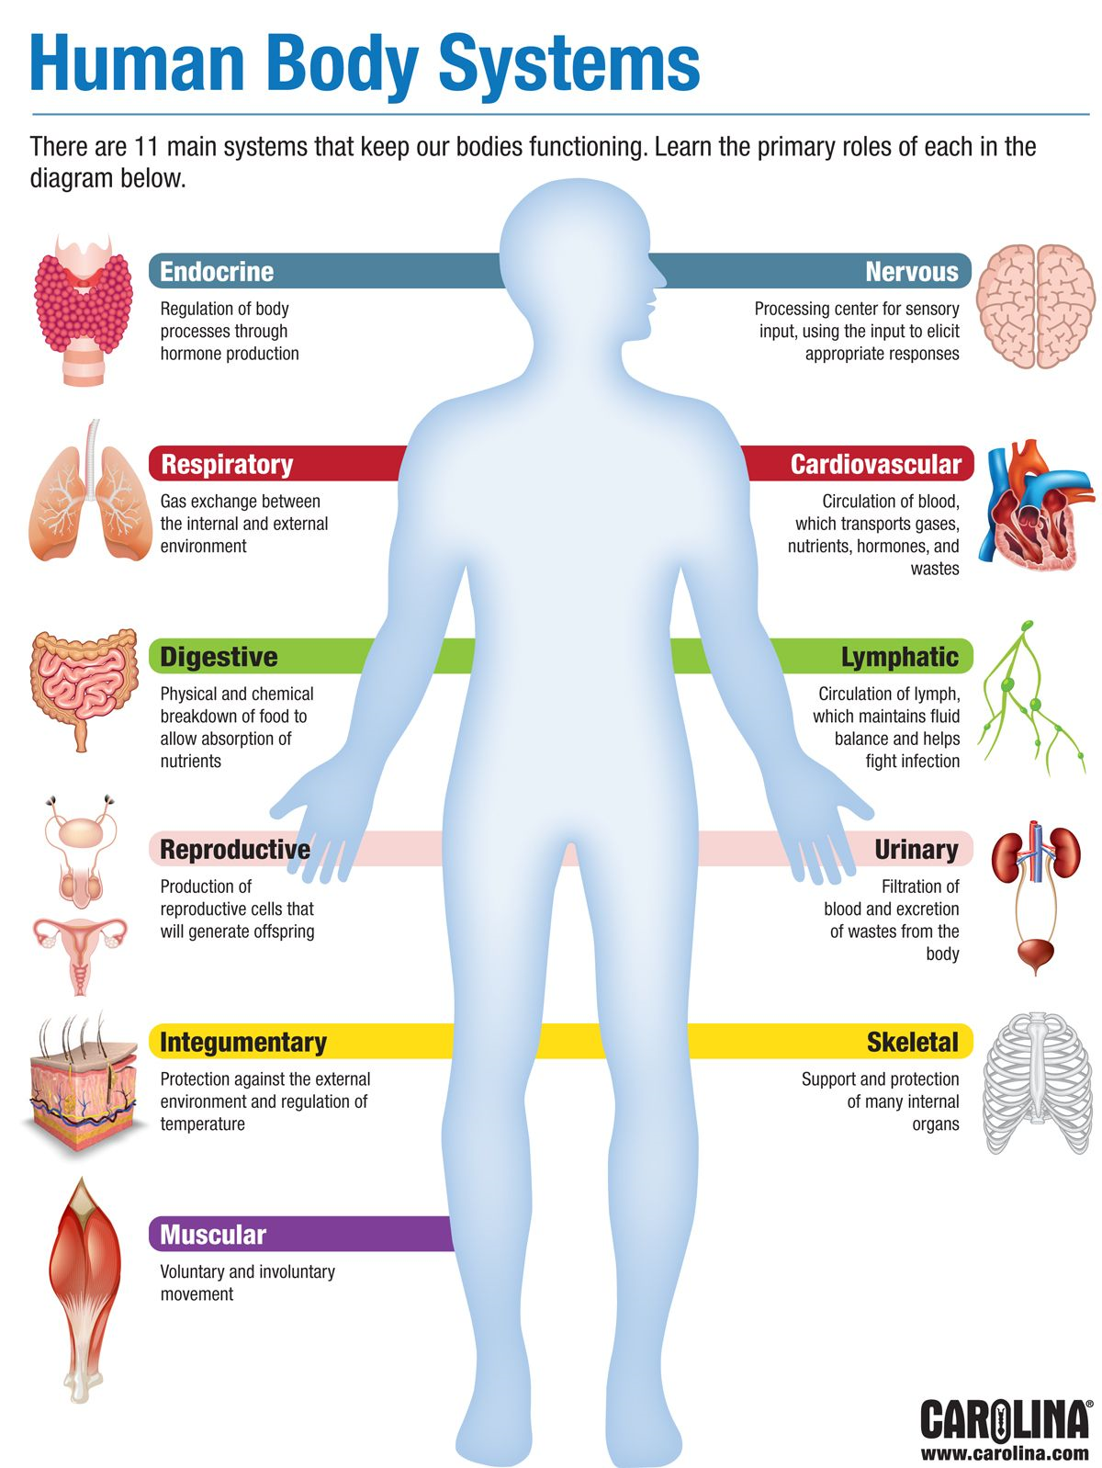
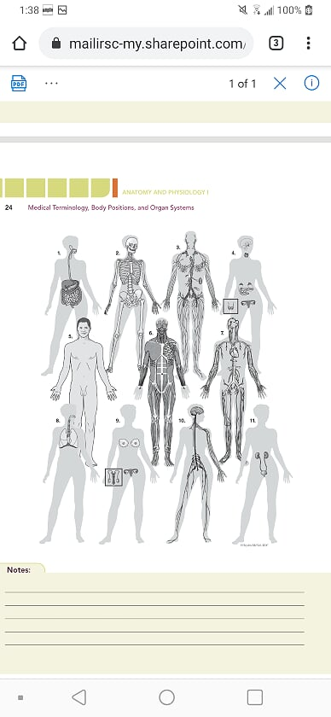
Part C. Major organ systems of the Body -There are 11 organ systems of the human body

