Slide 1
Integumentary System and Histology
A&P I Lab
BSC2093L

Slide 2
Classification of Tissue
Epithelial- lines body cavities, hollow organs and ducts. Also, forms skin. It has various roles: Protection, absorption, filtration, excretion, secretion and sensory reception.
Connective- protects and supports the body’s organs. The most abundant type of tissue. It also binds together other tissues of the body.
Muscle- generates force for movement. This tissue contracts to generate the movement.
Nervous- creates nerve impulses to respond to internal and external changes. Helps maintain homeostasis.

Slide 3
Epithelium
Characteristics of epithelium:
- Polarity: there is always one free surface aka the apical surface exposed to the environment or to an internal surface of the body
- Cells fit closely together to form sheets of cells and are connected by specialized junctions
- Supported by connective tissue. Basement membranes anchor the epithelium to underlying connective tissue.
- It is avascular. Has no blood supply of its own and has to rely on underlying connective tissue.
- It can regenerate.

Slide 4
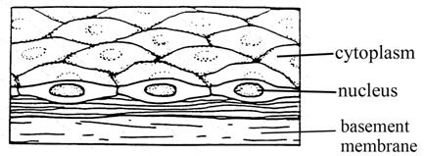
Classifying Epithelial Tissue
Can be: Simple (1 layer) or Stratified (2+ layers)

Slide 5
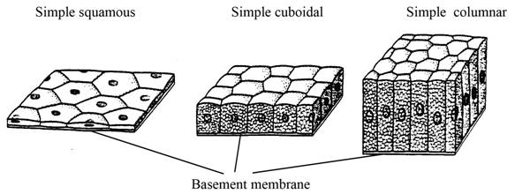
Classifying Epithelial Tissue
Squamous, Cuboidial or Columnar

Slide 6
Simple Squamous Epithelium (Surface View)

Slide 7
Kidney glomeruli (Bowman’s capsule)

Slide 8
Simple Squamous
Found in the glomeruli, air sacs of the lungs and the lining of the heart, blood vessels and lymphatic vessels.
Used for diffusion, osmosis and filtration.

Slide 9
Simple cubodial epithelium
Cube-like cells arranged in a single layer with large, round nuclei
Function: Secretion and absorption
Found in kidney tubules, ducts and secretory portions of small glands and ovary surfaces

Slide 10
Simple cubodial epithelium
Kidney tubule

Slide 11
Stratified squamous epithelium
Thick membrane made of several layers of cells
Function: Protects underlying areas that are subject to abrasion
Forms the external part of the epidermis (keratinized cells) and the linings of the esophagus, mouth and vagina (nonkeratinized cells).

Slide 12
Stratified squamous epithelium

Slide 13
***Simple columnar epithelium
Found in the stomach, small intestine, large intestine, rectum, fallopian tubes, endometrium, and respiratory bronchioles
Used for secretion and absorption
***Will not be tested on in first Practical.

Slide 14
***Simple columnar epithelium
1- Goblet cell- secrete mucin which will become mucous

Slide 15
***Pseudostratified epithelium
It is simple columnar epithelium but the cells vary in height giving the illusion of stratification
Often ciliated
Found in trachea and upper respiratory tract
Cilia and mucous secretions help collect foreign materials so you can cough or sneeze them out.
***Will not be tested on in first Practical.

Slide 16
***Pseudostratified ciliated columnar epithelium

Slide 17
***Transitional epithelium
Stratified squamous epithelia made of rounded cells that can slide over each other which allows the organ to stretch
Cells are round when the organ is empty and flat when the organ is distended
Found in organs that are subject to stretching such as: the lining of the urinary bladder, ureters and the urethra.
***Will not be tested on in first Practical.

Slide 18
***Transitional epithelium

Slide 19
Areolar Tissue
Type of Connective tissue
The Extracellular Matrix (ECM) made of gel-like ground substance and fibers (collagen and elastic fibers).

Slide 20
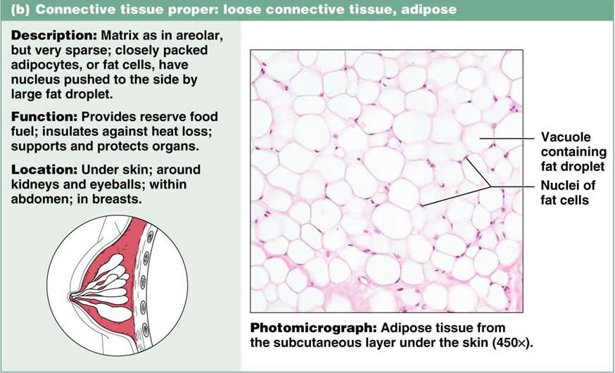
Adipose Tissue
Type of Connective Tissue
ECM made up of mostly cells known as adipocytes.

Slide 21
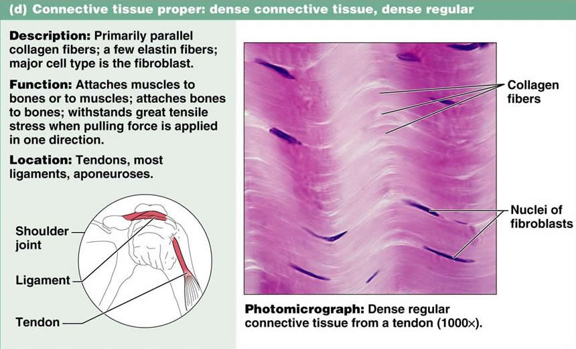
***Dense Regular
Type of Connective Tissue
***Not going to be on Practical 1

Slide 22
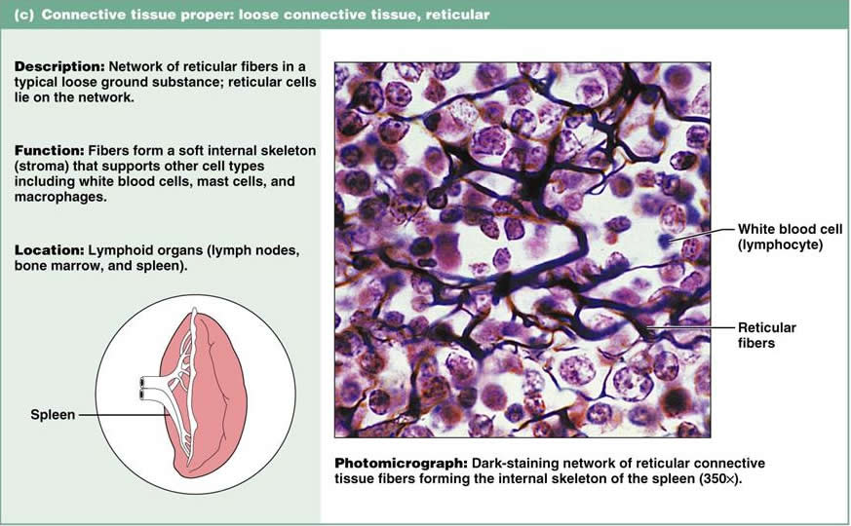
***Reticular
Type of Connective Tissue
***Will not be on Practical 1

Slide 23
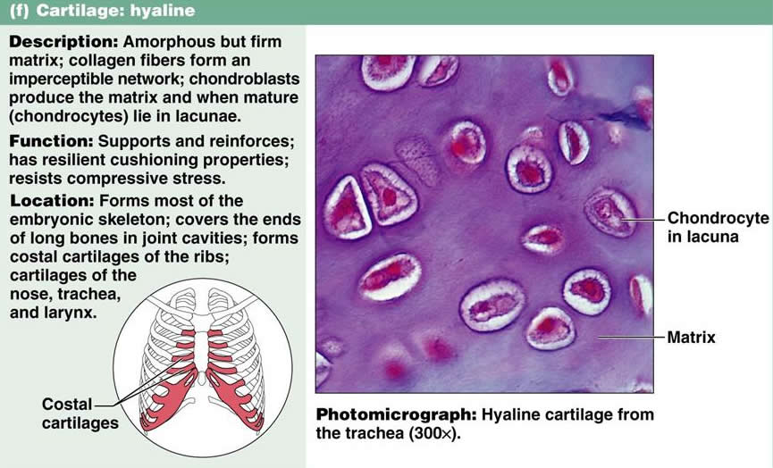
***Hyaline
Type of Connective Tissue
***Will not be on Practical 1

Slide 24
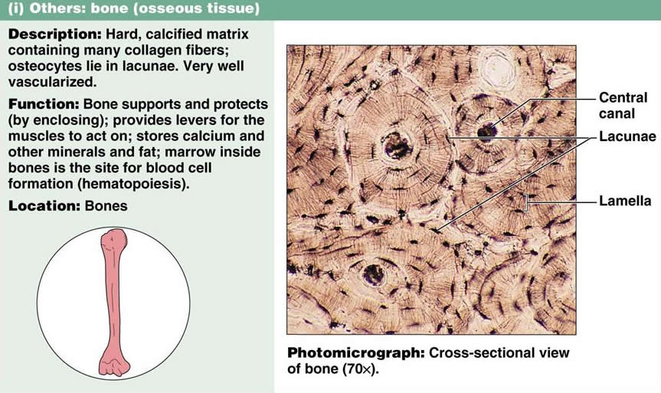
***Compact Bone
Type of Connective Tissue
***Will not be on Practical 1

Slide 25
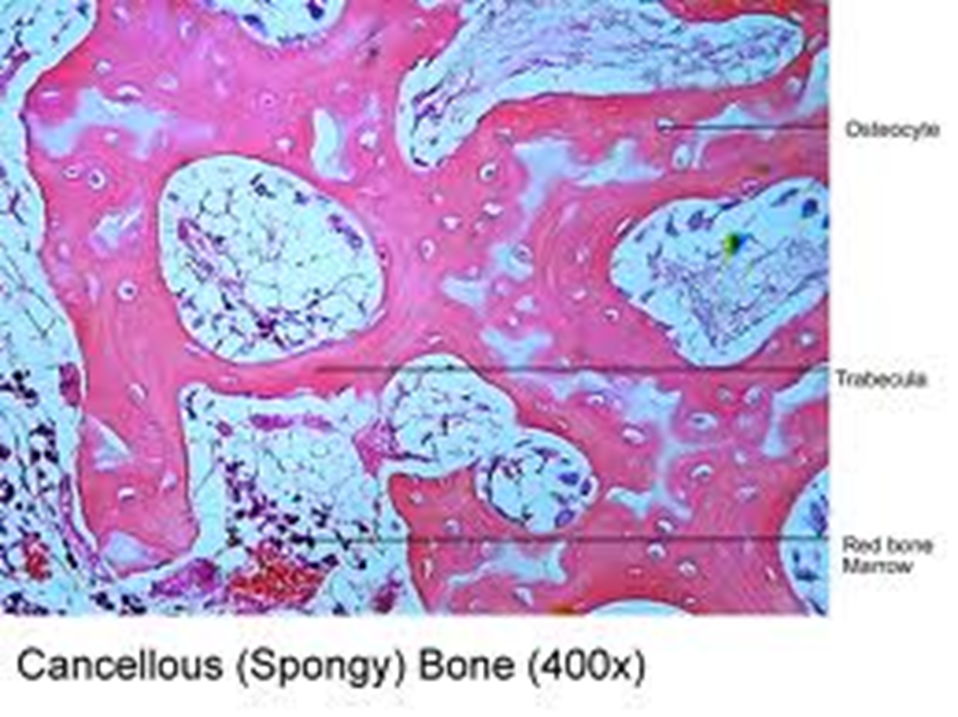
***Spongy Bone
Type of Connective Tissue
***Will not be on Practical 1
Found in the ends of long bones
Used for blood cell production (hematopoiesis)

Slide 26
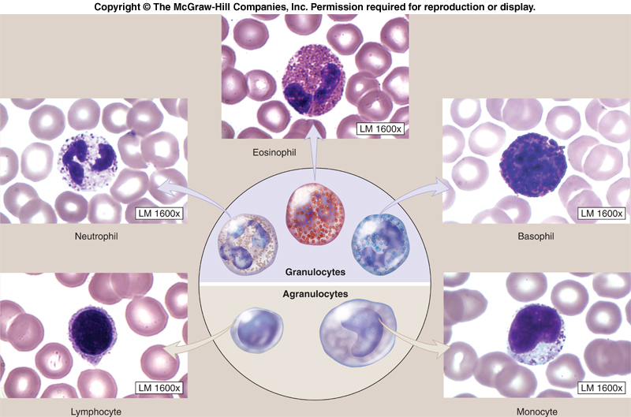
***Blood
Type of Connective Tissue
***Will not be on Practical 1
Found in blood vessels
Used for transportation of gases, nutrients and waste. Also used for immune response.

