Slide 1
Muscle Histology
BSc2093L-Fall 2019

Slide 2
Connective Tissue-Dense Regular

Slide 3
Muscle Tissue
Specialized contractile tissue
Three sub-groups:
- Skeletal muscle
- Cardiac muscle
- Smooth muscle

Slide 4
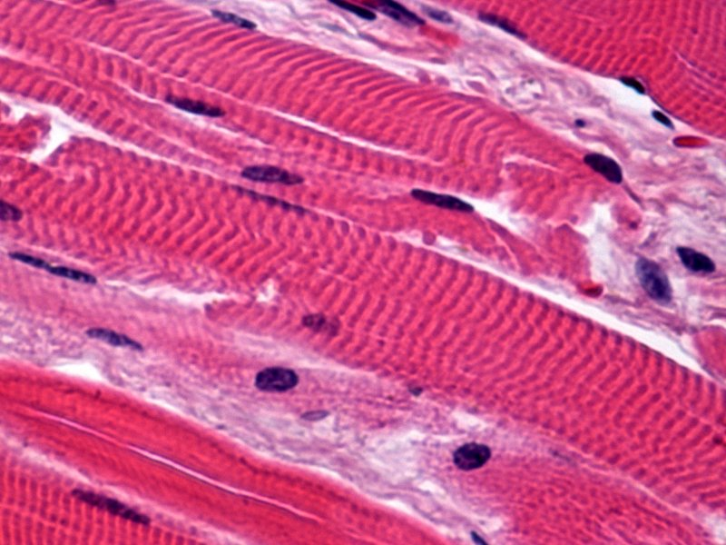
Skeletal Muscle
Voluntary
Striated
Multinucleated
Found attached to the skeleton
Allows for body movement, aids in
respiration, protection and heat
generation.
Nuclei

Slide 5
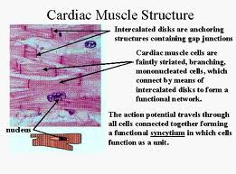
Cardiac Muscle
Involuntary
Branched cells
Uni-nucleate
Striated
Contains intercalated discs: along with the branched cells, these allow the muscle to work as unit. Also, a way to tell skeletal from cardiac
Found only in the heart
Pumps blood throughout body

Slide 6
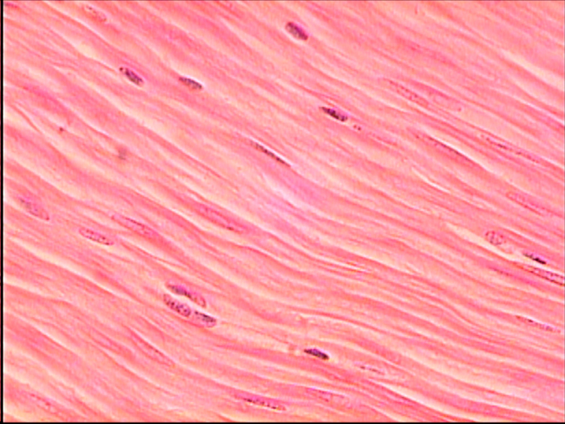
Smooth muscle
Mainly found in walls of hollow organs (digestive/ urinary tracts, uterus, blood vessels)
Involuntary
Has two layers that run perpendicular to one another (allows muscle to constrict and dialate)
- Enables it to push substances along
No striations
Uni-nucleate
Spindle-shaped cells

