Slide 1
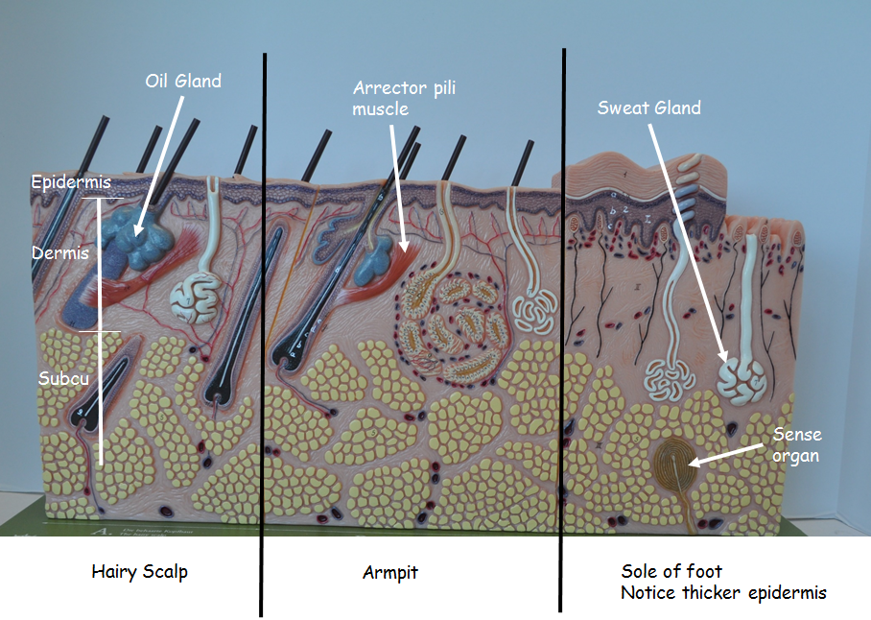
Skin Model
3 sections
left – hairy scalp
Middle – armpit
right – sole of foot (notice thick epidermis)
Identify
Epidermis
Dermis
Subcutaneous layer
Hair follicle
Oil gland
Sweat gland
Arrector pili muscle
Sense organs
Lab managers – place skin model

Slide 2
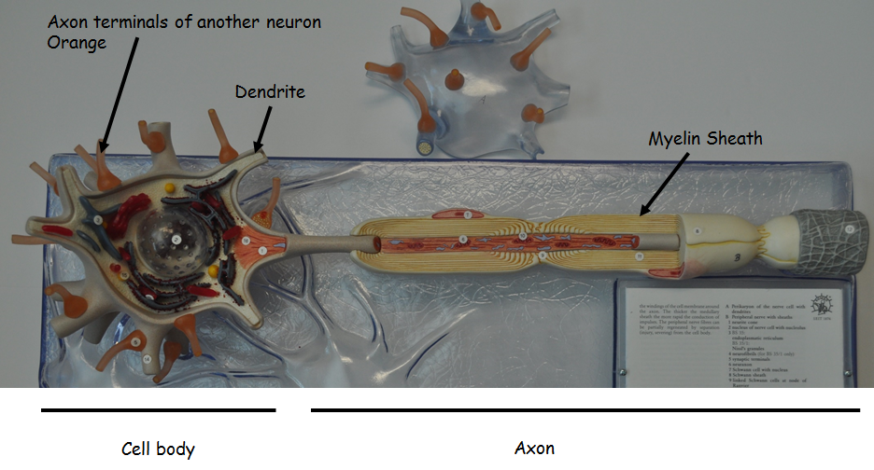
Neuron Model
Identify
Cell body
Axon
Myelin sheath covering axon
Dendrites – extensions of cell body
The tiny, orange structures you see attached in this area are the axon terminals of another neuron
Lab managers – place neuron model

Slide 3
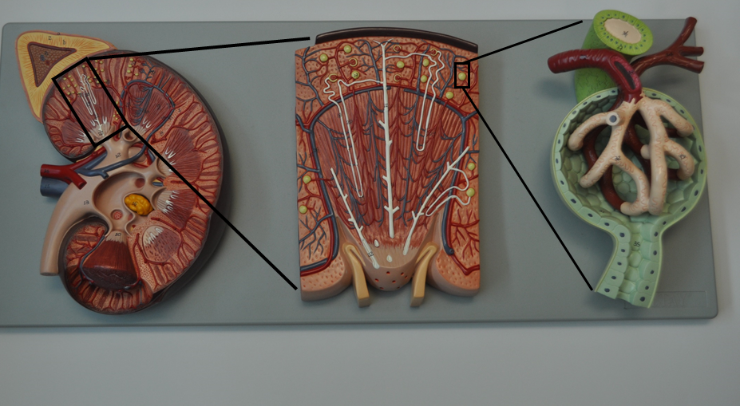
Kidney Model
3 parts
Cross-section of kidney
Magnified nephron
Magnified Bowman’s capsule of nephron
Identify
Ureter
Nephron
Bowman’s capsule
Glomerulus
Increased magnification
Lab managers – place kidney model

Slide 4
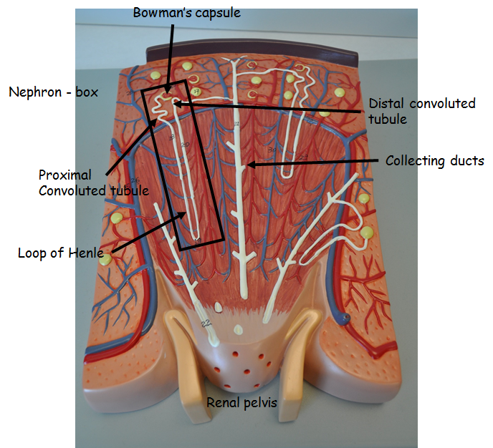
Magnified look at Renal Pyramid

Slide 5
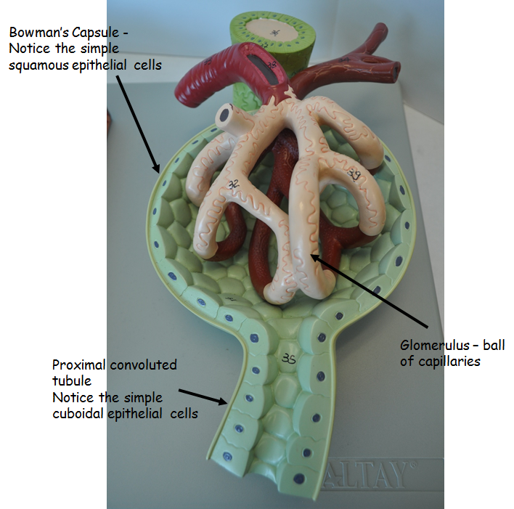
Magnified look at Bowman’s Capsule

Slide 6
Heart Model
Be able to trace a drop of blood through the heart
Start with entering through vena cava
Include chambers and valves
End with aorta
Open atrium to observe fossa ovalis between the 2 chambers
Identify
Chambers
Right, left atrium
Right, left ventricles
Valves
Tricuspid
Bicuspid
Aortic semilunar
Pulmonary semilunar
Septum (wall between ventricles)
Vessels
Inferior and superior vena cava
Pulmonary trunk leading to pulmonary arteries
Pulmonary veins
Aortic arch
Coronary artery
Lab managers – place heart model

Slide 7
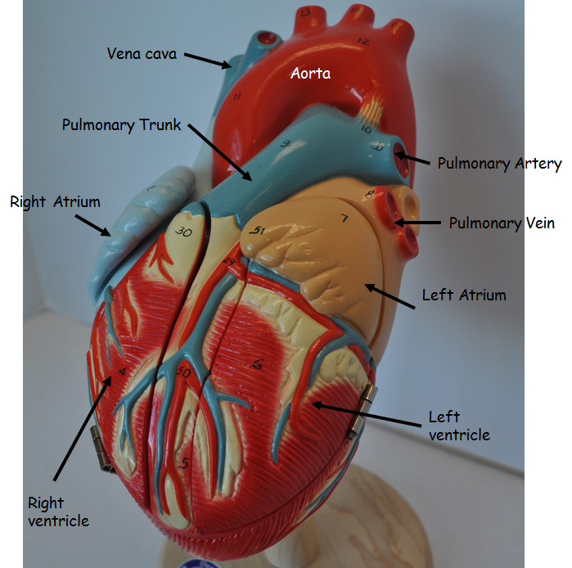
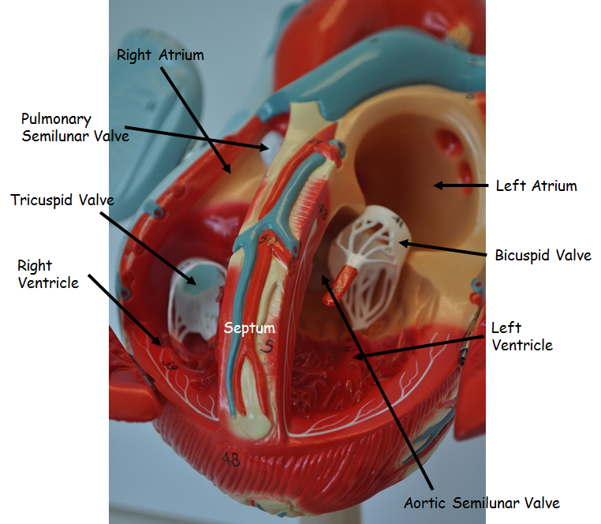

Slide 8
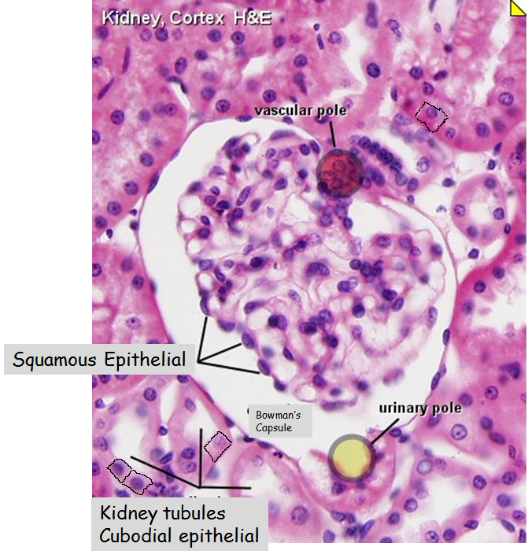
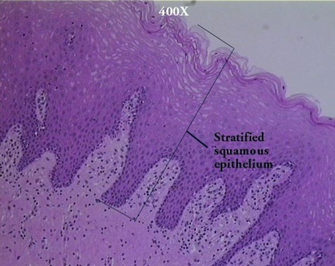
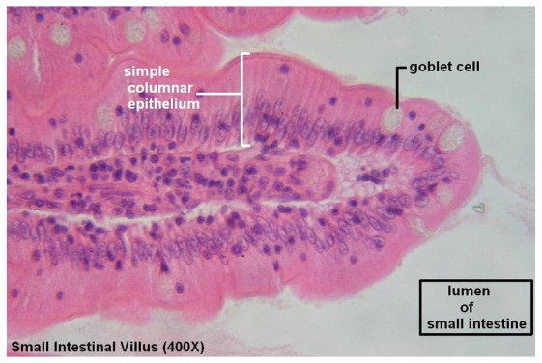
Tissues
Epithelial Tissue
Protects and lines body surfaces and cavities, forms glands, important in absorption
Squamous – flat
Alveoli, capillaries, Bowman’s capsule
Located where there needs to be exchange, diffusion
Stratified squamous – multiple layers of flat cells
Skin, esophageal lining
Located in areas where there is a lot of wear and tear
Cuboidal
Kidney tubules
Located in areas for filtration, diffusion
Columnar, have goblet cells to secrete mucus
Lining small intestine

Slide 9
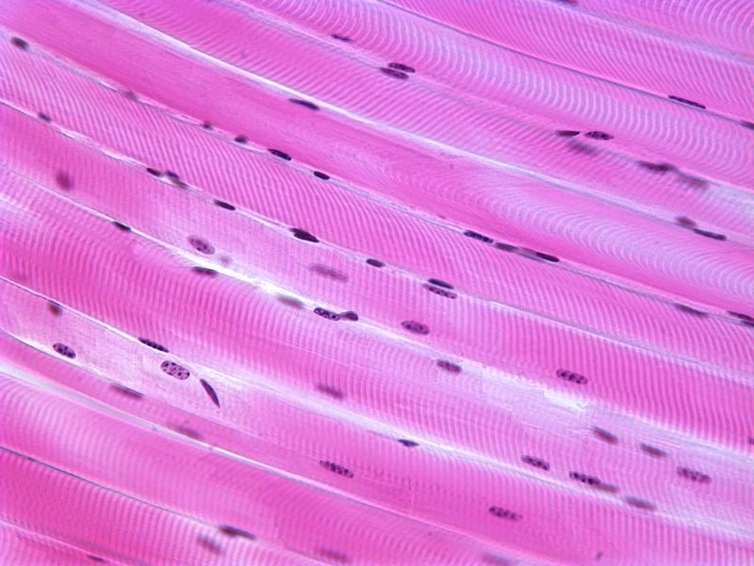
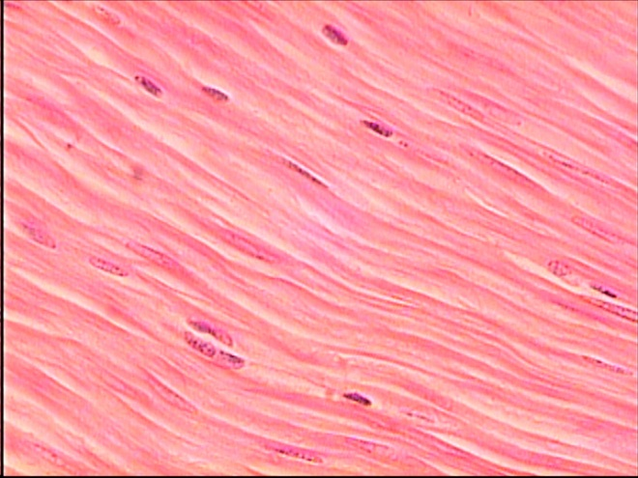
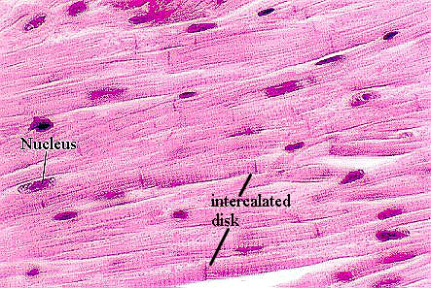
Tissue
Muscle Tissue - movement
Skeletal muscle
Multinucleated
Striated
Voluntary
Smooth muscle
No striations
Oval nucleus
Involuntary
Cardiac muscle
Striated, branched
Intercalated discs
Involuntary

Slide 10
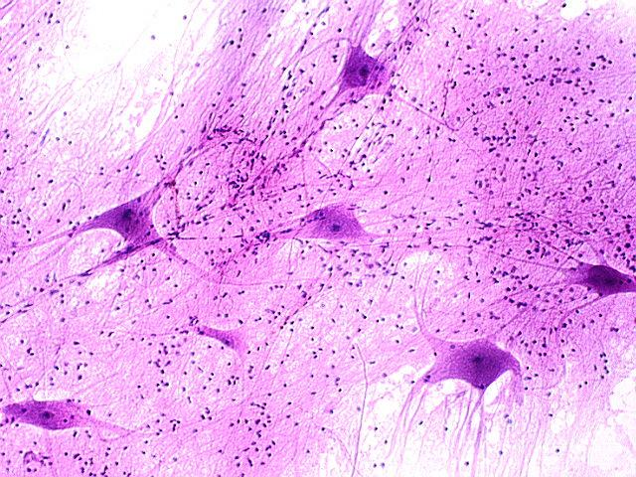
Tissue
Nervous Tissue
Relays electrical impulses for communication and coordination of body systems
Several neurons seen
here – sometimes it is
hard to see axon
compared to dendrites
depending on angle

Slide 11
Tissue
Connective Tissue – connects, transports, supports
Cells surrounded by extracellular matrix
Bone – more matrix
Blood – more cells, less matrix
Loose – found under skin
Dense – tendons and ligaments
Adipose – insulation, protection
Blood – transport
Compact bone – support and protection
Hyaline cartilage - support

