Slide 1
General Biology II Lab Plant, Animal and Organ Models

Slide 2
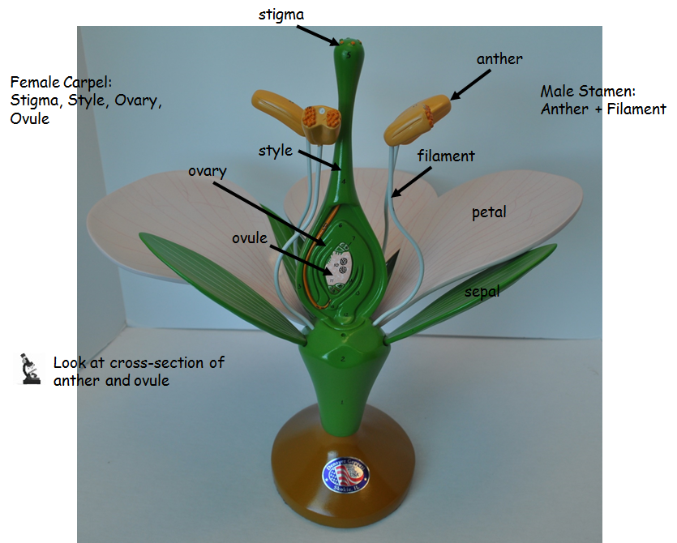
Angiosperm Flower

Slide 3
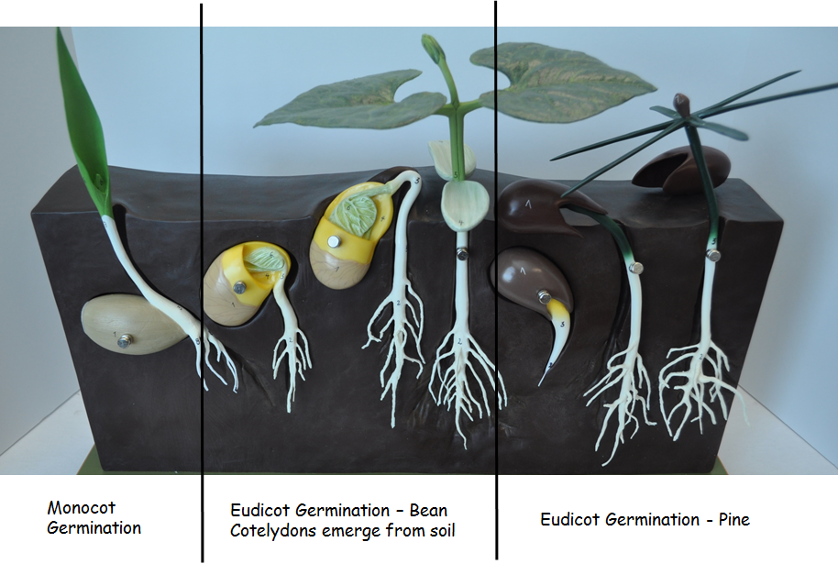
Seed Germination

Slide 4
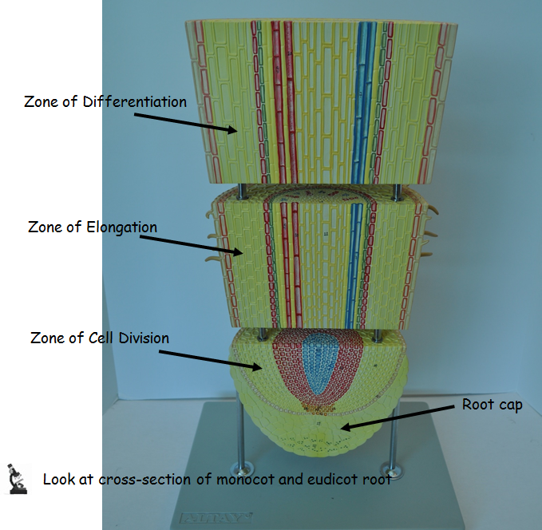
Eudicot Root

Slide 5
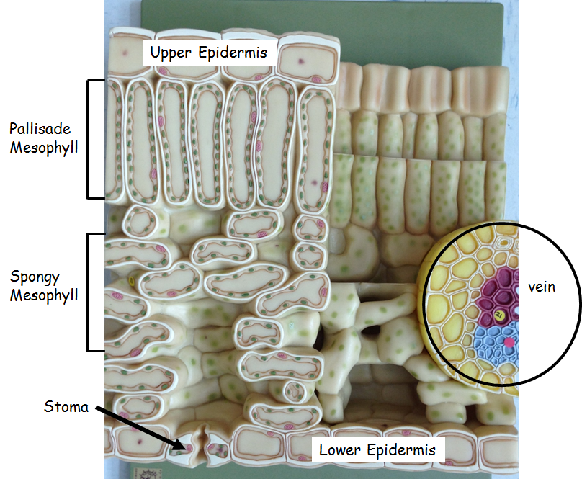
Eudicot Leaf

Slide 6
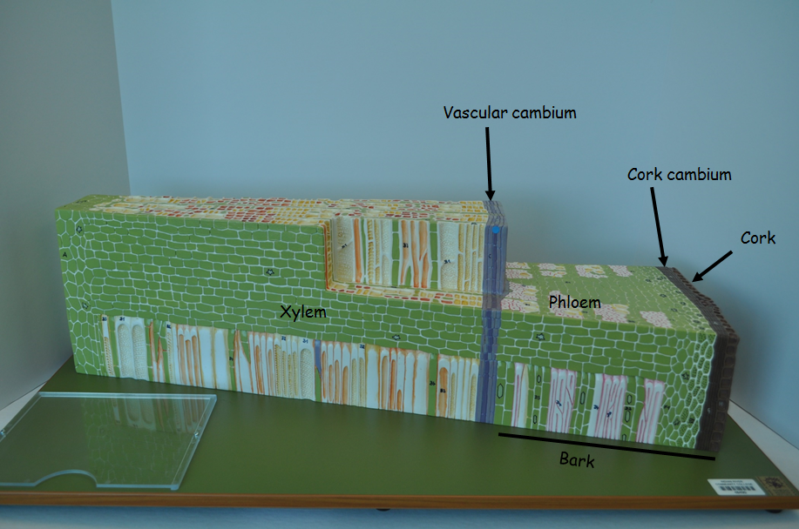
Cross-section of woody stem

Slide 7
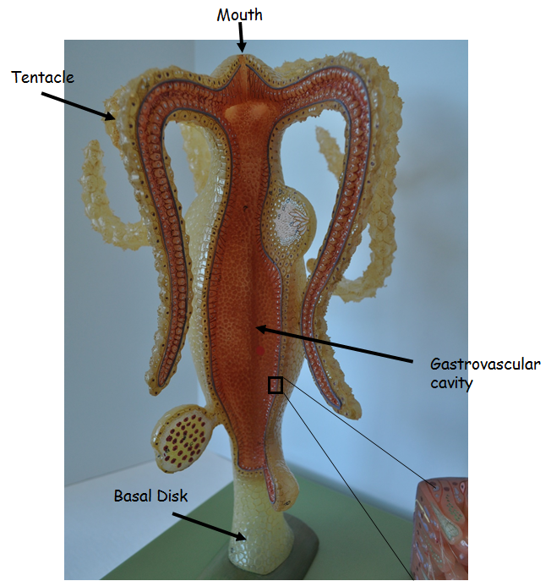
Hydra

Slide 8
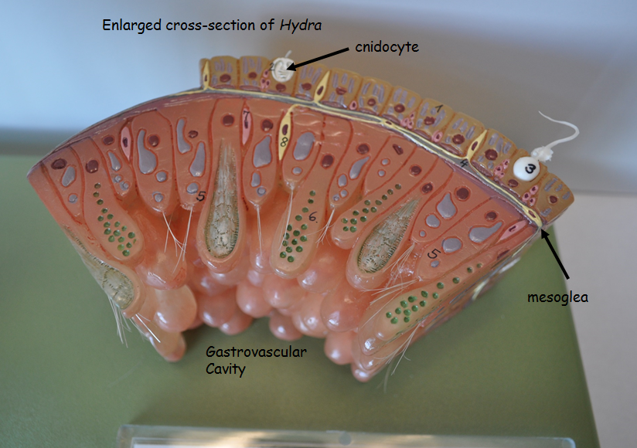
Cross-section of Hydra

Slide 9
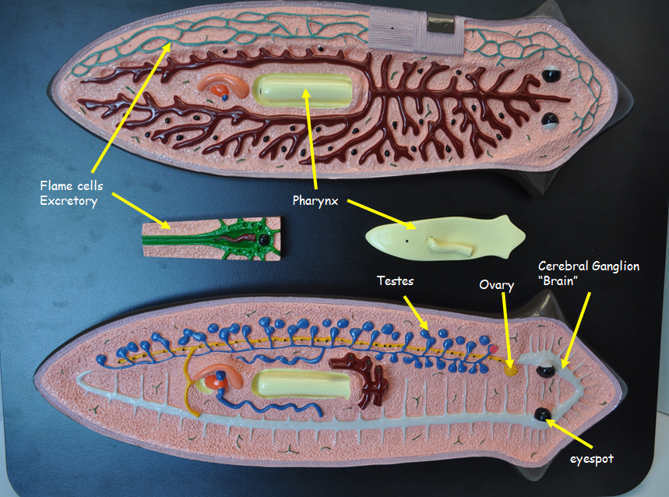
Planaria

Slide 10
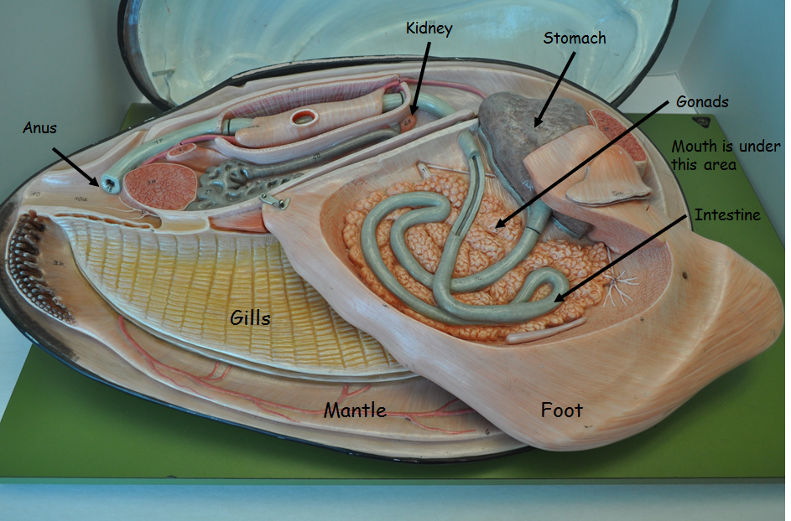
Clam

Slide 11
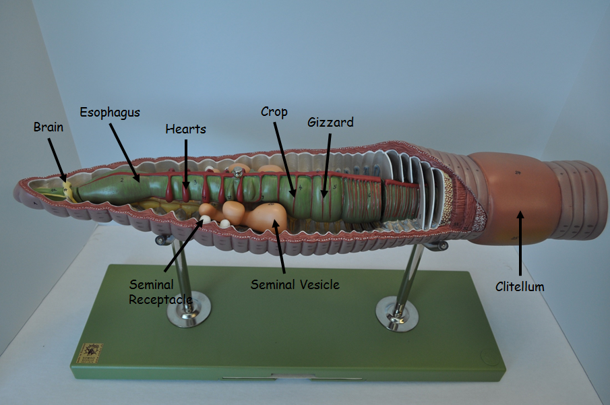
Earthworm

Slide 12
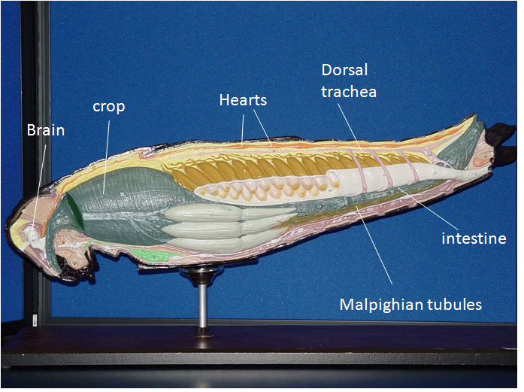
Grasshopper

Slide 13
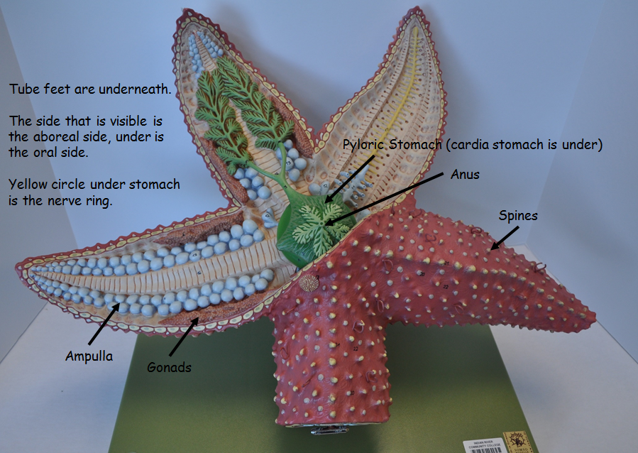
Sea Star

Slide 14
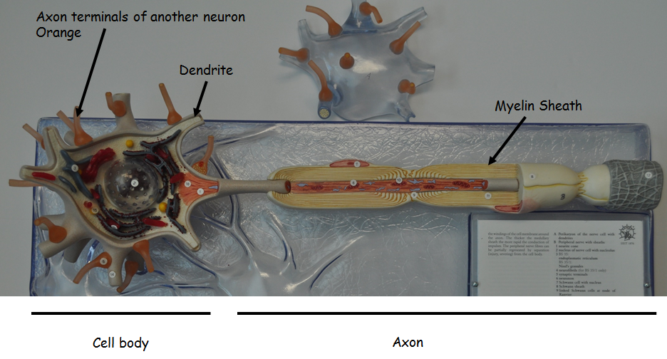
Neuron

Slide 15
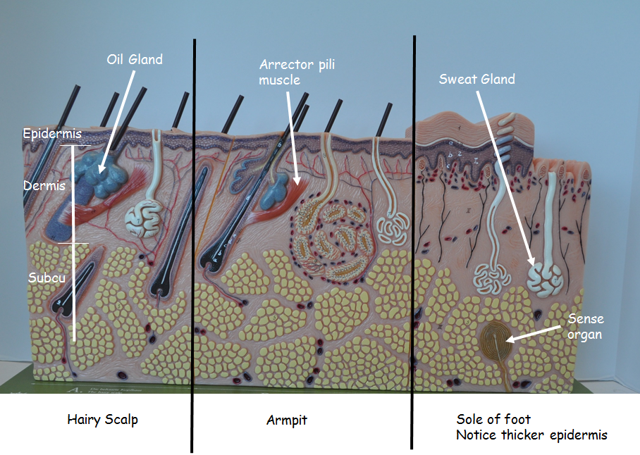
Skin

Slide 16
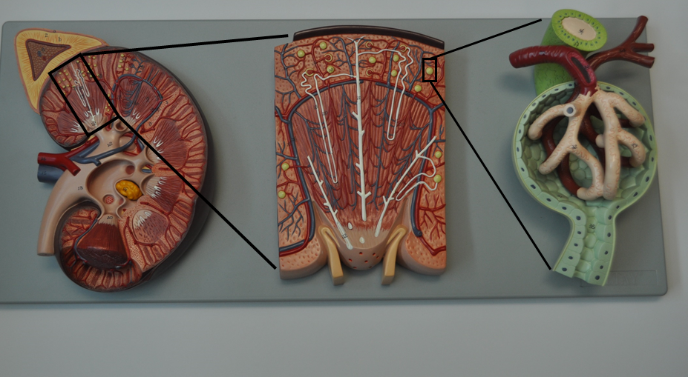
Kidney

Slide 17
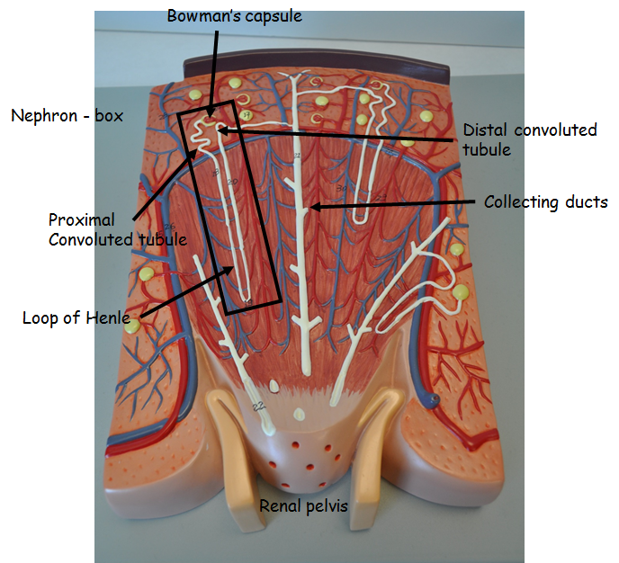
Magnified look at Renal Pyramid

Slide 18
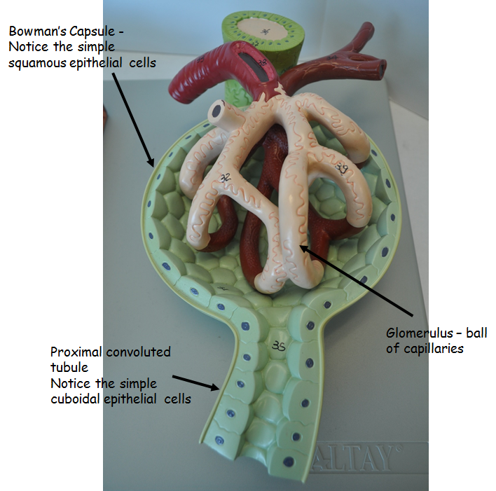
Magnified look at Bowman’s Capsule

Slide 19
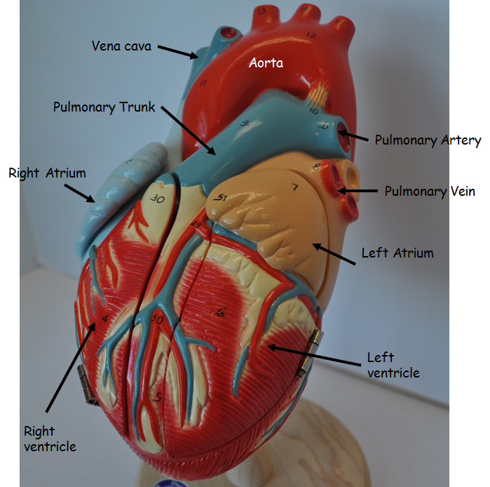
Heart - External

Slide 20
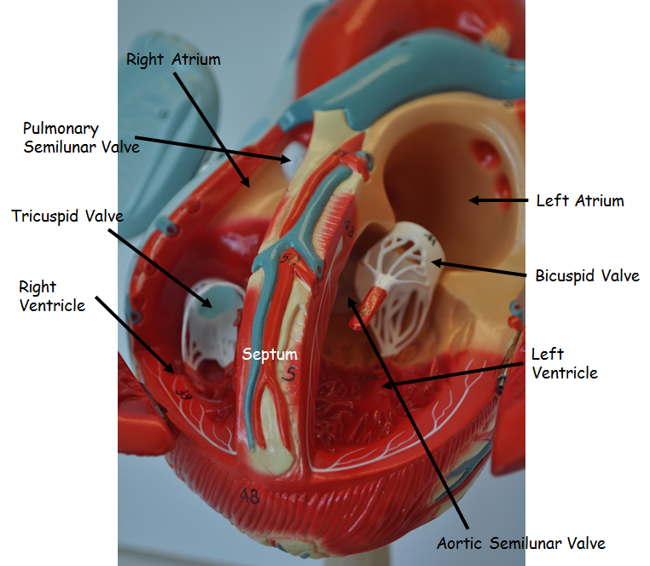
Heart - Internal

