Slide 1
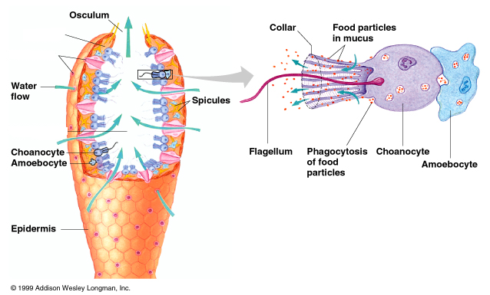
Phylum Porifera
Microscope
Look at spicules
Assymetrical
Do these organisms have true organized tissues?
At what life stage do these organisms have mobility?
Identify osculum and choanocytes
Invertebrates
Lab Managers – place sponge specimens

Slide 2
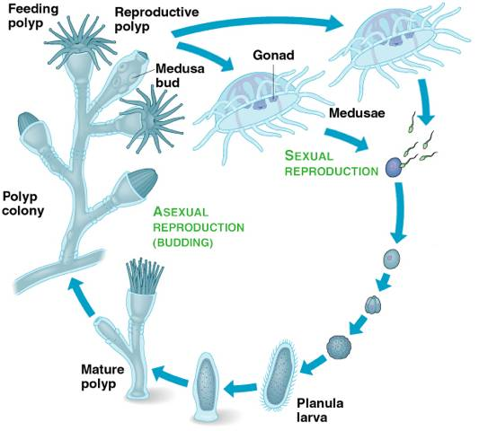
Phylum Cnidaria
Domain Eukarya
Eumetazoa
Radiata (diploblastic)
Phylum Cnidaria
Class Hydrozoa – Hydra, portuguese man-of-war
Microscope – look at hydra slide
Microscope – look at Obelia medusa and polyp
Class Scyphozoa – “jellyfish”
Class Anthozoa – hard corals and soft corals
Cnidarians are invertebrates, are diploblastic (2 embryonic tissue layers, and have radial symmetry
Lab Managers – place cnidarian specimens

Slide 3
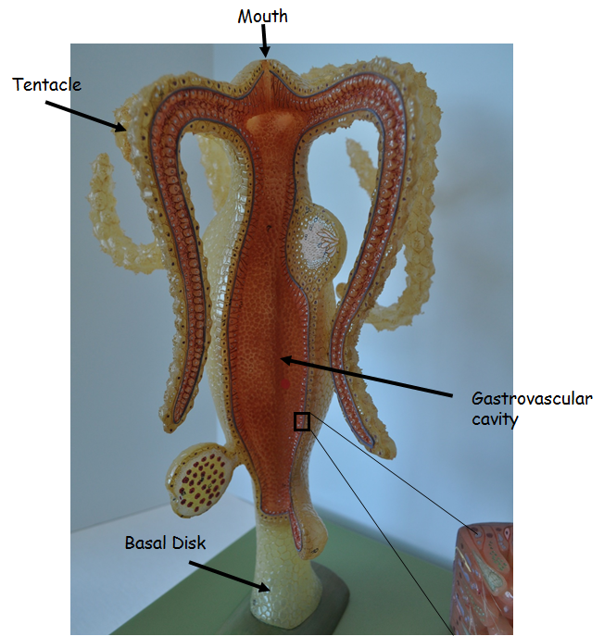
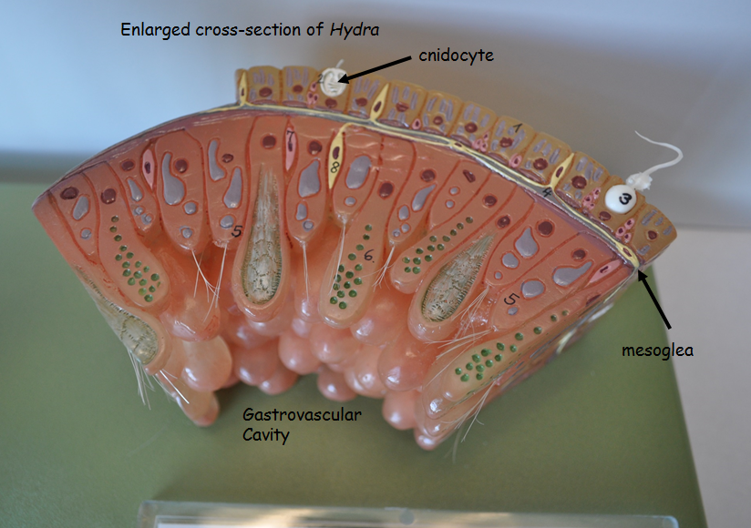
Phylum Cnidaria
Hydra Model
Identify:
Mouth
gastrovascular cavity
Tentacle
basal disk
gland cell
Mesoglea
Cnidocyte
Lab Managers – place Hydra model

Slide 4
Phylum Platyhelminthes
Domain Eukarya
Kingdom Animalia
Eumetazoa
Bilateria (what is bilateral symmetry?, what does triploblastic mean?)
Phylum Platyhelminthes (flat worms)
Class Turbellaria – free-living flatworms
Class Trematoda – flukes
Class Cestoda – tapeworms
Flatworms are invertebrates, acoelomates (no true coelom), have bilateral symmetry, some are parasites
Lab Managers – place a couple flatworms specimens

Slide 5
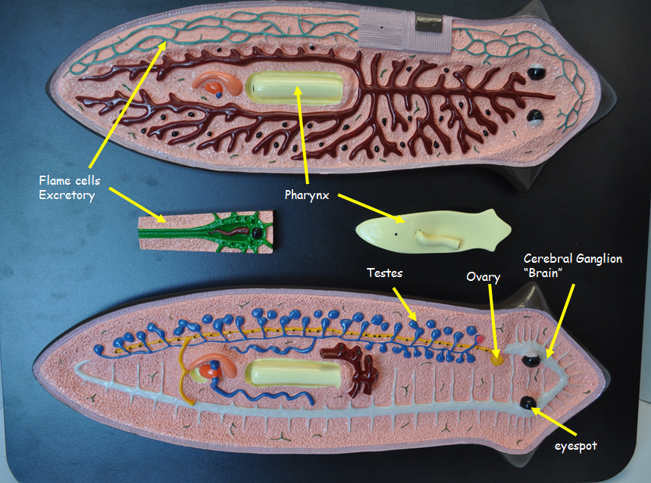
Phylum Platyhelminthes
Planaria Model
Identify :
eye spot
Pharynx
Ovary
Testis
flame cell
Brain
Auricles
Microscope
Look at cross-section of Planaria
Lab Managers – place planaria model

Slide 6
Phylum Nematoda
Domain Eukarya
Kingdom Animalia
Eumetazoa
Bilateria
Phylum Nematoda – round worms
Nematodes:
Are protostomes
Are pseudocoelomates
Have a complete digestive system
Are invertebrates
Many are parasitic
Have cuticle (for molting)
Note differences between sexes of Ascaris
Lab Managers – place few round worm specimens, Ascaris biomount

Slide 7
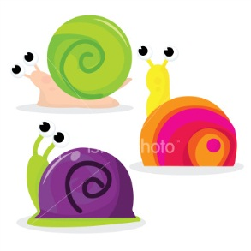
Phylum Mollusca
Domain Eukarya
Kingdom Animalia
Eumetazoa
Bilateria
Phylum Mollusca
Class Polyplacophora – chitins
Class Gastropoda – snails, slug
Class Bivalvia – clams
Class Cephalopoda – octopus, squid
Molluscs:
Are protostomes
Are coelomates
Are invertebrates
Have 3-part body – muscular foot, visceral mass, mantle
Have complete digestive system
Cephalopods have closed circulatory system
Cephalopods are considered to be the most intelligent invertebrates
Lab Managers – place a couple specimens from each class; squid dissection biomount; squid specimens for dissection

Slide 8
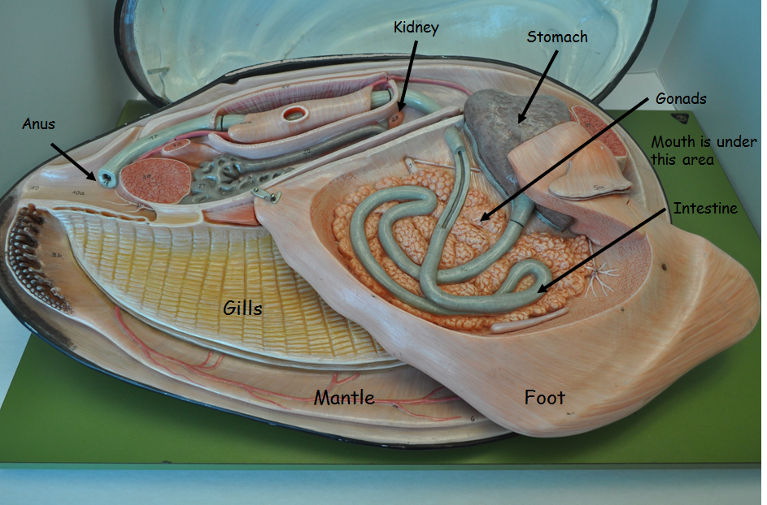
Phylum Mollusca
Clam model
Identify:
Foot
Gill
Gonad
Intestine
Mouth
Stomach
Anus
Kidney
heart
mantle
Lab Managers – place clam model

Slide 9
Phylum Annelida
Domain Eukarya
Kingdom Animalia
Eumetazoa
Bilateria
Phylum Annelida – segmented worms
Class Oligochaeta – earthworms
Class Polychaeta – sand worms, feather dusters
Class Hirudinea – leeches
Annelids
Are protostomes
Are coelomates
Are invertebrates
Have a complete digestive system
Have a closed circulatory system
Lab Managers – place couple specimens from each class

Slide 10
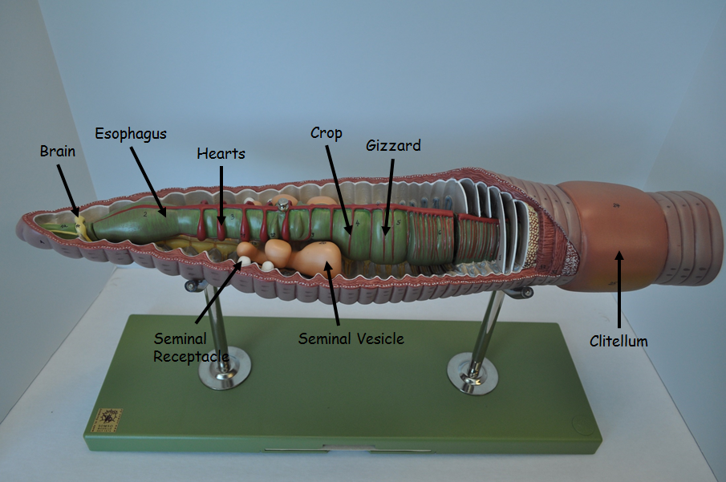
Phylum Annelida
Earthworm Model
Identify:
Brain
hearts
Esophagus
seminal vesicle
seminal receptacle
Crop
Gizzard
dorsal vessel
clitellum
Lab Managers – place earthworm model

Slide 11
Phylum Annelida
Earthworm Dissection
Locate clitellum
Place on ventral side
You want to cut along dorsal side
Make very light, shallow incision from mouth past clitellum
Lab Managers – place earthworm dissection biomount, provide earthworms for dissection

Slide 12
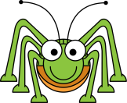
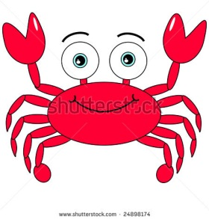
Phylum Arthropoda
Domain Eukarya
Kingdom Animalia
Eumetazoa
Bilateria
Phylum Arthropoda
Chelicerates – horseshoe crabs and arachnids (spider, ticks, scorpions)
Crustaceans – crabs, lobster, shrimp
Insects and relatives
Chilopods – centipedes
Diplopods – millipedes (2 pairs of legs per segment)
Insects/Hexapods – insects
Arthropods
Are protostomes
Are coelomates
Are invertebrates
Have “jointed legs”
Have hard exoskeleton – chitin, undergoes ecdysis
Have open circulatory system
Have complete digestive system
Lab Managers – place couple specimens from each class

Slide 13
Phylum Arthropoda
Grasshopper Model
Identify:
Brain
Heart
nerve ganglion
crop,
malpighian tubules
Insects
Head, thorax, abdomen
3 pairs jointed appendages and 2 antennae
Respiration – tracheae
Lab Managers – place grasshopper model

Slide 14
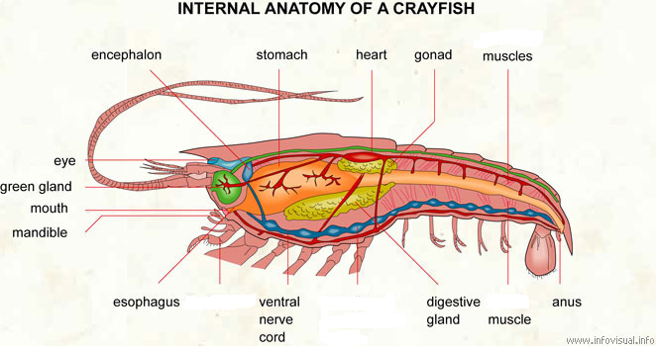
Phylum Arthropoda
Crayfish Dissection
Sex
Anterior (last) pair of swimmerets on abdomen are stiffened (claspers)
Locate cephalothorax and abdomen
Cephalothorax is covered by carapace
Find antennae
At base, look for opening
This is where green glands excrete
Cut away lateral (side) surface of carapace
This exposes gills
Remove gills

Slide 15
Insect Metamorphosis
Complete Metamorphosis
Drastic change
Larvae does not resemble adult
Example is butterfly
Incomplete metamorphosis
Gradual change
Larvae (nymphs) resemble adult
Example is grasshopper
Lab Managers – place metamorphosis biomount

Slide 16
Phylum Echinodermata
Domain Eukarya
Kingdom Animalia
Eumetazoa
Bilateria
Phylum Echinodermata
Class Astroidea – sea stars
Class Ophiuroidea – brittle stars
Class Echinodea – Sea urchins
Class Holothuroidea – sea cucumber
Class Crinodea – sea lillies
Echinoderms:
Are deuterostomes – up until this point we have been seeing protostomes
Are invertebrates
Have an endoskeleton
Adult can be radially symmetrical (pentrahedral) but larvae are bilateral
Most unique feature is water vascular system
Lab Managers – place couple specimens from each class

Slide 17
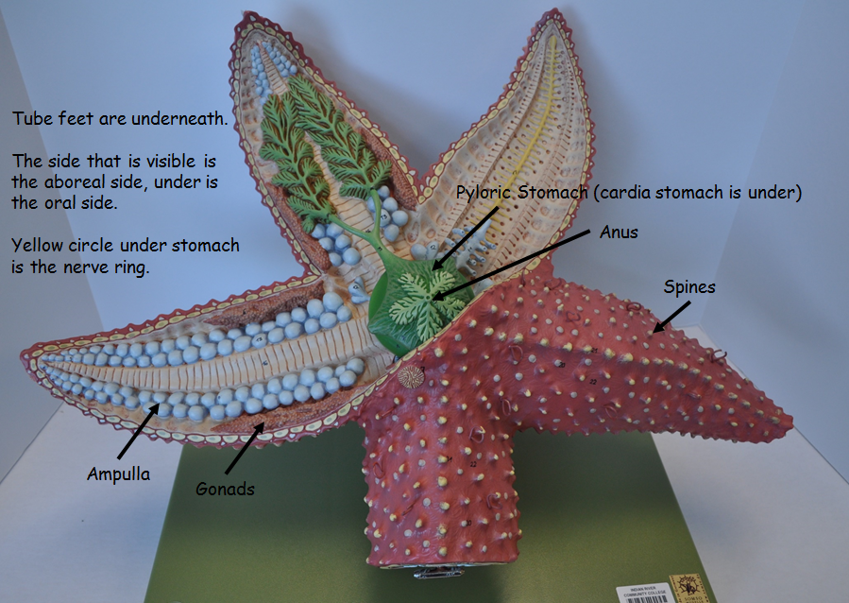
Phylum Echinodermata
Sea Star Model
Identify:
Tube feet
Ampulla
Anus
Mouth
Pyloric stomach
Cardiac stomach
Gonads
Radial canal (down arms)
Ring canal
Spines
Aboral side
Oral side
Lab Managers – place sea star model

Slide 18
Phylum Chordata
Domain Eukarya
Kingdom Animalia
Eumetazoa
Bilateria
Phylum Chordata
Subphylum Urochordata – tunicates
Subphylum Cephalochordata – lancelets
Subphylum Vertebrata – Vertebrates
Superclass Agnatha – jawless fishes
Superclass Gnathostoma – jaws
Class Chondrichthyes – sharks, rays
Class Osteichthyes – bony fish
Class Amphibia – amphibians
Class Reptilia – reptiles and Aves (birds)
Class Mammalia – mammals
Chordate characteristics
Dorsal tubular nerve cord
Notochord (supporting rod)
Postanal tail
Pharyngeal gill slits
Can become gills
Or in terrestrial chordates, will be modified during embryological development
Chordates are deuterostomes

Slide 19
Subphylum Vertebrata
Segmented bodies and jointed appendages like arthropods
But arthropods have exoskeleton and vertebrates have endoskeleton
Both aquatic and terrestrial vertebrates
Vertebrate brain is complex
High degree of cephalization

