Slide 1
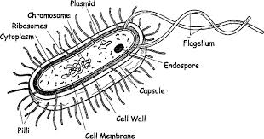
Domain Bacteria
Prokaryotic organisms
Cell wall made up of peptidoglycan
Very few are pathogenic

Slide 2
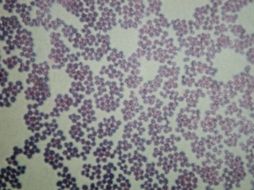
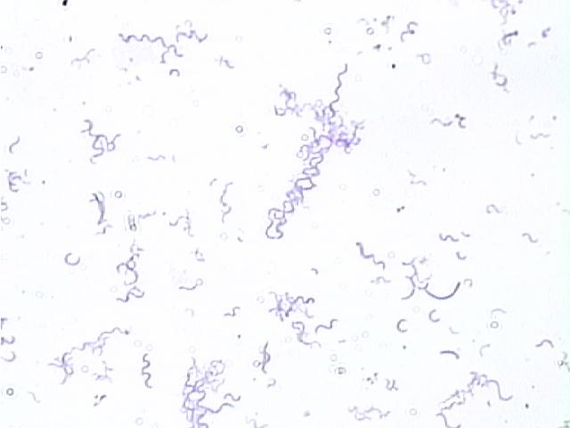
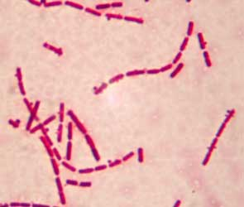
Domain Bacteria
3 basic morphological shapes
Coccus, bacillus, spirillum
Look at slide of bacterial shapes

Slide 3
Domain Bacteria
Colony Morphology
Colonies will look different based on species present and agar used
A bacterial colony – cluster of bacteria that arose from a single clone
Observe petri dishes on lab bench
Lab managers: set up petri dish showing growth of bacteria

Slide 4
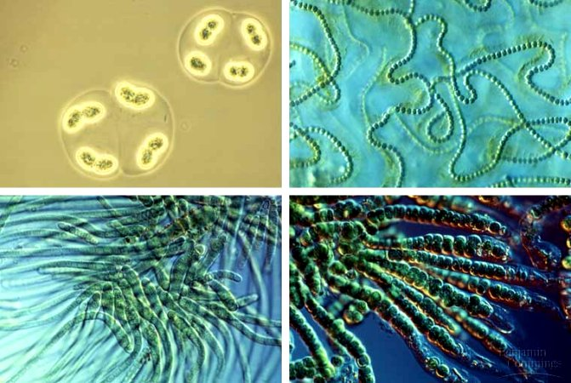
Domain Bacteria
Cyanobacteria – photosynthetic bacteria
Look at slides of cyanobacteria

Slide 5
Domain Eukarya
Protists
Fungi
Plants
Animals

Slide 6
Protists
Lots of variation, bridge to multicellularity – basically eukaryotes that aren’t fungi, plants, or animals
Taxonomy: “Protozoans” are heterotrophic; “algae” are photosynthetic
Excavata – Giardia, Trichomonas, Euglena, Trypanosoma
Alveolates – dinoflagellates, apicomplexans (Plasmodium), ciliates (Paramecium)
Stramenophiles – oomycetes, diatoms, brown algae
Rhodophytes – red algae
Chlorophytes – green algae
Rhizaria – foraminiferans, radiolarians
Amoebozoans – plasmodial slime molds, Amoeba
Look at slides of protists

Slide 7
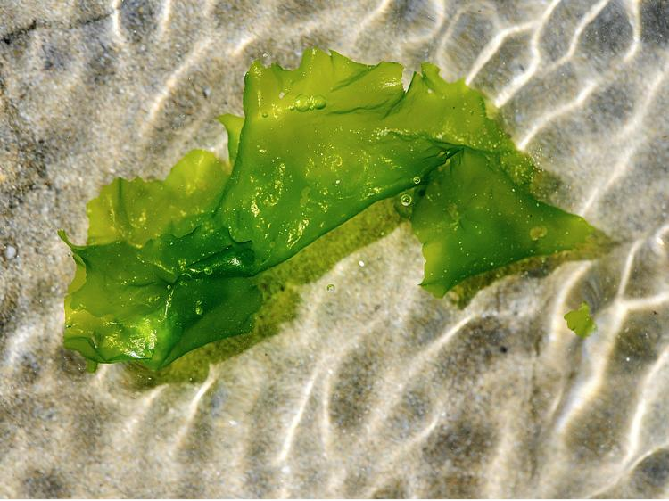
Protists
Green Algae
Macroscopic algae are called “seaweed”
Lab managers: set up herbarium mounts and jars of green algae examples

Slide 8
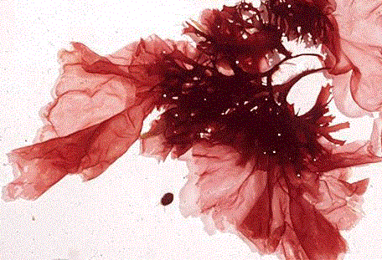
Protists
Red Algae
Lab managers: set up herbarium mounts and jars of red algae

Slide 9
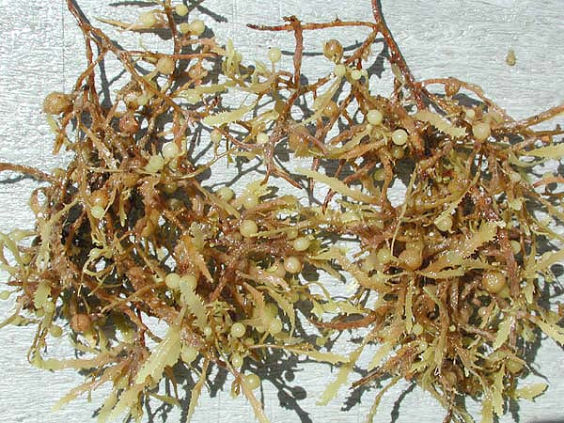
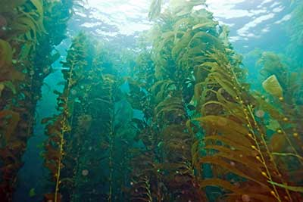
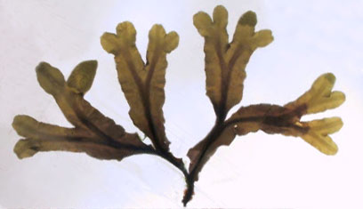
Protists
Brown Algae
Sargassum
Kelp
Lab managers: set up herbarium mounts and jars of brown algae
Fucus (“Foocus”)

Slide 10
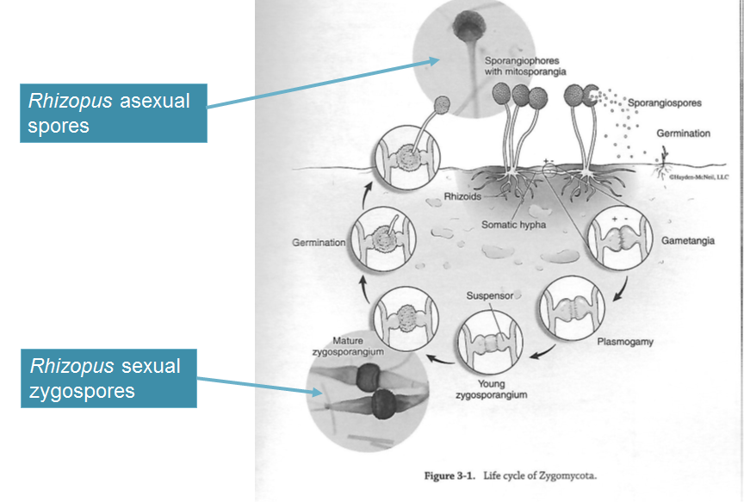
Fungi
Zygomycota
Black bread molds
Lab managers: set up examples of Zygomycota

Slide 11
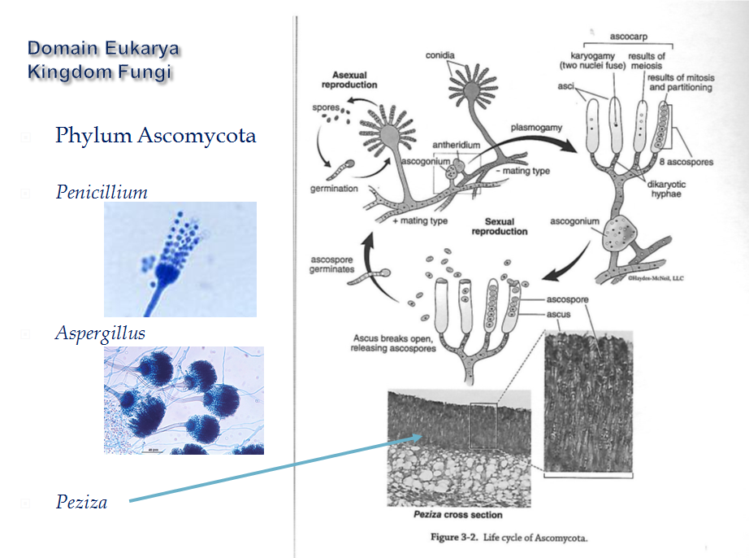
Fungi
Ascomycota
Yeasts, cup fungi
Lab managers: set up examples of Ascomycota

Slide 12
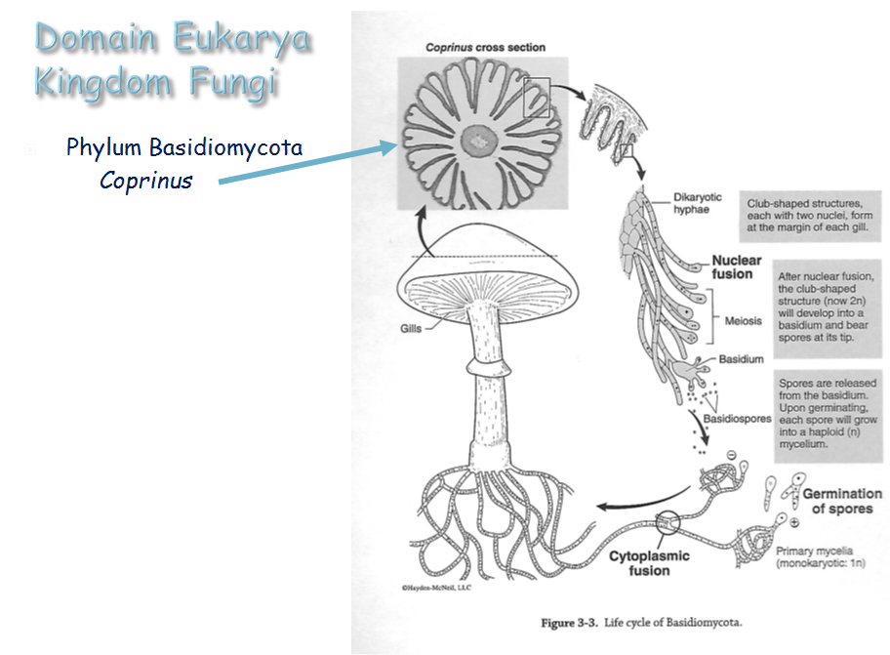
Fungi
Basidiomycota
mushrooms
Lab managers: set up examples of Basidiomycota

