Slide 1
Enterobacteriacae Indentification: EnteroPluri© System Set up

Slide 2
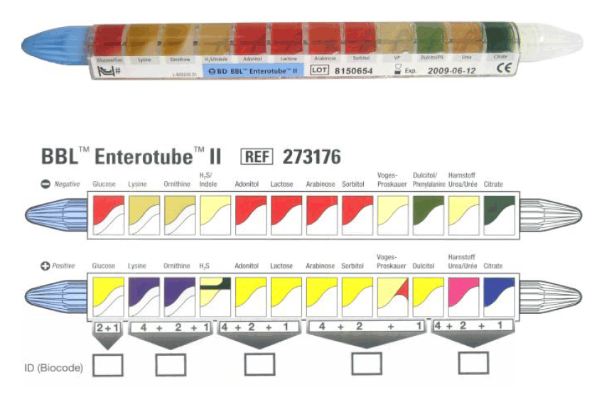
The EnteroPlurisystem
Used for rapid identification of organisms in the Enterobacteriacae family
12 chambers of different types of media and 15 Biochemical tests incorporated into a simple tube for rapid identification
Bacteria in the Enterobacteriacae family are gram-negative rods/coccobacillus and oxidase negative.
After incubation, based on the results of the change in the media, a numerical code is resulted and then this correlates with a different kind of organism

Slide 3
Inoculation of the Enterotube System
Uncap each side of the Enterotube. The White cap side is the inoculating end.
Touch the inoculating end to an isolated colony. Avoid touching the needle to the agar.
Using the other end (looped wire), pull the needle through all the chambers 3X. Make sure to pull it through ALL the chambers.
Reinsert the needle until the notch on the wire is aligned with the end of the last chamber. The tip of the wire should be visible in the citrate compartment. Replace the white cap on this end.
Break the wire at the handle by bending. The portion of the wire remaining in the tube maintains the anaerobic conditions for true fermentation. Replace the blue cap at this end.
Punch holes in the last 8 compartments through the thin plastic covering over depression on the sides. (adonitol through citrate)
Place inoculated Enterotube in the bin labeled with our class section. These will be incubated for 24 hours then we can read the results in next weeks lab.

Slide 4
Antimicrobic Sensitivity testing: The Kirby-Bauer Method

Slide 5
The Kirby Bauer Method
This method is used to test a panel of antibiotics to see which one is most effective to treat an organism.
An antibiotic disk is placed on the agar and the antibiotic diffuses out, creating a concentration gradient.
Very Similar to the Antiseptics lab
If the antibiotic inhibits or kills the test organisms, there will be a zone of no growth around the disk called the Zone of Inhibition.
Varies with the diffusibility of the agent, the size of the inoculum, type of medium and many other factors

Slide 6
Procedure
Organisms used (in TSB):
Staphylococcus aureus
Pseudomonas aeruginosa
1 MH plate/student
1 organism/ student
Sterile swabs
Dip sterile swab into designated broth
Inoculate your MH in 3 different directions.
Discard of swab in small orange biohazard bags at each bench
After you have inoculated your plate, the instructor will dispense the antibiotic disks.
Place your plates in the bin labeled with your class section

