Slide 1
General Biology II Lab IRSC
Ecdysozoan Protostomes, Exercise 9

Slide 4
Ecdysozoan Protostomes
Phylum Nematoda and Phylum Arthropoda
Ecdysis – molting the outer cuticle

Slide 5
Phylum Nematoda
Bilateral symmetry
Body Cavity – pseudocoelomate
Digestion – complete
Circulation – none
Respiration – diffusion through cuticle
Excretion – rennette glands
Locomotion – muscles (longitudinal)
Support – cuticle
Segmentation – no
Appendages – no
Nervous – ganglion
Reproduction – sexual dimorphism
Habitat – marine, freshwater

Slide 6
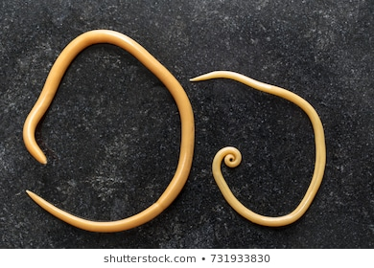

Slide 7
Phylum Arthropoda
Bilateral symmetry
Body Cavity –coelomate
Digestion – complete
Circulation – open circulatory
Respiration – gills in crustaceans, trachea system in insects
Excretion – malphagian tubules
Locomotion – muscles
Support – exoskeleton made of chitin
Segmentation – yes
Appendages – jointed
Nervous – ganglion brain
Reproduction – sexes are separate in most of them
Habitat – marine, freshwater , terrestrial

Slide 8
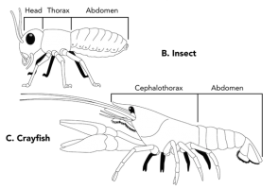

Slide 9
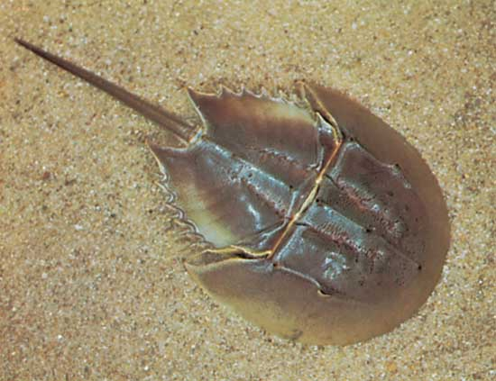
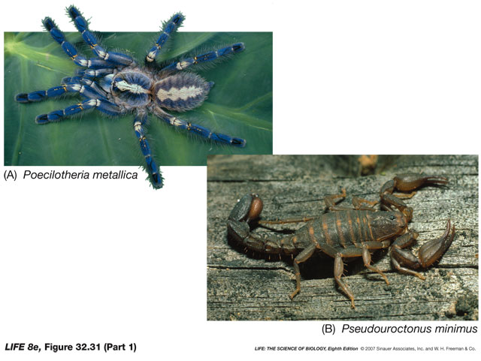
Phylum Arthropoda, Group Chelicerates
Horseshoe crab and arachnids
4 pairs of legs
No antennae
Cephalothroax and abdomen

Slide 10
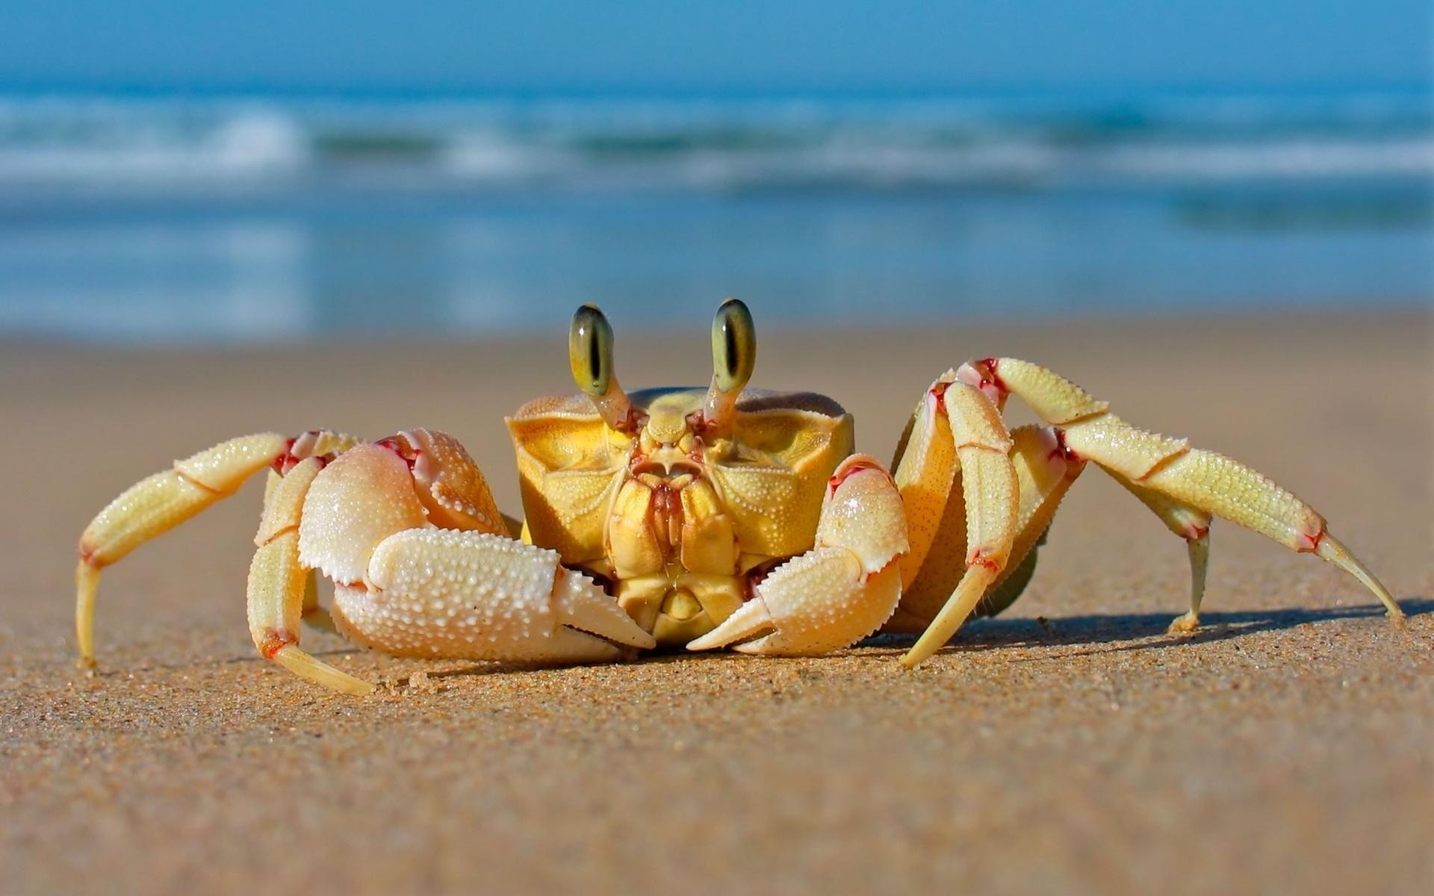
Phylum Arthropoda, Group Crustacea
Lobster, shrimp, crayfish, crabs
3 to 5 pairs of legs
Cephalothorax and abdomen
Gills

Slide 13
Phylum Arthropoda, Insects and Relatives
Insects
3 pairs of legs
1 pair of antennae
With or without wings
Head, thorax, abdomen
Respiration: spiracle openings with trachea
Millipedes – 2 pairs of legs per segment
Centipedes – 1 pair of legs per segment

Slide 14
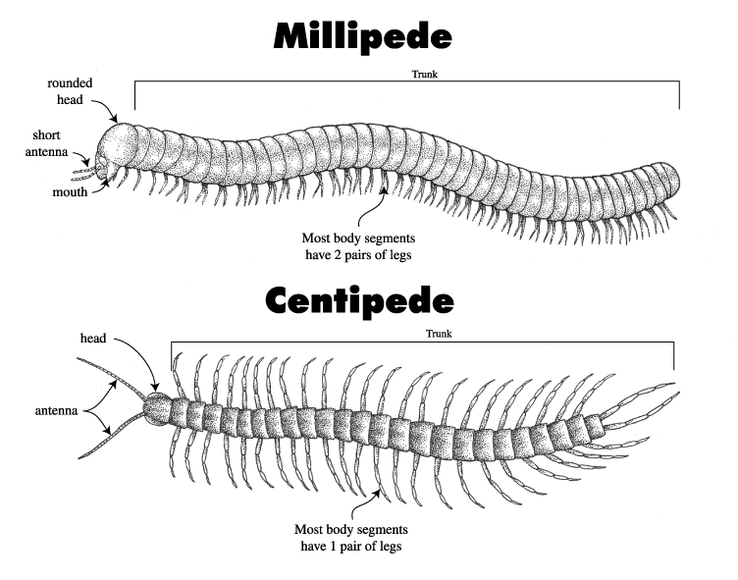

Slide 16
