Slide 1
General Biology II Lab IRSC
Flowering Plant Structure, Exercise 6

Slide 4
We are going to look at the organ structure of flowering plants
We have already look at the flower, the reproductive organ of the flowering plant

Slide 5
Plant growth
Primary growth – growth at roots and shoots
Secondary growth – increase in girth (find this in development of wood)

Slide 6
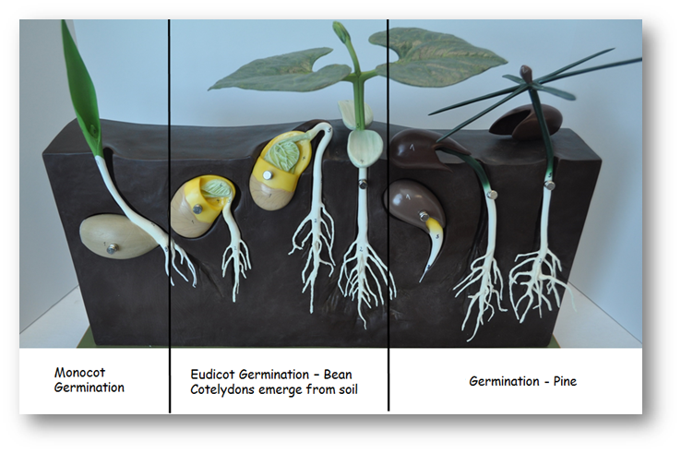
Seed Germination and Plant Growth

Slide 7
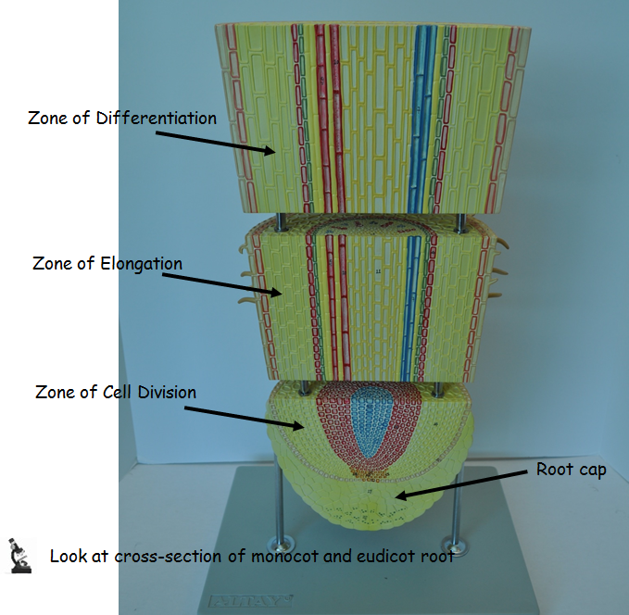
Roots

Slide 8
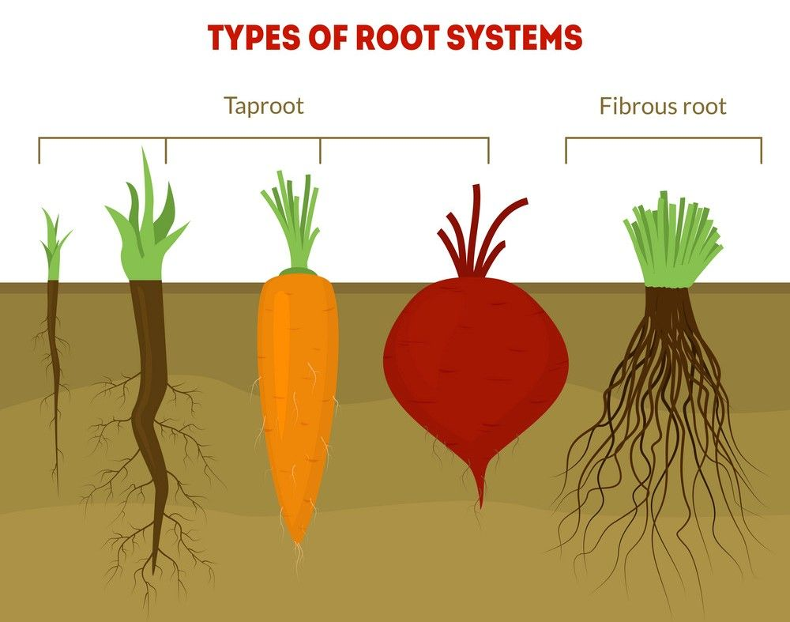
Tap root versus fibrous roots

Slide 9
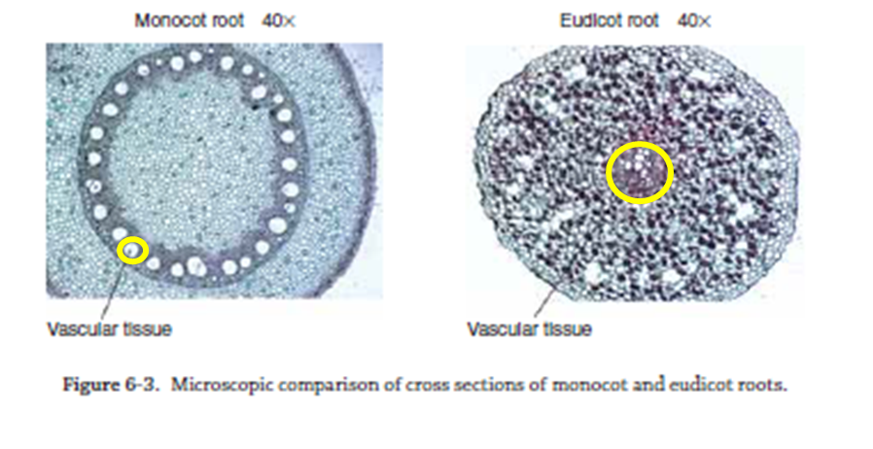

Slide 10
Stems
Stems provide support for leaves and flowers
Stems that do not contain wood are herbaceous (nonwoody)

Slide 11
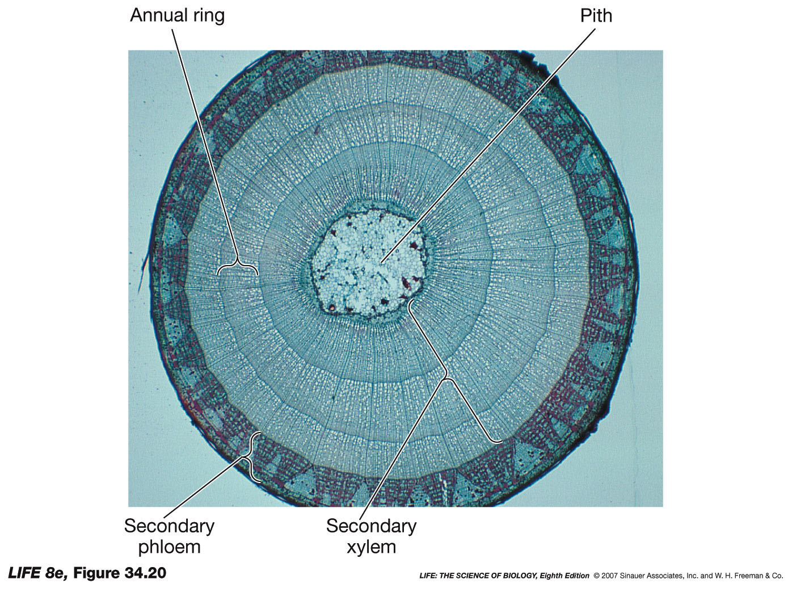

Slide 12
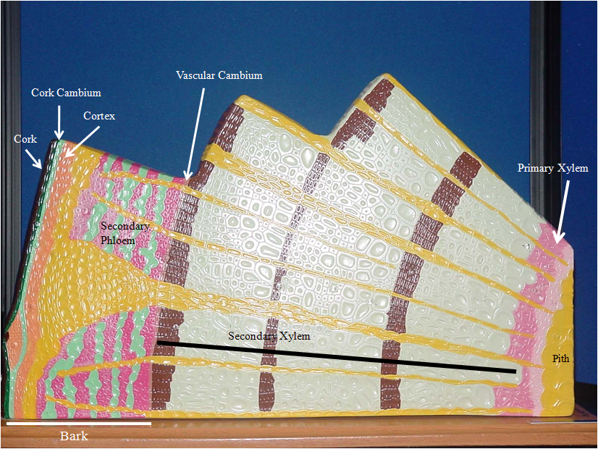

Slide 13
Leaves
Leaves are the organs of photosynthesis

Slide 14
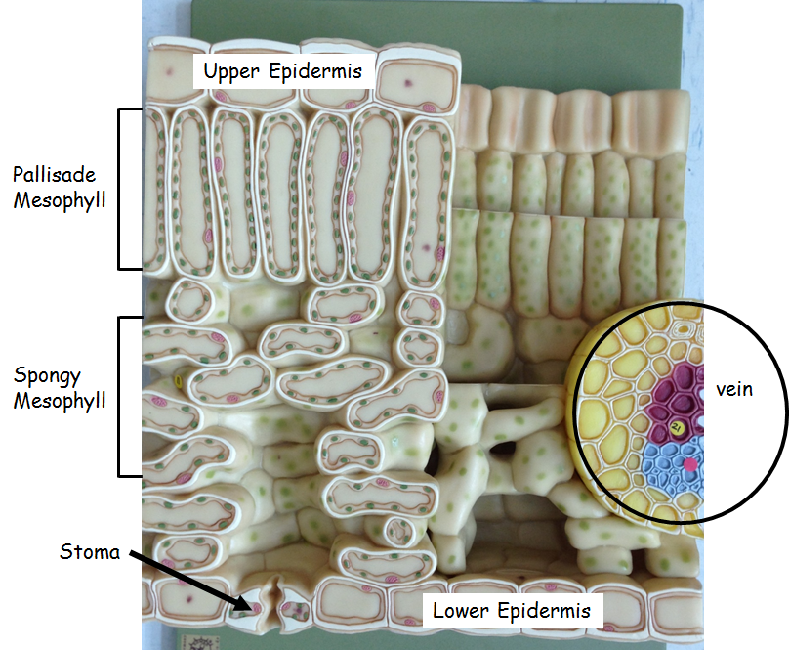

Slide 15
The way leaves are arranged on a stem differs from plant to plant and can serve as a way to identify that plant

