Slide 1
General Biology II Lab IRSC
Fungi, Exercise 3

Slide 2
The Fungi

Slide 4
Fungi
Heterotrophic organisms – external digesters
Cell wall made of chitin
Cells of the fungi are haploid (only diploid when sexual reproduction is occurring)
Can reproduce sexually and asexually
When reproducing sexually, there is no female and male with fungi – only different genetically different mating types (-) and (+)
Spores will develop into a mycelium

Slide 6
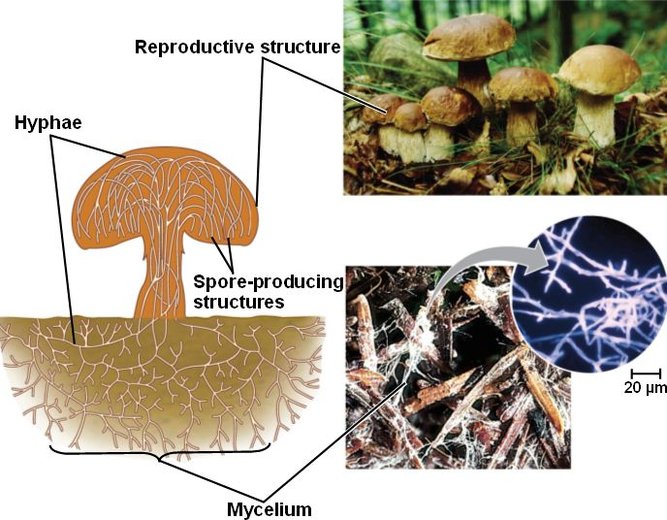

Slide 7
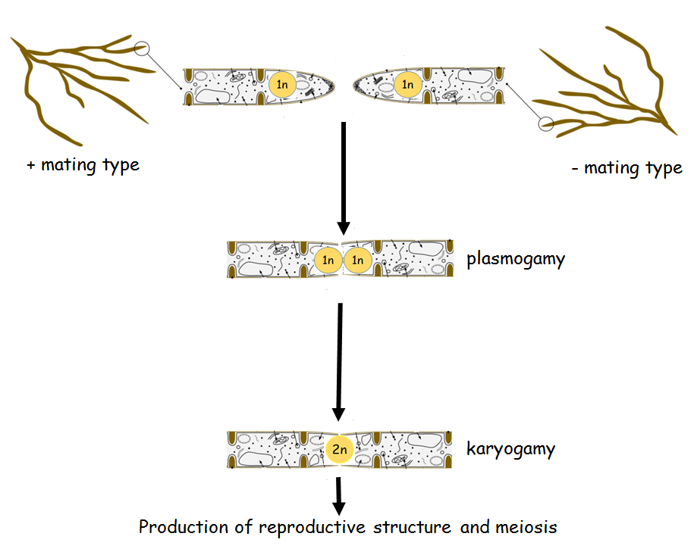
Sexual reproduction

Slide 8
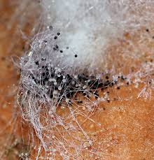
Phylum Zygomycota
Includes bread molds, includes Rhizopus
Sexual spores are zygospores
Asexual spores are sporangiospores

Slide 9
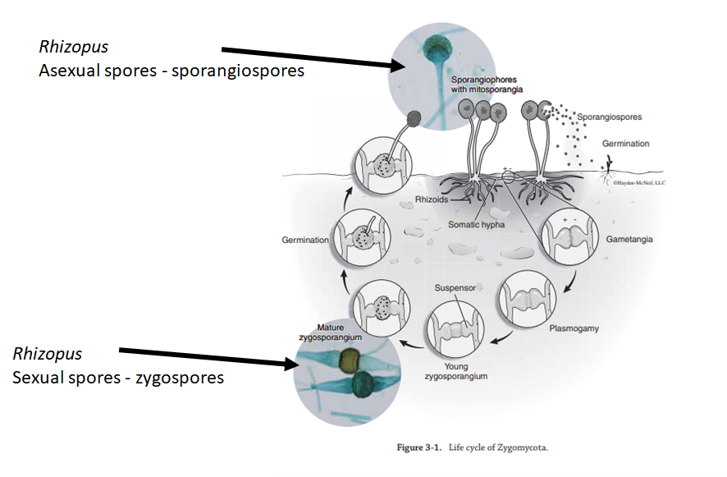

Slide 10
Phylum Ascomycota
Cup fungi (includes morels, yeasts, truffles)
Sexual spores – ascopsores
Asexual spores – conidiospores

Slide 11
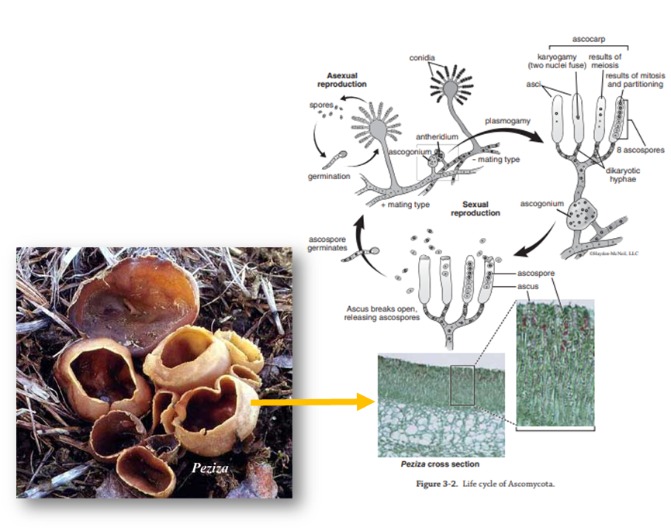

Slide 12
Penicillium and Aspergillus reproduce only asexually

Slide 13
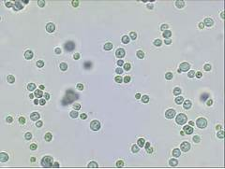
Saccharomyces – unicellular yeast
Reproduce by budding

Slide 14
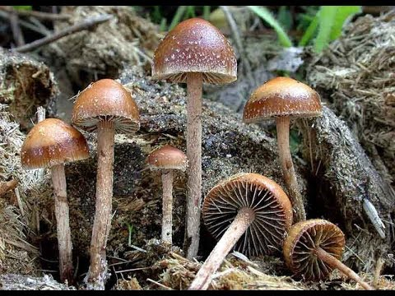
Phylum Basidiomycota
Mushrooms
Sexual spores – basidiospores
Asexual spores – odiaspores

Slide 16
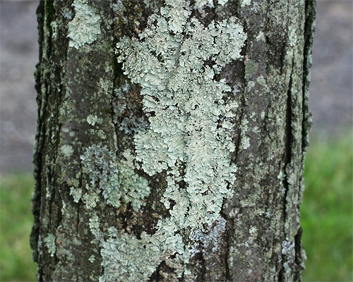
Lichens
Lichens are a symbiotic relationship between a fungus and a cyanobacteria or chlorophytes

Slide 17
Are fungi heterotrophic or autotrophic?
What are their cell walls made of?
Are fungi haploid or diploid for most of their life cycle?
In fungi, there are no male or female only different ______________?
What are the 2 morphological stages of fungi?
Draw the reproductive structure and the mycelium of a typical fungus (slide 6)
What are the 3 phyla of fungi we discussed?
For each group, know what the sexual and asexual spores are called
For each group, review the life cycles
For each group, be able to identify the species that were presented in this presentation

