Slide 1
General Biology II Lab IRSC
Protists, Exercise 2

Slide 2
The Protists The Eukaryotes that didn’t fit into the other Kingdoms

Slide 4
Domain Eukarya includes all organisms made up of eukaryotic cells
Includes protists, fungi, plant and animals
This exercise focuses on the protists

Slide 5
Domain Eukarya is divided into 6 Supergroups Protists are found in all 6

Slide 6
Some protists are unicellular, some are multicellular
Methods of protist motility
Some have flagella
Some have pseudopodia
Some have cilia
Protozoans – heterotrophic protists (some cause disease)
Algae – autotrophic protists
Microscopic algae – phytoplankton
Macroscopic algae - seaweed

Slide 7
Protozoan examples
Protozoans are heterotrophic
Some of them can cause disease

Slide 8
Amoeba

Slide 9
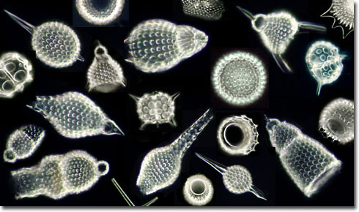
Radiolarians

Slide 10
Globigerina

Slide 11
Paramecium

Slide 12
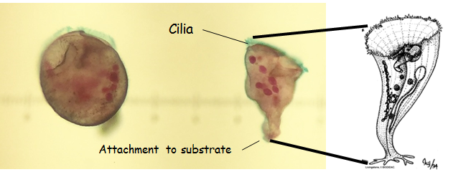
Stentor

Slide 13
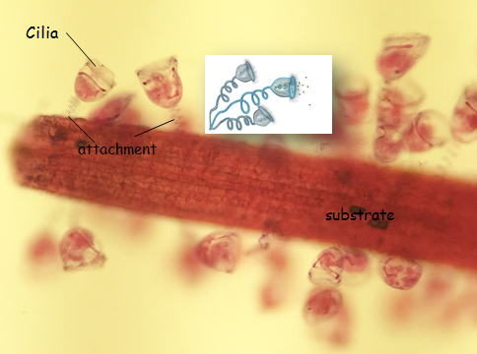
Vorticella

Slide 14
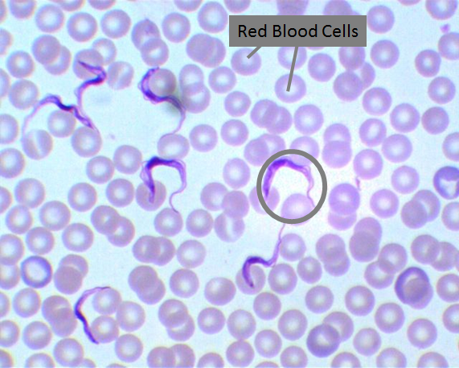
Trypanosoma
Causes diseases like African sleeping sickness, Chagas disease

Slide 15
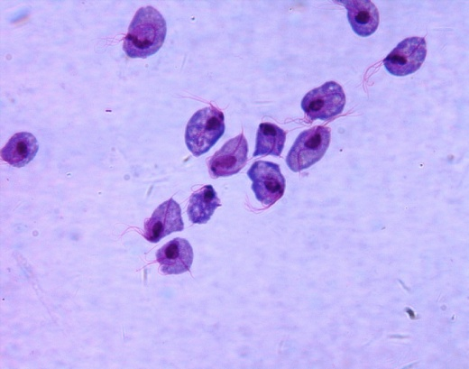
Trichomonas (notice they have a couple of flagella), STD

Slide 16
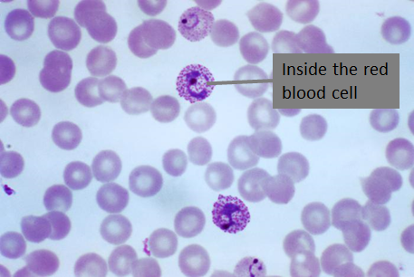
Plasmodium, causes malaria

Slide 17
Algae examples
Algae are photosynthetic
Unicellular algae are phytoplankton
Multicellular algae are seaweeds

Slide 18
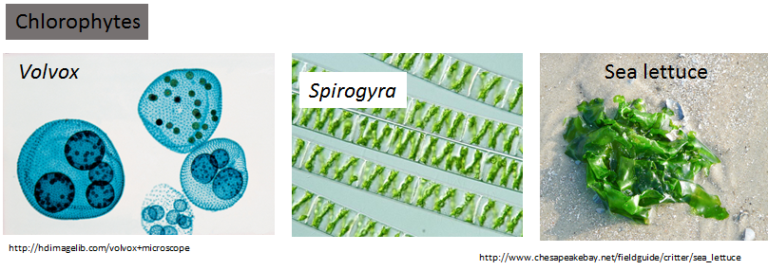
Green Algae

Slide 19
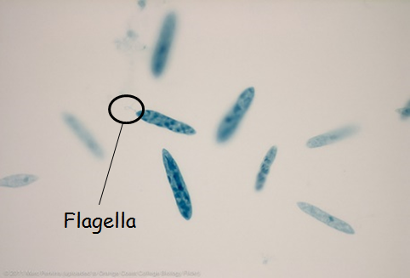
Euglena

Slide 20
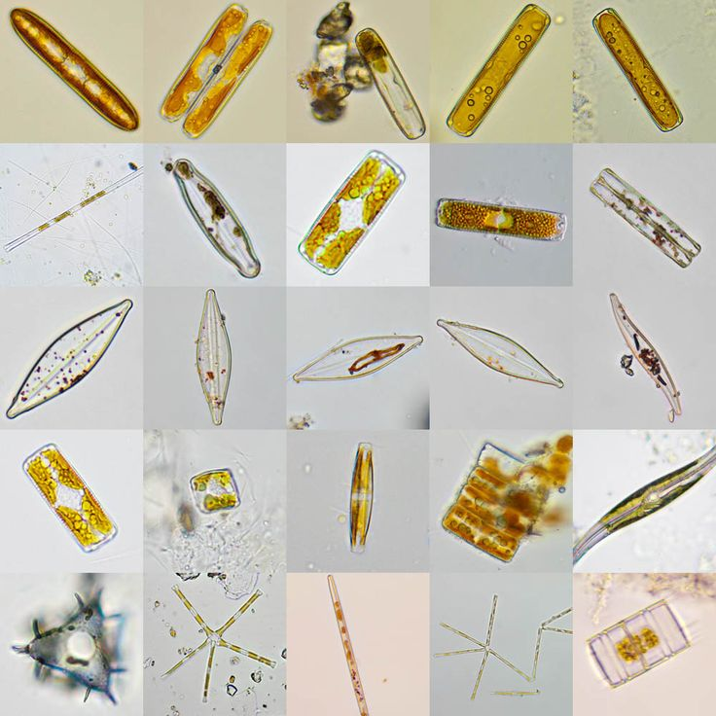
Diatoms

Slide 21
Ceratium (dinoflagellate, responsible for red tides)

Slide 22
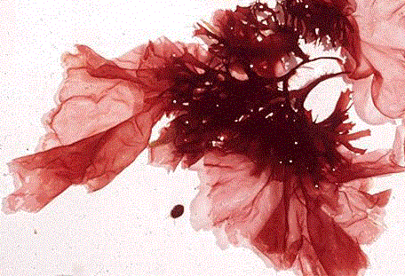
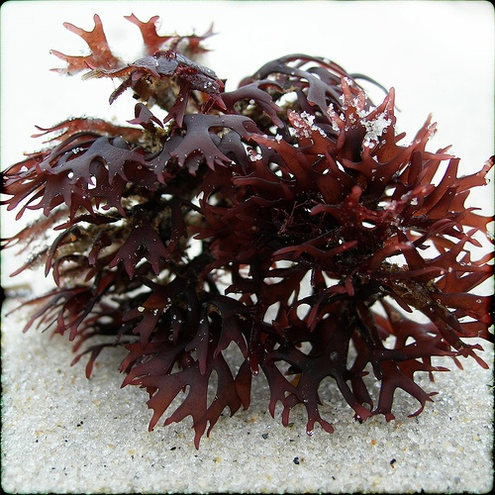
Red Algae

Slide 23
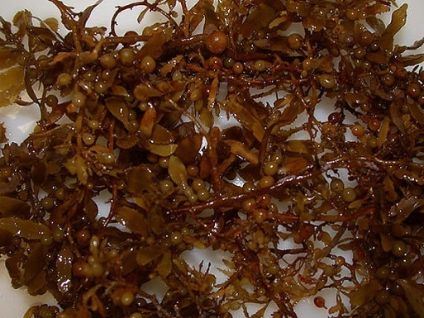
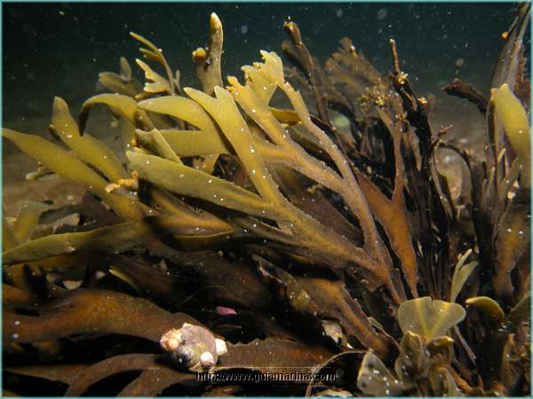
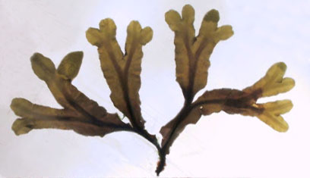
Brown Algae (remember that larger algae are called seaweeds)
Sargassum
Fucus

Slide 24
Slime molds
Once thought to be Fungi
Group of eukaryotic cells that can live freely as single cells but will aggregate together to form multicellular reproductive structures
Amoeba-like
They can move like an animal but act like a fungus

Slide 25
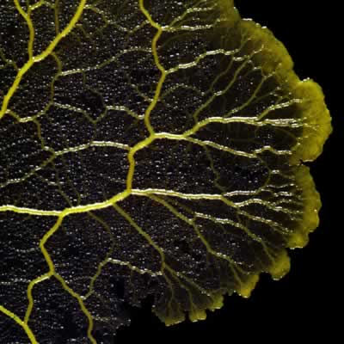
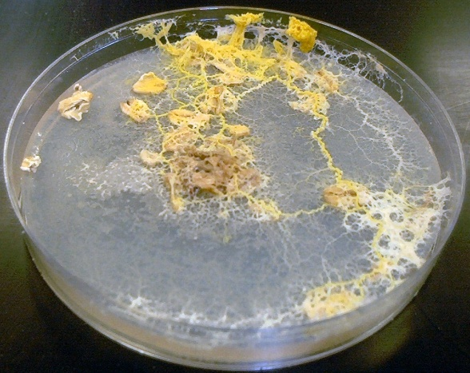
Slime Molds
Plasmodial slime molds
Physarum

Slide 26
Are protists prokaryotic or eukaryotic?
Are photosynthetic protists called protozoans or algae?
What are microscopic algae called?
What are macroscopic algae called?
Make flashcards

