Slide 1
General Biology II Lab IRSC
Pig Dissection,
Exercise 12

Slide 3
Anatomical terms:
Dorsal – back
Ventral – front
Anterior – towards the head in 4 legged animal
Posterior – away from the head in 4 legged animal
Superior – towards the head in upright animal
Inferior – away from the head in upright animal

Slide 5
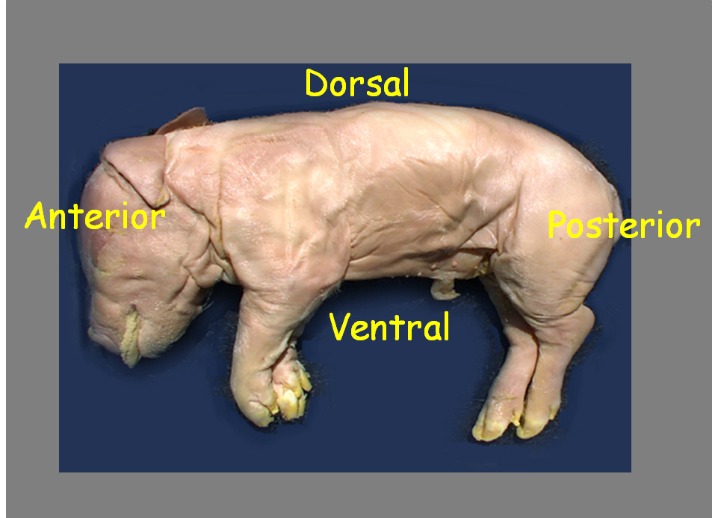

Slide 7
The following pictures will show the location of these vessels and organs in the pig
Be able to identify these and be able to name a function of each organ

Slide 8
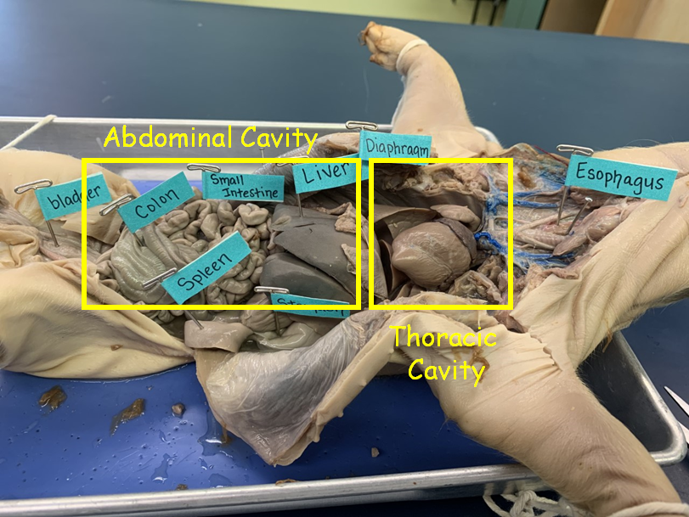

Slide 9
Let’s go through the systems.
First the Immune System:
Thymus
Spleen

Slide 11
Respiratory System
Larynx
Trachea
Lungs
Endocrine System
Thyroid

Slide 13
Digestive System
Path of food:
Esophagus
Stomach
Small intestine
Duodenum (first part of small intestine that leaves stomach)
Jejuno-ileum (last part of small intestine)
All of it held in place by mesentary
Large Intestine (colon)
Caecum
Rectum (last part of colon)
Anus
Accessory organs:
Liver
Gall bladder
pancreas

Slide 16
Excretory System
Kidney
Ureter
Urinary bladder

Slide 18
Reproductive System
Female
Uterine horns
Uterus
Ovary
Male
Testis
Epididymis
Vas deferens
Bulbourethral gland

Slide 21
Cardiovascular System
Heart
Vessels (not all can be seen on this pig but I’ll describe where they lead); refer to figure 12-2

Slide 23
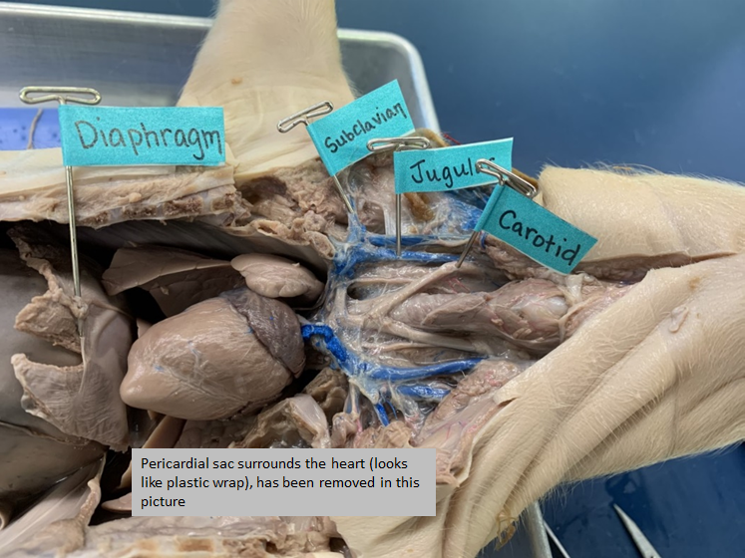

Slide 24
