Slide 1
General Biology II Lab IRSC
Dueterostomes,
Exercise 10

Slide 4
Deuterostomes – 1st blastopore become the anus
Phylum Echinodermata
Phylum Chordata
Subphylum Vertebrata

Slide 5
Phylum Echinodermata
Bilateral symmetry (larvae, the adults have pentahedral symmetry)
Body Cavity –coelomate
Digestion – complete
Circulation – water vascular system with tube feet
Respiration – tube feet
Excretion – water vascular system
Locomotion – muscles
Support – endoskeleton (calcium carbonate)
Segmentation – no (have no area of cephalization)
Appendages – arms
Nervous – nerve ring
Reproduction – can reproduce asexually as well
Habitat – marine

Slide 6
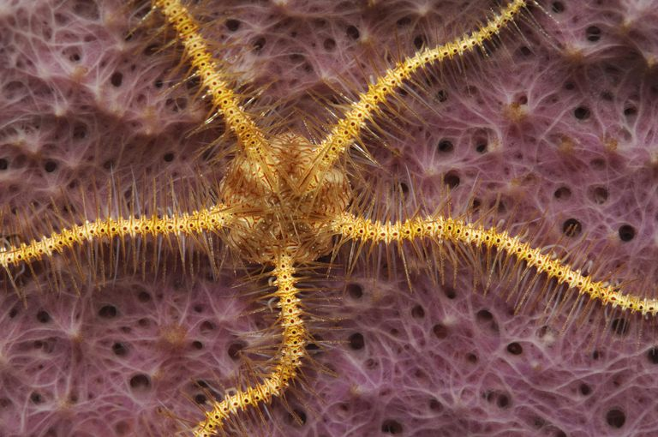
Phylum Echinodermata, Class Ophiuroidea
Brittle stars

Slide 7
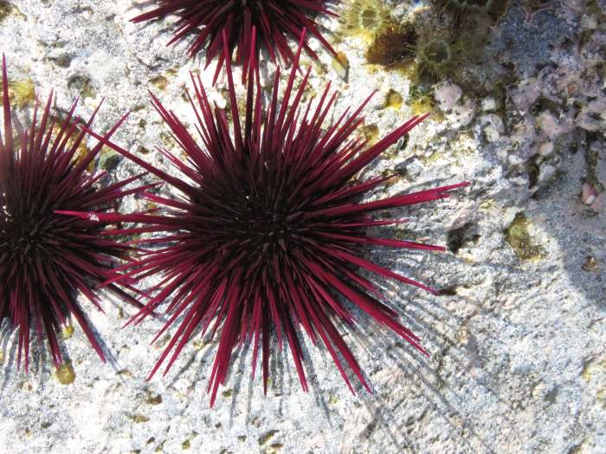
Phylum Echinodermata, Class Echinoidea
Sea urchins

Slide 8
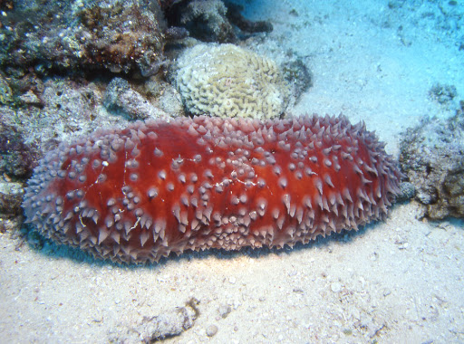
Phylum Echinodermata, Class Holothuroidea
Sea cucumbers

Slide 9
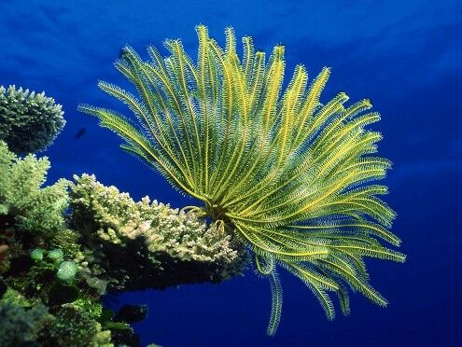
Phylum Echinodermata, Class Crinoidea
Sea lilies

Slide 10
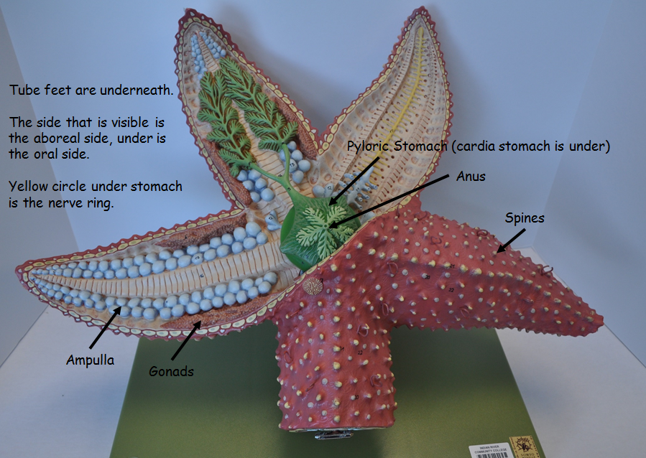
Phylum Echinodermata, Class Asteroidea
Sea Stars

Slide 11
Phylum Chordata
Subphylum Cephalochordata – lancelets
Subphylum Urochordata – tunicates
Subphylum Vertebrata - Vertebrates

Slide 12
What are the 4 main characteristics of animals in Phylum Chordata?
Pharyngeal gill slits
Dorsal, hollow nerve cord
Notochord
Post anal tail
All animals in Phylum Chordata have these characteristics at some point in their life cycle.

Slide 14
Phylum Chordata, Subphylum Vertebrata
Bilateral symmetry
Body Cavity –coelomate
Digestion – complete
Circulation – closed
Respiration – gills or lungs
Excretion – kidneys
Locomotion – muscles
Support – endoskeleton, vertebrate
Segmentation – yes
Appendages – yes
Nervous – brain, becomes more complex with higher vertebrates
Reproduction –
Habitat – marine, freshwater, terrestrial

Slide 15
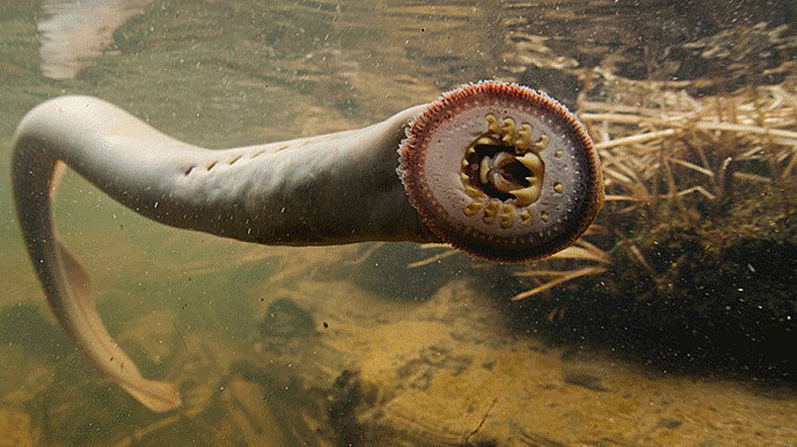
Phylum Chordata, Subphylum Vertebrata, SuperClass Agnatha
Jawless fish (lamprey)

Slide 16
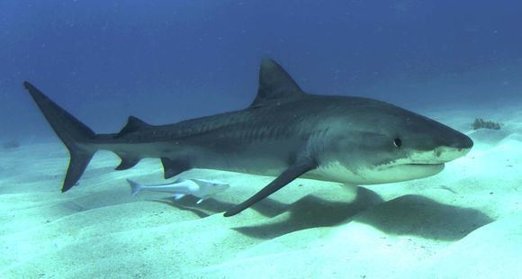
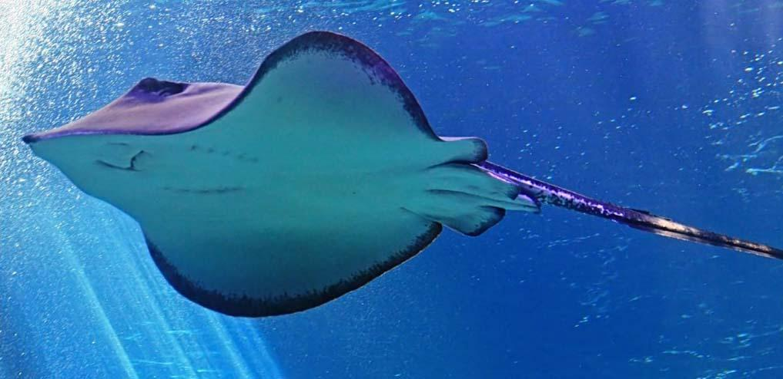
Phylum Chordata, SubPhylum Vertebrata, SuperClass Gnathostomata, Class Chondrichthyes
Cartilaginous fish – sharks, skates, rays

Slide 17
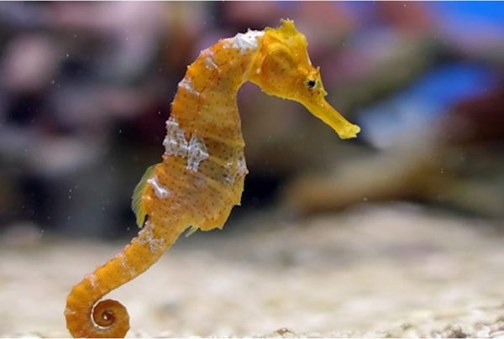
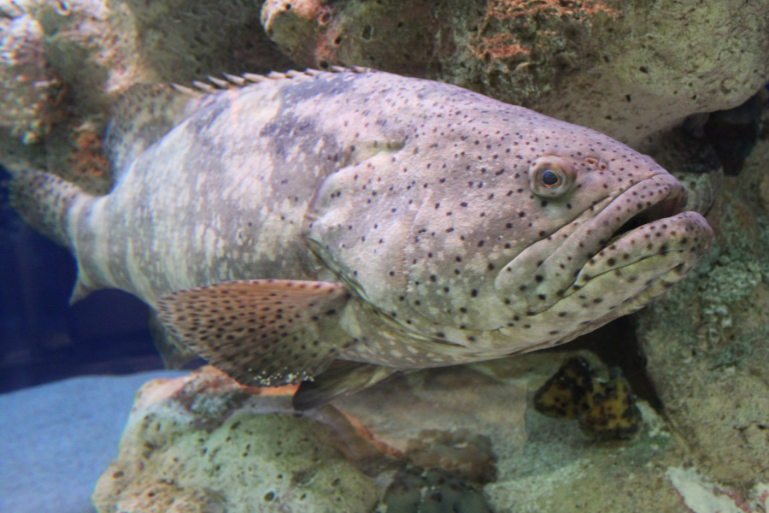
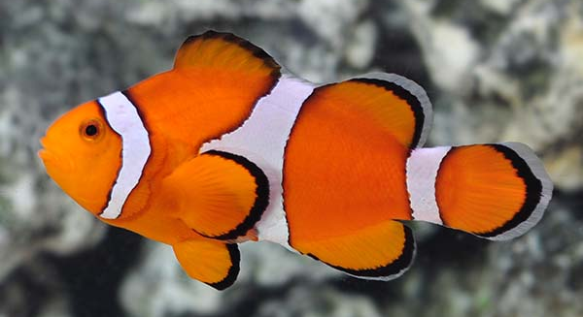
Phylum Chordata, Subphylum Vertebrata, SuperClass Gnathostomata, Class Osteichthyes
Bony fish, very diverse, 2 chambered heart

Slide 18
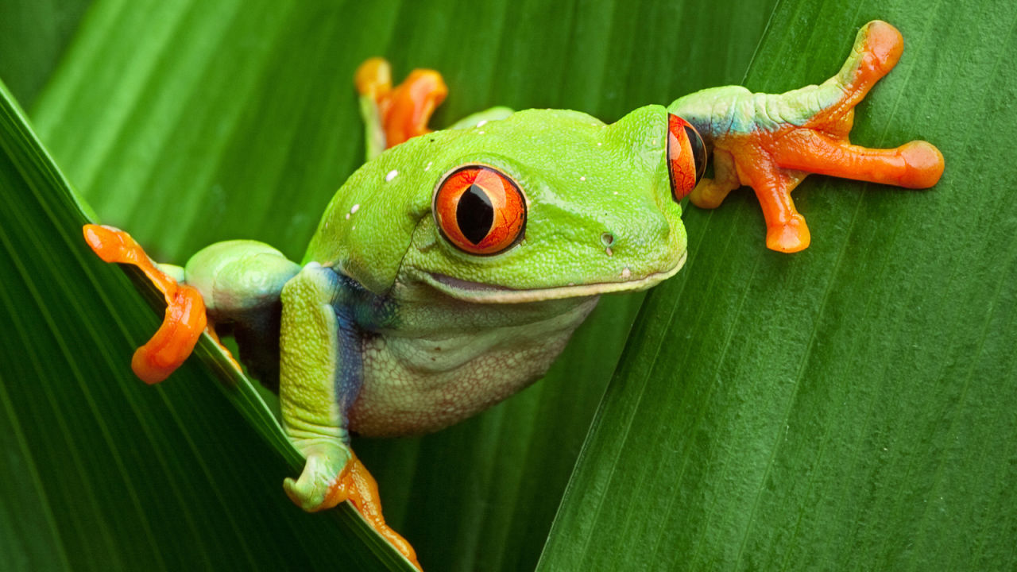
Phylum Chordata, Subphylum Vertebrata, SuperClass Gnathostomata, Class Amphibia
Tetrapods, 3-chambered heart

Slide 19
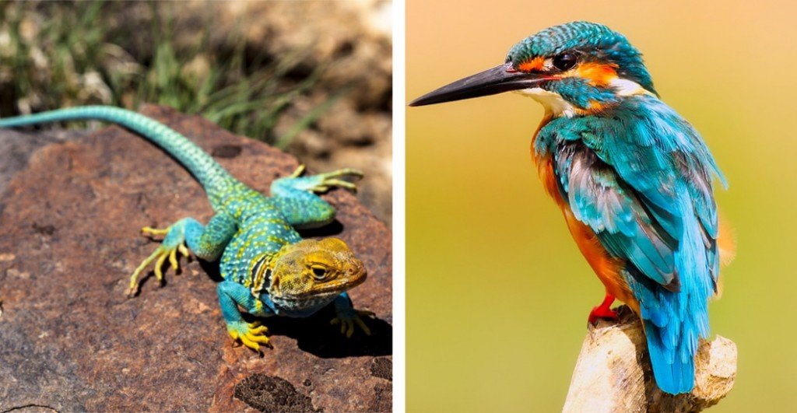
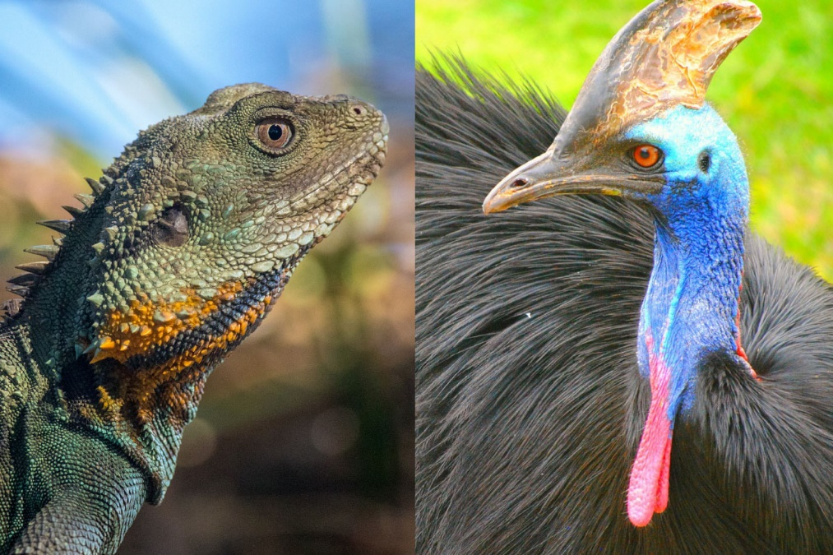
Phylum Chordata, Subphylum Vertebrata, SuperClass Gnathostomata, Reptiles and Birds
Tetrapods, amniotic egg, reptiles are ectothermic, birds are endothermic

Slide 20
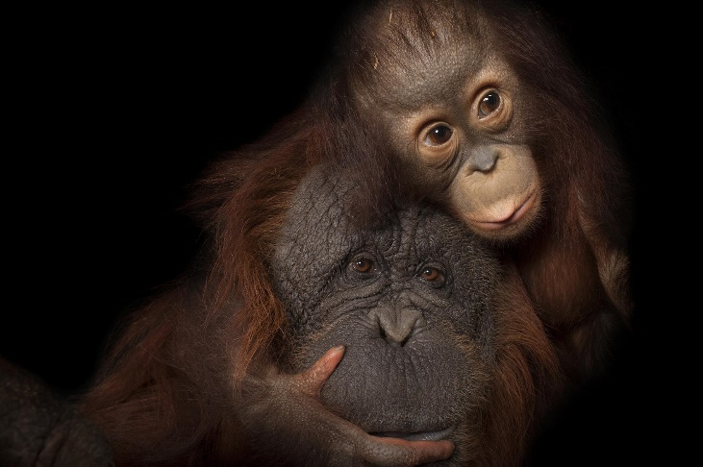
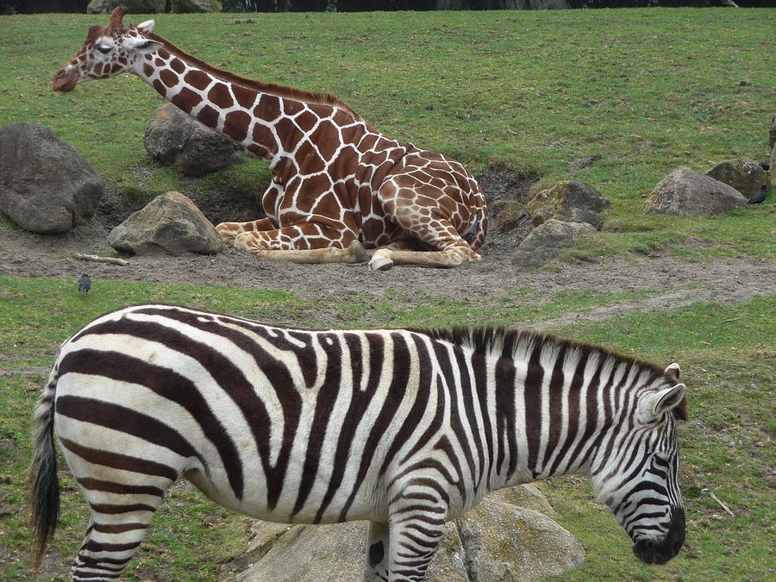
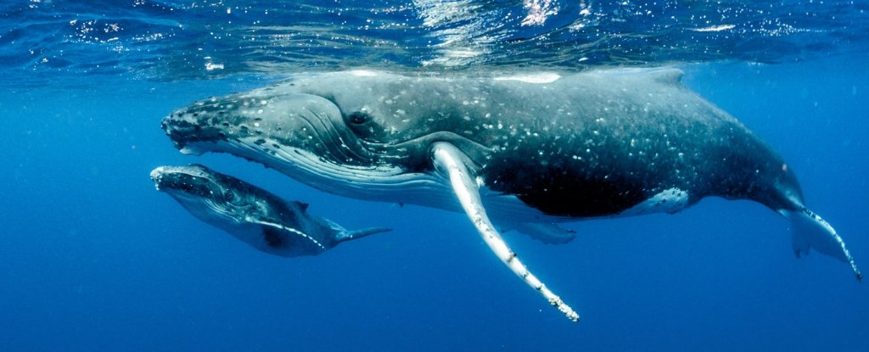
Phylum Chordata, Subphylum Vertebrata, SuperClass Gnathostomata, Class Mammalia
Tetrapods, 4-chambered heart, hair, mammary glands

