Slide 1
Chapter 39 Respiratory System
General Biology II
BSC 2011
Caption: Respiration ©Kristian Thøgersen, License

Slide 2
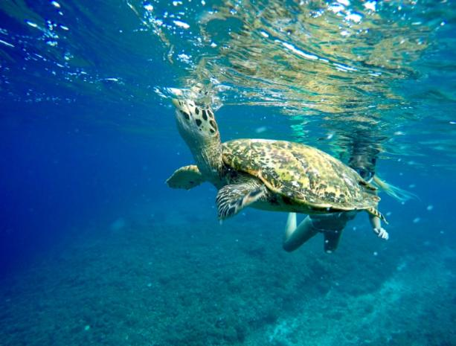
Gas Exchange
All cells require oxygen for use in the efficient production of energy through cellular respiration
One of the major physiological challenges facing all multicellular animals is obtaining sufficient oxygen and disposing of excess carbon dioxide
Caption: Sea Turtle Breath Underwater © dronepicr, License

Slide 3
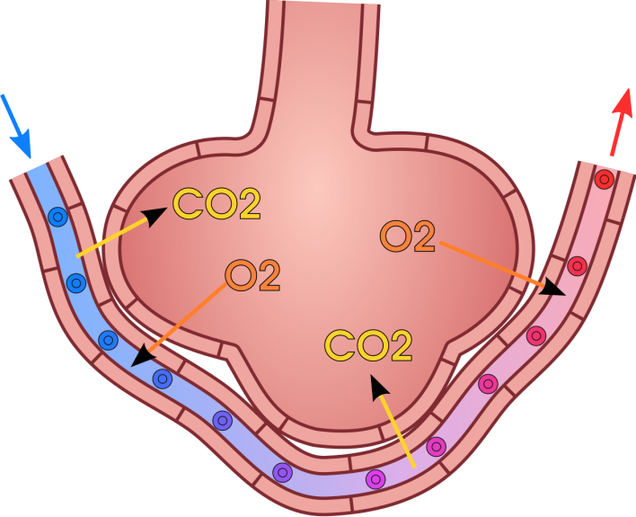
Gas Exchange between Alveoli and Blood
In vertebrates, the gases diffuse into the aqueous layer covering the epithelial cells that line the respiratory organs
Diffusion is passive, driven only by the difference in O₂ and CO₂ concentrations on the two sides of the membranes and their relative solubility's in the plasma membrane
High O2 in Alveoli into Blood
High CO2 in Blood into Alveoli
Opposite Occurs in the Tissue
Caption: Gas Exchange in the Alveolus © domdomegg, License

Slide 4
Gas Exchange
Rate of diffusion between two regions is governed by Fick’s Law of Diffusion
R = Rate of diffusion
D = Diffusion constant
A = Area over which diffusion takes place
Δp = Pressure difference between two sides
d = Distance over which diffusion occurs
DA Δp
R =
d

Slide 5
Gas Exchange
Evolutionary changes have occurred to optimize the rate of diffusion R. This can be done in several ways:
Increase surface area A
Decrease distance d
Increase concentration difference Δp

Slide 6
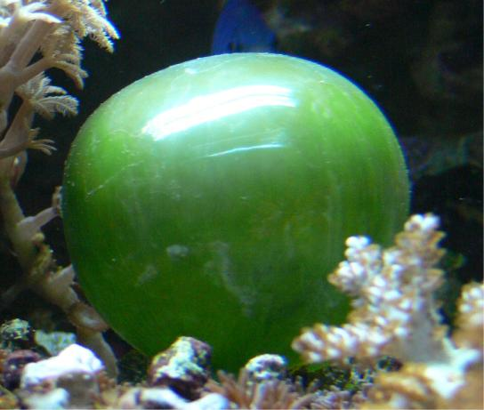
Gas Exchange
Gases diffuse directly into unicellular organisms
However, most multicellular animals require system adaptations to enhance gas exchange
Amphibians respire across their skin
Insects have an extensive tracheal system
Fish use gills
Mammals have a large network of alveoli in lung tissue
The cell of the unicellular algae Ventricaria ventricosa is one of the largest known, reaching one to five centimeters in diameter. Like all single-celled organisms, V. ventricosa exchanges gases across the cell membrane.
Download for free at http://cnx.org/contents/185cbf87-c72e-48f5-b51e-f14f21b5eabd@10.61

Slide 7
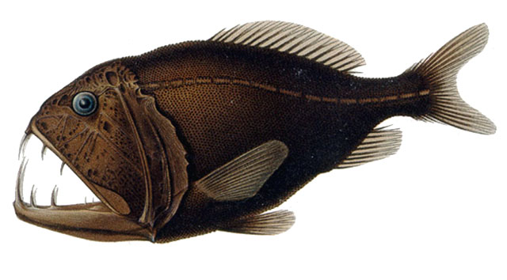
Gills
Specialized extensions of tissue that project into water
Increase surface area for diffusion
Move water into the mouth, through the gills, and out of the fish through the open operculum or gill cover
Caption: Fangtooth © A Brauer, Public Domain

Slide 8
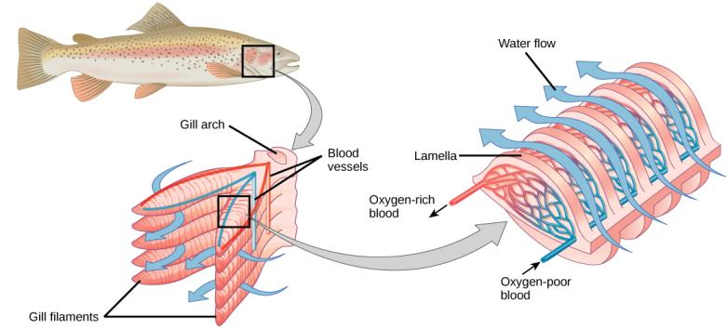
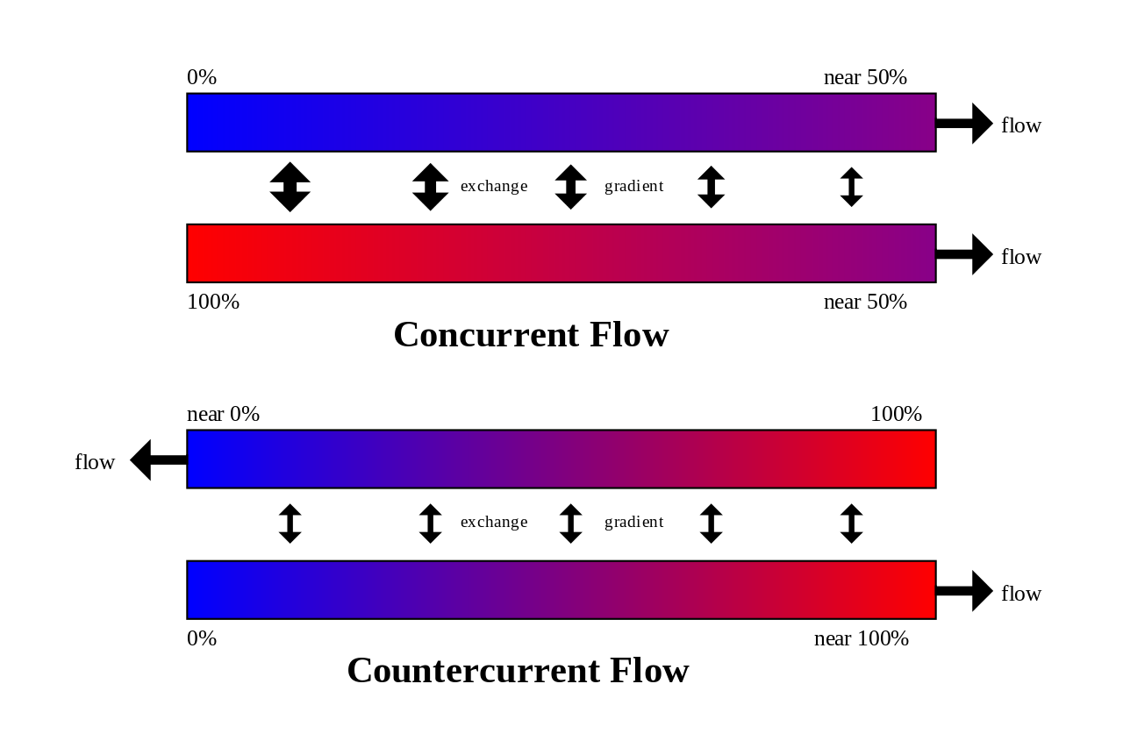
Gills
Each gill filament consist of lamellae
Thin membranous plates that project into water flow
Within each lamella, blood flows opposite to direction of water movement
Countercurrent flow
Maximizes oxygenation of blood
Increases Δp
Fish gills are the most efficient of all respiratory organs
Download for free at http://cnx.org/contents/185cbf87-c72e-48f5-b51e-f14f21b5eabd@10.61
Caption: Countercurrent flow for the exchange across a gradient © Joe , Public Domain

Slide 9
Lungs
Gills were replaced in terrestrial animals because
Air can’t support feathery gills
The lung minimizes evaporation by moving air through a branched tubular passage
A two-way flow system (air flows in and out the same passage)
Except birds

Slide 10
Lungs
Air exerts a pressure downward, due to gravity
A pressure of 760 mm Hg is defined as one atmosphere (1.0 atm) of pressure
Partial pressure is the pressure contributed by a gas to the total atmospheric pressure

Slide 11
Lungs
Partial pressures are based on the % of the gas in dry air
At sea level or 1.0 atm or 760 mmHg
PN₂ nitrogen= 760 x 79.02% = 600.6 mmHg
PO₂ oxygen= 760 x 20.95% = 159.2 mmHg
PCO₂ carbon dioxide= 760 x 0.03% = 0.2 mmHg
At 5364 m (17,598 ft.) the atmospheric pressure is 401 mmHg, this is the pressure at base camp 1 on Mount Everest.
PO₂ = 401 x 20.95% = 84 mmHg
Notice that the % of oxygen is the same at this altitude as it is at sea level but the partial pressure of oxygen is lower
This is why most climbers on Mount Everest use supplemental oxygen!

Slide 12
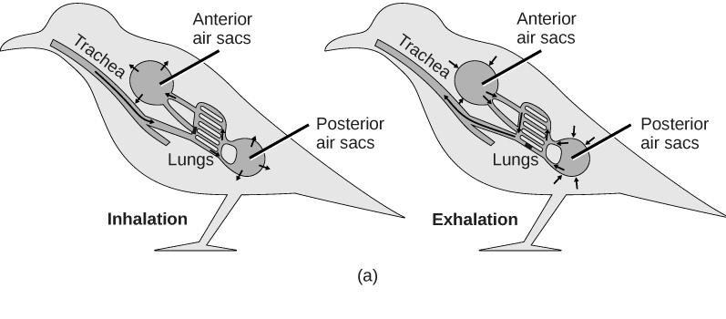
Lungs
Download for free at http://cnx.org/contents/185cbf87-c72e-48f5-b51e-f14f21b5eabd@10.61
Lungs of birds have unidirectional flow
Achieved through the action of anterior and posterior sacs (unique to birds)
When expanded during inhalation, they take in air
When compressed during exhalation, they push air in and through lungs

Slide 13
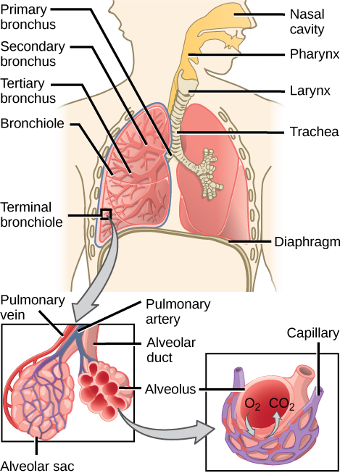
Lungs
Lungs of mammals are packed with millions of alveoli (sites of gas exchange)
Inhaled air passes through the larynx, glottis, and trachea
Bifurcates into the right and left bronchi, which enter each lung and further subdivide into bronchioles
Alveoli are surrounded by an extensive capillary network
Download for free at http://cnx.org/contents/185cbf87-c72e-48f5-b51e-f14f21b5eabd@10.61

Slide 14
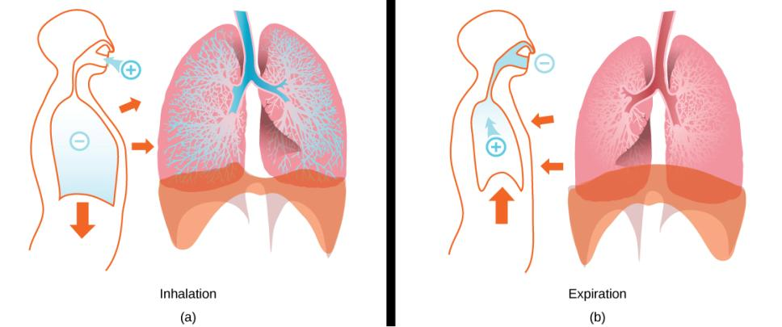
Lung Structure and Function
Download for free at http://cnx.org/contents/185cbf87-c72e-48f5-b51e-f14f21b5eabd@10.61
During inhalation, thoracic volume increases through contraction of two muscle sets
Contraction of the external intercostal muscles expands the rib cage
Contraction of the diaphragm expands the volume of thorax and lungs
Produces negative pressure which draws air into the lungs

Slide 15
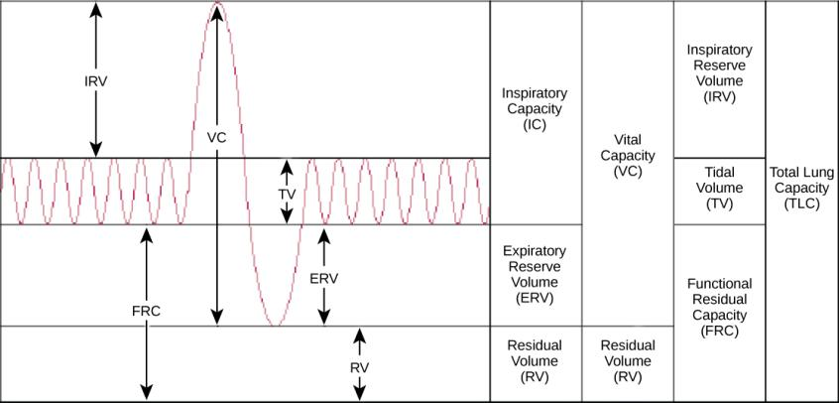
Lung Structure and Function
Tidal volume
Volume of air moving in and out of lungs in a person at rest
Vital capacity
Maximum amount of air that can be expired after a forceful inspiration
Hypoventilation
Insufficient breathing
Blood has abnormally high PCO₂
Hyperventilation
Excessive breathing
Blood has abnormally low PCO₂
Download for free at http://cnx.org/contents/185cbf87-c72e-48f5-b51e-f14f21b5eabd@10.61

Slide 16
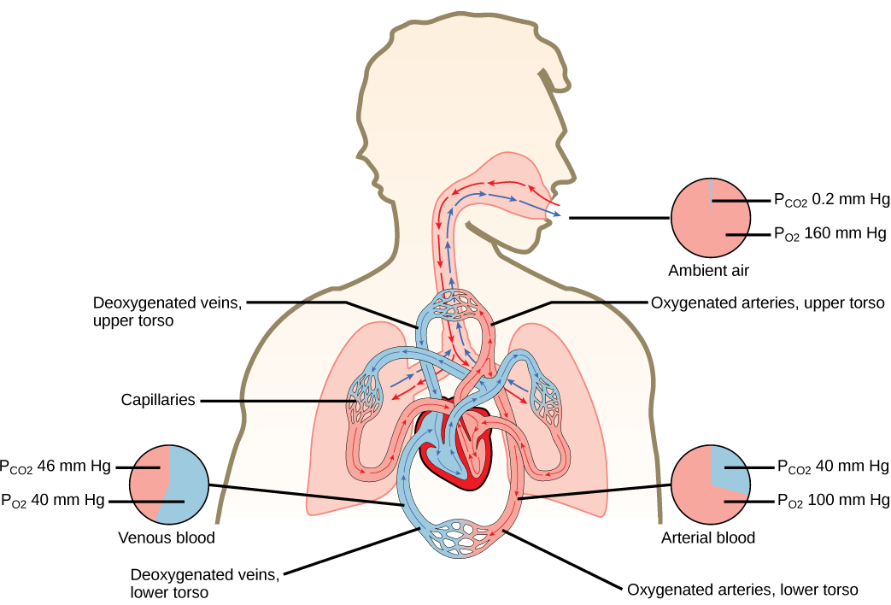
Gas Exchange
Gas exchange is driven by differences in partial pressures
Blood returning from the systemic circulation, depleted in oxygen, has a partial oxygen pressure (PO₂) of about 40 mm Hg
By contrast, the PO₂ in the alveoli is about 105 mm Hg
The blood leaving the lungs, as a result of this gas exchange, normally contains a PO₂ of about 100 mm
Download for free at http://cnx.org/contents/185cbf87-c72e-48f5-b51e-f14f21b5eabd@10.61

Slide 17
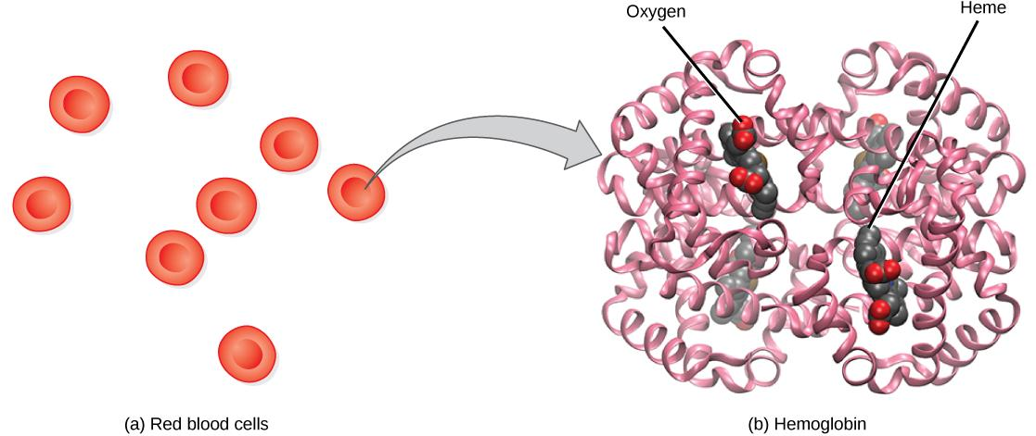
Hemoglobin
The protein inside (a) red blood cells that carries oxygen to cells and carbon dioxide to the lungs is (b) hemoglobin. Hemoglobin is made up of four symmetrical subunits and four heme groups. Iron associated with the heme binds oxygen. It is the iron in hemoglobin that gives blood its red color.
Download for free at http://cnx.org/contents/185cbf87-c72e-48f5-b51e-f14f21b5eabd@10.61
Consists of four polypeptide chains: two α and two β
Each chain is associated with a heme group
Each heme group has a central iron atom that can bind a molecule of O₂
Hemoglobin loads up with oxygen in the lungs, forming oxyhemoglobin

Slide 18
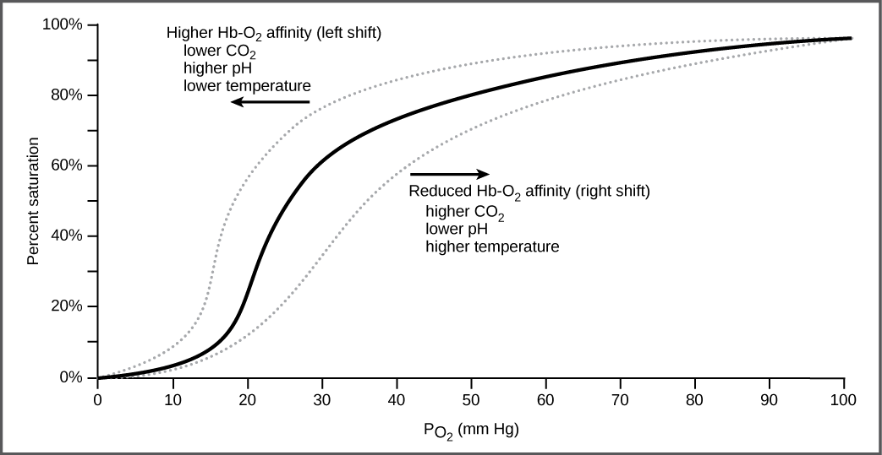
Hemoglobin
Hemoglobin’s affinity for O₂ is affected by pH and temperature
The pH effect is known as the Bohr shift
Increased CO₂ in blood increases H⁺
Lower pH reduces hemoglobin’s affinity for O₂
Facilitates oxygen unloading in the tissue
Increasing temperature has a similar effect
The oxygen dissociation curve demonstrates that, as the partial pressure of oxygen increases, more oxygen binds hemoglobin. However, the affinity of hemoglobin for oxygen may shift to the left or the right depending on environmental conditions.
Download for free at http://cnx.org/contents/185cbf87-c72e-48f5-b51e-f14f21b5eabd@10.61

Slide 19
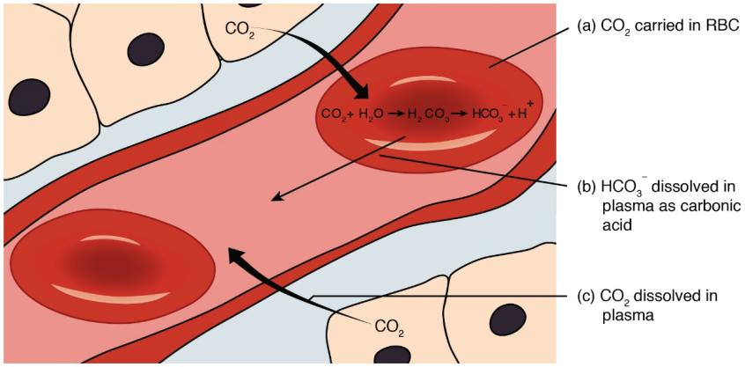
Transportation of Carbon Dioxide
Not the same as oxygen
About 8% of the CO₂ in blood is dissolved in plasma
20% of the CO₂ in blood is bound to hemoglobin
Remaining 72% diffuses into red blood cells
Enzyme carbonic anhydrase combines CO₂ with H₂O to form H₂CO₃
H₂CO₃ dissociates into H⁺ and HCO₃–
H⁺ binds to deoxyhemoglobin
HCO₃– moves out of the blood and into plasma
One Cl– exchanged for one HCO₃– – “chloride shift”
Download for free at http://cnx.org/contents/185cbf87-c72e-48f5-b51e-f14f21b5eabd@10.61

Slide 20
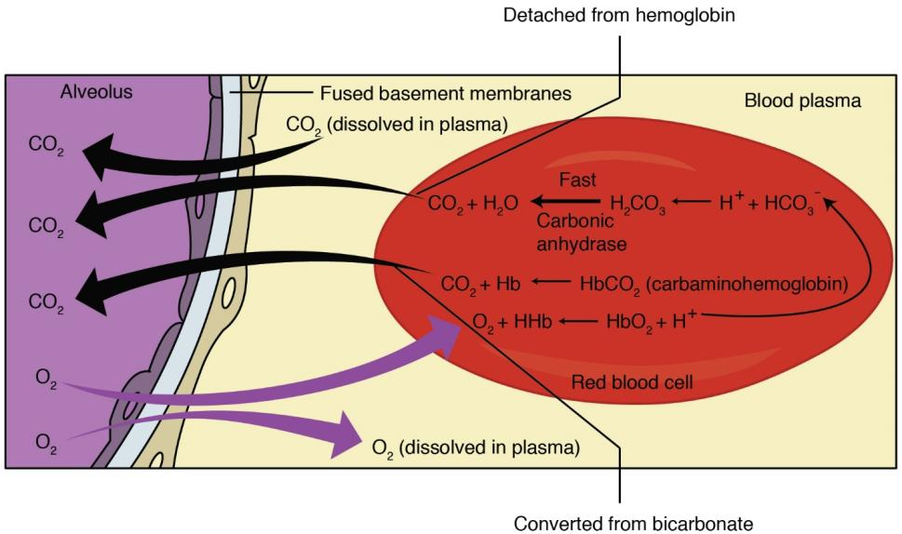
Transportation of Carbon Dioxide
When the blood passes through pulmonary capillaries, these reactions are reversed
Download for free at http://cnx.org/contents/185cbf87-c72e-48f5-b51e-f14f21b5eabd@10.61

Slide 21
Lung Structure and Function
Neurons are sensitive to blood PCO₂ changes
A rise in PCO₂ causes increased production of carbonic acid (H₂CO₃), lowering the blood pH
Stimulates chemosensitive neurons in the aortic and carotid bodies
Send impulses to respiratory control center to increase rate of breathing
Brain also contains central chemoreceptors that are sensitive to changes in the pH of cerebrospinal fluid (CSF)

Slide 22
Respiratory Diseases
Chronic obstructive pulmonary disease (COPD)
Refers to any disorder that obstructs airflow on a long-term basis
Asthma
Allergen triggers the release of histamine, causing intense constriction of the bronchi and sometimes suffocation
Emphysema
Alveolar walls break down and the lung exhibits larger but fewer alveoli
Lungs become less elastic
Eighty to 90% of emphysema deaths are caused by cigarette smoking

Slide 23
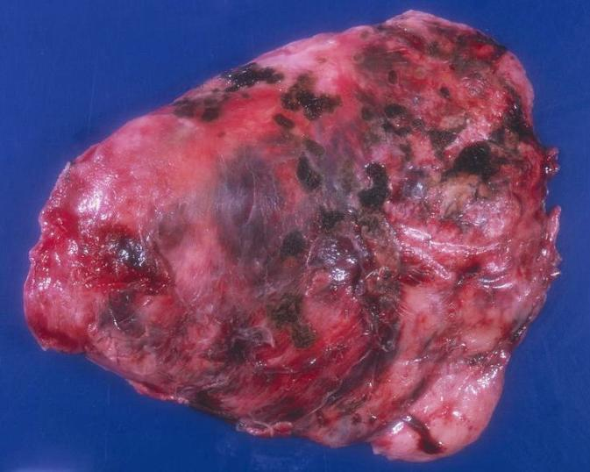
Respiratory Diseases
Lung cancer accounts for more deaths than any other form of cancer
Caused mainly by cigarette smoking
Follows or accompanies COPD
Lung cancer metastasizes (spreads) so rapidly that it has usually invaded other organs by the time it is diagnosed
Chance of recovery from metastasized lung cancer is poor, with only 3% of patients surviving for 5 years after diagnosis
Caption: Solitary fibrous tumor of pleura © Yale Rosen, License

