Slide 1
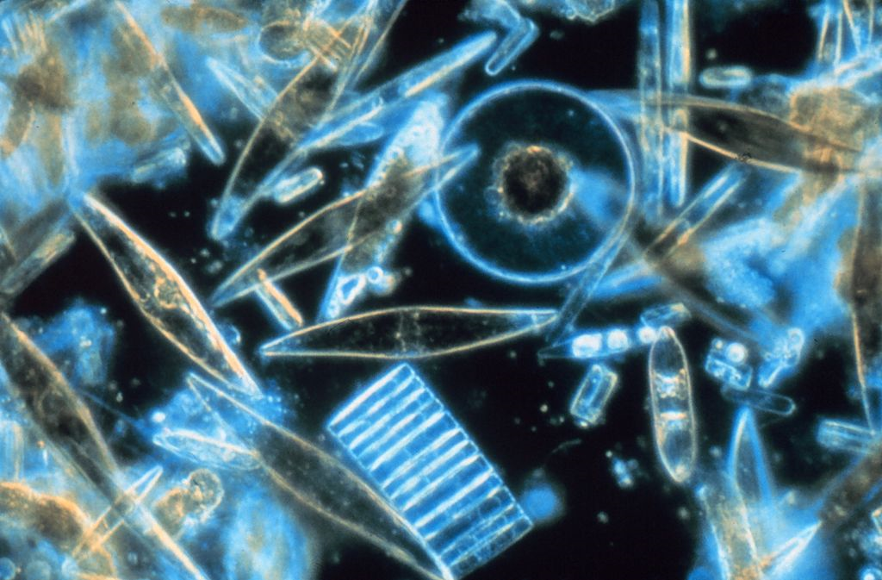
Chapter 23 - Protists
General Biology II
BSC 2011
Insert photo here representing
chapter
Caption: Diatoms through the microscope (c)Gordon T. Taylor, Public domain

Slide 2
By the end of this chapter you should be able to:
List the characteristics of eukaryotes.
Explain the endosymbiotic theory.
Describe the different characteristics of protists.
Describe the metabolic diversity of protists.
Describe the life cycle diversity of protists.
Describe representative protist organisms from each of the 6 supergroups of eukaryotes.
Describe the way protists play in the ecosystem.

Slide 3
In the previous chapter, we discussed the prokaryotes.
From now on, we will be discussing the organisms composed of eukaryotic cells, those in Domain Eukarya.
Eukaryotic organisms that are not fungi, animals or plants are collectively called Protists
Formerly in Kingdom Protista

Slide 4
Characteristics of Eukaryotes
Nucleus
Mitochondria
Some extant eukaryotes have reduced or missing mitochondria but most have a typical mitochondria
Cytoskeleton
Eukaryotic cells are larger than prokaryotic cells, needs support structure
Flagella that look different than prokaryotic flagella
Linear chromosomes
Remember that prokaryotes have circular chromosome
Mitosis
In order to keep track of all the linear chromosomes, eukaryotes need the process of mitosis for division

Slide 5
Endosymbiosis and the Evolution of the Eukaryotes
Let’s review prokaryotic metabolism
Earth formed about 4.5 billion years ago
Prokayotes arose ~3.7-3.5 billion years ago
First prokaryotes used anaerobic respiration, fermentation
~3.5 billion years ago, some prokaryotes began to photosynthesize
Remember that a by-product of photosynthesis is O₂
This allowed the evolution of aerobic respiration, which was able to generate much higher levels of ATP (which is needed if you are a complex eukaryote)
Eukaryotes arose ~2 – 2.1 billion years ago

Slide 6
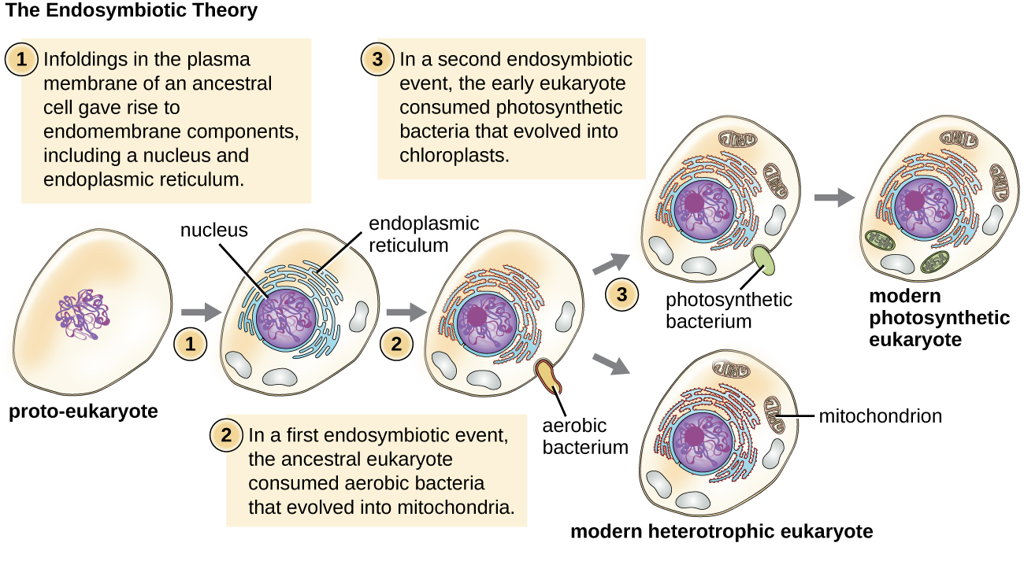
Endosymbiotic Theory
States that one prokaryotic cell engulfed another prokaryotic cell, resulting in both being dependent on each other and the engulfed cell began to function as the mitochondria
Download for free at http://cnx.org/contents/185cbf87-c72e-48f5-b51e-f14f21b5eabd@10.61

Slide 7
Evidence for the endosymbiotic theory
Mitochondria and chloroplasts
Arise from division of existing mitochondria in the cell
This division process looks a lot like binary fission in prokaryotes
Most mitochondria are shaped like alpha-proteobacteria
Have a circular chromosome

Slide 8
Modern science is shying away from the idea of traditional ranks such as “Kingdom” and “Phylum”
The field of molecular genetics shows that some protists are more closely related to animals, plants or fungi then they are to other protists
Therefore, they cannot be classified in the same Kingdom anymore

Slide 9
Domain Eukarya is now divided into 6 main Super Groups
The protists that were once in Kingdom Protista are now spread over these super groups
We’ll go over those 6 groups in a bit

Slide 10
Protist Diversity
Protists are very diverse
“Protozoa” – heterotrophic protists
Some cause disease
“Algae” – autotrophic protists
Unicellular – phytoplankton
Multicellular – seaweed (not plants!)
Variety of habitats
Most are aquatic (freshwater and marine)
Damp soil
Some are parasites that infect animals or plants
A few are decomposers

Slide 11
Characteristics of Protists
Cell Structure
Most protists are microscopic and unicellular
There are multicellular forms
Some live colonially
Some are multi-nucleated that look like enormous blobs of slime
Some have animal-like cell membrane, some have plant-like cell wall
Some might be encased in silica-based shell

Slide 12
Characteristics of Protists
Metabolism
Some protists are autotrophs – photosynthesize
Some are heterotrophic
Some are mixotrophs – can be autotrophic or heterotrophic

Slide 13
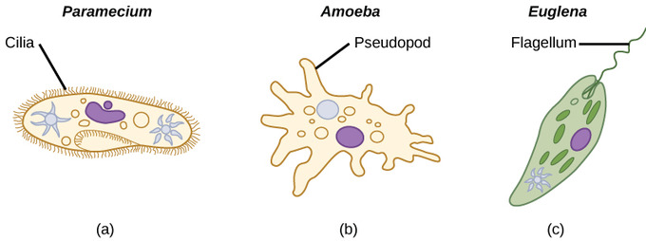
Characteristics of Protists
Motility
Majority of protists have motility
Download for free at http://cnx.org/contents/185cbf87-c72e-48f5-b51e-f14f21b5eabd@10.61

Slide 14
Characteristics of Protists
Life Cycles
Protists reproduce by a variety of different mechanisms:
Asexual reproduction
Binary fission
Budding
Shizongony – multiple nuclear divisions before division of the cell
Sexual reproduction
Some form cysts
Protective resting stage – resistant to temperature, pH, etc
Some parasitic protists have complicated life cycles involving multiple hosts

Slide 15
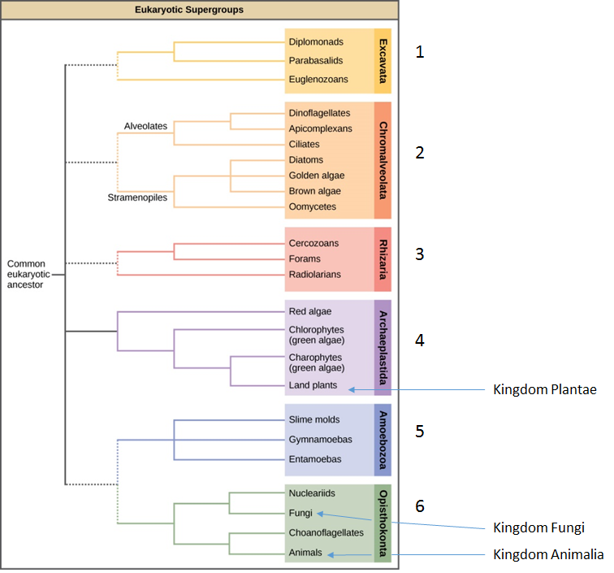
Download for free at http://cnx.org/contents/185cbf87-c72e-48f5-b51e-f14f21b5eabd@10.61

Slide 16
Excavata
Characteristics of Excavata:
Asymmetrical
Single celled
Feeding groove “excavated” on one side
Includes autotrophs, heterotrophs (some parasites)

Slide 17
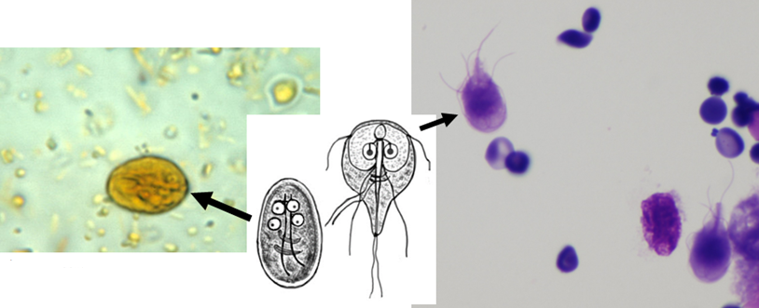
Excavata
Excavata
Diplomonads
Only have mitochondrial remnants
Includes intestinal parasite, Giardia lamblia
Forms cysts
First picture: Caption: Giardia lamblia cyst. Iodine stain (c)CDC, Public domain
Second picture: Caption: Giardia lamblia (G. intestinalis) imago and cystis (c) CDC/Alexander J. da Silva, PhD/Melanie Moser, Public domain
Third picture: Caption: Giardia lamblia seen in a cytologic preparation (cytospin of formalin from small bowel biopsy of a patient with giardia)
(c) Jerad M Gardner, MD, CC BY-SA 3.0

Slide 18
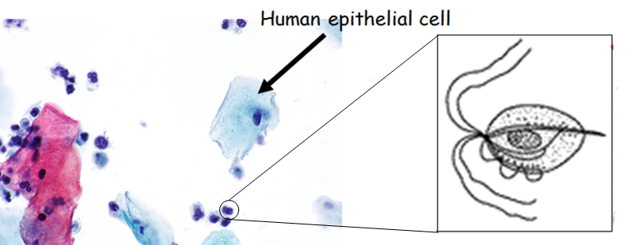
Excavata
Excavata
Parabasalids
Includes Trichomonas vaginalis
First picture: Caption: Micrograph showing trichomonas on a Pap test (c)Nephron, CC BY-SA 3.0
Second picture: Caption: Trichomoniasis: life cycle of Trichomonas vaginalis (c)CDC, Public domain

Slide 19
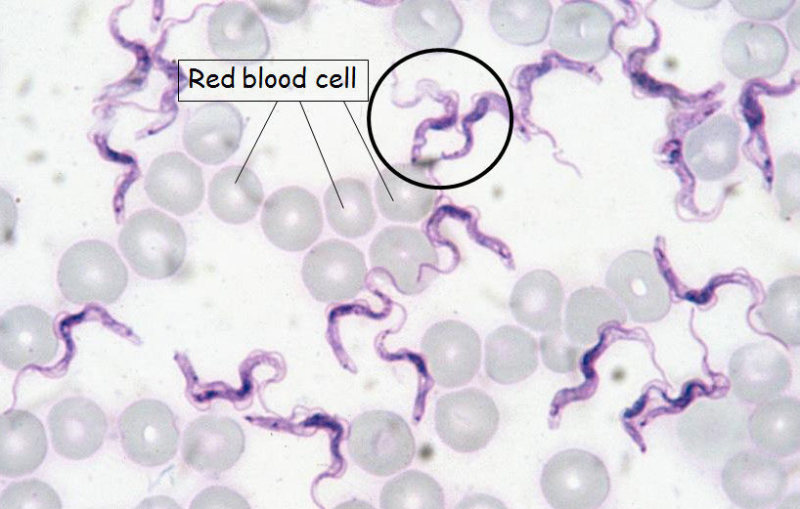
Excavata
Excavata
Euglenozoans
Includes parasites, heterotrophs, autotrophs and mixotrophs
Euglena
Mixotroph, have primitive ocular organ called an eyespot guides them towards light sources
Trypanosoma
Parasite- transmitted by insects
Blood borne disease (causes diseased such as African Sleeping Sickness)
First picture: Caption: Euglena sp., a diagrammatic drawing (c) Alexei Kouprianov, CC BY-SA 3.0
Second picture: Caption: Trypanosoma evansi protozoa (c)Alan R. Walker, CC BY-SA 3.0

Slide 20
Chromalveolata
Alveolates
Presence of alveolus (membrane enclosed sac) under cell membrane, exact function unknown
Dinoflagellates
Apicomplexans
Ciliates
Stramenopiles
“hairy” flagellum
Diatoms
Brown algae
Oomycetes

Slide 21
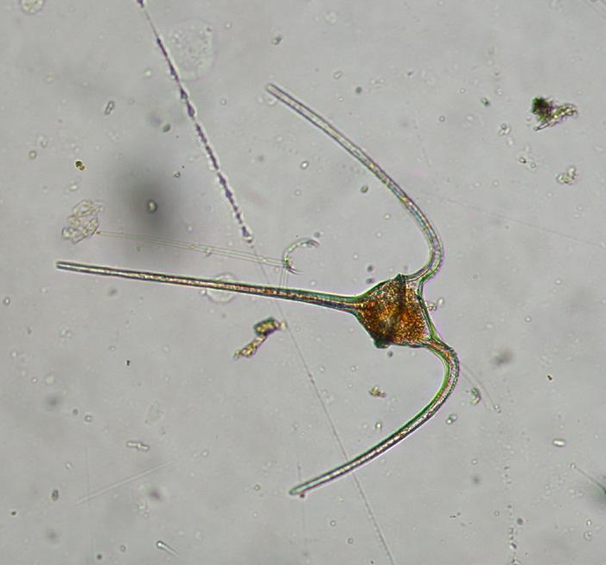
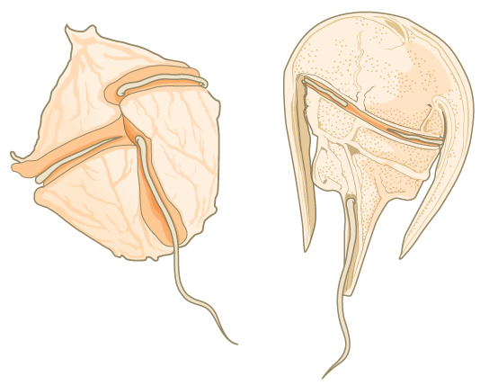
Chromalveolata
Alveolates, Dinoflagellates
Can be photosynthetic or heterotrophic
Major part of the plankton
Many exhibit bioluminescence
Example: Ceratium
First picture: Download for free at http://cnx.org/contents/185cbf87-c72e-48f5-b51e-f14f21b5eabd@10.61
Second picture: caption: Ceratium sp. (Dinophyta) (c) Keisotyo, CC BY-SA 3.0

Slide 22
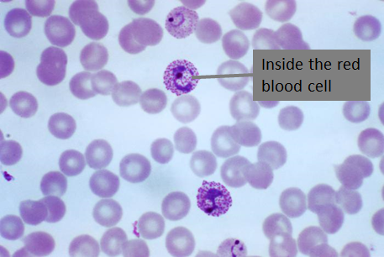
Chromalveolata
Aveolates, Apicomlexans
Example: Plasmodium (causes malaria)
Complex life cycle in the mosquito and human
caption: Immature and mature trophozoites of the Plasmodium vivax parasite PHIL 2720 lores (c) CDC/ Dr. Mae Melvin, Public domain

Slide 23
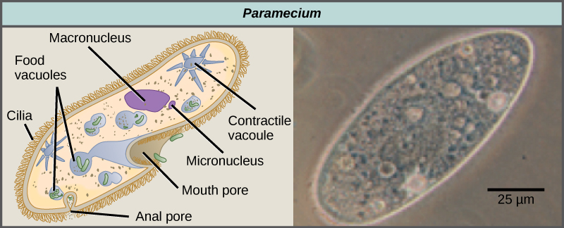
Chromalveolata
Alveolates, Ciliates
Have cilia
Capture food particles in oral groove and then congregate food in food vacuole
Paramecium
Download for free at http://cnx.org/contents/185cbf87-c72e-48f5-b51e-f14f21b5eabd@10.61

Slide 24
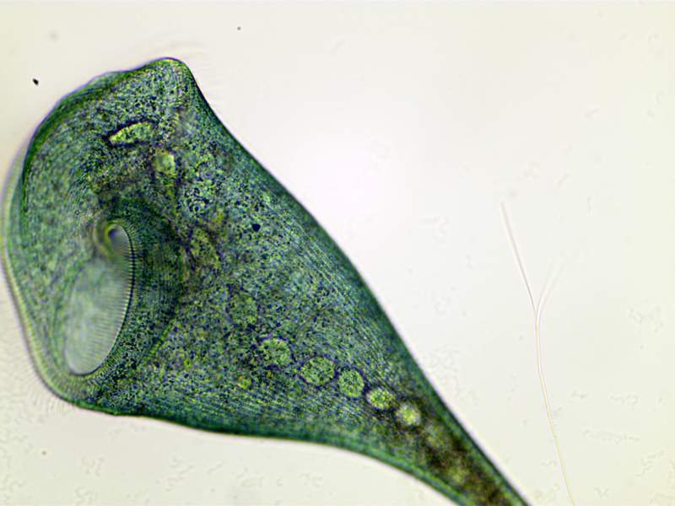
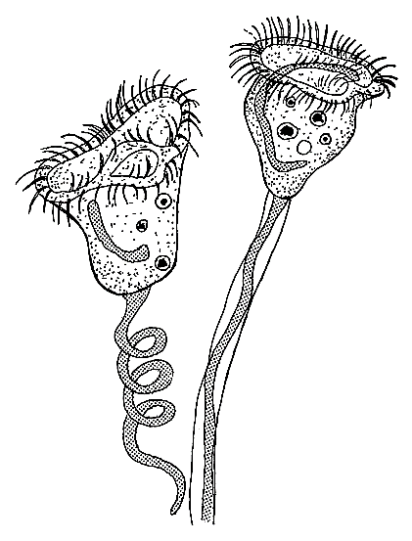
Stentor
Vorticella
First picture: Caption: Stentor coeruleus (c) Flupke59, CC BY-SA 3.0
Second picture: Caption: Stentor (c)Popular Science Monthly vol. 71, Public domain
Third picture: Caption: Vorticella (c)Pearson Scott Foresman, Public domain

Slide 25
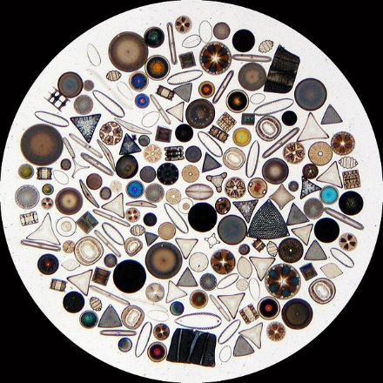
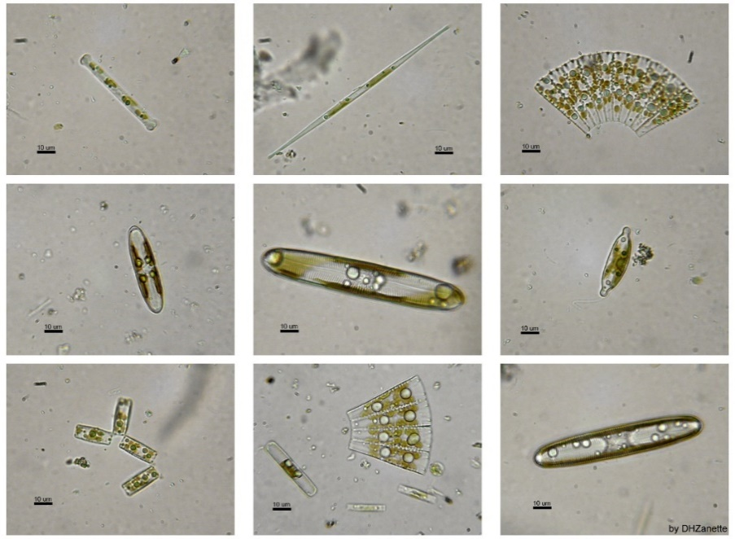
Chromalveolata
Stramenopiles, Diatoms
Unicellular photosynthetic protists
Part of the plankton, phytoplankton
Glassy cell wall made of silica dioxide
First picture: Caption: Several species of freshwater diatoms (c)Damián H. Zanette, Public domain
Second picture: Caption:Circle of diatoms on a slide (c)Wipeter, CC BY-SA 3.0

Slide 26
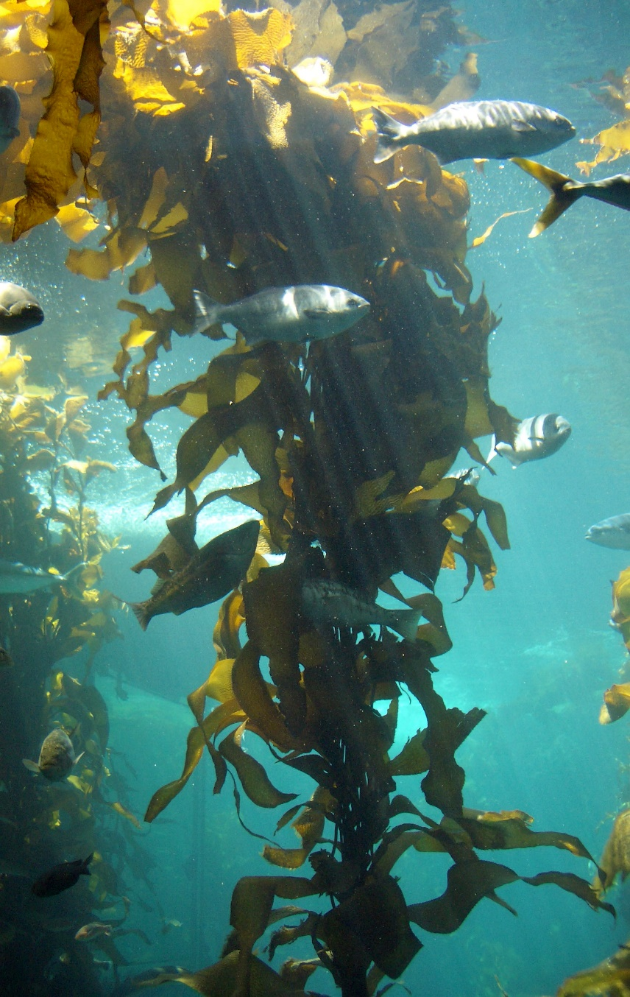
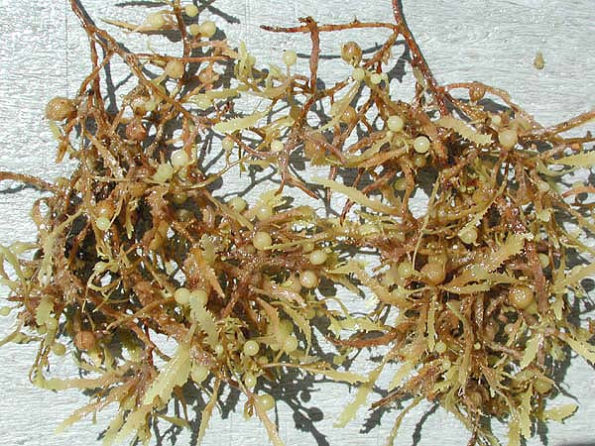
Chromalveolata
Stramenopiles, Brown Algae
Macroscopic seaweed
First picture: Caption: Sargassum weeds closeup (c)Islands in the Sea 2002, NOAA/OER, Public domain
Second picture: Caption:Kelp forest Monterey (c)Stef Maruch, CC BY-SA 2.0

Slide 27
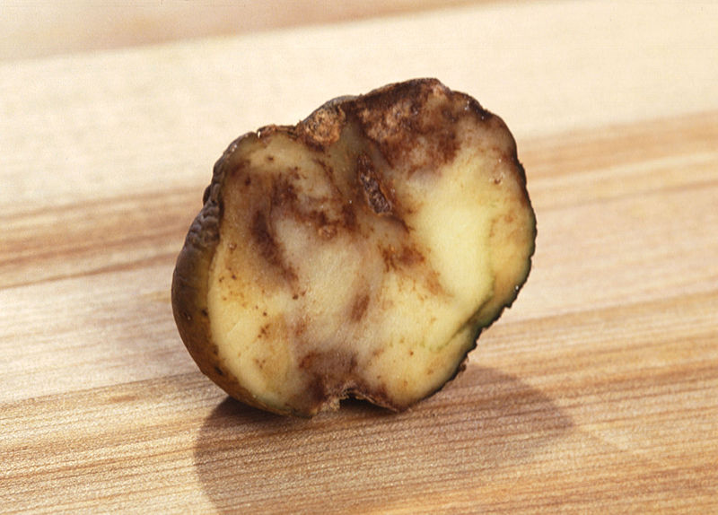
Chromalveolata
Stramenopiles, Oomycetes
Once thought to be a fungus
“egg fungus”
Include many saprobes and parasites
Saprobes appear as white and fluffy on dead organisms
Includes pathogen responsible for Irish potato famine
caption: Potato Blight effects (c)United States Department of Agriculture, Public domain

Slide 28
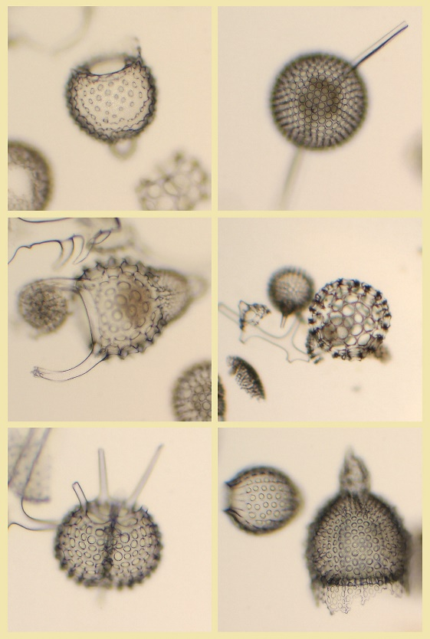
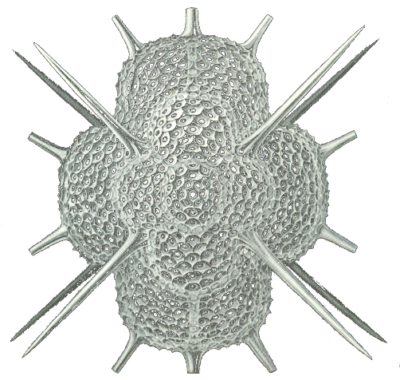
Rhizaria
Rhizaria include many of the amoebas (most have threadlike or needle like pseudopods)
Includes Radiolarians (part of the phytoplankton)
First picture: Caption: Radiolaria varios (c) Luis Fernández García, CC BY-SA Spain
Second picture: Caption: Haeckel Radiolarian detail (c) Ernst Haeckel, Public domain

Slide 29
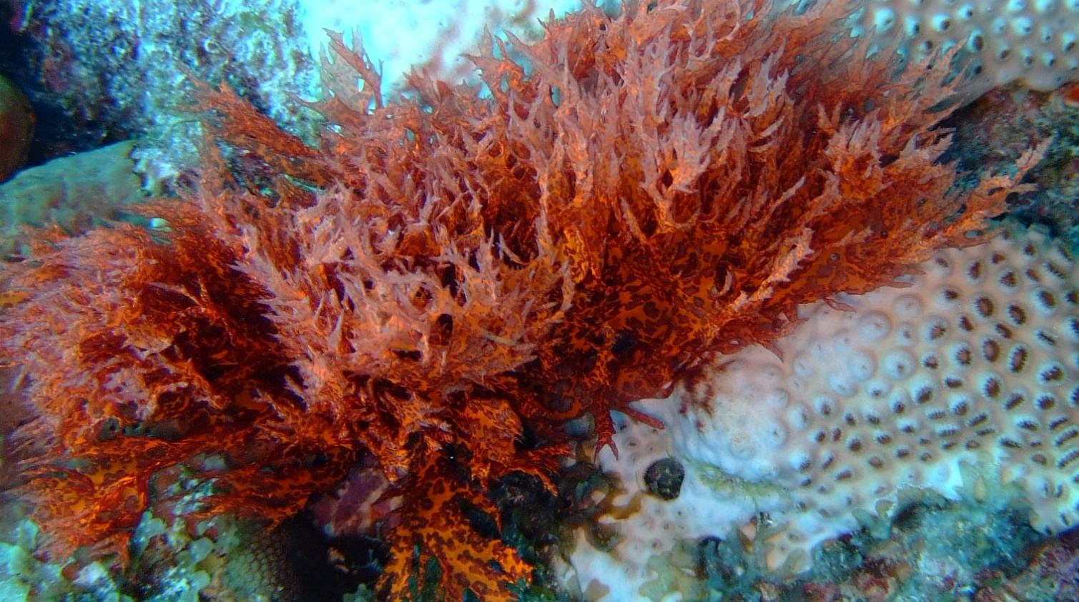
Archaeplastida
Includes Red Algae, Green Algae and the Land Plants (Kingdom Plantae)
Red Algae
caption: Red Algae on bleached coral (c) Johnmartindavies, CC BY-SA 3.0

Slide 30
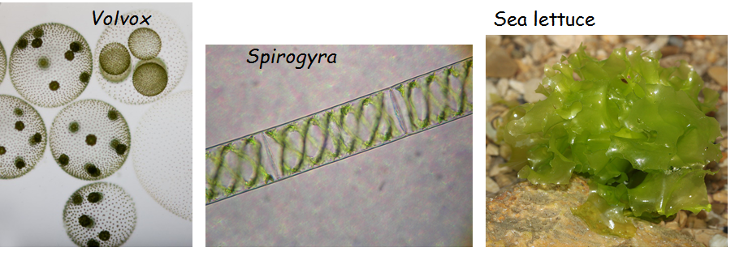
Archeaplastida
Green Algae
Charophytes – closest living relative to land plants
Common in wet habitats
Chlorophytes
Microscopic and macroscopic
First picture: Caption: Mikrofoto.de-volvox (c)Frank Fox, CC BY-SA 3.0 Germany
Second picture: Caption: 3x2 millimeters of Spirogyra (c)Bob Blaylock, CC BY-SA 3.0
Third picture: Caption: Meersalat-Ulva-lactuca (c) H. Krisp, CC BY-SA 3.0

Slide 31
The Archaeplastids also include the plants in Kingdom Plantae that we will discuss in a future chapter

Slide 32
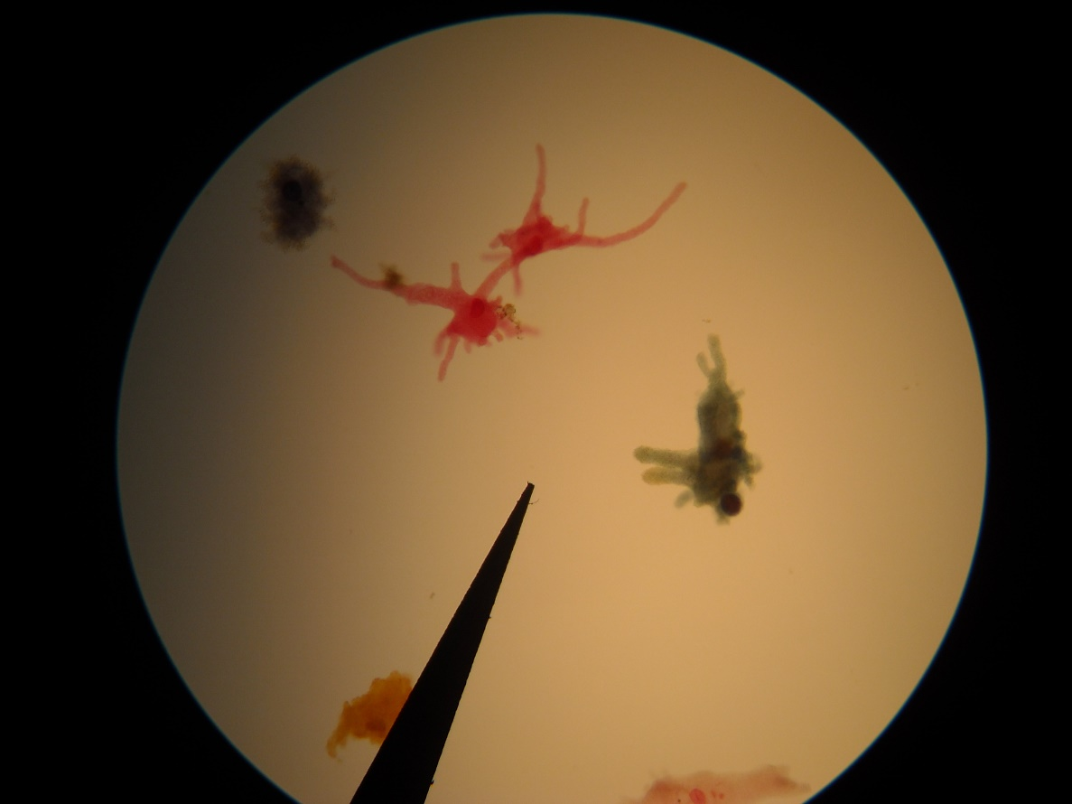
Amoebozoa
Amoebozoans exhibit pseudopodia that are flat rather than hair-like found in Rhizarians
Amoeba
Download for free at http://cnx.org/contents/185cbf87-c72e-48f5-b51e-f14f21b5eabd@10.61

Slide 33
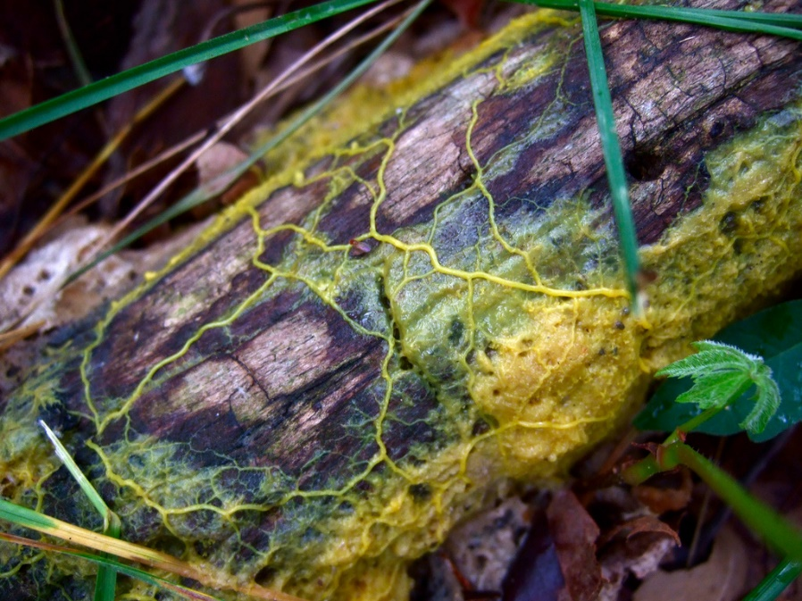
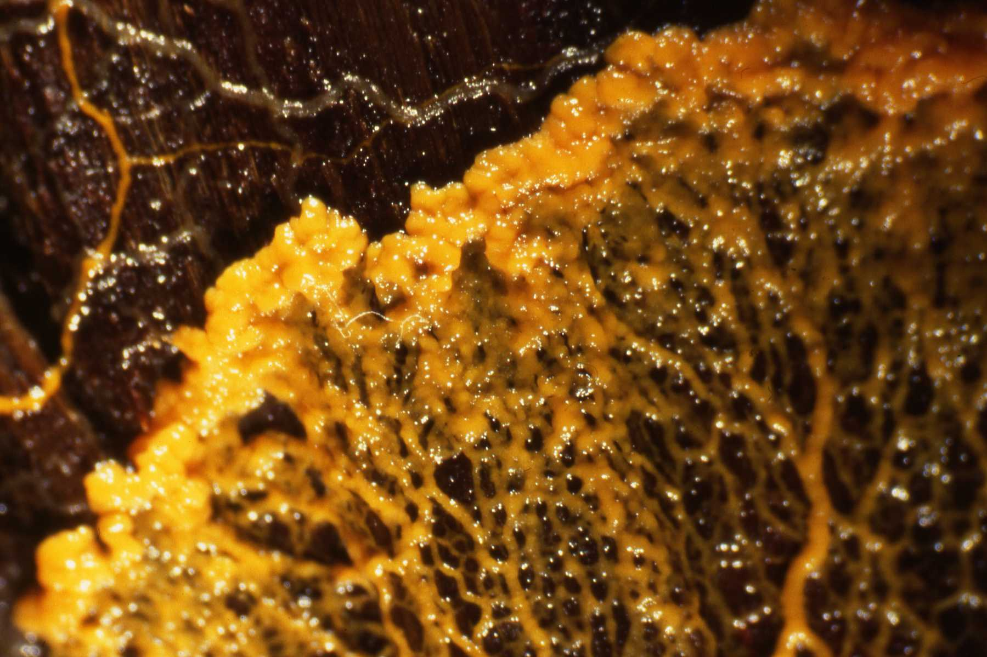
Amoebozoa
Plasmodial slime molds
Stream along as a plasmodium
Nonwalled, multinucleate mass of cytoplasm
Form called feeding phase
Ingests bacteria and other organic material
When food or moisture is scarce, organism forms sporangia, where spores are produced
Physarum
First picture: Caption: Physarum polycephalum plasmodium (c)frankenstoen, CC BY
Second picture: Caption: Physarum psittacinum (c)HelenGinger, CC BY-SA 3.0

Slide 34
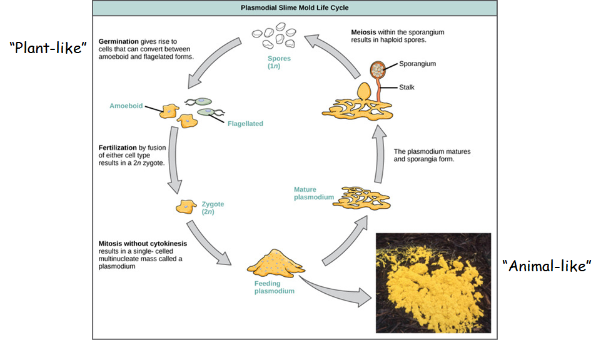
Cellular slime molds
Individual organisms behave as separate amoebas when food is abundant
Move through soil ingesting bacteria
When food is scarce, organisms aggregate to form a slug, “animal-like”
Slug differentiates into a sporocarp that will asexually produce spores
caption: modification of work by Dr. Jonatha Gott and the Center for RNA Molecular Biology, Case Western Reserve University OR Download
for free at http://cnx.org/contents/185cbf87-c72e-48f5-b51e-f14f21b5eabd@10.61

Slide 35
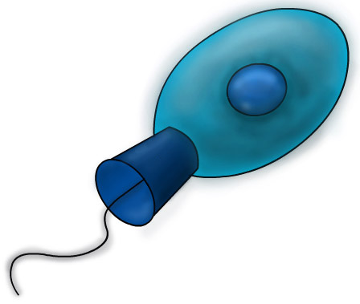
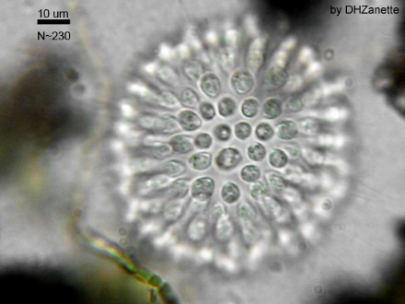
Opisthokonta
Single apical flagellum is present
This group includes animals, fungi and choanoflagellate protists
Choanoflagellates:
Live colonially
Believed to resemble ancestor to animals
Resemble choanocyte cells found in sponges
First picture: Caption: Cronoflagelado2 (c)Urutseg, CC BY-SA 3.0
Second picture: Caption: Sphaeroeca-colony (c)Dhzanette, Public domain

Slide 36
Ecology of Protists
Phytoplankton – important primary producers
Feed large portion of ocean species
Some dinoflagellates have symbiotic relationship with corals
Some are human pathogens
Plasmodium – malaria
Trypanosoma – African sleeping sickness
Amoeba – some species can be parasitic
Some are plant pathogens
Can be responsible for taking out large amounts of crops
Some are important decomposers
Fossil Fuels
Large amounts of ancient blooms of plankton over time have been transformed to fossil fuels

