Slide 1
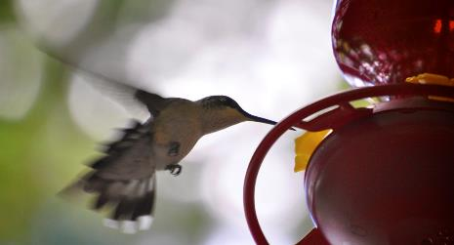
Chapter 6
Metabolism
Download for free at http://cnx.org/contents/185cbf87-c72e-48f5-b51e-f14f21b5eabd@10.61
Caption: Mitochondria, Mammalian Lung - TEM (c)Louisa
Howard, Public domain

Slide 2
Every task performed by living things requires energy
Cells constantly need energy
Keeps biochemical processes happening in order
Biology needs ORDER!
Chaos = Death

Slide 3
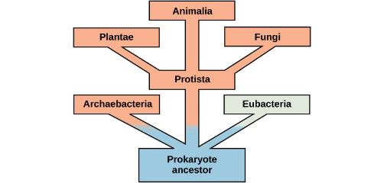
Metabolism – all of the chemical reactions that take place inside cells
Some of these reactions use energy and build molecules
Anabolic Reactions
Some break down molecules and release energy
Catabolic Reactions
Evolution of Metabolic Pathways:
Download for free at http://cnx.org/contents/185cbf87-c72e-48f5-b51e-f14f21b5eabd@10.61

Slide 4
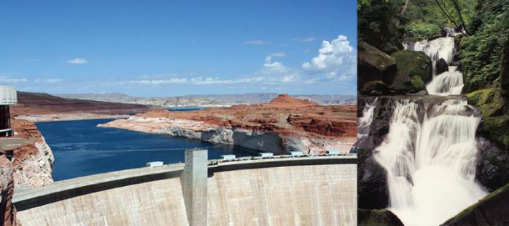
Potential energy – potential to do work
Kinetic energy – energy
Download for free at http://cnx.org/contents/185cbf87-c72e-48f5-b51e-f14f21b5eabd@10.61

Slide 5
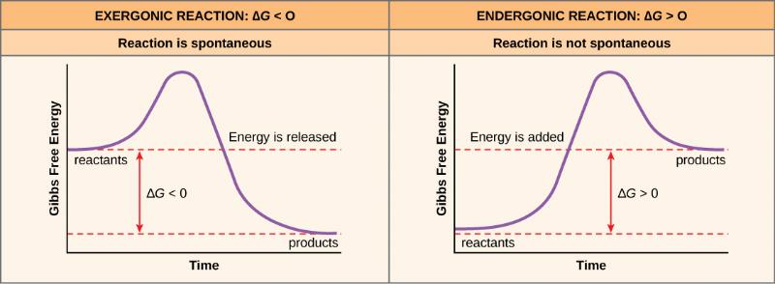
Endergonic – energy in, results in energy-storing molecules
Exergonic – energy out
Download for free at http://cnx.org/contents/185cbf87-c72e-48f5-b51e-f14f21b5eabd@10.61

Slide 6
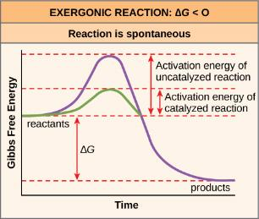
Activation energy
Input of energy to get reaction started
A catalyst is needed to lower this activation energy
Our reactions are catalyzed by enzymes
Without functioning enzymes, our chemical reactions would not happen efficiently or at all
How enzymes work, watch this video: https://www.youtube.com/watch?v=qgVFkRn8f10 or
https://www.youtube.com/watch?v=rlH1ym916Fo
Download for free at http://cnx.org/contents/185cbf87-c72e-48f5-b51e-f14f21b5eabd@10.61

Slide 7
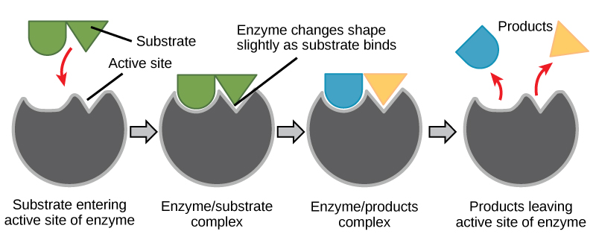
Download for free at http://cnx.org/contents/185cbf87-c72e-48f5-b51e-f14f21b5eabd@10.61

Slide 8
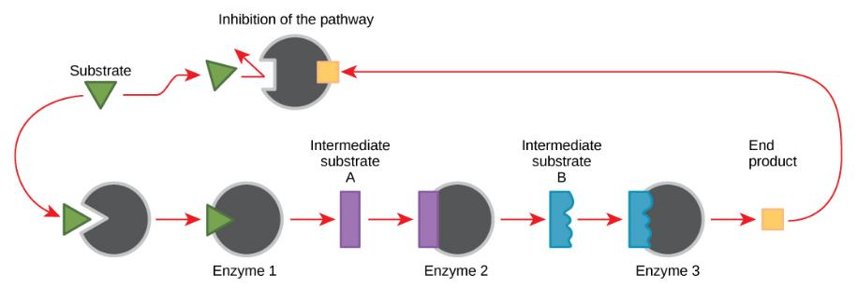
Feedback inhibition

Slide 9
The First Law of Thermodynamics
Energy cannot be created nor destroyed, it will just change form
The Second Law of Thermodynamics
As energy changes form, some of it will be lost as an unusable form

Slide 10
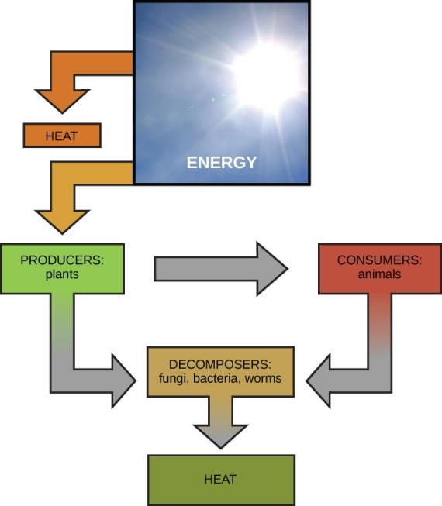
Download for free at http://cnx.org/contents/185cbf87-c72e-48f5-b51e-f14f21b5eabd@10.61

Slide 11
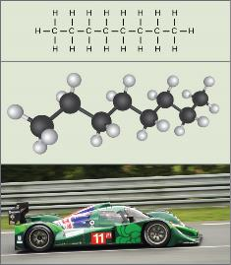
Chemical energy is stored as potential energy in bonds of molecules
Metabolism of Carbohydrates:
Photosynthesis
Anabolic reaction that is endergonic (energy in, energy from the sun is transformed into bonds in sugar molecule)
Cellular Respiration
Catabolic reaction that is exergonic (sugar is broken down and energy is released), the energy from this results in:
Anabolic reaction that is endergonic (that energy is put into the bonds of an ATP molecule, that ATP molecule can now be used by the cell for energy)
Download for free at http://cnx.org/contents/185cbf87-c72e-48f5-b51e-f14f21b5eabd@10.61

Slide 12
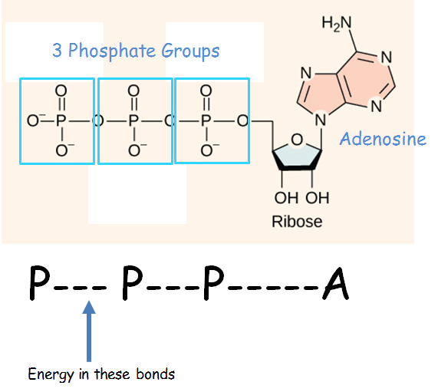
What is ATP?
Adenosine Triphosphate - ATP

Slide 13
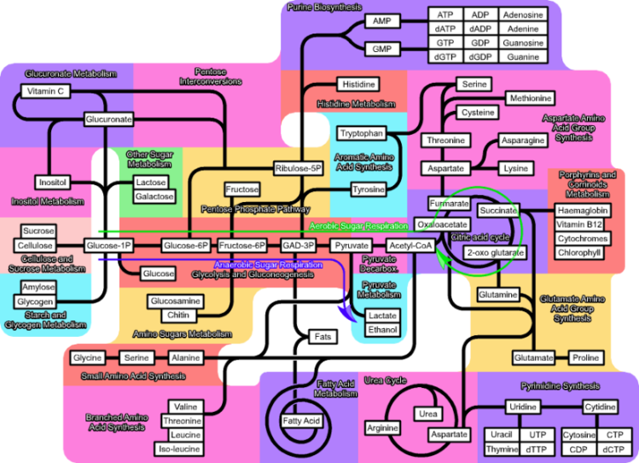
Metabolism – don’t need to know all of this!

Slide 14
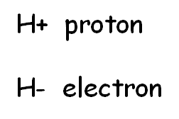
Redox Reactions
With reactions of photosynthesis and cellular respiration, we are going to be following the electrons
That will allow us to see the transformation of the energy
Remember, we have to get the energy from the sun transformed to ATP so our cells can use that energy
REDOX reactions
Reduced – molecule gains electron (becomes more negative)
Oxidized – molecule loses an electron
Remember this: OIL RIG
“oxidized it loses, reduced it gains”

