Slide 1
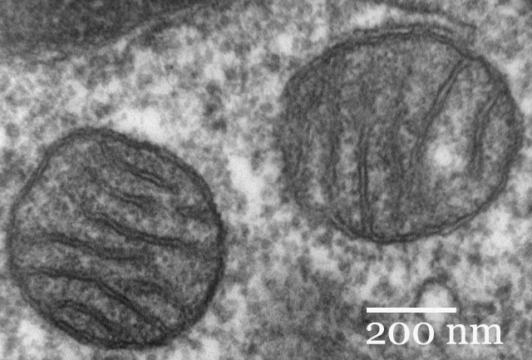
Chapter 7 Cellular Respiration
General Biology I
BSC 2010
Insert photo here representing
chapter
Caption: Mitochondria mammalian lung (c) Louisa Howard, Public domain

Slide 2
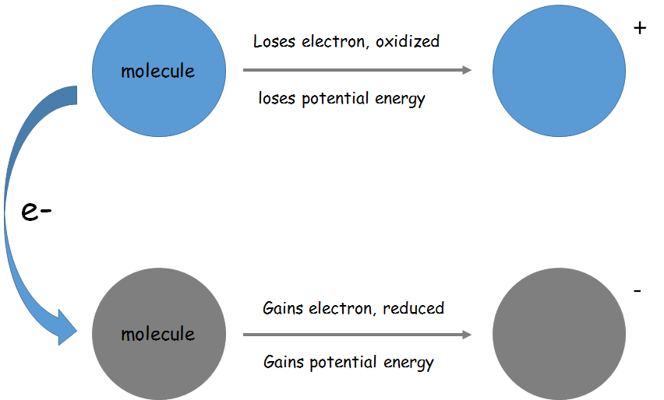
Electrons and Energy
REDOX Reactions
Reduced – molecule gains an electron
Oxidized – molecule loses an electron

Slide 3
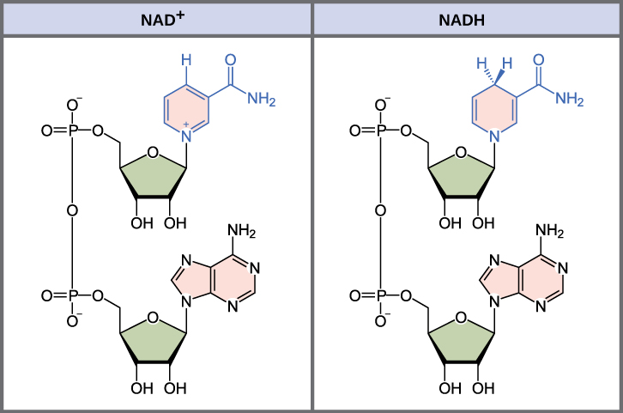
Electron Carriers
We will talk about how electrons removed from molecules will be carried from the molecule to an electron transport chain by electron carriers
Example: NAD+ and FAD+

Slide 4
ATP
ATP is the energy currency of the cell
We take in food, the energy in the bonds of those food molecules is released and transformed into the bonds of the ATP molecule
This transformation process happens during cellular respiration
ADP is phosphorylated – now there is energy in the bonds of the ATP molecule
Substrate level phosphorylation and Oxidative phosphorylation
The energy in the bonds of the ATP molecule that was formed in cellular respiration is immediately used by the cell

Slide 5
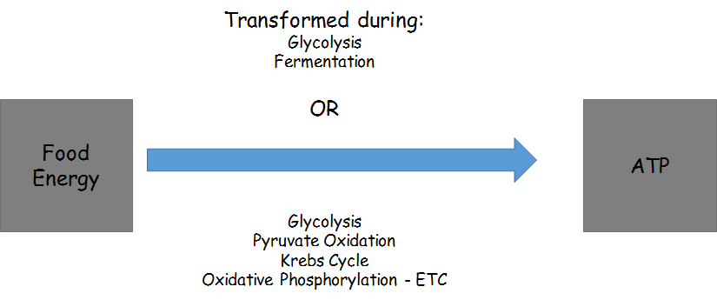

Slide 6
Steps of Cellular Respiration
Anaerobic Respiration – does not use oxygen
Glycolysis
Fermentation
Aerobic Respiration – uses oxygen
Glycolysis
Pyruvate Oxidation
Krebs (Citric Acid) Cycle
Oxidative Phosphorylation, Electron Transport Chain
Results in complete oxidation of glucose, produces more ATP than anaerobic respiration

Slide 7
First we’ll talk about aerobic respiration, using oxygen

Slide 8
1. Glycolysis
Glycolysis
All organisms do glycolysis, despite whether they are using oxygen or not
Happens in the cytosol
10 steps
Need ATP to jump start the process
Results in the net production of 2 ATP
Start with glucose (6C), end with 2 molecules of pyruvate (3)

Slide 9
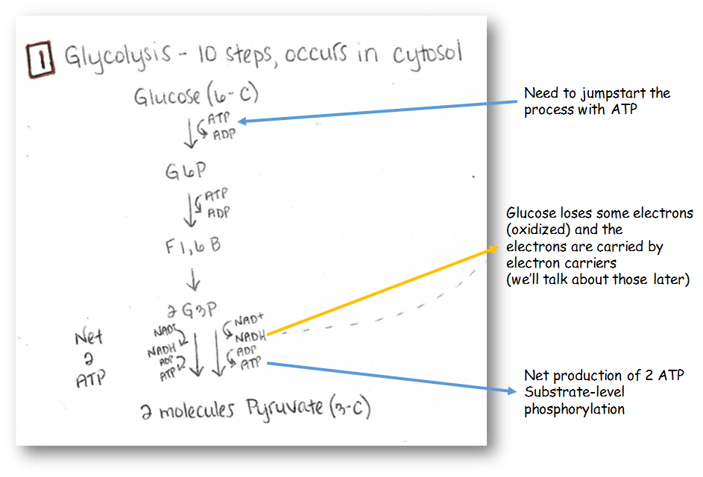

Slide 10
Glycolysis happens in the cytosol
In bacteria utilizing aerobic cellular respiration, the rest of the processes will just happen in the cell
In eukaryotes, the pyruvate molecules move into the mitochondria

Slide 11
Mitochondria
Caption: Animal Mitochondrion Diagram (c) LadyofHats, Public domain

Slide 12
2. Pyruvate Oxidation
Pyruvate Oxidation
Happens in mitochondrial matrix
2 molecules of pyruvate (3C) are oxidized
Decarboxylation
Some carbon is lost (results in production of CO₂)
Start with 2 molecules pyruvate (3C) and ends with 2 molecules Acetyle CoA (2C)

Slide 13
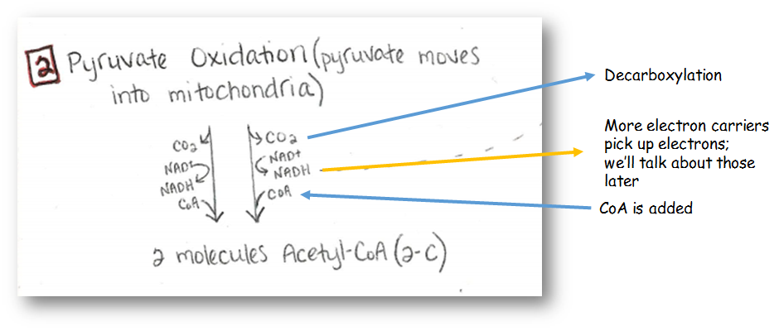

Slide 14
3. Citric Acid Cycle (Krebs)
Citric Acid Cycle
Happens in the mitochondrial matrix
8 steps
For every glucose molecule, there are 2 turns of the citric acid cycle
At the end of the citric acid cycle, the glucose molecule has been completely oxidized
More decarboxylation
Produces a little ATP

Slide 15
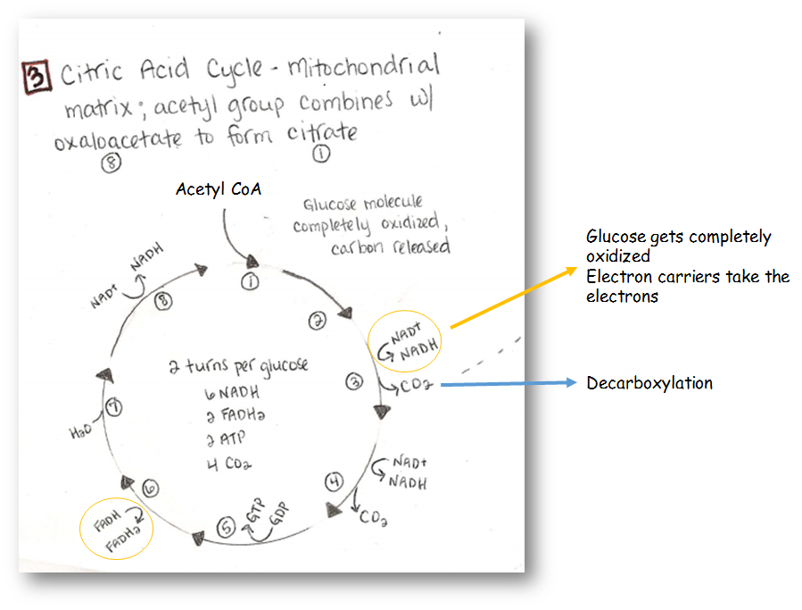

Slide 16
4. Oxidative Phosphorylation via the Electron Transport Chain (ETC)
Oxidative Phosphorylation
Happens in the mitochondrial membrane
Electron carriers that have been reduced during glycolysis, pyruvate oxidation and citric acid cycle bring the electrons over to the membrane and are oxidized – the drop off the electrons at the electron transport chain
Oxygen is the final electron acceptor in the ETC
The electron transport chain results in protons (H+) being pumped in the inner membrane space
This creates a proton gradient – lots of potential energy
Protons can only escape through ATP synthase
Chemiosmosis
Results in a lot of production of ATP

Slide 17
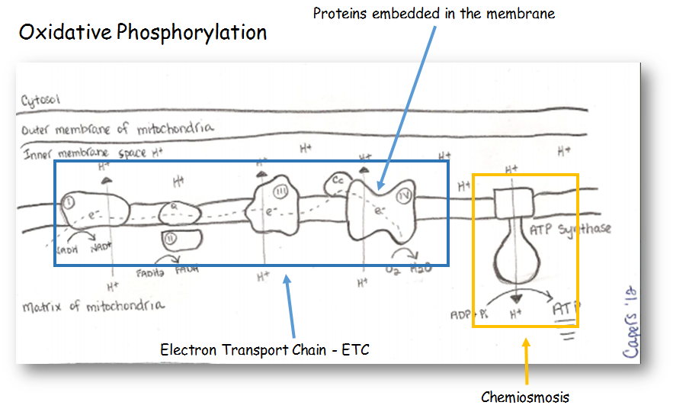

Slide 18
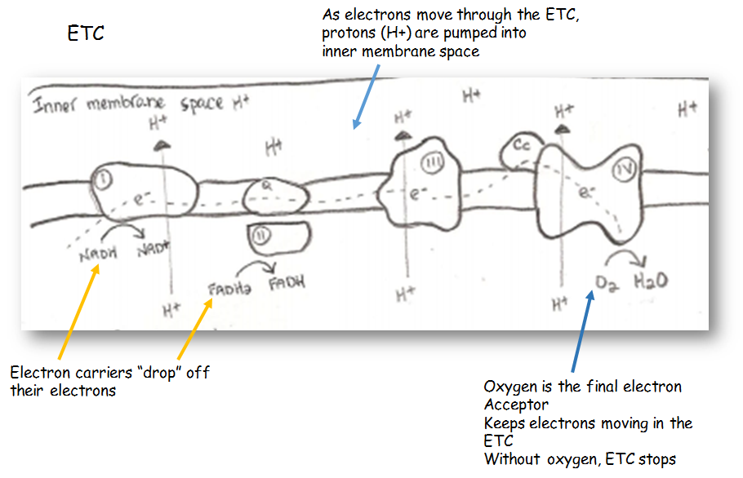

Slide 20
The proton gradient is like having water behind a dam, LOTS of potential energy
Caption: Open flood gates – Beaver Lake Dam (c) Doug Wertman, Public domain

Slide 21
ATP Yield
When a glucose is oxidized in aerobic respiration, ~32-36 ATP are generated
Not all of the energy in the glucose molecule is converted to ATP
In the process, some of the energy is lost as heat
The ATP will be immediately used by the cell. Have to continually produce ATP even when at rest (our cells are never “at rest”)

Slide 22
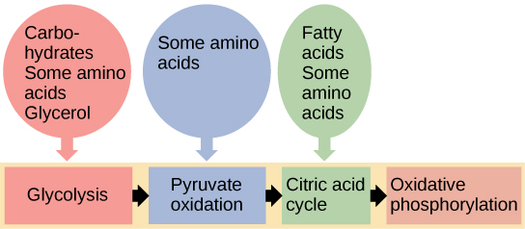
Glucose is not always used for energy source
Other sugars can enter in different steps of glycolysis
Amino acids can enter the citric acid cycle
Lipids can also enter in at different spots during the process
Download for free at http://cnx.org/contents/185cbf87-c72e-48f5-b51e-f14f21b5eabd@10.61

Slide 23
What happens when oxygen is not available?
Anaerobic Respiration
Glycolysis
Produces 2 ATP
Electron carriers are reduced, but there is no ETC to take the electrons to
Fermentation (lactic acid fermentation, alcohol fermentation)
Purpose of this is to oxidize the electron carriers so that they can be used again in glycolysis
Results in pyruvate transformation into lactate or alcohol
Organic compounds that still have a lot of energy in them
Whole process only results in 2 ATP

Slide 24
Who uses it?
Some bacteria, yeast
In animals, it can happen in our muscle cells when oxygen is low (part of fight and flight response)
A multicellular plant or animal has to use aerobic respiration – we need all the ATP we can get!

Slide 25
Download for free at http://cnx.org/contents/185cbf87-c72e-48f5-b51e-f14f21b5eabd@10.61

