Slide 1
Anatomy & Physiology II Laboratory
Spring -20

Slide 2
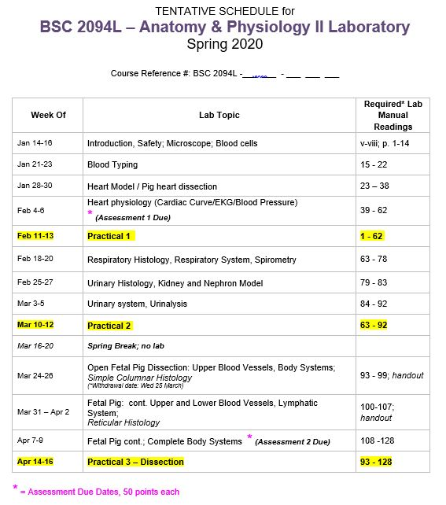
Welcome to AP 2 Lab!
We are all going to go through the Syllabus
Located on Weebly with Link on Blackboard
WRITE IN YOUR EXACT COURSE REFERENCE #!!!
BSC2094L-##-###
You need this for ALL communication with any Faculty, Manager, Chair or Instructor!!!
**NOTE: Labs are set up by “week” = supplies/tools only out for the week

Slide 3
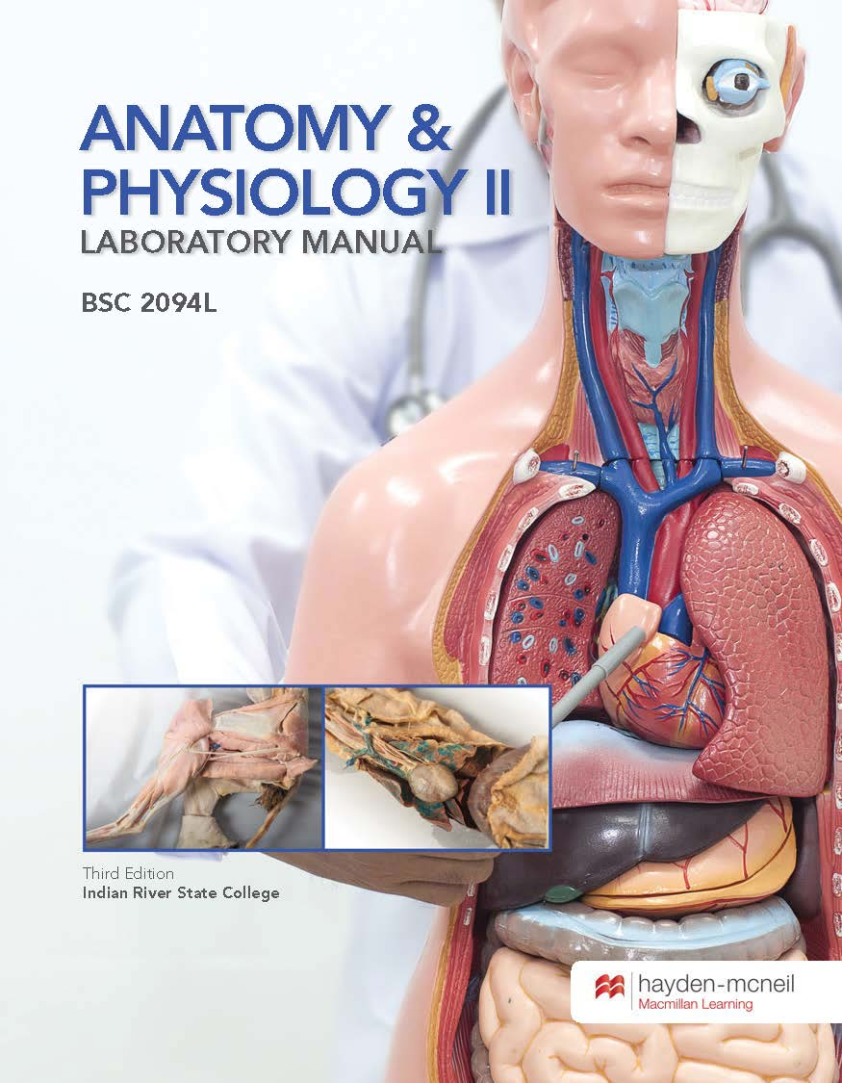
Instructor Contact Information:
IOR – name(Instructor of Record*)
******@irsc.edu
email to make appointment​
EMAILS without REF # MAY NOT BE ANSWERED!!!!!!
Instructors Contact Info
All Adjunct and TLS contact info
Biology Faculty info <click here>
LAB MANUAL: Required 3rd Ed.
Lab Materials on Weebly & additional resources in BlackBoard
http://biology-irsc.weebly.com/laboratory-resources-click-here-for-infromation-on-the-labs-including-powerpoints-handouts-etc.html

Slide 4
Grading
Exam 1 100 pts
Exam 2 100 pts
Exam 3 100 pts
Assessment 1 50 pts
Assessment 2 50 pts
Total Possible pts 400 pts
Absences –3% -12 pts
*NOTICE* : YOUR GRADE IS MADE UP ENTIRELY from the 400 possible points YOU EARN from your THREE TESTS and TWO ASSESSMENTS!!!
= No Homework, No extra credit, No lab book points, No Blackboard Quiz points
HOWEVER, Attendance can negatively influence your final grade -3% for EACH missed class!

Slide 5
Lab Exams = Practical's
This is NOT a LECTURE!!!
Can’t take tests in the Testing center
No make-up unless Department Chair Approved!
PLAN NOW FOR THESE DATES!!!!
Book back up babysitter
Have back up transportation
Schedule early off of work
Plan to be here 30 min earlier
than class to anticipate traffic
Set two alarms (one battery)
Book back up babysitter
Back-up pants and shoes in car
Lab Schedules​
All labs on all campus’ w/instructor contact emails

Slide 6
Lab Assessments
2 parts, 50 pts. Each
Part 1 – all answers from your book re: cardio system
Part 2 – Lab Report write-up Urinanalysis
Both Blackboard online Submissions
Due on these dates and will CLOSE after = you will not be able to submit late so plan accordingly
Individual Assignment = plagiarism/copying will result in a ZERO “0”
Details to come after Practical 1

Slide 7
Open Lab
Come in to use your microscope or look at models from the week…
Main Campus primarily (some at Pruitt/STEM)
8:30am -4:45pm M-R and only available during weeks WITHOUT scheduled Practical Exams.
See Weebly online for more details http://biology-irsc.weebly.com/open-lab-information.html

Slide 8
Attendance : MANDITORY/penalized
Attendance (mandatory to finish each lab)
1 Freebee = 1 emergency absence is ‘free’ and will not penalize you
this is FOR the one time you may be sick, missed your flight, went to a wedding, too hung-over...
Eliminates need to email your instructor to ASK if you can be excused because you “bought tickets to your brothers wedding during July and didn’t know the schedule yet…”
2nd Absence = then -3% (or -12 points) off FINAL GRADE, NO EXCEPTIONS
3rd Absence = another -3% off your FINAL GRADE
-6% equates to a loss of – 24 points, so that 80% you got on Practical 1 is now an F…you need to consider Withdrawing.
You missed lab… now what?? ALP – alternative lab participation
Find a Lab that SAME WEEK, email the instructor to see if you can attend their class, so you don’t miss content that you WILL be tested on!
http://biology-irsc.weebly.com/laboratory-schedules-click-here-for-current-semesters-schedule-of-all-the-labs-on-all-campuses.html
Note: Attending another instructor’s lab does not count as “attending your lab.”

Slide 9
Taking attendance:
I will take attendance in every Lab at the beginning of class.
To be considered present, you must follow Lab CODE:
Correctly Dressed (closed toed shoes, long pants)
On Time in your seat
Drinks outside
Electronics off
POP QUIZ!
Q. You are in your seat on time, book out, but have sandals on…are you present?
Q. You are in your seat, correctly dressed, and your cell phone rings…are you present?
Q. Your dressed correctly, coffee is outside the classroom but you are not in your seat when class begins…are you present?
Q. You have closed toed shoes on, you are in your seat on time, but are wearing shorts with no lab coat… are you present?
Q. You are in your seat on time, wearing your closed toed shoes and pants, pencil ready next to your water bottle…are you present?

Slide 10
Make Up-Policy for a Lab
Missing a Practical Exam
MUST be approved by a DEPARTMENT CHAIR via email within 24 hours of missing your test
Dr. Jennifer Capers jcapers@irsc.edu or Dr. Robin Willoughby rwilloug@irsc.edu
Must submit verifiable documentation (medical papers, ticket, etc...)
Being "late" for an undocumented reason, will not be considered
No approval = 0% on the test; No exceptions
Monday after test week @ Main Campus ONLY
Times TBA testing week
STANDARIZED TEST – not your instructors!!!
Failure to attend an APPROVED make-up:
Your test remains 0 earned points
Final course grade is reported on your transcript
If you communicate with your Instructor:
‘I’ = Incomplete, if current grade is passing grade
'W' = Instructor Withdrawal if current grade is Failing *student cannot attend final practical exam

Slide 11
Laboratory Rules
Lab Attire
Shoes: closed-toe and closed-heel
Long pants or buy a lab coat (in bookstore)
Recommendation: Leave Shoes & Pants/Coat in Car!
Not dressed properly = NOT allowed in lab! (including Exam days = a ZERO “0” on the test)
Cell Phone Policy
On silent, no video*, pics okay during actual experiments (* lab is about focused application in the moment, recording decreases active learning)
Disruptive Behavior - will be asked to leave
Cheating
Zero Tolerance - Both students will be reported
Are you coming to class to benefit your neighbor or yourself? You wouldn’t hand over your paycheck to your neighbor…don’t help your future competition!
If you require additional services (extended time testing, note taker etc.) , see me after class or contact me this FIRST WEEK.

Slide 12
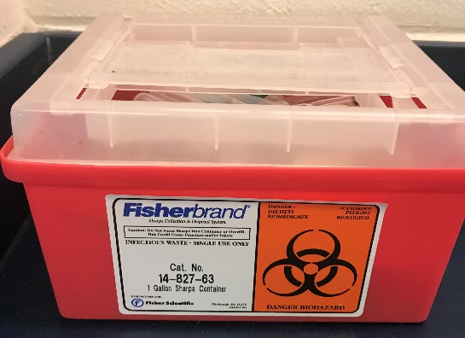
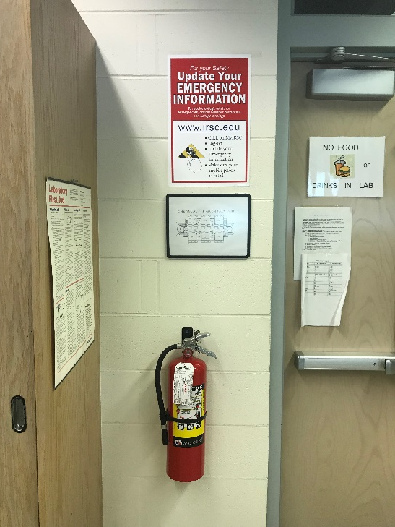
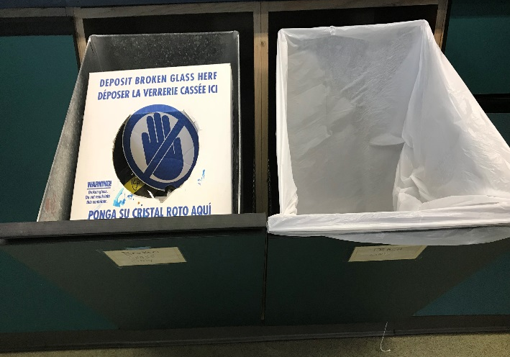
Safety
Biohazard
Be sure to familiarize yourself with safety procedures
Where does broken glass go?
What goes in the biohazard?
Eye wash station
Chemical Shower
Fire Blanket
Fire Extinguisher
Fire
Broken Glass vs. Trash

Slide 13
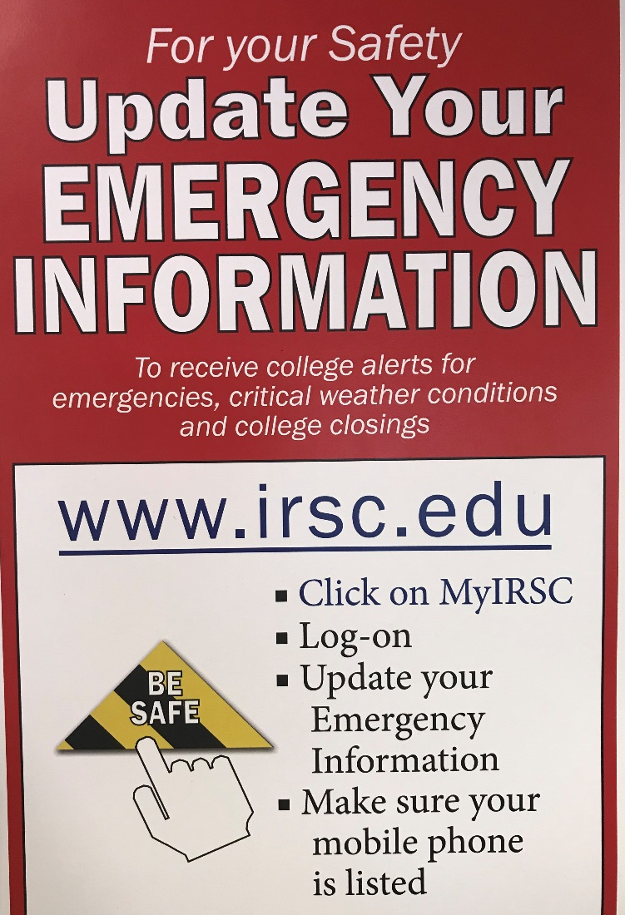
Safety
Point out posted Evacuation Map & Emergency Info
- Main Campus
STATEMENT OF UNDERSTANDING of LAB MANAGEMENT PROCEDURES
<Ctrl Click> and read this document

Slide 14
What to Expect from a LAB:
FUN, Engaging, and a chance to learn out of your seat!
Fast Paced with lots of info, jammed into a small time period
Physical participation/movement/manipulation – YOU will be learning to demonstrate new skills weekly, building confidence!
Labs require learning time management as exercises build upon one another…keep up, don’t procrastinate!
Expect to study for exams the same if not more than a Lecture, in various formats (groups, online, ol’fashion read/writing notes!)
Mandatory attendance, missing a Lab is detrimental to Exams
Taking a lab will help you further define your career path and may open your eyes to a new direction you haven’t thought of!

Slide 15
What’s a typical lab class consist of:
Start with LAB C.O.D.E. attendance and answer any questions from last week
Since you already “pre-read” the day’s material (ah hem…), your instructor will briefly go over what the days experiment will consist of and highlight any procedure changes etc.
You read and follow the lab book directions (yes this is a LARGE part of actual LAB…and you will have to be very comfortable doing so in the real world!)
Complete and Understand entire exercise and all associated questions in your lab manual, discuss with your group or neighbor!
Clean and reset experiments/models/workstation
Return to seats so your instructor and classmates can go over results, review the key points, talk about what you should be taking away from today’s class period *this is a good time to think about what test questions an instructor would ask on a test!!!**
ASK QUESTIONS or for more Explanation if needed (THIS is the time to do this when your brain is fresh and you have the resources in the room!)
Review next weeks exercise (you will have 5 min of downtime at some point) – this is how you “prime your brain” to pick up on those topics in lecture
Clean up before you leave/ PUSH IN YOUR CHAIRS!

Slide 16
Start Exercise 1 Blood Cells

