Slide 1
Chapter 25 seedless plants

Slide 2
Chapter outlines
25.1 Early Plant Life
25.2 Green Algae: Precursors of Land Plants
25.3 Bryophytes
25.4 Seedless Vascular Plants

Slide 3
introduction
The evolutionary transition from water to land imposed severe constraints to plants.
They had to develop strategies to avoid drying out, structural support, capturing sunlight, and reproductive cells dispersal.
Seed plants development allowed them to populate even the most arid habitats.
Most seedless plants still require a moist environment.

Slide 4
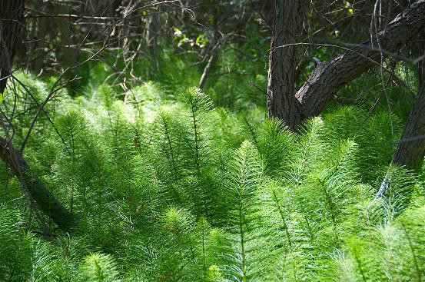
25.1 early plant life
Seedless plants, like these horsetails (Equisetum sp.), thrive in damp, shaded environments under a tree canopy where dryness is rare.

Slide 5
25.1 early plant life
Plants Adaptations to Life on Land
Plants developed strategies to combat dryness.
Moss has one strategy called tolerance, dry out to brown brittle mats but can be restored when water is available.
They also colonize in the moist habitats.
Later on, plant developed “resistance” than “tolerance” such as cacti that can survive in extremely dry conditions.

Slide 6
25.1 early plant life
Advantages of land plants
Sunlight are abundant for photosynthesis.
CO₂ is readily available in the air.
No predators threatened plant life in the beginning.
Once animals evolved, plants developed strategies to deter predation: from spines and thorns to toxic chemicals.

Slide 7
25.1 early plant life
Alternation of Generations
Haplontic refers to life cycle in which there is a dominant haploid stage.
Diplontic refers to a life cycle in which diploid is a dominant stage (human is diplontic).
Most plants exhibit alternation of generations, haplodiplontic known as gametophyte and sporophyte for haploid and diploid forms, respectively.
Gametophytes are dominant in mosses and liverworts which sporophytes are barely noticeable.
In higher plants, gametophytes are restricted in gametes such as pollen grain and ovules.

Slide 8
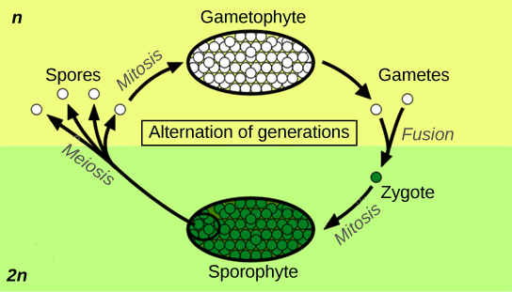
25.1 early plant life
Alternation of Generations
Alternation of generations between the 1n gametophyte and 2n sporophyte is shown.

Slide 9
25.1 early plant life
Sporangia in Seedless Plants
The sporophyte of seedless plants is diploid (2n).
The sporophyte bears the sporangia.
Inside the multicellular sporangia, the diploid sporocytes, or mother cells produce haploid (n) spores by meiosis. Spores germinate into gametophyte.
  Homosporous produce only one kind of spore.
  Heterosporous produce two morphologically different types of spores. The males spores are called microspores, and the female spores are called megaspores.

Slide 10
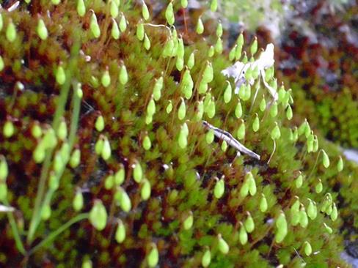
25.1 early plant life
Spore-producing sacs called sporangia grow at the ends of long, thin stalks in this photo of the moss Esporangios bryum.

Slide 11
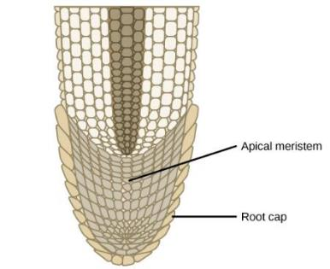
25.1 early plant life
Apical Meristems
Addition of new cells in a root occurs at the apical meristem. Subsequent enlargement of these cells causes the organ to grow and elongate. The root cap protects the fragile apical meristem as the root tip is pushed through the soil by cell elongation.

Slide 12
25.1 early plant life
Additional Land Plant Adaptations
Early land plants did not grow more than a few inches off the ground.
By developing and shoot and growing taller, individual plants captured more light.
Land plants incorporated more rigid molecules in their stems for support.
The vascular tissues were developed for the transport of water and food derived from photosynthesis.
  Xylem conduct water and minerals from soil up to the shoot.
  Phloem transport food throughout the entire plant.

Slide 13
25.1 early plant life
Additional Land Plant Adaptations
Waxy cuticle protects leaves and stem from desiccation.
However, it also prevents intake of CO₂.
Stomata can overcome this problem.
Protective flavonoids and other pigments are developed to prevent photodynamic damage from UVB.
Poisonous secondary metabolites such as alkaloids are used to deter predators.
In contrast, plants co-evolved with animals by developing sweet and nutritious metabolites for animal to aids in pollination and dispersing pollen grains and seeds.

Slide 14
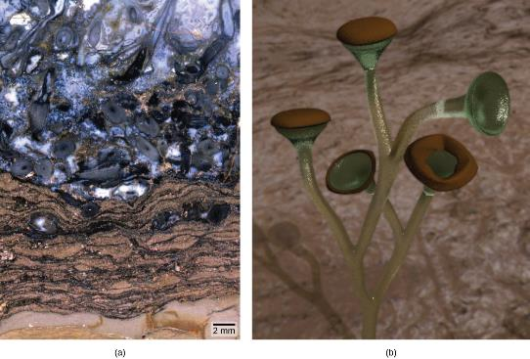
25.1 early plant life
Evolution of Land Plants
This Rhyniechert contains fossilized material from vascular plants. The area inside the circle contains bulbous underground stems called corms, and root-like structures called rhizoids.

Slide 15
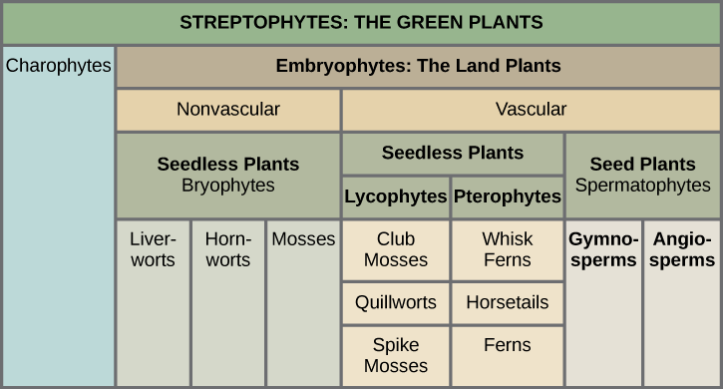
25.1 early plant life
The Major Divisions of Land Plants

Slide 16
25.2 green algae
Streptophytes
Land plants and closely related green algae are part of a new monophyletic group “Streptophyta”.
Green algae contains carotenoids and chlorophyll a and b as in land plants.
They both store carbohydrates as starch.
Cell in green algae divide along their cell plates called phragmoplasts.
The remaining green algae belong to a group called Chlorophyta.

Slide 17
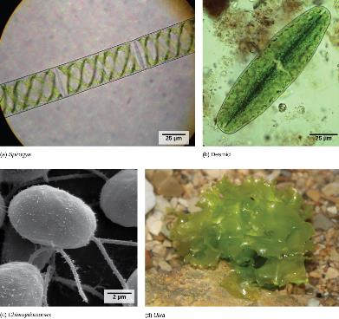
25.2 green algae
Chlorophyta include (a) Spirogyra, (b) Desmids, (c) Chlamydomonas, and (d) Ulva. Desmids and Chlamydomonas are single-celled organisms, Spirogyra forms chains of cells, and Ulva forms colonies resembling leaves

Slide 18
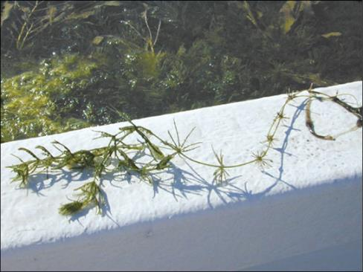
25.2 green algae
Charales : The closest living relative of land plants
The representative alga, Chara, is a noxious weed in Florida, where it clogs waterways.

Slide 19
25.3 bryophytes
More than 25,000 species of bryophytes thrive in mostly damp habitats, although some live in desserts.
They generally lack lignin and do not have actual vascular tissue. Water and nutrients circulate inside specialized conducting cells.
Bryophytes are commonly called nonvascular plants.
All the conspicuous vegetative organs are gametophyte. The sporophyte are barely noticeable and supported by gametophyte.
There are three phyla: Hepaticophyta (Liverorts), Anthocerotophyta (Hornworts), and Bryophyta (Mosses)

Slide 20
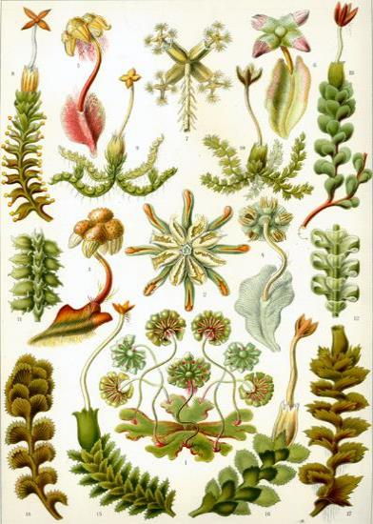
25.3 bryophytes
Hepaticophyta
This 1904 drawing shows the variety of forms of liverworts, Hepaticophyta.

Slide 21
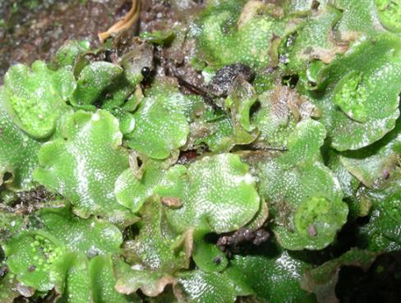
25.3 bryophytes
Hepaticophyta
A liverwort, Lunularia cruciata, displays its lobate, flat thallus. The organism in the photograph is in the gametophyte stage.

Slide 22
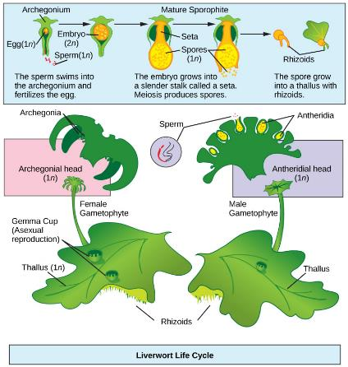
25.3 bryophytes
The life cycle of a typical liverwort starts with haploid spores developed in sporangium on sporophyte by meiosis.
Male and female gametangia develop on separate individual gametophyte.
Once fertilized, zygote grows into a small sporophyte and still attached to the parent gametophyte.
Asexual reproduction involves production of gemmae that can develop into gametophyte.
Hepaticophyta

Slide 23
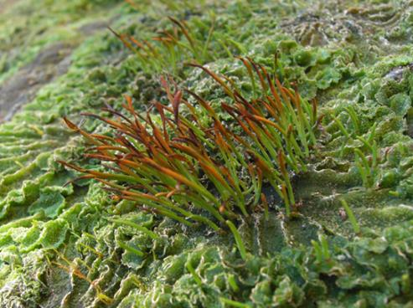
25.3 bryophytes
Anthocerotophyta
Hornworts grow a tall and slender sporophyte.

Slide 24
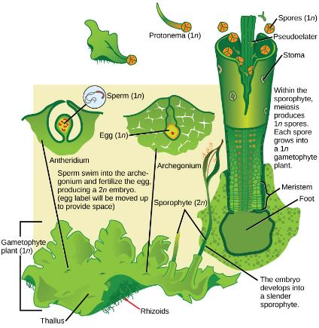
25.3 bryophytes
Anthocerotophyta
The alternation of generation in hornworts is shown.
The gametophyte grows as flat thalli on the soil embedded with gametangia.
Sperms swim to archegonia and fertilize eggs.
The zygote develops into a long slender sporophyte that eventually splits open, releasing spores by pseudoelaters.

Slide 25
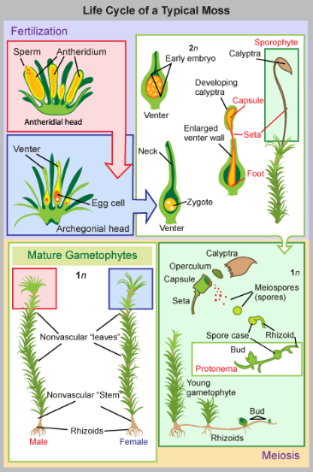
25.3 bryophytes
Bryophyta
Haploid spore germinates to, first, form protonema.
Gametophyte consists of photosynthetic stem and foliage-like structures, and rhizoids form at the base of gametophores.
Gametangia of both sex develop on separate gametophores.
The antheridium produces many sperms, whereas the archegonium produce a single egg.
The zygote develops into sporophyte after fertilization and still attached by it foot to the gametophyte.

Slide 26
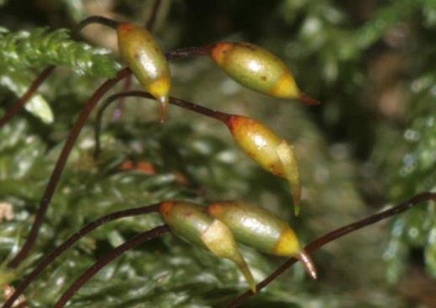
25.3 bryophytes
Bryophyta
This photograph shows the long slender stems, called setae, connected to capsules of the moss Thamnobryum alopecurum.

Slide 27
25.4 seedless vascular plants
Bryophytes may have been successful at the transition from an aquatic habitat to land, but they are still dependent on water for reproduction and absorb moisture and nutrients through the gametophyte surface.
The lack of roots and reinforced conducting cells limit Bryophytes to small sizes.
On the other hand, vascular plants can achieve enormous heights, thus competing successfully for sunlight.
In seedless vascular plants, the diploid sporophyte is the dominant phase of the life cycle.
However, reproduction still depend on water during fertilization, thus, ferns and their relatives are more abundant in damp environments.

Slide 28
25.4 seedless vascular plants
Vascular Tissue: Xylem and Phloem
Xylem is the tissue responsible for the storage and long-distance transport of water and nutrients.
The tissue consists of conducting cells, tracheids, and supportive filling tissues, parenchyma.
Xylem tissue is lignified for mechanical strength and impermeable to water, as well as support.
With strengthened xylem, plant can achieve impressive height resulting in successfully compete for the sun light and disperse their spores or seeds further away.
Phloem transports sugars, proteins, and other solutes throughout the plant.
Phloem consists of sieve elements (conducting cells) and supportive cells.

Slide 29
25.4 seedless vascular plants
Roots: Support for the Plant
Thin rhizoids attached Bryophytes to the substrate but did not provide a strong anchor for the plant, neither effective absorption.
Roots appeared later in evolution than vascular tissue.
With their prominent vascular tissue systems, roots can absorb water and minerals from soil and transfer throughout the plant.
The extensive network of roots allow them to reach to water sources and stabilize the trees.
The majority of roots establish a symbiotic relationship with mycorrhiza fungi which benefit absorption of mineral especially phosphorus.
Nitrogen-fixing bacteria are also found in roots of legume plants.

Slide 30
25.4 seedless vascular plants
Leaves, Sporophylls, and Strobili
The appearance of true leaves thus improving their photosynthesis efficiency marks the third innovation of the seedless vascular plants (accompanying the prominence of the sporophytes and vascular tissue).
The first type of leaf, microphyll, is small and has a simple vascular system with a single unbranched vein run through the center of the leaf.
Microphylls may originate from flattened lateral branches or from sporangia that lost their reproductive capability.
Megaphylls are larger leaves with a pattern of branching veins.
Sporophylls are leaves that were modified structurally to bear sporangia.
Strobili are cone-like structures that contain sporangia.

Slide 31
25.4 seedless vascular plants
Phylum Lycopodiophyta: Club Mosses
These are the earliest group of seedless vascular plants.
Today’s club mosses are diminutive, evergreen plants consisting of a stem (which may be branched) and microphylls.
The phylum Lycopodiophyta consists of ~ 1,200 species, including
  Club mosses (Lycopodiales)
  Spike mosses (Selaginellales)
  Quillworts (Isoetales)
None of which are true mosses or Bryophytes.
The sporophyte is the major state of the lifecycle. Gametophyte is independent from sporophyte and can be associated with Mycorrhiza.

Slide 32
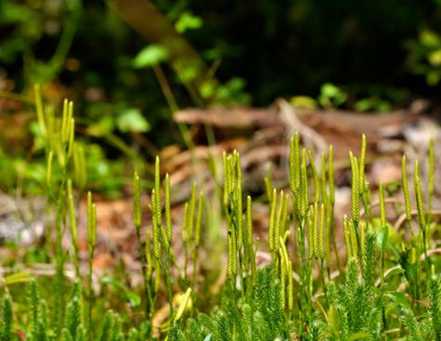
25.4 seedless vascular plants
Phylum Lycopodiophyta: Club Mosses
In the club mosses such as Lycopodium clavatum, sporangia are arranged in clusters called strobili.

Slide 33
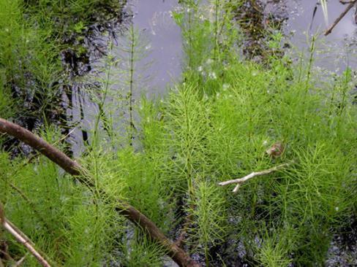
25.4 seedless vascular plants
Phylum Monilophyta: Equisetopsida (Horsetails)
The single genus Equisteum (Horsetails) thrive in a marsh.

Slide 34
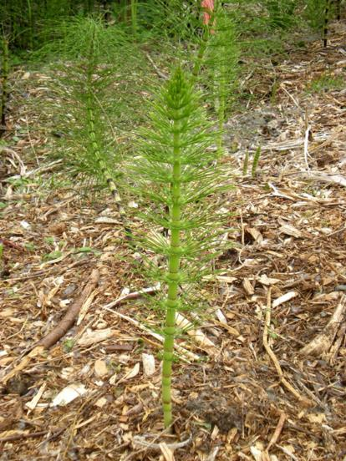
25.4 seedless vascular plants
Phylum Monilophyta: Equisetopsida (Horsetails)
Thin leaves originating at the joints are noticeable on the horsetail plant.
Horsetails were once used as scrubbing brushes because of silica in epidermal cells and were nicknamed scouring brushes.

Slide 35
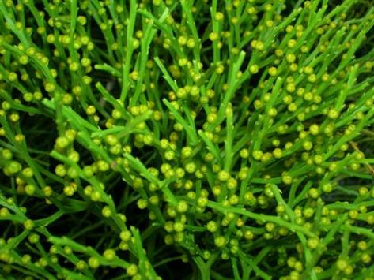
25.4 seedless vascular plants
Phylum Monilophyta: Psilotopsida (Whisk Ferns)
The whisk fern Psilotum nudum has conspicuous green stems with knob-shaped sporangia.
They lack boths root and leaves, probably loss by reduction.
DNA analysis suggests that they are more closely related to ferns.

Slide 36
25.4 seedless vascular plants
Phylum Monilophyta: Polipodiopsida (Ferns)
Ferns are the most readily recognizable seedless vascular plants.
They are considered the most advance seedless vascular plants and display characteristics commonly observed in seed plants.
More than 20,000 species live in environments ranging from tropics to temperate forests.
Although some ferns live in dry environments, most ferns are restricted to moist, shaded places.
Sporophyte is dominant stage in the life cycle which consists of large compound leaves called fronds.

Slide 37
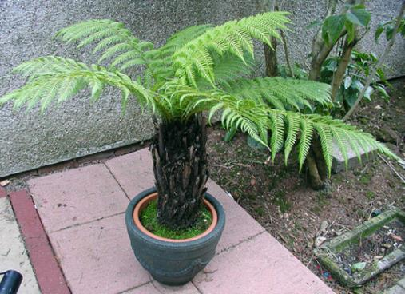
25.4 seedless vascular plants
Phylum Monilophyta: Polipodiopsida (Ferns)
Some specimens of this short tree-fern species can grow very tall.

Slide 38
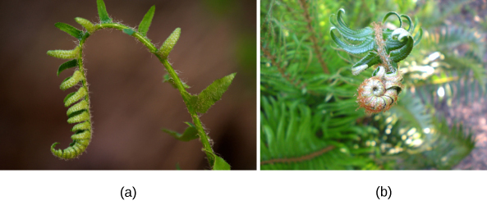
25.4 seedless vascular plants
Phylum Monilophyta: Polipodiopsida (Ferns)
Croziers, or fiddleheads, are the tips of fern fronds.
They are traditional spring food of Native Americans in Pacific Northwest.

Slide 39
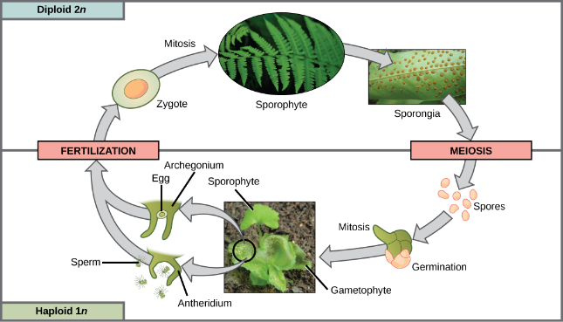
25.4 seedless vascular plants
Phylum Monilophyta: Polipodiopsida (Ferns)
This life cycle of a fern shows alternation of generations with a dominant sporophyte stage.

Slide 40
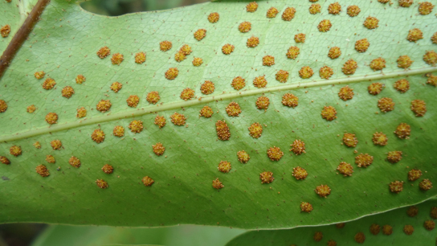
25.4 seedless vascular plants
Phylum Monilophyta: Polipodiopsida (Ferns)
Sori appear as small bumps on the underside of a fern frond.

Slide 41
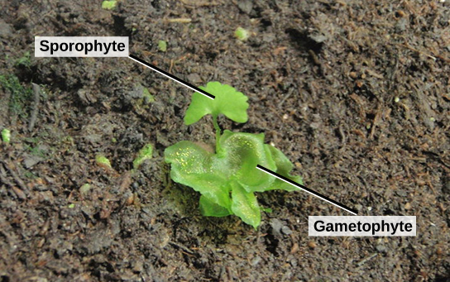
25.4 seedless vascular plants
Phylum Monilophyta: Polipodiopsida (Ferns)
Shown here are a young sporophyte (upper part of image) and a heart-shaped gametophyte (bottom part of image).

Slide 42
25.4 seedless vascular plants
The Importance of Seedless Vascular Plants
Mosses are at the base of the food chain in the tundra biome.
Bryophytes make the soil more amenable to colonization by other plants.
Ferns contribute to the environment by promoting the weathering of rock, accelerating the formation of topsoil, and slowing down erosion.
The water ferns of the genus Azolla, harbor nitrogen-fixing cyanobacteria and restore this important nutrient to aquatic habitats.
Dried peat moss, Sphagnum, is commonly used as fuel as renewable resource.
Florists use blocks of Sphagnum to maintain moisture in floral arrangements.

