Slide 1
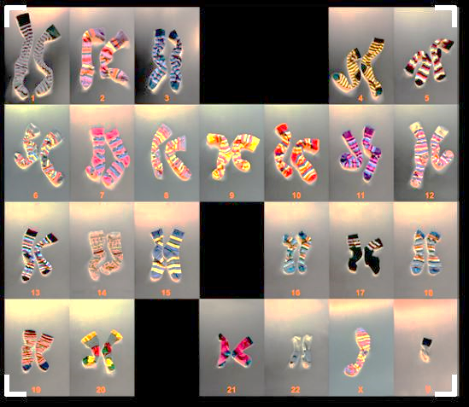

Human Genetics & Karyotyping
Exercise 9, pg. 89-104
Exercise 10, pg.105-112
BSC2010L

Slide 2
Human Genetics Exercise 9, pg. 89-104
Lab Objectives:
Understand Non-disjunction
Explain/Predict Sex Chromosome Abnormalities
Determine Genotypes
Investigate Inheritance Patterns
Construct Pedigrees

Slide 3
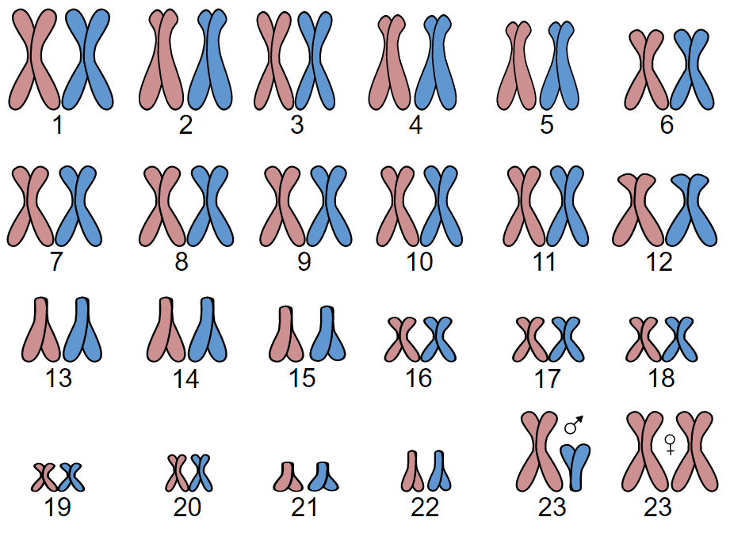

Human Karyotype
Shown here is the karyotype of a human. All 23 pairs of different length and functions are shown.
Pair #23, the sex chromosomes, indicate male (XY) or female (XX)
By AGeremia - Own work, CC BY-SA 3.0,
https://commons.wikimedia.org/w/index.php?curid=37184677
XX = Female
XY = Male
♀

Slide 4
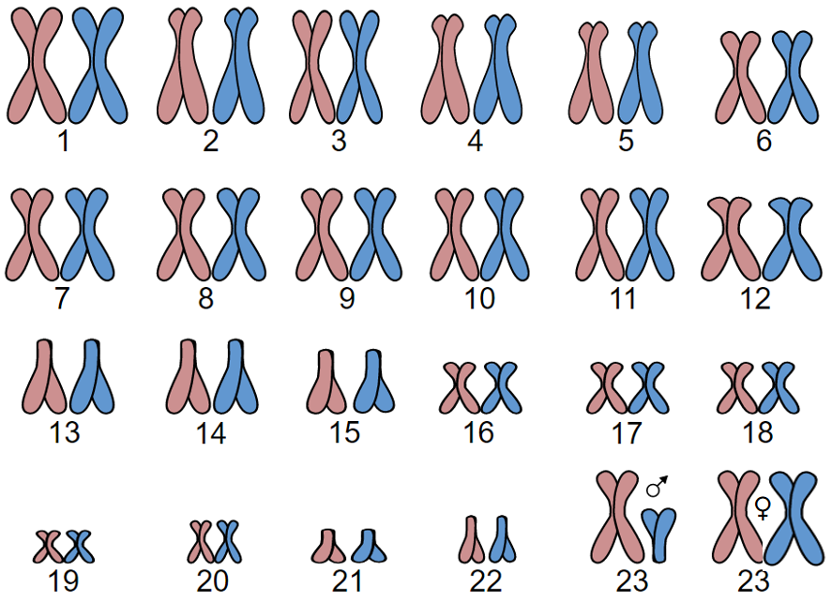
Note that we have 22 autosomal chromosome pairs and 1 pair of sex chromosomes.
Humans
Haploid # of chromosomes: 23 (1n)
  Gametes only (sperm or ovum (egg))
Diploid # of chromosomes: 46 (2n)
  23 homologous pairs
    1 chromosome came from mom
    1 chromosome came from dad
By AGeremia - Own work, CC BY-SA 3.0,
https://commons.wikimedia.org/w/index.php?curid=37184677

Slide 5
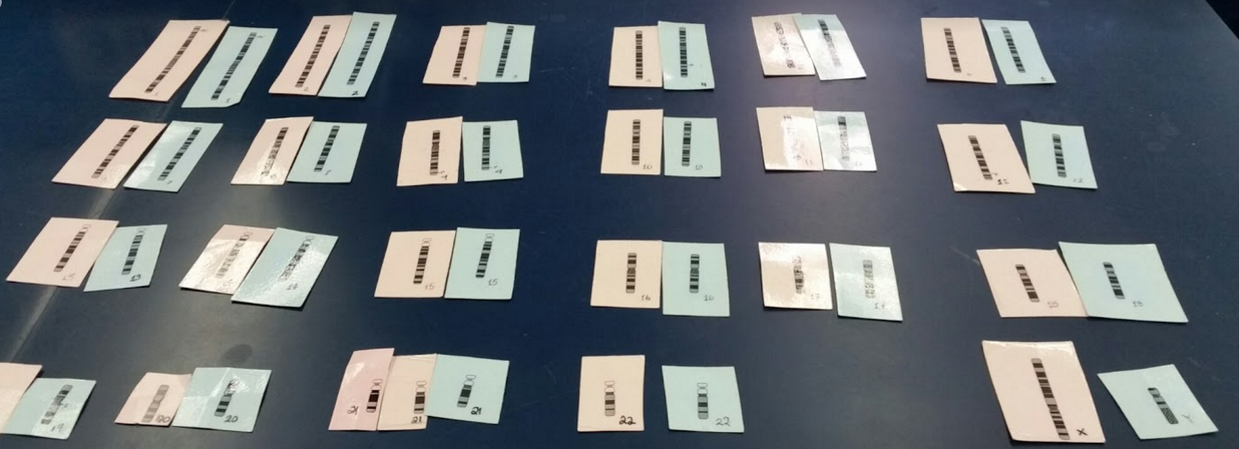
Karyotyping Babies
Each group (2 students) gets one bag (Ex: child #4)
Contains 1 blue set and 1 pink set each containing 23 chromosomes
Each set represents a haploid gamete (1n=23) (egg + sperm)
These two fuse to form a diploid zygote (2n=46; full set of chromosomes in humans)
Pair each of the 23 chromosomes up with its homologue.
Order 1 to 22 autosomal pairs plus the sex chromosomes.
Use KEYS to decode babies sex, genetic disease(expressed), carrier of any disease, blood type, hair color, and eye color.

Slide 6
Karyotyping Babies
You “made” Baby #4…Congrats!!
Start by looking at his or her sex chromosomes…
Is your baby a male (XY) or female (XX)?

Slide 7
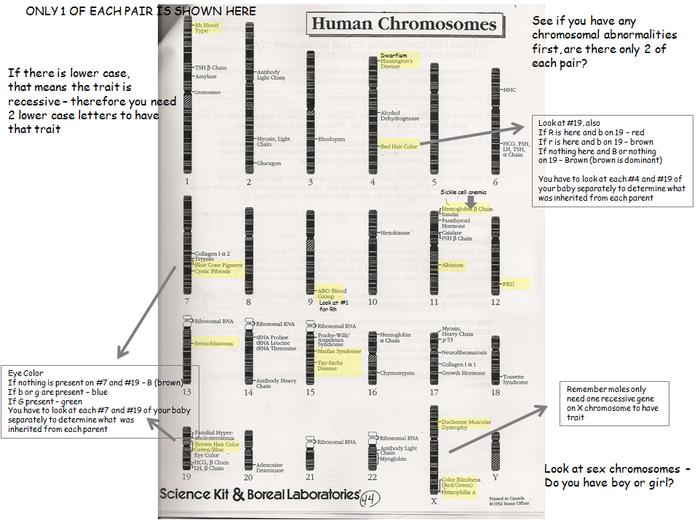
Karyotyping Babies

Slide 8
Karyotyping Babies
Do you see – or + ?
Chromosome #1

Slide 9
Dom vs. Rec Trait Review:
Each pair of the 22 autosomal chromosomes have the same genes
For each gene there can be 2 alleles (different forms) (G or g)
A human with two different alleles for a trait is heterozygous for that trait (Gg)
Heterozygous (Gg) will show the dominant trait and carry* the recessive
A human with two of the same alleles is homozygous (GG or gg)
Homozygous Dominate (GG) will show the dominant trait
Homozygous recessive(gg) will not show the dominate trait
***(no “G” instructions for it!)***

Slide 10
Dominant vs. Recessive Traits
Given that Huntington’s Disease is dominant ‘H’ :
What type of chromosome is this trait found?
  Autosomal or Sex Linked?
Would a human who is heterozygous (Hh) express Huntington’s? Yes or No?
A human who is homozygous dominant (HH) _________ show the disease.
A human who is homozygous recessive (hh) ___________ show the disease.
will
will not
*BECAUSE the genetic info for ‘G’ is not present.
This inheritance pattern is called Autosomal Dominant

Slide 11
Dominant vs. Recessive Traits
Given that an Cystic Fibrosis is recessive ‘c’:
A human who is heterozygous (Cc) _________ express the disease.
  However, this human (Cc) is a carrier for the disease and 50% of its gametes will have the ‘c’ trait.
A human who is homozygous dominant (CC) _________ express the disease.
A human who is homozygous recessive (gg) _________ express the disease.
will not
will not
will
This inheritance pattern is called Autosomal Recessive

Slide 12
Autosomal Traits
Some autosomal dominant traits in Humans:
  Widow’s peak
  Unattached earlobes
  Freckles
Some autosomal recessive traits in Humans:
  No hair on back of hand
  Not able to roll tongue
  Joined eyebrows

Slide 13
Other non X-linked Traits
Incomplete Dominance
  Form of inheritance where heterozygous alleles are both expressed => combined phenotype
    Example: a plant with white flowers and plant with red flowers has offspring with pink flowers
Codominant
  Both alleles are expressed
    Example: Blood types in humans
        If a person has the A allele and the B allele, then both A and B are expressed on the surface of the red blood cell (RBC) as AB.

Slide 14
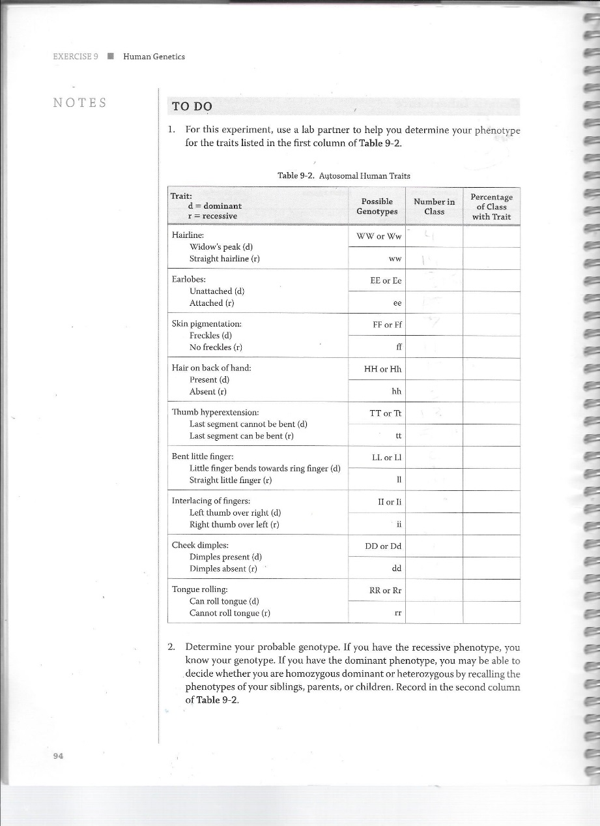
Autosomal Traits
Turn to page 94 in Lab book:
*turn on projector to do class tally together

Slide 15
X-linked crosses
Chromosomal pair #23 (Sex Chromosomes):
XX (so, one chromosome is X,
the other is also X) => results in female
XY (so, one chromosome is X, the other is Y)
=> results in male

Slide 16
X-linked crosses
Possible gametes of a sperm: X or Y
male female | X | Y
X | XX (female) | XY (male)
X | XX (female) | XY (male)
Possible gametes of an ovum: X (only X)

Slide 17
X-linked crosses
When we mark a dominant or recessive trait that is located on chromosome 23, we need to indicate if the trait is on the ‘Y’ or the ‘X’ chromosome.
In this course we will analyze recessive diseases that are expressed X-linked recessive.
Here is the notation for an X-linked mutations:
  X^{b} = recessive mutation
  X^{B} = dominant; not affected

Slide 18

X-linked crosses
Given an X-linked recessive disorder (X^{b} X^{b}), this leads to the following possible combinations:
X^{b} X^{b} = female showing disease (sick!)
X^{B} X^{b} = female carrying disease (healthy!)
X^{B} X^{B} = female healthy /not carrier
X^{b} Y = male showing disease (sick!)
X^{B} Y = male healthy

Slide 19
X-linked crosses
Given an X-linked recessive disorder (X^{b} X^{b}), this leads to the following possible combinations:
X^{b} X^{b} = female showing disease (sick!)
X^{B} X^{b} = female carrying disease (healthy!)
X^{B} X^{B} = female healthy /not carrier
X^{b} Y = male showing disease (sick!)
X^{B} Y = male healthy

Slide 20
X-linked crosses: non-carrying female w/ disease showing male
What are the Genotypes of the parents?
Female: X^{B} X^{B} Male: X^{b} Y
Punnett square setup:
Female male | X^{b} | Y
X^{B} | X^{B}X^{b} (female, healthy, but carrier for the disease) | X^{B}Y (male, healthy)
X^{B} | X^{B}X^{b} (female, healthy, but carrier for the disease) | X^{B}Y (male, healthy)

Slide 21
X-linked crosses: female showing disease w/ healthy male
What are the Genotypes of the parents?
Female: X^{b} X^{b} Male: X^{B} Y
Punnett square setup:
Female male | X^{B} | Y
X^{b} | X^{B}X^{b} (female, healthy, but carrier for the disease) | X^{b}Y (male, sick)
X^{b} | X^{B}X^{b} (female, healthy, but carrier for the disease) | X^{b}Y (male, sick)

Slide 22
X-linked crosses: female carrier w/ healthy male
What are the Genotypes of the parents?
Female: X^{B} X^{b} Male: X^{B} Y
Punnett square setup:
Female male | X^{B} | Y
X^{B} | X^{B}X^{B} (female, healthy) | X^{B}Y (male, healthy)
X^{b} | X^{B}X^{b} (female, healthy, but carrier for the disease) | X^{b}Y (male, sick)

Slide 23
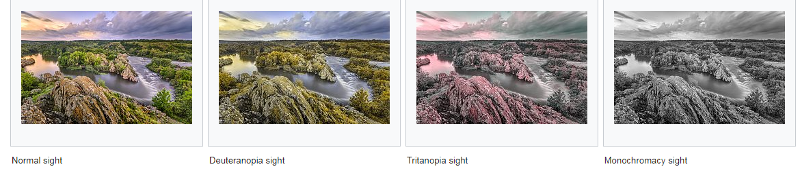
Color Blindness – X-linked
Color blindness is an X-linked recessive disorder (X^{b} X^{b}), thus:
X^{b} X^{b} = female expressing colorblind
X^{B} X^{b} = female carrying (non-colorblind)
X^{B} X^{B} = female non-expressing/not carrier
X^{b} Y = male expressing colorblind
X^{B} Y = male non-expressing/not carrier

Slide 24
Color Blindness – X-linked
Color blindness is an X-linked recessive disorder (X^{b} X^{b}), thus:
X^{b} X^{b} = female expressing colorblind
X^{B} X^{b} = female carrying (non-colorblind)
X^{B} X^{B} = female non-expressing/not carrier
X^{b} Y = male expressing colorblind
X^{B} Y = male non-expressing/not carrier
NOTE: MALES CANNOT CARRY COLORBLINDESS!

Slide 25
Color Blindness – X-linked
Color blindness is an X-linked recessive disorder (X^{b} X^{b}), thus:
X^{b} X^{b} = female expressing colorblind
X^{B} X^{b} = female carrying (non-colorblind)
X^{B} X^{B} = female non-expressing/not carrier
X^{b} Y = male expressing colorblind
X^{B} Y = male non-expressing/not carrier
 | X^{b} | Y
X^{b}
X^{b}
 | X^{b} | Y
X^{b} | X^{b}X^{b}
X^{B}
X^{b}X^{b}
X^{b}Y
X^{b}Y
NOTE: MALES CANNOT CARRY COLORBLINDESS!
If you are a colorblind male, your mom either is also colorblind or she is a carrier !!!!
X^{b}X^{b}
X^{b}Y
X^{B} X^{b}
X^{B}Y

Slide 26
Color Blindness – X-linked
Color blindness is an X-linked recessive disorder (X^{b} X^{b}), thus:
X^{b} X^{b} = female expressing colorblind
X^{B} X^{b} = female carrying (non-colorblind)
X^{B} X^{B} = female non-expressing/not carrier
X^{b} Y = male expressing colorblind
X^{B} Y = male non-expressing/not carrier
 | X^{b} | Y
X^{b}
X^{b}
 | X^{b} | Y
X^{b} | X^{b}X^{b}
X^{B}
X^{b}X^{b}
X^{b}Y
X^{b}Y
NOTE: MALES CANNOT CARRY COLORBLINDESS!
If you are a colorblind male, your mom either is also colorblind or she is a carrier !!!!
If you are a colorblind female, Dad MUST be colorblind and mom is at minimum a carrier!
X^{b}X^{b}
X^{b}Y
X^{B} X^{b}
X^{B}Y

Slide 27
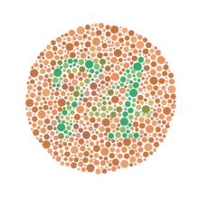
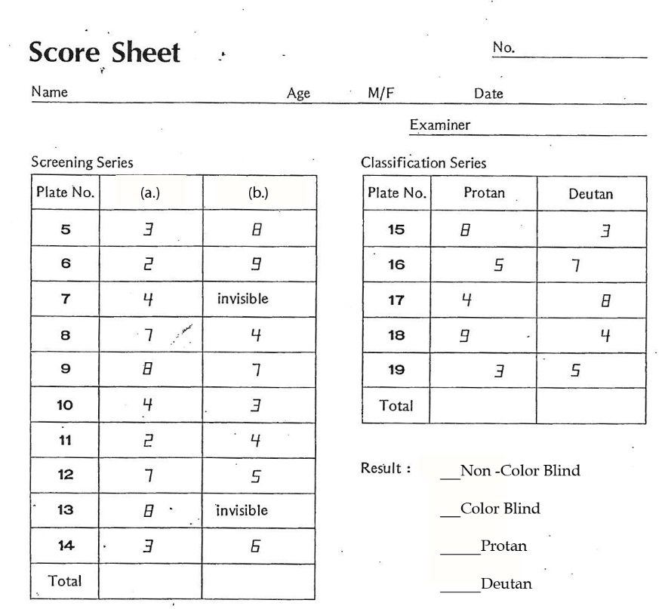
Color Blindness – experiment
Class Activity – pg.95
  Pull out Score Sheets
  I will walk around room slowly holding book of “plates” one at a time (#5-19)
    View approx. 10 sec and >10ft from eyes
    Students: circle what number(s) you see
  Total Columns
    Non-colorblind > 8
    Color Blind < 8
      Protan – sensitive to reds
      Deutan – sensitive to greens

Slide 28
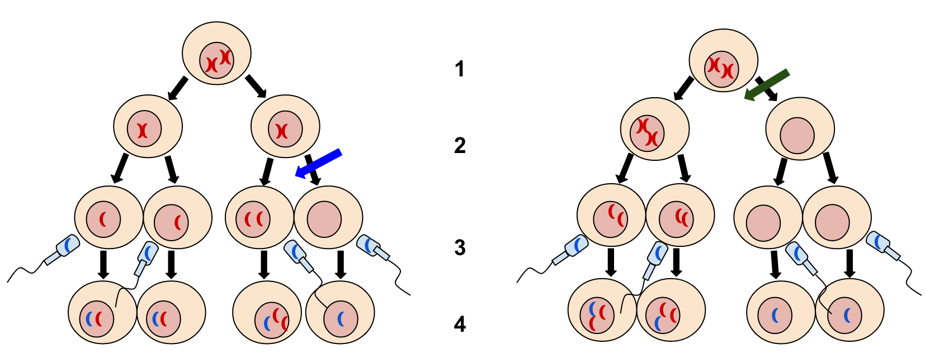
Chromosomal Abnormalities resulting from non-disjunction during Meiosis
Meiosis II
Meiosis I
By Tweety207 - Own work, CC BY-SA 3.0,
https://commons.wikimedia.org/w/index.php?curid=26233546
Non-disjunction in Meiosis II – 50% chance gametes may be unaffected
Non-disjunction in Meiosis I – ALL gametes affected

Slide 29
Abnormalities from non-disjunction
Autosomal
    Down Syndrome (Trisomy 21)
      intellectual disability, weak muscle tone (hypotonia) in infancy, cognitive delays
Sex linked
    Turner Syndrome – 45, XO
        Female missing one X = Never reaches puberty
    Poly-X Syndrome - 47, XXX
        Female – taller, Tend to have learning disabilities
    Klinefelter Syndrome – 47, XXY
        Male - Testes underdeveloped, long limbs, poor muscle growth
    Jacob Syndrome – 47, XYY
        Male - Taller, speech and reading problems

Slide 30
Pedigrees
Method that allows tracking of a genetic disorder within a family
  Circles – Females
  Squares – Males
  Affected individuals – filled in
  Carriers – half filled in (sometimes…)

Slide 31
Pedigrees Example
bb
BB
 | B | B
b | Bb | Bb
b | Bb | Bb
Bb
Bb
Bb
Bb
A new type of representation of our Punnett Square, but now we can trace traits through generations!

Slide 32
Pedigrees Examples how to draw a pedigree
John’s parents are one
generation level up.
They are connect to their
children.
John’s sister is on the
same generation level
and has the same
parents.
John’s sister is on the
same generation level
and has the same
parents.
John is male = square
Bill next generation
connected to John and
Anna
Anna = same generation
level as John and
connected but not to
John’s siblings.
  John does not show disease.
  His sister Jill does not show disease either.
  His sister Mary shows disease.
  His mother shows disease while his father does not.
  John is married to Anna who does not show disease.
  John and Anna have a child (Bill) who shows disease.

Slide 33
Pedigrees Examples how to draw a pedigree
 | C | c
c | Cc | cc
c | Cc | cc
cc
Cc
Cc
Cc
cc
cc
Cc
Cc
cc
cc
Cc
 | c | c
C | Cc | Cc
c | cc | cc

Slide 34
Pedigrees Example
bb
BB
 | B | B
b | Bb | Bb
b | Bb | Bb
Bb
Bb
Bb
Bb
Super recessive Mary & Super Dominate Jim have 4 normal heterozygous children, 50% being a girl or a boy, but all possessing one dominate allele and one recessive allele.
Let’s say “B” represents dominance of how the kids look.
They all look like Jim – he’s proud … but poor Mary, her kids will never express her recessive-recessive traits.

Slide 35
Pedigrees Example
bb
BB
Heterozygous normal Bill has kids with heterozygous normal Sally (kid of Mary/Jim)
Bb
Bb
Bb
Bb
Bb
BB
Bb
Bb
bb
Sally pops some kids out and one of her grandkids looks just like Mary! So how is that possible if Sally looks like her dad and married Bill who also looks like her dad?
 | B | b
B | BB | Bb
b | Bb | bb
All Jim/Mary’s kids carried one recessive allele – and Bill supplied the other.

Slide 36
Autosomal Dominant – B = disease
BB
Bb
Both Affected parents; one or both Homozygous
Both Affected Heterozygous parents
BB
BB
Bb
Bb
Bb
BB
Bb
bb
bb
Bb
Patterns of inheritance | Pedigrees shows Carriers | Pedigrees without showing Carriers
Autosomal Dominant –both affected parents | Impossible to be a carrier. | If both parents are affected and one parent is homozygous (regardless of which), all children will be affected. If at least one child shows no disease (“bb”), neither parent can be homozygous dominant (“BB”).

Slide 37
Autosomal Dominant – B = disease
Bb
bb
Affected Female w/ Unaffected Male
Unaffected Female w/ Affected Male
Bb
Bb
bb
bb
Bb
Bb
bb
bb
Bb
Patterns of inheritance | Pedigrees shows Carriers | Pedigrees without showing Carriers
Autosomal Dominant – one heterozygous parent affected | Impossible to be a carrier. | If at least one child shows no disease (“bb”), neither parent can be homozygous dominant (“BB”).

Slide 38
Autosomal Dominant – B = disease
bb
BB
Homozygous parents: Unaffected Female w/ Affected Male
Heterozygous parents: Affected Female w/ Unaffected Male
Bb
Bb
Bb
Bb
Bb
BB
Bb
bb
Bb
Patterns of inheritance | Pedigrees shows Carriers | Pedigrees without showing Carriers
Autosomal Dominant– one homozygous parent affected | Impossible to be a carrier. | If one homozygous parent “BB” is affected, all children will be affected. If at least one child shows no disease (“bb”), than neither parent can be homozygous dominant (“BB”).

Slide 39
Autosomal Recessive – bb = Disease
bb
BB
Female Affected w/ Male Unaffected
Bb
Bb
Bb
Bb
Bb
Bb
Bb
Bb
bb
Bb
BB
Bb
Patterns of inheritance | Pedigrees shows Carriers | Pedigrees without showing Carriers
Autosomal Recessive | If one parent is “BB” (regarless other parent affected “bb” or carrying “Bb”parent) => No child can be showing the disease “bb” | Can skip a generation.

Slide 40
X-linked Recessive - X^{b}X^{b +} X^{B}Y
bb
Y
B
Female Affected w/ Male Unaffected
X^{b}X^{b}
X^{B}Y
b
Y
Y
Bb
b
Bb
Bb
Y
B
Y
Y
b
BB
Bb
B
Bb
Patterns of inheritance | Pedigrees shows Carriers | Pedigrees without showing Carriers
X-linked recessive – dad not affected | No male can be a carrier.* | All sons of an affected mother (X^{b}X^{b}) will also show disease (X^{b}Y).

Slide 41
X-linked Recessive - X^{b}X^{b +} X^{b}Y
bb
Y
b
Both parents Affected
X^{b}X^{b}
X^{b}Y
Y
b
Y
bb
b
Bb
bb
Y
B
Y
Y
b
b
Bb
Bb
Bb
Bb
Bb
Patterns of inheritance | Pedigrees shows Carriers | Pedigrees without showing Carriers
X-linked recessive – Both parents affected | No male can be a carrier but females can second generation. | All sons of an affected mother (X^{b}X^{b}) will also show disease (X^{b}Y).

Slide 42
X-linked Dominant - X^{B}X^{B} + X^{B}Y
BB
Y
Homozygous Female Affected w/ Male Affected
B
X^{B}X^{B}
X^{B}Y
BY
BB
BY
BB
Patterns of inheritance | Pedigrees shows Carriers | Pedigrees without showing Carriers
X-linked dominant – Mom Homozygous | Impossible to be a carrier. | All children of an affected homozygous mother (X^{B}X^{B}) will also show disease (X^{B}Y), (X^{B}X^{B})

Slide 43
X-linked Dominant - X^{B}X^{b} + X^{B}Y
Bb
Y
Dad is Dominant
B
X^{B}X^{b}
X^{B}Y
BY
BB
bY
Bb
bY
Dad is recessive
BY
BY
bb
Bb
Patterns of inheritance | Pedigrees shows Carriers | Pedigrees without showing Carriers
X-linked dominant – Mom Heterozygous | Impossible to be a carrier. | Heterozygous affected mother has ¼ chance a child will not be affected due to the Y chromosome lacking trait. (If dad is dominate, chance 1 son unaffected; if dad is recessive, chance 1 daughter unaffected.)

Slide 44
X-linked Dominant - X^{B}X^{B} + X^{b}Y
BB
bY
Female Affected w/ Male Unaffected
X^{B}X^{B}
X^{b}Y
Y
Y
B
B
Bb
Bb
Y
b
Y
Y
B
B
bb
Bb
Patterns of inheritance | Pedigrees shows Carriers | Pedigrees without showing Carriers
X-linked dominant | Impossible to be a carrier. | All children of an affected homozygous mother (X^{B}X^{B}) will also show disease either (X^{B}Y), (X^{B}X^{B}), or (X^{B}X^{b}). Heterozygous affected mother with heterozygous father has ¼ chance a child will not be affected.

Slide 45
Find inheritance from pedigrees
Patterns of inheritance | Pedigrees shows Carriers | Pedigrees without showing Carriers
Autosomal Dominant | Impossible to be a carrier. | If at least one child shows no disease (“bb”), neither parent can be homozygous dominant (“BB”)
Autosomal Recessive | One parent carrier (“Bb”) other parent homozygous dominant (“BB”) => No child can be showing the disease (“bb”) | Can skip a generation.
X-linked recessive | No male can be a carrier. | All sons of an affected mother (X^{b}X^{b}) will also show disease (X^{b}Y).
X-linked dominant | Impossible to be a carrier. | All children of an affected mother (X^{B}X^{B}) will also show disease either (X^{B}Y), (X^{B}X^{B}), or (X^{B}X^{b}).

Slide 46
Find inheritance from pedigrees
Patterns of inheritance | Pedigrees shows Carriers | Pedigrees without showing Carriers
Autosomal Dominant | Impossible to be a carrier. | If at least one child shows no disease (“bb”), neither parent can be homozygous dominant (“BB”)
Autosomal Recessive | One parent carrier (“Bb”) other parent homozygous dominant (“BB”) => No child can be showing the disease (“bb”) | Can skip a generation.
X-linked recessive | No male can be a carrier. | All sons of an affected mother (X^{b}X^{b}) will also show disease (X^{b}Y).
X-linked dominant | Impossible to be a carrier. | All children of an affected mother (X^{B}X^{B}) will also show disease either (X^{B}Y), (X^{B}X^{B}), or (X^{B}X^{b}).
If Carriers Present, can’t be Dominant
If Male Carriers are seen, can’t be X-linked
If Carriers Present, can’t be Dominant

Slide 47
What is the Inheritance Pattern?
Autosomal Dominant
Autosomal Recessive
X-linked Dominant
X-linked Recessive
Step 1: We see carriers which means this inheritance pattern cannot be dominate

Slide 48
What is the Inheritance Pattern?
Autosomal Recessive
X-linked Recessive
Step 2: We see MALE carriers which means this inheritance pattern cannot be X-linked

Slide 49
What is the Inheritance Pattern?
Autosomal Recessive

Slide 50
What is the Inheritance Pattern?
Autosomal Dominant
Autosomal Recessive
X-linked Dominant
X-linked Recessive

Slide 51
What is the Inheritance Pattern?
Autosomal Dominant
Autosomal Recessive
X-linked Dominant
X-linked Recessive
Step 1: We see carriers which means this inheritance pattern cannot be dominate
We don’t see any Male carriers, so we can’t eliminate X-linked recessive yet

Slide 52
What is the Inheritance Pattern?
x^{B}x^{b}
x^{B}y
Autosomal Recessive
X-linked Recessive
x^{B}x^{B}
BB
x^{B}x^{B}
x^{B}x^{b}
?
x^{B}y
x^{b}y
bb
?
x^{b}y
x^{b}y
x^{B}y
  Step 2: Assume a pattern, Say Autosomal Recessive…What would this genotype have to be?
  And His father, what would his genotype have to be? *hint he isn’t a carrier*
  Impossible for a father to be BB and son to be bb…soooo….
  This is X-linked recessive.

Slide 53
Today’s Lab
Review Autosomal Human Traits we did as class pg. 94
Review Color Blindness we did as class pg. 95
Work on “To Do” & Genetics Pedigree problems pgs. 98 – 104 (answers are in back of lab book)
“To Do” Karyotyping Babies pgs. 108-109 - set up your own baby, then walk around and identify all others
    Answer questions pg. 110-112 at home

