Slide 1
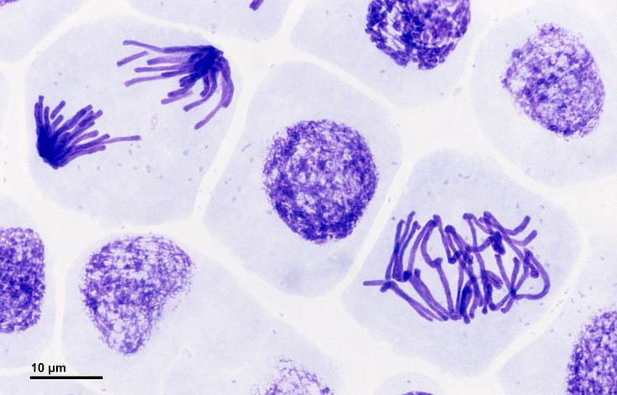
Mitosis & Meiosis in Eukaryotes
Exercise 8, pgs. 93-106
BSC2010L

Slide 2
Mitosis & Meiosis Exercise 8, pg. 93-106
Lab Objectives:
- Understand why cell division is necessary
- Understand the cell cycle
- Identify the stages Mitosis & Meiosis
- Understand the difference between mitosis & meiosis
- Describe Ploidy: diploid (2n) & haploid (1n)

Slide 3
Why do cells divide?
Growth and Repair
Produces 2 identical cells / same # chromosomes
ex: growing taller, healing injury
Mitosis
Reproduction
Produces 4 cells with ½ the genetic material / ½ the # of chromosomes
ex: sperm and egg cells
Meiosis

Slide 4
Chromosomes – “Instruction manuals”
http://images.slideplayer.com/26/8770399/slides/slide_5.jpg

Slide 5
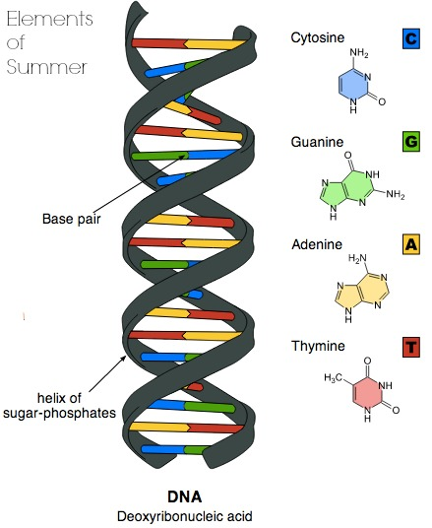
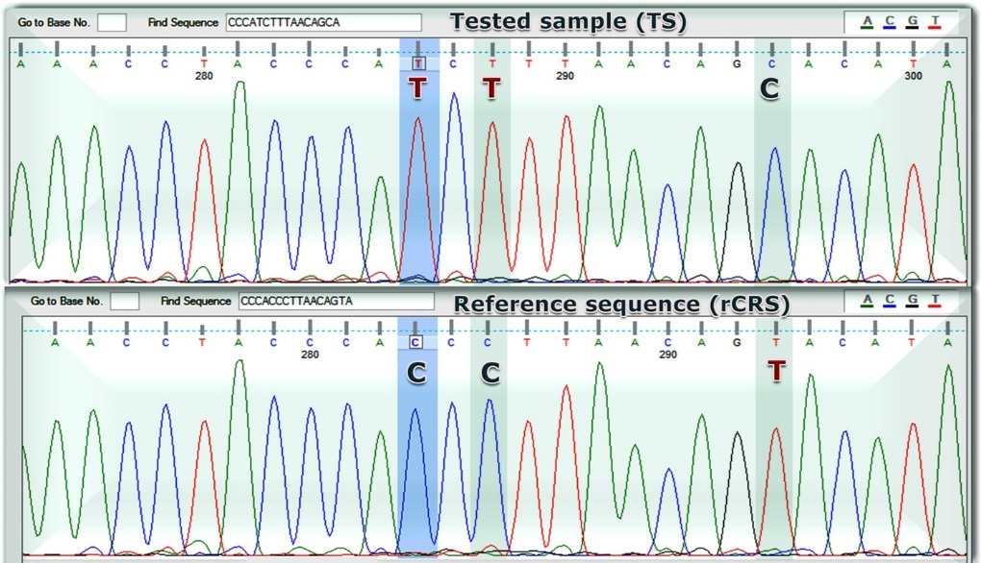
DNA
Deoxyribonucleic Acid - macromolecule essential for all known forms of life
Made of a sugar & phosphate backbone (spiral part) and nitrogenous bases (C,G,A,T)
http://gene-factory.com/attachments/Image/mtDNAtest-sequence%3D20analysis-red.jpg?template=generic
Gene : codes for function
DNA/cell - 3 billion base pairs or 20,000 genes
https://s-media-cache-ak0.pinimg.com/originals/3b/aa/e2/3baae24f25e680448a7d8196e401ecbe.jpg

Slide 6
Chromosomes – “Instruction manuals”
Chromosomes not involved in replicating are unassembled inside the nuclear envelope.
http://images.slideplayer.com/26/8770399/slides/slide_5.jpg

Slide 7
Chromosomes – “Instruction manuals”
Chromosomes not involved in replicating are unassembled inside the nuclear envelope.
Once the cell gets the signal to start cell division, then each chromosome is copied.
http://images.slideplayer.com/26/8770399/slides/slide_5.jpg

Slide 8
Chromosomes – “Instruction manuals”
Chromosomes not involved in replicating are unassembled inside the nuclear envelope.
Once the cell gets the signal to start cell division, then each chromosome is copied.
http://images.slideplayer.com/26/8770399/slides/slide_5.jpg

Slide 9
Chromosomes – “Instruction manuals”
Once a chromosome is copied (DNA replication), it is now called a “chromatid” and is held together with a centromere. Both chromatids bound by the centromere are now collectively called “sister chromatids” and have identical “instructions” or DNA.
http://images.slideplayer.com/26/8770399/slides/slide_5.jpg

Slide 10
Chromosomes – “Instruction manuals”
During Anaphase in cell division, the centromere is broken and the two sister chromatids now separate
http://images.slideplayer.com/26/8770399/slides/slide_5.jpg

Slide 11
Chromosomes – “Instruction manuals”
During Anaphase in cell division, the centromere is broken and the two sister chromatids now separate and one cell is now two duplicates, each with one of the exact same chromosome/instructions as the original parent cell.
http://images.slideplayer.com/26/8770399/slides/slide_5.jpg

Slide 12
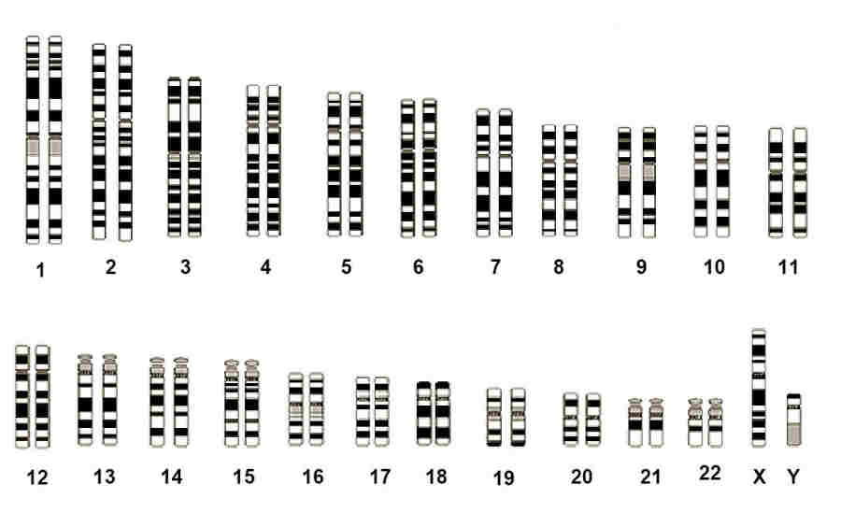
Chromosomes
Humans have 46 chromosomes, 23 homologous* pairs
http://images.slideplayer.com/26/8770399/slides/slide_5.jpg

Slide 13
Chromosomes
Humans have 46 chromosomes, 23 homologous pairs
http://www.chromosomewalk.ch/en/list-of-chromosomes/
http://www.karakalpak.com/images/genetic08.jpg

Slide 14
Chromosomes
Humans have 46 chromosomes, 23 homologous pairs homologous = the same structural features and pattern of genes.
http://www.karakalpak.com/images/genetic08.jpg

Slide 15
Chromosomes
Humans have 46 chromosomes, 23 homologous pairs homologous = the same structural features and pattern of genes.
Homologous Chromosomes

Slide 16
Chromosomes
Humans have 46 chromosomes, 23 homologous pairs homologous = the same structural features and pattern of genes.
This specific genes sequence (allele) encodes blue eyes
This allele (at the same location) is slightly different and encodes green eyes
Same Locus
(same location)
Homologous Chromosomes
Locus = Specific Gene = Codes for same thing

Slide 17
Eukaryotic Cell Cycle
2 main phases
Mitosis combined with cytokinesis (called M-phase)
Interphase
Long period between cell division
Some cells stay in interphase indefinitely
G₁
G₂
S
Mitosis
Cytokinesis

Slide 18
The Cell Cycle (pg.64)
Cytokinesis: completion of cell division; cleavage
G₁: cell gets signal to divide; rapid growth and metabolic activity
---- M-Phase -----
------- Interphase ------------
G₁
G₂
S
Mitosis
Cytokinesis
S: DNA replicates; chromosome replication
Mitosis: Prophase
Metaphase
Anaphase
Telophase
G₂: prep for division; chromosomes coil more tightly

Slide 19
Mitosis
Prophase
Metaphase
Anaphase
Telophase
By LadyofHats - Own work, Public Domain, https://commons.wikimedia.org/w/index.php?curid=4757631
Cytokinesis
pg. 65
pg.66
pg.67
pg.68
Chromosomes condense
Nuclear membrane breaks down
Chromatids line up via spindle fibers
Spindle fibers pull chromatids to opposite pole
Dup of other organelles; nucular membrane(s) reform
Cell Cleavage – cytoplasm dividing
Result: two daughter cells (each 2n)
Mitosis (5:42) – https://www.youtube.com/watch?v=ofjyw7ARP1c
Mitosis (4:31) – https://www.youtube.com/watch?v=nPG6480RQo0

Slide 20
Mitosis
Prophase
Metaphase
Anaphase
Telophase
By LadyofHats - Own work, Public Domain, https://commons.wikimedia.org/w/index.php?curid=4757631
Cytokinesis
pg. 65
pg.66
pg.67
pg.68
Chromosomes condense
Nuclear membrane breaks down
Chromatids line up via spindle fibers
Spindle fibers pull chromatids to opposite pole
Dup of other organelles; nucular membrane(s) reform
Cell Cleavage – cytoplasm dividing
Interphase
Prophase

Slide 21
Mitosis
Prophase
Metaphase
Anaphase
Telophase
By LadyofHats - Own work, Public Domain, https://commons.wikimedia.org/w/index.php?curid=4757631
Cytokinesis
pg. 65
pg.66
pg.67
pg.68
Chromosomes condense
Nuclear membrane breaks down
Chromatids line up via spindle fibers
Spindle fibers pull chromatids to opposite pole
Dup of other organelles; nucular membrane(s) reform
Cell Cleavage – cytoplasm dividing
Prophase
Metaphase

Slide 22
Mitosis
Prophase
Metaphase
Anaphase
Telophase
By LadyofHats - Own work, Public Domain, https://commons.wikimedia.org/w/index.php?curid=4757631
Cytokinesis
pg. 65
pg.66
pg.67
pg.68
Chromosomes condense
Nuclear membrane breaks down
Chromatids line up via spindle fibers
Spindle fibers pull chromatids to opposite pole
Dup of other organelles; nucular membrane(s) reform
Cell Cleavage – cytoplasm dividing
Metaphase
Anaphase

Slide 23
Mitosis
Prophase
Metaphase
Anaphase
Telophase
By LadyofHats - Own work, Public Domain, https://commons.wikimedia.org/w/index.php?curid=4757631
Cytokinesis
pg. 65
pg.66
pg.67
pg.68
Chromosomes condense
Nuclear membrane breaks down
Chromatids line up via spindle fibers
Spindle fibers pull chromatids to opposite pole
Dup of other organelles; nucular membrane(s) reform
Cell Cleavage – cytoplasm dividing
Anaphase
Telophase

Slide 24
Mitosis
Prophase
Metaphase
Anaphase
Telophase
Cytokinesis
pg. 65
pg.66
pg.67
pg.68
Chromosomes condense
Nuclear membrane breaks down
Chromatids line up via spindle fibers
Spindle fibers pull chromatids to opposite pole
Dup of other organelles; nucular membrane(s) reform
Cell Cleavage – cytoplasm dividing
Cytokinesis
Telophase

Slide 25
Microscope Use Refresher!
Use Nosepiece and set to Scanning Objective (4x Red color band)
Place slide on stage
Use coarse adjustment knob to raise stage all the way up.
Focus (both: fine and coarse adjustment knobs) and center
Use Nosepiece and set to Low-power objective (10x Yellow color band)
Focus (only fine adjustment knob)
Use Nosepiece and set to Low-power objective (40x Blue color band)
Focus (only fine adjustment knob)
Rotate Nosepiece “backwards” (not THROUGH OIL lense!!) and set to Scanning Objective (4x Red color band)
Now, you can lower the stage

Slide 26
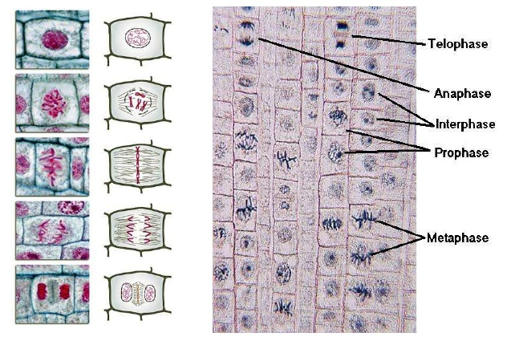
Onion Root Tip – Mitosis
Slide # 5
Interphase
Prophase
Metaphase
Anaphase
Telophase

Slide 27
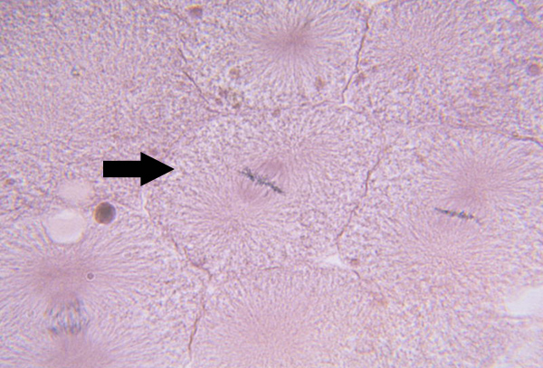
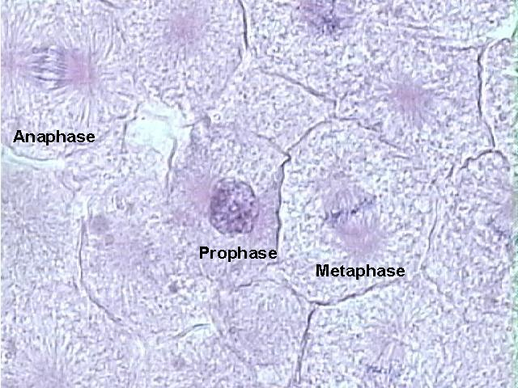
Whitefish blastula – Mitosis Slide # 8
Metaphase
By the University of South Carolina, Aiken http://sciences.usca.edu/biology/zelmer/122/celldivision/mitosis/wfanaphase.jpg
Anaphase

Slide 28
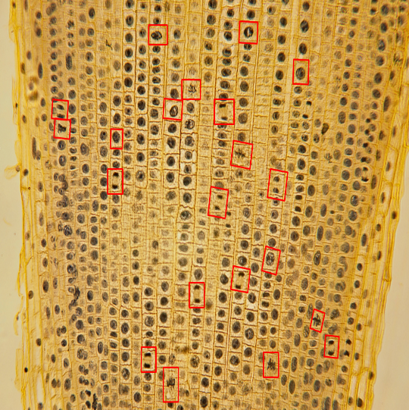
Mitosis Slides – may need to scan multiple cross-sections to find all phases
# 5
40X
Focus at Root Tip
# 8
40X

Slide 29
Mitosis Models – on side bench
P
A
Mitosis: Prophase
Metaphase
Anaphase
Telophase
M
T

Slide 30
Meiosis
haploid (1n) sperm
haploid (1n) ovum
23
23
46
diploid (2n) zygote

Slide 31
Meiosis
During S-phase, each of the 46 human chromosomes is duplicated.
You look JUST like me!
Let’s say this is chromosome #7 from dad.
Each duplicated chromosome is bound together with its identical original as sister chromatids.

Slide 32
Meiosis
Meanwhile, same process is happening for the other chromatid #7
Uhhhgg, what a copy cat.
Let’s say this is chromosome #7 from mom.
Each duplicated chromosome is bound together with its identical original as sister chromatids.

Slide 33
Meiosis
We gotta find those #7 twins that were sister’s … where are they??!?
Heyyooo, the PARTAY is here!!!
At the beginning of Meiosis I, duplicated homologous pairs find each other
Together they form tetrads (so “four” #7 chromatids)
They meet and “crossing over” occurs – literately they swap genes*

Slide 34
Meiosis
After crossing over has occurred, each of the 4 chromatids that encode the same information is now different from each other; after two rounds of cell division in meiosis, each egg cell or sperm cell will have a different chromosome #7.

Slide 35
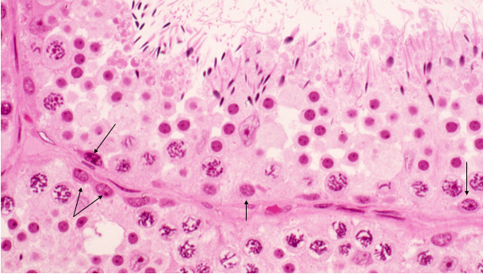
Gametogenesis in Animals (pg. 72)
Spermatogenesis (Example of a species with two pairs of homologous chromosomes)
spermatocyte
2n
Primary spermatocyte (after S-phase)
Produces four sperm cells per primary spermatocyte
2n (4c)
Secondary spermatocyte
1n (2c)
Spermatid
1n
Spermatozoa
(Sperm)
1n

Slide 36
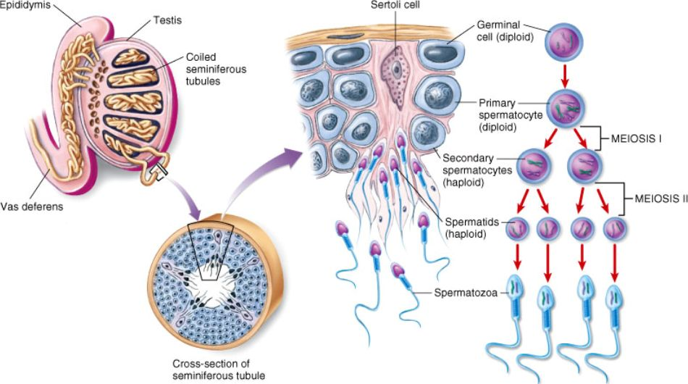
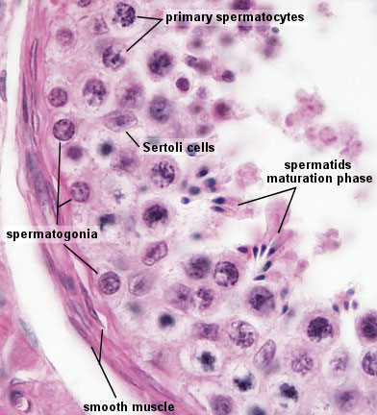
Gametogenesis in Animals (pg. 72)
Spermatogenesis – Slide # 14

Slide 37
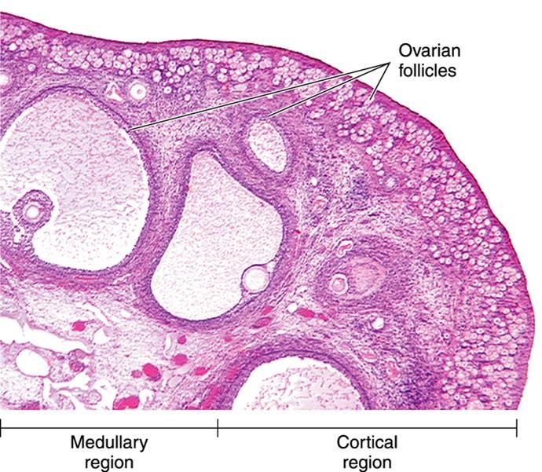
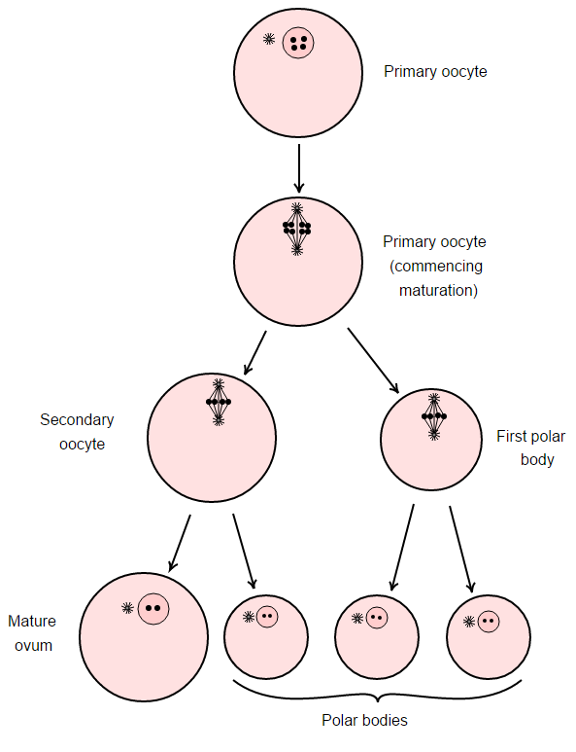
Gametogenesis in Animals (pg. 72)
Oogenesis
Produces just one viable egg per primary oocyte
- Remaining polar bodies don’t have enough cytoplasm or stored nutrients to feed a developing embryo
By Henry Vandyke Carter - The original can be viewed here: Gray5.png. Modifications made by Mysid., Public Domain, https://commons.wikimedia.org/w/index.php?curid=1415394

Slide 38
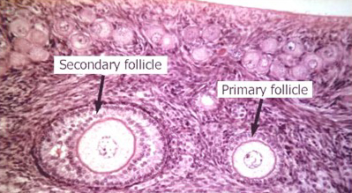
Gametogenesis in Animals (pg. 72)
Oogenesis – Sldie # 31
secondary - 1N
primary - 2N

Slide 39
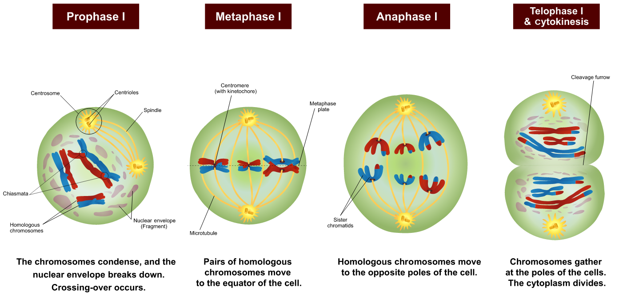
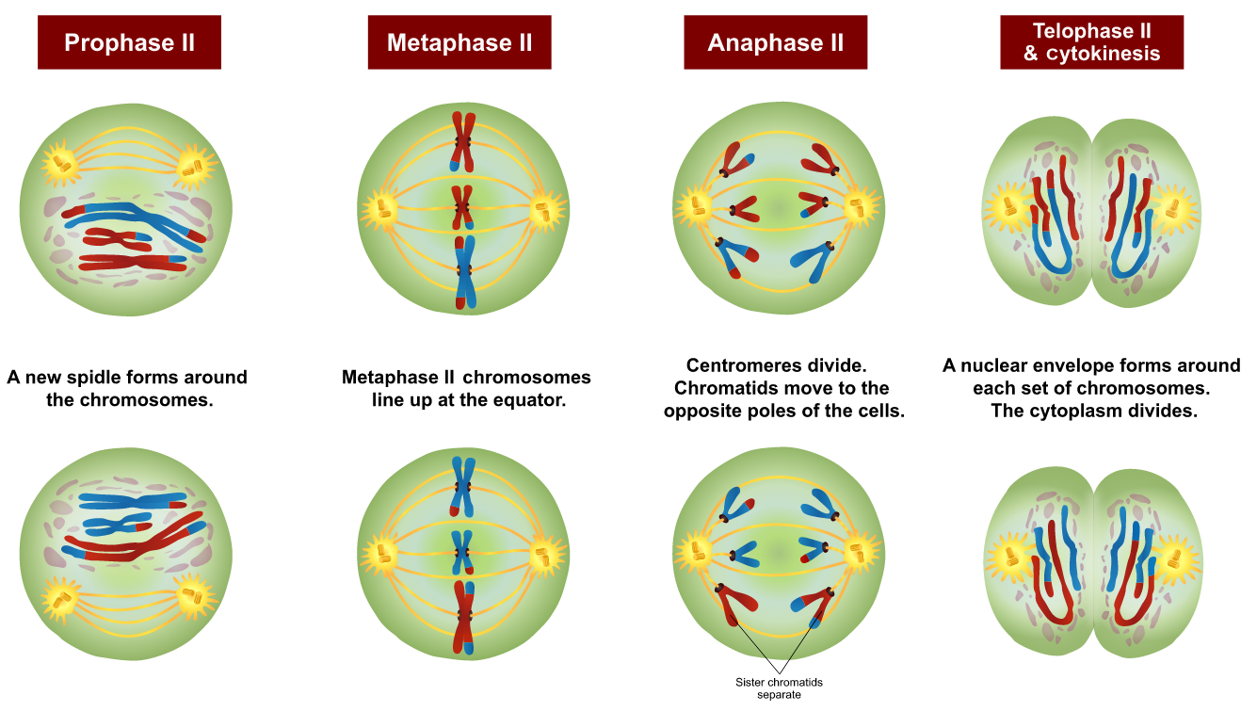
Meiosis (pg. 69-71)
By Ali Zifan - Own work; Used information from Campbell Biology (10th Edition) by: Jane B. Reece & Steven A. Wasserman., CC BY-SA 4.0, https://commons.wikimedia.org/w/index.php?curid=49630204
Result: four haploid cells (each 1n)
Meiosis (1:10) – https://www.youtube.com/watch?v=nMEyeKQClqI
Meiosis (2:58) – https://www.youtube.com/watch?v=BVO-Ram1L2M

Slide 40
Meiosis I (pg. 71)
By Ali Zifan - Own work; Used information from Campbell Biology (10th Edition) by: Jane B. Reece & Steven A. Wasserman., CC BY-SA 4.0, https://commons.wikimedia.org/w/index.php?curid=49630204
spindle

Slide 41
Meiosis II (pg. 71)
By Ali Zifan - Own work; Used information from Campbell Biology (10th Edition) by: Jane B. Reece & Steven A. Wasserman., CC BY-SA 4.0, https://commons.wikimedia.org/w/index.php?curid=49630204
spindle

Slide 42
Meiosis Models
Anaphase I
Anaphase II
Meiosis: Prophase I
Metaphase I Anaphase I
Telophase I
Prophase II
Metaphase II
Anaphase II
Telophase II
Spermatogenesis
Cytokinesis
Oogenesis
Cytokinesis

Slide 43
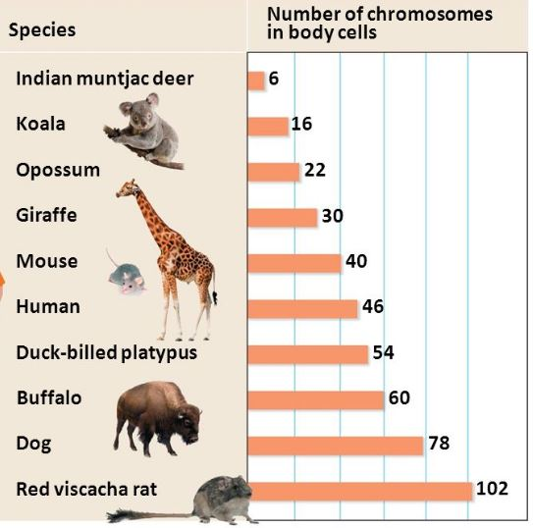
Ploidy
# of sets of chromosomes in a cell
Diploid (2n) – two sets
Almost all cells
Haploid (n) – one set
Egg and sperm
Example, in humans:
Diploid # = 46
Haploid # = 23
Chromosome # vary per species!!!!!!

Slide 44
Diploid vs. Haploid
Mitosis
1 round of duplication
1 round of cell division
Meiosis
1 round of duplication
2 rounds of cell division
46
(2n)
46
(2n)
S-phase
92
S-phase
Meiosis I
92
46
46
Mitosis
Meiosis II
23
(n)
23
(n)
23
(n)
23
(n)
46
(2n)
46
(2n)

Slide 45
Diploid vs. Haploid
Mitosis
1 round of duplication
1 round of cell division
Meiosis
1 round of duplication
2 rounds of cell division
46
(2n)
46
(2n)
S-phase
92
S-phase
Meiosis I
92
46
46
Mitosis
Meiosis II
23
(n)
23
(n)
23
(n)
23
(n)
46
(2n)
46
(2n)

Slide 46
Diploid vs. Haploid
Mitosis
1 round of duplication
1 round of cell division
Meiosis
1 round of duplication
2 rounds of cell division
22
(2n)
18
(2n)
S-phase
44
S-phase
Meiosis I
36
22
22
Mitosis
Meiosis II
11
(n)
11
(n)
11
(n)
11
(n)
18
(2n)
18
(2n)

Slide 47
Nondisjunction (pg. 72)
By Tweety207 - Own work, CC BY-SA 3.0, https://commons.wikimedia.org/w/index.php?curid=26233546
Nondisjunction during Meiosis 1
Nondisjunction during Meiosis 2

Slide 48
Differences between Mitosis & Meiosis (In Written Table Format*)
 | Mitosis | Meiosis
After S-Phase | 1 (one) division | 2 (two) divisions
Results in | 2 (two) identical diploid (2n) cells | 4 (four) haploid (1n) cells (in oogenesis one viable ovum + 3 polar bodies)
Genetic difference | None – identical | Homologous chromosomes crossing over occurs during Meiosis I Random assortment of homologous pairs. Zygote gets a complete new set of homologous chromosomes
Function | Growth and Repair | Reproduction

Slide 49
Activities for today:
“ToDo” pg 97-99 – Practice viewing Slides #5, #8
“ToDo” pg 104 – Complete rounds of duplication for both Mitosis and Meiosis
Answer these “Before you go” questions pg 105-106:
“What are sister chromatids?” * exact copies –> S-phase
“What are homologous chromosomes?” *similar (mom/dad)
Prepare for Ex. 9 – Mendelian Genetics next week
Use Nosepiece and set to Scanning Objective (4x Red color band)
Place slide on stage
Use coarse adjustment knob to raise stage all the way up.
Focus (both: fine and coarse adjustment knobs) and center
Use Nosepiece and set to Low-power objective (10x Yellow color band)
Focus (only fine adjustment knob)
Use Nosepiece and set to Low-power objective (40x Blue color band)
Focus (only fine adjustment knob)
Rotate Nosepiece “backwards” (not THROUGH OIL lense!!) and set to Scanning Objective (4x Red color band)
Now, you can lower the stage

