Slide 1
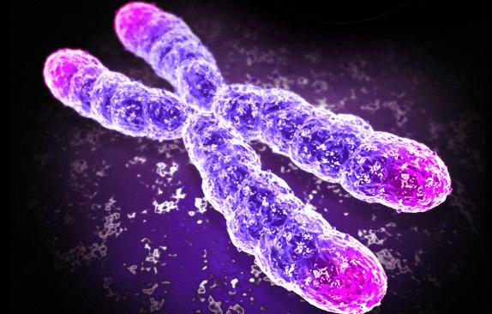

Mendelian Genetics
Exercise 8, pg.77-88
BSC2010L

Slide 2
Withdrawal Date = Mon., Oct 26th
It is YOUR responsibility to assess your grade (always available via Blackboard) in this course at this time to determine your academic standing.
In most cases, a “W” won’t count against your overall GPA, but it will show on your transcript that you attempted the class but withdrew for any number of reasons. You will need to repay to fully retake the course.
If you have two low test scores, you need to talk with your TLS/Adjunct about the probability of your success in passing the course. If you fail to notify AND discuss this with your instructor (which he or she will document), you will NOT be considered a candidate for an Instructor Withdrawal or Incomplete if any situation arises come the final, thus the grade you have earned will be what is reported on your transcript… NO EXCEPTIONS!
There is NO Make-up Final, so make absolutely sure you will be present and ON TIME to class the week of April 16th!!!

Slide 3
Mendelian Genetics Exercise 8, pg.77-88
Lab Objectives:
- Understand Mendel’s Laws
- Explain/Predict Monohybrid Cross results
- Explain/Predict Dihybrid Cross results
- Support/Reject Hypothesis based of Chi-Square stat test

Slide 4
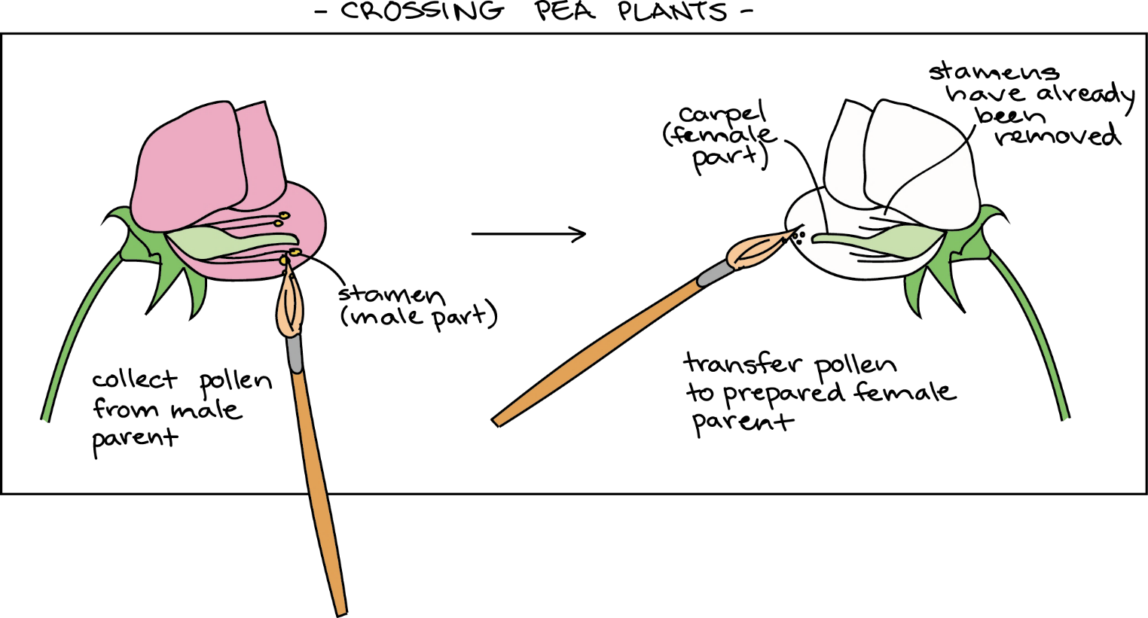
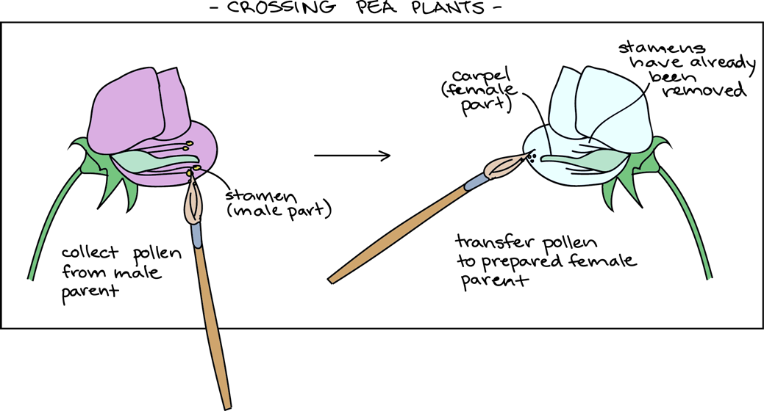
G. J. Mendel
1865/1900’s - monk hybridized pea plants in his garden

Slide 5
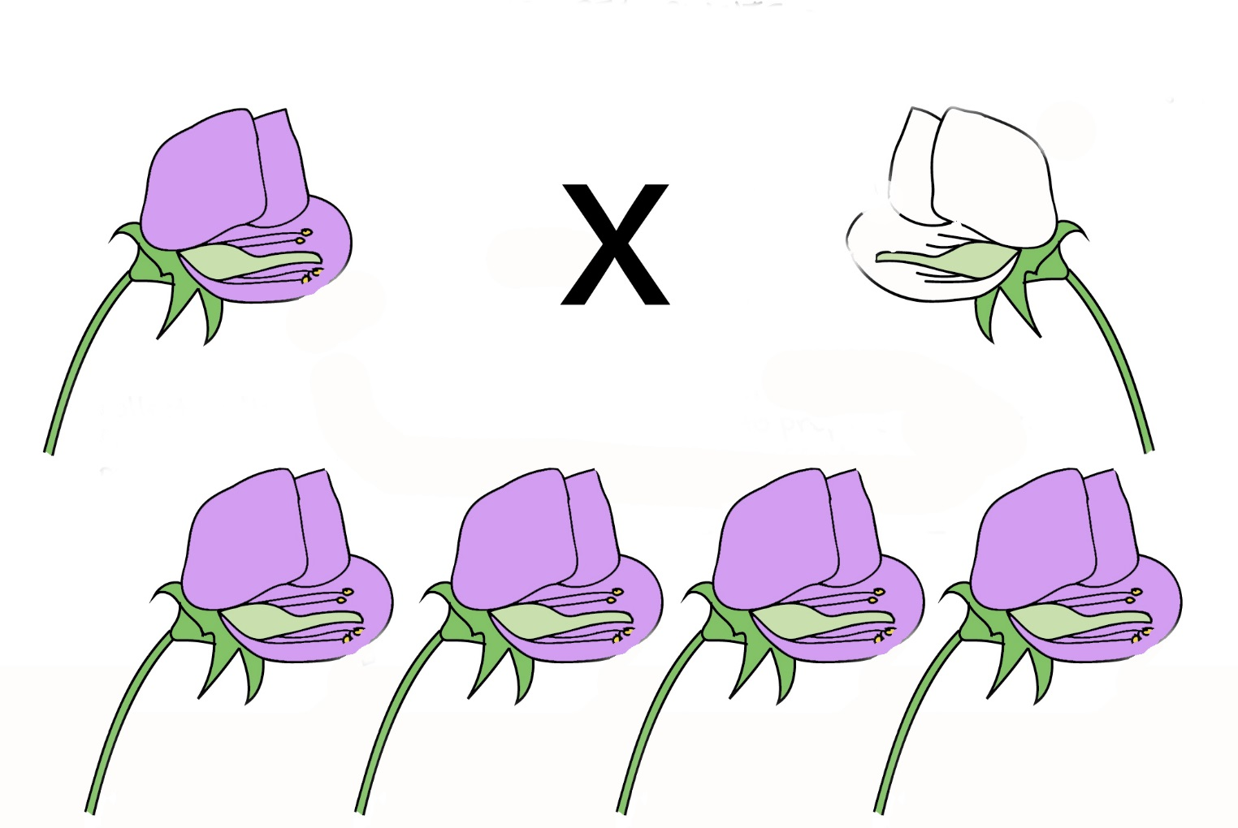
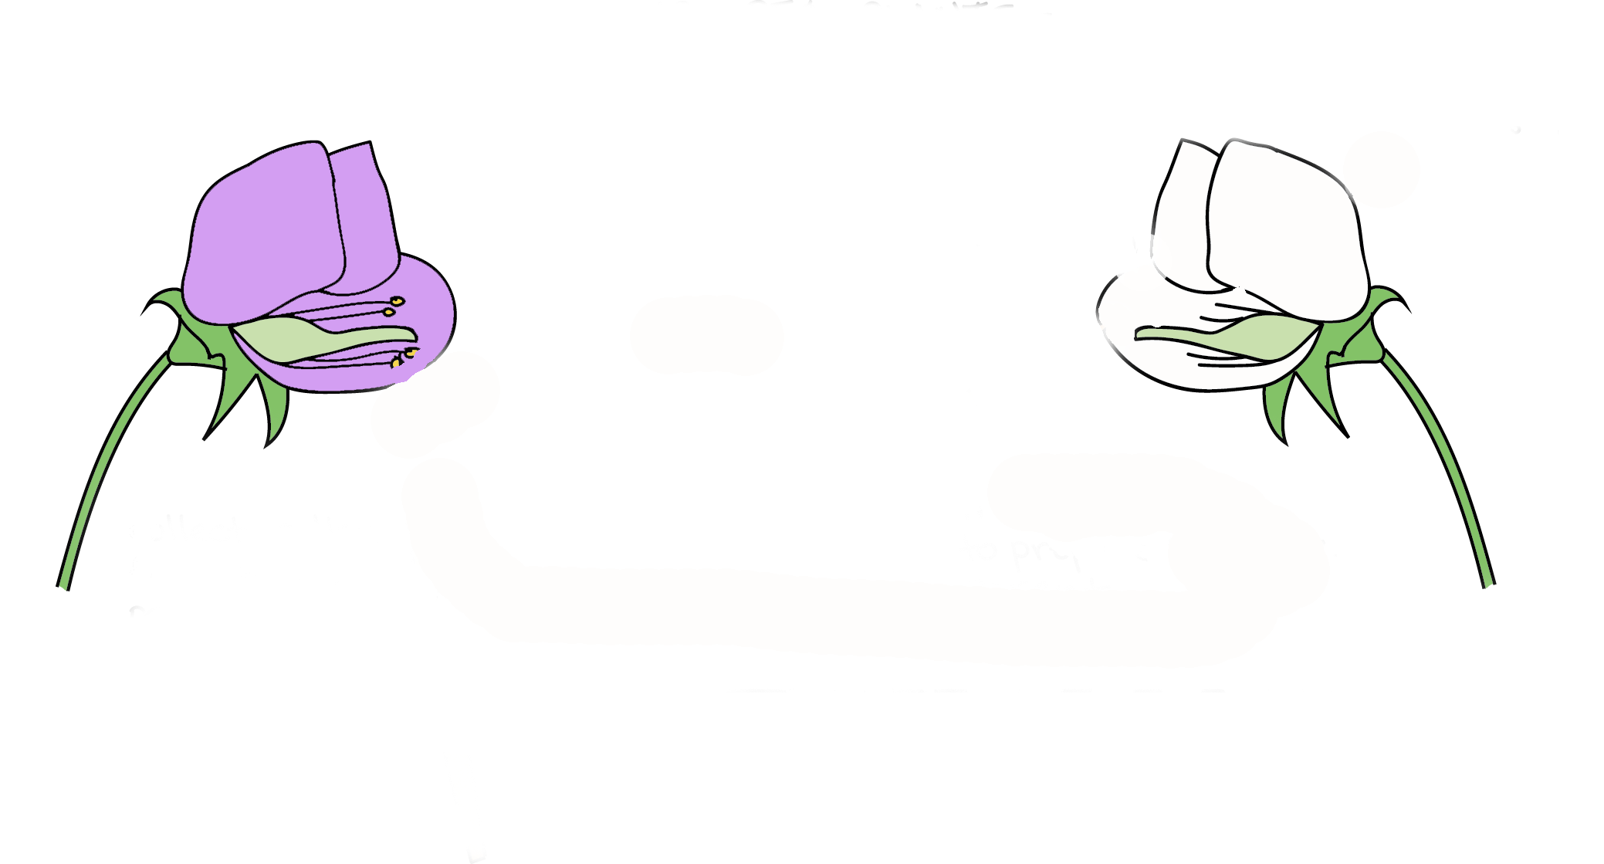
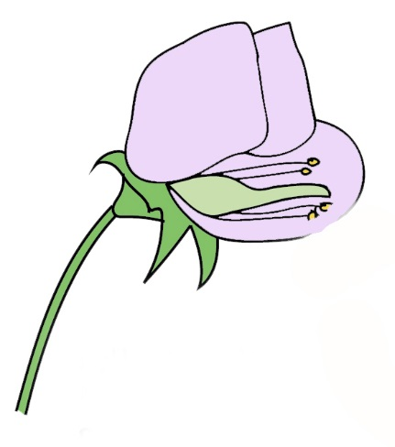
G. J. Mendel
1865/1900’s - monk hybridized pea plants in his garden
  When he crossed purebred white flowers with purebred purple flowers – the result was not a blend…hummm…
X

Slide 6
G. J. Mendel
1865/1900’s - monk hybridized pea plants in his garden
  When he crossed purebred white flowers with purebred purple flowers – the result was not a blend…hummm…
    First generation was all purple?!?!
Parents
F - 1

Slide 7
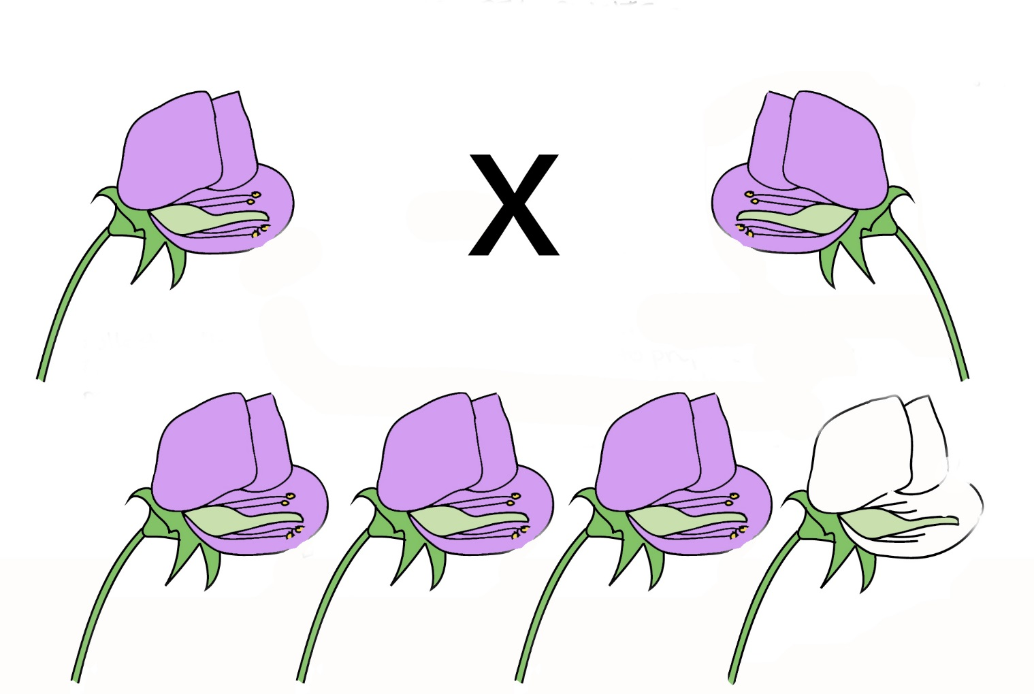
G. J. Mendel
1865/1900’s - monk hybridized pea plants in his garden
  When he crossed purebred white flowers with purebred purple flowers – the result was not a blend…hummm…
    First generation was all purple?!?!
    2nd gen…? flowers
F - 1

Slide 8
G. J. Mendel
1865/1900’s - monk hybridized pea plants in his garden
  When he crossed purebred white flowers with purebred purple flowers – the result was not a blend…hummm…
    First generation was all purple?!?!
    2nd gen he kept getting a 3:1 ratio of purple over white
F - 1
F - 2

Slide 9
G. J. Mendel
1865/1900’s - monk hybridized pea plants in his garden
  When he crossed purebred white flowers with purebred purple flowers – the result was not a blend…hummm…
    First generation was all purple?!?!
    2nd gen he kept getting a 3:1 ratio of purple over white
  Heredity units – must have alternate forms of instructions
  Hypothesized “units” paired randomly during meiosis (Law of Segregation) and they do this independently from one another (Law of Independent Assortment)
  Some “unit’s” get masked by others (Law of Dominance)
    Preformed years of tests, crossing parents, massive sample size, and repetition gave credibility
However, his results were super controversial and ignored (they implied heredity was erratic/unexplained and many didn’t believe the Laws could apply to other sexually reproducing organisms).
  Not accepted until others came along to investigate heredity, gene expression, cell structure, and mathematically probabilities…only then ‘Oops, our bad Mendel, you were right all along!’

Slide 10
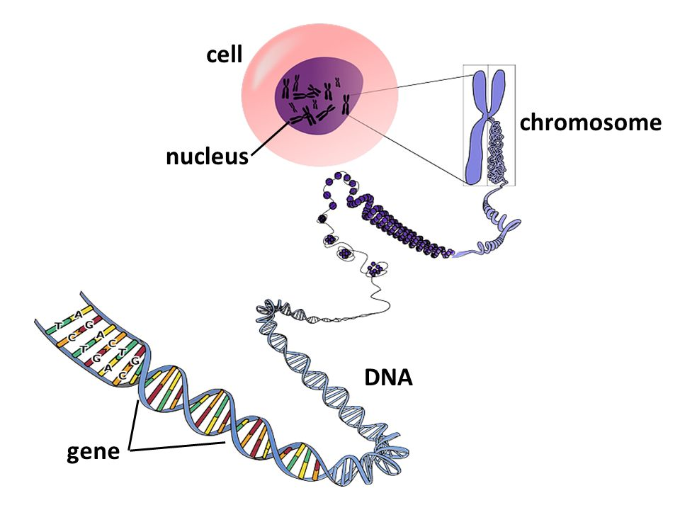
So what’s going on here??? –
“Instruction manuals”
http://images.slideplayer.com/26/8770399/slides/slide_5.jpg

Slide 11
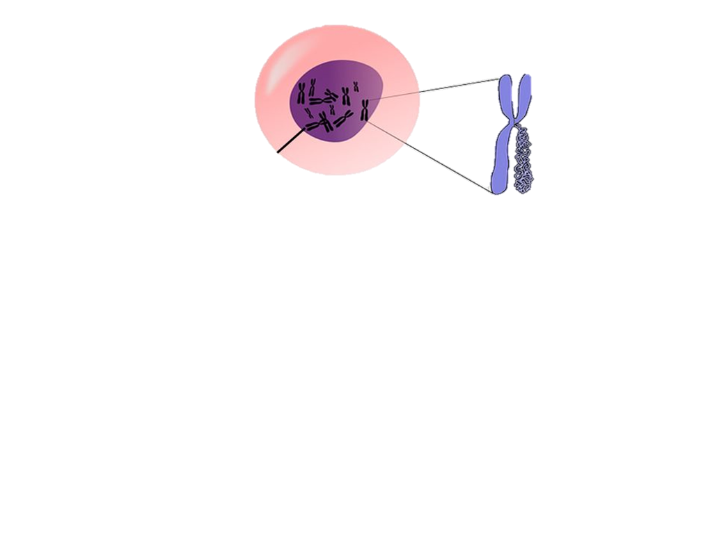
Chromosomes –
“Instruction manuals”
Chromosomes not involved in replicating are unassembled inside the nuclear envelope.
http://images.slideplayer.com/26/8770399/slides/slide_5.jpg

Slide 12
Chromosomes –
“Instruction manuals”
Chromosomes not involved in replicating are unassembled inside the nuclear envelope.
Once the cell gets the signal to start cell division, then each chromosome is copied.
http://images.slideplayer.com/26/8770399/slides/slide_5.jpg

Slide 13
Chromosomes –
“Instruction manuals”
Chromosomes not involved in replicating are unassembled inside the nuclear envelope.
Once the cell gets the signal to start cell division, then each chromosome is copied.
http://images.slideplayer.com/26/8770399/slides/slide_5.jpg

Slide 14
Chromosomes –
“Instruction manuals”
Once a chromosome is copied (DNA replication), it is now called a “chromatid” and is held together with a centromere. Both chromatids bound by the centromere are now collectively called “sister chromatids” and have identical “instructions” or DNA.
http://images.slideplayer.com/26/8770399/slides/slide_5.jpg

Slide 15

Chromosomes –
“Instruction manuals”
During Anaphase in cell division, the centromere is broken and the two sister chromatids now separate
http://images.slideplayer.com/26/8770399/slides/slide_5.jpg

Slide 16
Chromosomes –
“Instruction manuals”
During Anaphase in cell division, the centromere is broken and the two sister chromatids now separate and one cell is now two duplicates, each with one of the exact same chromosome/instructions as the original parent cell.
This happens to every homologus pair, so one from mom AND one from dad
http://images.slideplayer.com/26/8770399/slides/slide_5.jpg

Slide 17
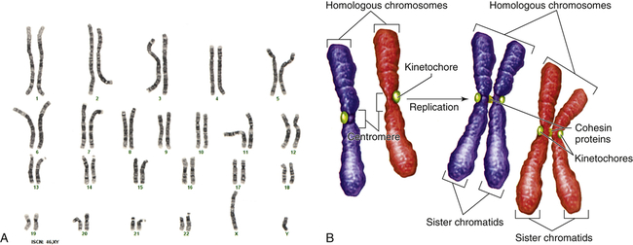
Chromosomes
Pea plants have 28 chromosomes, 14 homologous* pairs
https://basicmedicalkey.com/wp-content/uploads/2016/09/B9780323088541000047_f04-09ab-9780323088541.jpg

Slide 18
Chromosomes
Homologous = the same structural features and pattern of genes.
http://www.karakalpak.com/images/genetic08.jpg

Slide 19
Chromosomes
Homologous = the same structural features and pattern of genes.
Homologous Chromosomes

Slide 20
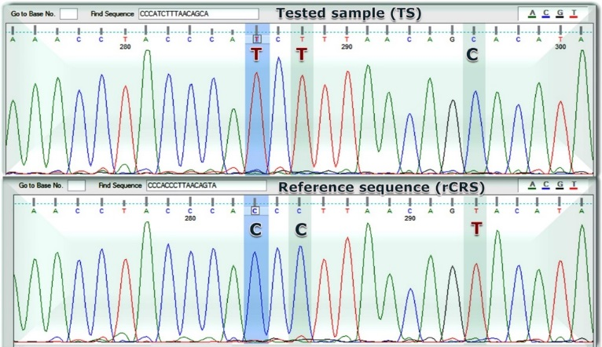
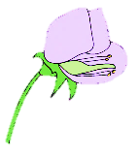
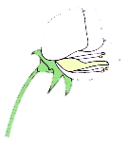
Chromosomes
“p” = petal color
Same Locus
(same location)
Homologous Chromosomes
Locus = Specific Gene = Codes for same thing

Slide 21
Chromosomes
P variant
p variant
“p” = petal color
This specific gene sequence (allele) encodes purple leaves
This allele (at the same location) is slightly different and encodes white leaves
Homologous Chromosomes
Locus = Specific Gene = Codes for same thing

Slide 22
Alleles
Alleles (a variant form of a gene)
  They can be dominant (expressed) or recessive (not expressed)
  For example: Let’s look at petal color (Locus designated by the letter ”p”)
    Purple petals are dominant – P
    white petals are recessive – p
Heterozygous – having different alleles (Pp)
Homozygous – having the same alleles (PP or pp)
Genotype vs. Phenotype
  Genotype – what alleles (letter combo) does that plant have for that gene? (PP or pp or Pp)
  Phenotype – refers to an individual’s appearance, what is their physical plant color?
    PP or Pp genotype = Purple petals phenotype
    pp genotype = white petal phenotype

Slide 23
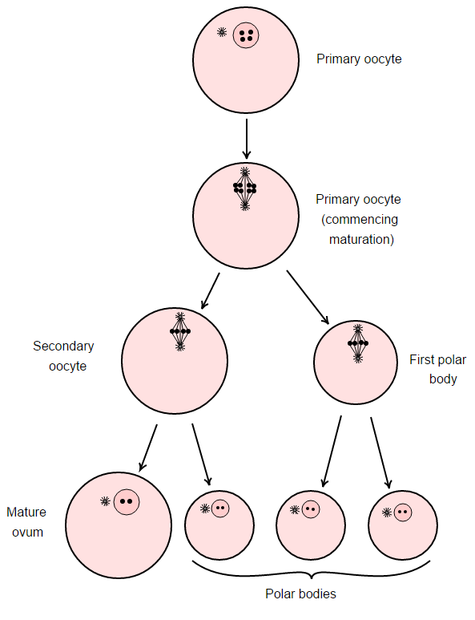
Law of Segregation
Each primary cell contains 2 alleles for each trait, and the alleles segregate during the formation of gametes (egg or sperm). Each gamete then contains only 1 allele for each trait.
spermatocyte
2n
Primary
spermatocyte (after S-phase)
2n (4c)
Secondary
spermatocyte
1n (2c)
Spermatid
1n
Spermatozoa
(Sperm)
1n

Slide 24
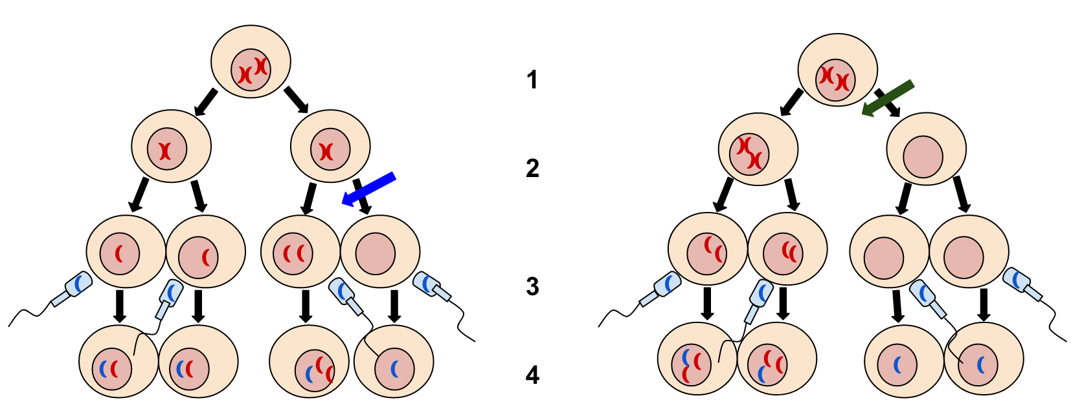
Law of Segregation
Each primary cell contains 2 alleles for each trait, and the alleles segregate during the formation of gametes (egg or sperm). Each gamete then contains only 1 allele for each trait. When fertilization occurs, the new 2n (diploid) cell will have a total of 2 alleles for each trait, one supplied from each parent gamete

Slide 25

Law of Segregation
Each primary cell contains 2 alleles for each trait, and the alleles segregate during the formation of gametes (egg or sperm). Each gamete then contains only 1 allele for each trait. When fertilization occurs, the new 2n (diploid) cell will have a total of 2 alleles for each trait, one supplied from each parent gamete
This is why it is important that 1 of each homologous pair of chromosomes ends up in the gamete at the end of meiosis!!! (aka. Non Disjunction = lack or multiple instructions = ISSUES*)

Slide 26
Zygote (baby) – this egg was fertilized by a sperm and now has two sets of instructions for eyes… one from mom, one from dad.
BUT, didn’t we just say multiple instructions or not enough instructions causes issues, so… now what?!
With two sets of instructions, which allele gets to call the shots???
Meiosis II
Non-disjunction in Meiosis II – 50% chance gametes may be unaffected

Slide 27
Law of Dominance:
Dominant vs. Recessive Traits
In humans, each pair of the 22 autosomal chromosomes have the same genes
For each gene there can be 2 alleles (different forms) (G or g)
For this class, we will represent all dominant alleles with a Capital Letter and all recessive alleles with a lower case letter (*this is important to memorize!)
Different alleles for a trait (Gg) is heterozygous
Same alleles for a trait (GG or gg) is homozygous

Slide 28
Dominant vs. Recessive Traits
Given that a trait (say green eyes) is dominant ‘G’:
An organism who is heterozygous (Gg) ______ show this trait.
An organism who is homozygous dominant (GG) ______ show the trait.
An organism who is homozygous recessive (gg) ________ show the trait.
***BECAUSE ***The genetic information for ‘G’ is not present.
will
will
will not
WHY?!?

Slide 29
Dominant vs. Recessive Traits
Given that a trait (say blue eyes) is recessive ‘g’:
An organism who is heterozygous (Gg) ___________show the trait.
  However, this organism (Gg) is a carrier for the trait and 50% of its gametes will have the ‘g’ trait.
A organism who is homozygous dominant (GG) ________show the trait.
***BECAUSE***The genetic information for the trait “g” is not present.
Only organisms who are homozygous recessive (gg) will express it!!!!
will not
will not
WHY?!?

Slide 30
Gamete formation = allelic combo’s
Jim has an allele from his father for Green eyes (B) and an allele from his mother for blue eyes (b).
What is his genotype (“letter/allelic combination”)?
What is his phenotype (“trait or character”)?
Bb
Bb
Mary has an allele from her father for blue eyes (b) and an allele from her mother for Green eyes (B).
What is her genotype?
What is her phenotype?
Bb
Bb

Slide 31
Monohybrid cross = 1 trait
Jim and Mary have the same genotype and the same phenotype.
What are the possible gametes that Jim can have in his sperm cells?
What are the possible gametes that Mary can have in her ovum (egg) cells?
Bb
Bb
B
b
Bb
B
b

Slide 32
Monohybrid cross = 1 trait*
What would Jim (Bb) and Mary’s (Bb)
children look like?
Jim Mary
We can cross all their possible gamete combos
using a Punnet Square!

Slide 33
Monohybrid cross = 1 trait*
What would Jim (Bb) and Mary’s (Bb)
children look like?
What is the genotypic ratio?
  How many different allelic (letter) combinations?
  BB Bb bb
What is the phenotypic ratio?
  How many different
  observable traits?
Jim Mary
B
b
BB
BB
Bb
B
Bb
bb
b
bb
BB 1x
Bb 2x
bb 1x
1 : 2 : 1
3x
1x
3 : 1

Slide 34
Monohybrid cross = 1 trait
John has an allele from his father for Green eyes (B) and an allele from his mother for Green eyes (B).
What is his genotype (allelic combo)?
BB
  Homozygous dominant (homo=same)
What is his phenotype?
  Green eyes
BB

Slide 35
Monohybrid cross = 1 trait
Jill has an allele from her father for blue eyes (b) and an allele from her mother for blue eyes (b).
What is her genotype (allelic combo)?
bb
  Homozygous recessive (homo=same)
What is her phenotype?
  Blue eyes
bb

Slide 36
Monohybrid cross = 1 trait
John and Jill have different genotypes and phenotypes.
What are the possible gametes that John can have in his sperm cells?
What are the possible gametes that Jill can have in her ovum (egg) cells?
BB
bb
BB
B
B
bb
b
b

Slide 37
Monohybrid cross = 1 trait
What would John and Jill’s children look like?
What is the genotypic ratio?
  How many different letter combinations?
  BB Bb bb
What is the phenotypic ratio?
  How many different
  observable traits?
John Jill
B
B
Bb
Bb
Bb
b
b
Bb
Bb
0: 4 : 0
BB 0x
Bb 4x
bb 0x
4 : 0
4x

Slide 38
Dihybrid Cross
In fertilization, each possible male gamete (sperm) could form a zygote with each possible female gamete (ovum or egg).
Remember – in monohybrid with one trait, each parent could give one of each of their alleles.
  2 x 2 = 4 possible offspring outcomes
In a Dihybrid Cross, we cross two traits between parents (ex. Eye color and hair color)
  So four possible male gamete combinations meeting four possible female combinations.
  4 x 4 = 16 possible offspring outcomes.
  Now let’s do a Punnett Square to visualize the possibilities

Slide 39
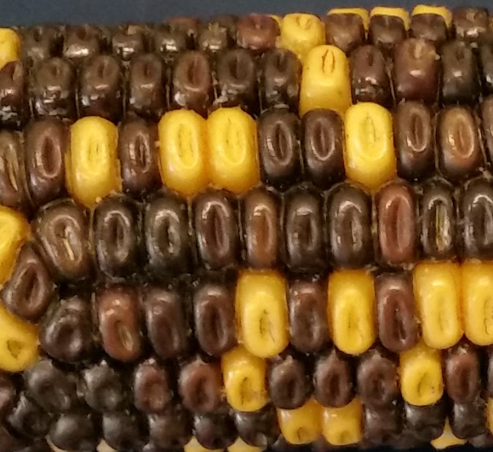
Dihybrid Cross
Let’s look at corn
  P = purple kernel
  p= yellow kernel
  S = smooth
  s = wrinkled kernel
Think of each kernel as being an individual offspring
  So each kernel has both traits
    A color (P or p)
    A shape (S or s)
© Kornelia Fillmer, CC BY-SA 3.0
https://goo.gl/photos/T5DjKV4bSfPm22B7A
Trait: Color
Trait: Shape

Slide 40
Dihybrid Cross = two traits
Trait 1: Color
Trait 2: Shape
Both parents have this genotype: PpSs
In Meiosis I the homologous
chromosome pairs separate.
  So each gamete (after Meiosis II) will have either P or p from the color trait AND either S or s for the shape trait
What are the possible allele combinations of the Parents?
© Kornelia Fillmer, CC BY-SA 3.0
https://goo.gl/photos/T5DjKV4bSfPm22B7A
Trait 1: Color
P
p
  P = purple kernel
  p = yellow kernel
  S = smooth
  s = wrinkled kernel
Sister chromatids:
S
PS
pS
Trait 2: Shape
Sister chromatids:
s
Ps
ps

Slide 41
Dihybrid Cross PpSs x PpSs
male
female
  P = purple kernel
  p= yellow kernel
  S = smooth
  s = wrinkle
male
PS
Ps
pS
ps
female
PPSS
PPSs
PPSs
PpSS
PpSs
PS
PPSs
PPss
PpSs
Ppss
Ps
PpSS
PpSs
ppSS
ppSs
pS
ps
PpSs
Ppss
ppSs
ppss
Genotypic ratio: 4xPpSs,
2xPPSs, 2x PpSS, 2xPpss, 2xppSs, 1xPPSS, 1xPPss,1xppSS, 1xppss
4:2:2:2:2:1:1:1:1
Phenotypic ratio: 9 : 3 : 3 : 1
9:3:3:1

Slide 42
Dihybrid Cross
Dihybrid cross between 2 heterozygous individuals results in a 9:3:3:1 phenotypic ratio
=> 16 possibilities (count # of boxes in cross)
Resulting possible offspring:
  9/16 – purple, smooth (DOM,DOM)
  3/16 – purple, wrinkled (DOM, rec)
  3/16 – yellow, smooth (rec, DOM)
  1/16 – yellow wrinkled (rec, rec)

Slide 43
Dihybrid Cross – ex. 2
Parent has this genotype: ppSs
Possible gamete combinations
for this for this male?
Four male sperm gametes with
one allele of each trait
© Kornelia Fillmer, CC BY-SA 3.0
https://goo.gl/photos/T5DjKV4bSfPm22B7A
Trait: Color
Sister chromatids:
p
Sister chromatids:
p
Trait: Shape
=
Sister chromatids:
S
pS
pS
=
  P = purple kernel
  p = yellow kernel
  S = smooth
  s = wrinkled kernel
Sister chromatids:
s
ps
ps
(actually two are equal)

Slide 44
Dihybrid Cross ex. 2 ppSs x PpSs
male
female
  P = purple kernel
  p= yellow kernel
  S = smooth
  s = wrinkle
male
pS
ps
pS
ps
female
PpSS
PpSs
PpSS
PpSs
PS
PpSs
Ppss
PpSs
Ppss
Ps
ppSS
ppSs
ppSS
ppSs
pS
ps
ppSs
ppss
ppSs
ppss
Genotypic ratio: 4xPpSs, 4xppSs, 2xPpSS, 2xPpss, 2xppSS, 2xppss
4:4:2:2:2:2
Phenotypic ratio: 6 : 6 : 2 : 2
ps
(6:6:2:2 = 3:3:1:1)
PS
pS
Ps

Slide 45
Like Mendel, how would you know if your results were legit?!?
What happens when doing these Punnett Square Crosses, the data does not follow exactly the calculated ratios?
Uhhh, then what? Was the mistake by chance or some other error?
Fret not!
We can test our results to see if there are differences (deviations) from what Mendel Expected vs. what you Observe, and if so, shed light on who dropped the ball using a Chi-Square Test (X²)

Slide 46
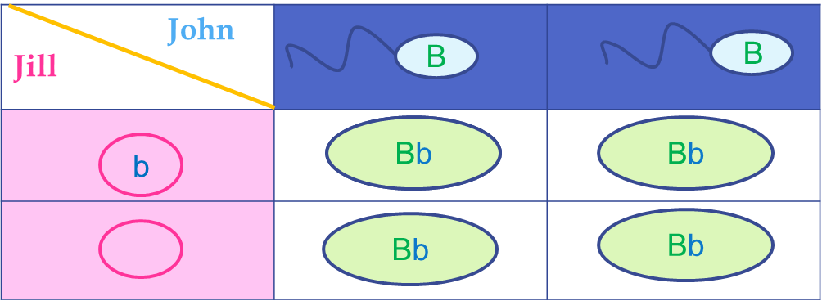
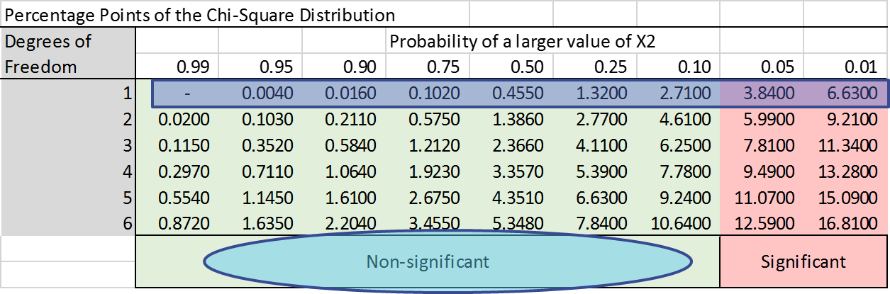
Before we go on:
Chi-Square versus Punnett Square
  Don’t get these confused!
    Punnett squares are actual squares that we use to help us match up chromosomes that are in gametes
    Chi-Square
      Statistical test – the number is referred to as “X²=“

Slide 47
Chi-Square Prep: From Ratio to Fraction
The ratio of male to female students in a class is 3:2. There are 30 students in the class. How many are female, how many males?
3:2 is ratio. The total members of a ratio = set
3:2, so the total set number is = 3+2 = 5
In every set of 5 students, there are 3 boys and 2 girls.
In other words,
  3/5 of the total set are male
  2/5 of the total set are female

Slide 48





Chi-Square Prep: From Ratio to Fraction
3/5 of the total number of students (30) are male
The word “of” is always translated to multiplication
3/5 of 30 => $\frac{3}{5} x 30$
  (0.6 x 30 =18)
2/5 of 30 => $\frac{2}{5} x 30$
          (0.4 x 30 =12)
Adding the 18 males to the 12 females results in the total of 30 students.
$$6$$
  $3 x 6=18$ males
$$6$$
  $2 x 6=12$ females

Slide 49
Chi-Square Prep: From Ratio to Fraction
The “phenotypic ratio” (physically looks like) of a heterozygous monohybrid cross is 3:1
The total members of ratio (3:1) = set
3:1, so the set = 3+1 = 4
In other words, you expect:
  3/4 of the total offspring should appear to be DOMINATE
    (or .75 of 1 )
  1/4 of the total offspring should appear to be recessive
    (or .25 of 1 )

Slide 50

Monohybrid Chi-Square
Tobacco seedling example
C
c
C
c
Heterozygous
Parents
182
C = Chlorophyll present
c = cholorphyll absent
60
Parent 1 Parent 2 | C | C
C
C
CC
Cc
3:1
Cc
cc
add these up for total X²
3 of 4 offspring will have Cholorphyll present (green) &
1 of 4 will have cholorphyll absent (white)

Slide 51
Monohybrid Chi-Square
Expected Ratio 3 : 1
Observed 195 : 55
182
1
2
60
add these up for total X²

Slide 52
Monohybrid Chi-Square
Expected Ratio 3 : 1
Observed 195 : 55
182
1
2
195
55
60
2
250
1
How many Phenotypes can you see (how many categories) ?
add these up for total X²

Slide 53
Monohybrid Chi-Square
Expected Ratio 3 : 1
Observed 195 : 55
182
1
2
195
55
60
2
250
1
How many Phenotypes can you see (how many categories) ? Record ‘Degrees of Freedom’
add these up for total X²

Slide 54
Monohybrid Chi-Square
Expected Ratio 3 : 1
Observed 195 : 55
182
1
2
195
55
60
2
250
1
How many Phenotypes can you see (how many catagories) ? Record ‘Degrees of Freedom’
Count and record data separately by phenotype then together for “Set #”
add these up for total X²

Slide 55
Monohybrid Chi-Square
Expected Ratio 3 : 1
Observed 195 : 55
182
1
2
195
55
60
¾ or 0.75
¼ or 0.25
2
250
1
How many Phenotypes can you see (how many catagories) ? Record ‘Degrees of Freedom’
Count and record data separately by phenotype then together for “Set #”
From phenotypes, calculate Expected Ratio (mono 3:1, di 9:3:3:1)
add these up for total X²

Slide 56
Monohybrid Chi-Square
Expected Ratio 3 : 1
Observed 195 : 55
182
1
2
195
55
60
250 x 0.75 =
187.5
¾ or 0.75
¼ or 0.25
250 x 0.25 =
62.5
2
250
1
How many Phenotypes can you see (how many catagories) ? Record ‘Degrees of Freedom’
Count and record data separately by phenotype then together for “Set #”
From phenotypes, calculate Expected Ratio (mono 3:1, di 9:3:3:1)
From ratio and Set #, calculate Expected #
add these up for total X²

Slide 57
Monohybrid Chi-Square
Expected Ratio 3 : 1
Observed 195 : 55
182
1
2
195
55
60
250 x 0.75 =
187.5
195 -187.5 =
7.5
¾ or 0.75
¼ or 0.25
250 x 0.25 =
62.5
55 - 62.5 =
-7.5
2
250
1
How many Phenotypes can you see (how many catagories) ? Record ‘Degrees of Freedom’
Count and record data separately by phenotype then together for “Set #”
From phenotypes, calculate Expected Ratio (mono 3:1, di 9:3:3:1)
From ratio and Set #, calculate Expected #
Calculate the difference between your Observed data and what you Expected
add these up for total X²

Slide 58
Monohybrid Chi-Square
Expected Ratio 3 : 1
Observed 195 : 55
182
1
2
195
55
60
250 x 0.75 =
187.5
195 -187.5 =
7.5
56.25
56.25
¾ or 0.75
¼ or 0.25
250 x 0.25 =
62.5
55 - 62.5 =
-7.5
2
250
1
How many Phenotypes can you see (how many catagories) ? Record ‘Degrees of Freedom’
Count and record data separately by phenotype then together for “Set #”
From phenotypes, calculate Expected Ratio (mono 3:1, di 9:3:3:1)
From ratio and Set #, calculate Expected #
Calculate the difference between your Observed data and what you Expected
Square the difference
add these up for total X²

Slide 59
Monohybrid Chi-Square
Expected Ratio 3 : 1
Observed 195 : 55
182
1
2
195
55
60
250 x 0.75 =
187.5
195 -187.5 =
7.5
56.25/187.5 =
0.3
1
2
¾ or 0.75
¼ or 0.25
56.25
56.25
¾ or 0.75
¼ or 0.25
250 x 0.25 =
62.5
55 - 62.5 =
-7.5
56.25/62.5 =
0.9
2
250
2
1
1
How many Phenotypes can you see (how many catagories) ? Record ‘Degrees of Freedom’
Count and record data separately by phenotype then together for “Set #”
From phenotypes, calculate Expected Ratio (mono 3:1, di 9:3:3:1)
From ratio and Set #, calculate Expected #
Calculate the difference between your Observed data and what you Expected
Square the difference
Divide the Squared Difference by your Expected #
add these up for total X²

Slide 60
Monohybrid Chi-Square
Expected Ratio 3 : 1
Observed 195 : 55
182
1
2
195
55
60
250 x 0.75 =
187.5
195 -187.5 =
7.5
56.25
56.25
56.25/187.5 =
0.3
¾ or 0.75
¼ or 0.25
250 x 0.25 =
62.5
55 - 62.5 =
-7.5
56.25/62.5 =
0.9
250
1.2
2
1
How many Phenotypes can you see (how many catagories) ? Record ‘Degrees of Freedom’
Count and record data separately by phenotype then together for “Set #”
From phenotypes, calculate Expected Ratio (mono 3:1, di 9:3:3:1)
From ratio and Set #, calculate Expected #
Calculate the difference between your Observed data and what you Expected
Square the difference
Divide the Squared Difference by your Expected #
Add partial chi-squares for TOTAL Chi-Square #
add these up for total X²

Slide 61
Chi-Square Analysis
  X² ⁼ 1.2
    Degrees of Freedom (C) = # of phenotypes-1
              Green or White so, 2 - 1 = 1
    Scan across row 1
  p value for x² value of 1.2 falls below 0.05 = non-significant!
    Hypothesis is supported (not rejected)!!!
    Our sample fits 3:1 ratio, differences are due to just random chance

Slide 62
Monohybrid Chi-Square
182
1
2
195
55
60
187.5
62.5
250
The differences between what you Observed vs. Mendel’s Expectations, aren’t large enough to be of any concern !!!
(i.e. you started with heterozygote parents, you counted correct, you calculated correct, others can use your results to build on)
add these up for total X²

Slide 63
From Ratio to Fraction
The “phenotypic ratio” of a heterozygous dihybrid cross is 9:3:3:1
The total members of ratio (9:3:3:1) = set
9:3:3:1, so the set = 9+3+3+1 = 16
In other words, you expect:
  9/16 of the total offspring should be DOMINATE DOMINATE
    0.5625 of 1
  3/16 of the total offspring should be recessive DOMINATE
    0.1875 of 1
  3/16 of the total offspring should be DOMINATE recessive
    0.1875 of 1
  1/16 of the total offspring should be recessive recessive
    0.0625 of 1

Slide 64
Dihybrid Chi-Square
Observed 201 : 70 : 89 : 22
Expected Ratio 9 : 3 : 3 : 1
1
2
3
4
214.9
71.6
71.6
23.9
4
3
How many Phenotypes can you see (how many categories) ?

Slide 65
Dihybrid Chi-Square
Observed 201 : 70 : 89 : 22
Expected Ratio 9 : 3 : 3 : 1
1
2
3
4
214.9
71.6
71.6
23.9
4
3
How many Phenotypes can you see (how many categories) ? Record ‘Degrees of Freedom’

Slide 66
Dihybrid Chi-Square
Observed 201 : 70 : 89 : 22
Expected Ratio 9 : 3 : 3 : 1
1
2
3
4
201
70
89
22
214.9
71.6
71.6
23.9
4
382
3
How many Phenotypes can you see (how many catagories) ? Record ‘Degrees of Freedom’
Count and record data separately by phenotype then together for “Set #”

Slide 67
Dihybrid Chi-Square
Observed 201 : 70 : 89 : 22
Expected Ratio 9 : 3 : 3 : 1
1
2
3
4
201
70
89
22
214.9
9/16 or 0.5625
71.6
3/16 or 0.1875
71.6
3/16 or 0.1875
23.9
1/16 or 0.0625
4
382
3
How many Phenotypes can you see (how many catagories) ? Record ‘Degrees of Freedom’
Count and record data separately by phenotype then together for “Set #”
From phenotypes, calculate Expected Ratio (mono 3:1, di 9:3:3:1)

Slide 68
Dihybrid Chi-Square
Observed 201 : 70 : 89 : 22
Expected Ratio 9 : 3 : 3 : 1
1
2
3
4
201
70
89
22
214.9
382 x 0.5625 =
214.875
9/16 or 0.5625
71.6
382 x 0.1875 =
71.625
3/16 or 0.1875
71.6
382 x 0.1875 =
71.625
3/16 or 0.1875
23.9
382 x 0.0625 =
23.875
1/16 or 0.0625
4
382
3
How many Phenotypes can you see (how many catagories) ? Record ‘Degrees of Freedom’
Count and record data separately by phenotype then together for “Set #”
From phenotypes, calculate Expected Ratio (mono 3:1, di 9:3:3:1)
From ratio and Set #, calculate Expected #

Slide 69
Dihybrid Chi-Square
Observed 201 : 70 : 89 : 22
Expected Ratio 9 : 3 : 3 : 1
1
2
3
4
201
70
89
22
214.9
382 x 0.5625 =
214.875
201 – 214.875 =
13.875
9/16 or 0.5625
71.6
382 x 0.1875 =
71.625
70 – 71.625 =
1.625
3/16 or 0.1875
71.6
382 x 0.1875 =
71.625
89 – 71.625 =
17.375
3/16 or 0.1875
23.9
382 x 0.0625 =
23.875
22 – 23.875 =
1.875
1/16 or 0.0625
4
382
3
How many Phenotypes can you see (how many catagories) ? Record ‘Degrees of Freedom’
Count and record data separately by phenotype then together for “Set #”
From phenotypes, calculate Expected Ratio (mono 3:1, di 9:3:3:1)
From ratio and Set #, calculate Expected #
Calculate the difference between your Observed data and what you Expected

Slide 70
Dihybrid Chi-Square
Observed 201 : 70 : 89 : 22
Expected Ratio 9 : 3 : 3 : 1
1
2
3
4
201
70
89
22
214.9
382 x 0.5625 =
214.875
201 – 214.875 =
13.875
192.516
2.641
301.89
3.516
9/16 or 0.5625
71.6
382 x 0.1875 =
71.625
70 – 71.625 =
1.625
3/16 or 0.1875
71.6
382 x 0.1875 =
71.625
89 – 71.625 =
17.375
3/16 or 0.1875
23.9
382 x 0.0625 =
23.875
22 – 23.875 =
1.875
1/16 or 0.0625
4
382
3
How many Phenotypes can you see (how many catagories) ? Record ‘Degrees of Freedom’
Count and record data separately by phenotype then together for “Set #”
From phenotypes, calculate Expected Ratio (mono 3:1, di 9:3:3:1)
From ratio and Set #, calculate Expected #
Calculate the difference between your Observed data and what you Expected
Square the difference

Slide 71
Dihybrid Chi-Square
Observed 201 : 70 : 89 : 22
Expected Ratio 9 : 3 : 3 : 1
1
2
3
4
201
70
89
22
214.9
382 x 0.5625 =
214.875
201 – 214.875 =
13.875
192.516
2.641
301.89
3.516
192.516/214.875 =
1.116
9/16 or 0.5625
71.6
382 x 0.1875 =
71.625
70 – 71.625 =
1.625
2.641/71.625 =
.0369
3/16 or 0.1875
71.6
382 x 0.1875 =
71.625
89 – 71.625 =
17.375
301.89/71.625 =
4.215
3/16 or 0.1875
23.9
382 x 0.0625 =
23.875
22 – 23.875 =
1.875
3.516/23.875 =
.0147
1/16 or 0.0625
4
382
3
How many Phenotypes can you see (how many catagories) ? Record ‘Degrees of Freedom’
Count and record data separately by phenotype then together for “Set #”
From phenotypes, calculate Expected Ratio (mono 3:1, di 9:3:3:1)
From ratio and Set #, calculate Expected #
Calculate the difference between your Observed data and what you Expected
Square the difference
Divide the Squared Difference by your Expected #

Slide 72
Dihybrid Chi-Square
Observed 201 : 70 : 89 : 22
Expected Ratio 9 : 3 : 3 : 1
1
2
3
4
201
70
89
22
214.9
382 x 0.5625 =
214.875
201 – 214.875 =
13.875
192.516
2.641
301.89
3.516
192.516/214.875 =
1.116
9/16 or 0.5625
71.6
382 x 0.1875 =
71.625
70 – 71.625 =
1.625
2.641/71.625 =
.0369
3/16 or 0.1875
71.6
382 x 0.1875 =
71.625
89 – 71.625 =
17.375
301.89/71.625 =
4.215
3/16 or 0.1875
23.9
382 x 0.0625 =
23.875
22 – 23.875 =
1.875
3.516/23.875 =
.0147
1/16 or 0.0625
4
382
5.52
3
How many Phenotypes can you see (how many catagories) ? Record ‘Degrees of Freedom’
Count and record data separately by phenotype then together for “Set #”
From phenotypes, calculate Expected Ratio (mono 3:1, di 9:3:3:1)
From ratio and Set #, calculate Expected #
Calculate the difference between your Observed data and what you Expected
Square the difference
Divide the Squared Difference by your Expected #
Add partial chi-squares for TOTAL Chi-Square #

Slide 73
Chi-Square Analysis
  X² ⁼ 5.52
    C-1=3 (C = # of phenotypes, 4-1=3)
    Scan across row 3
  p value for x² value of 5.52 falls between 0.25 and 0.10 = non-significant!
    Hypothesis is supported (not rejected)!!!
    Our sample fits 9:3:3:1 ratio, differences are due to just random chance

Slide 74
Dihybrid Chi-Square
1
2
3
4
201
70
89
22
214.9
214.875
71.6
71.625
71.6
71.625
23.9
23.875
382
The differences between what you Observed vs. Mendel’s Expectations, aren’t large enough to be of any concern !!!
(i.e. you started with heterozygote parents, you counted correct, you calculated correct, others can use your results to build on)

Slide 75
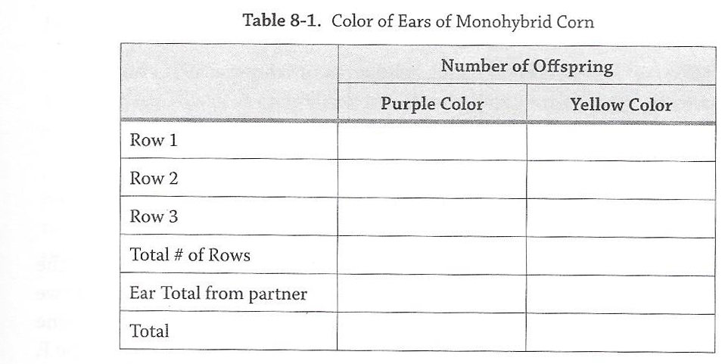
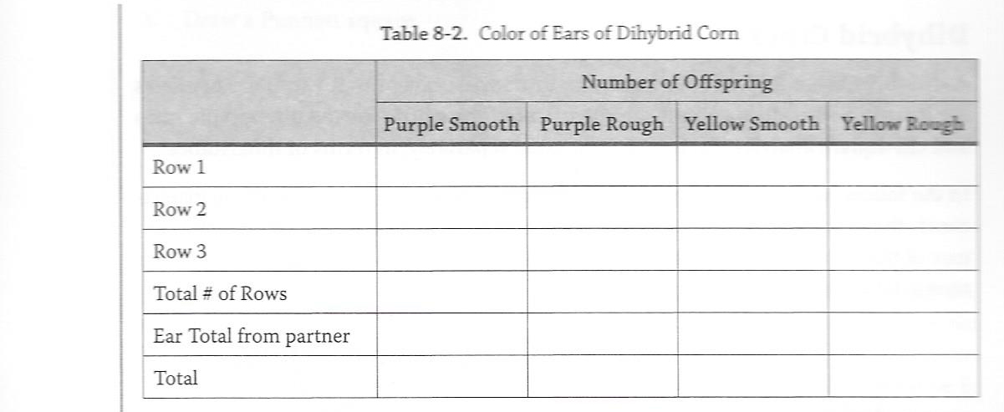
Today’s Lab
“To Do” Count Mono corn pg. 80
“To Do” Count Dihy corn pg. 83
Ave.
Ave.
“To Do” Chi Square Analysis for both pg. 85-87
***Can you answer all “Before you Go”???***

