Slide 1
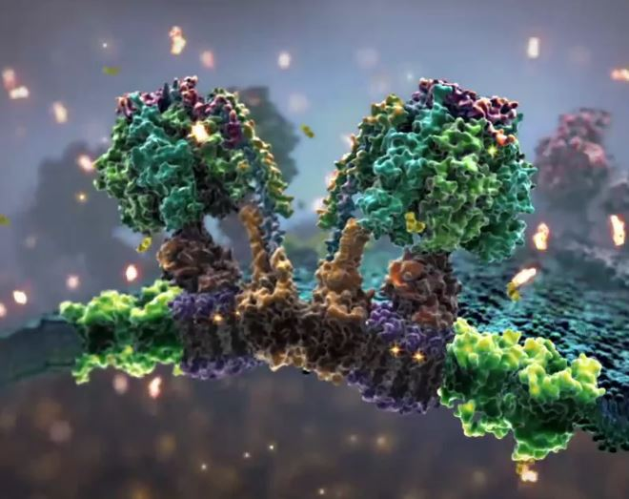
Respiration & Fermentation
Exercise 7, pg. 83-92
BSC2010L
http://www.xvivo.net/animation/powering-the-cell-mitochondria/

Slide 2
Withdrawal Date = Tues., June 4th
It is YOUR responsibility to assess your grade (always available via Blackboard) in this course at this time to determine your academic standing.
In most cases, a “W” won’t count against your overall GPA, but it will show on your transcript that you attempted the class but withdrew for any number of reasons. You will need to repay to fully retake the course.
If you have two low test scores, you need to talk with your TLS/Adjunct about the probability of your success in passing the course. If you fail to notify AND discuss this with your instructor (which he or she will document), you will NOT be considered a candidate for an Instructor Withdrawal or Incomplete if any situation arises come the final, thus the grade you have earned will be what is reported on your transcript… NO EXCEPTIONS!
There is NO Make-up Final, so make absolutely sure you will be present and ON TIME to class the week of June 17/18th!!!

Slide 3
Respiration & Fermentation Exercise 7, pg. 83-92
Lab Objectives:
Understand Respiration & Fermentation equation components
Investigate the process of respiration & fermentation
Explain experimental results of respiration with and without oxygen
Walk through how lab book data is integrated into a Lab Report

Slide 4
What is cellular respiration?
Oxidation of organic compounds to extract energy from chemical bonds
95% of living things are heterotrophic = must intake food to make energy
Other 5% (plants) can use additional method via sunlight (aka. Photosynthesis)
Every living thing (whether unicellular or multicellular) needs to go through respiration to produce ATP.
What do cells need energy for?
Survive & Thrive!!! (if your not livin’ your dyin’)

Slide 5
General Global Perspective
Plants produce oxygen (O₂) via photosynthesis:
carbon dioxide + water + sunlight→ glucose + oxygen + water
CO₂ + H₂O + sunlight → C₆H₁₂O₆ + O₂ + H₂O
Food and oxygen (O₂) are needed to power cell respiration:
glucose + oxygen → carbon dioxide + water + ENERGY
C₆H₁₂O₆ + 6 O₂ → 6 CO₂ + 6 H₂O + ENERGY

Slide 6
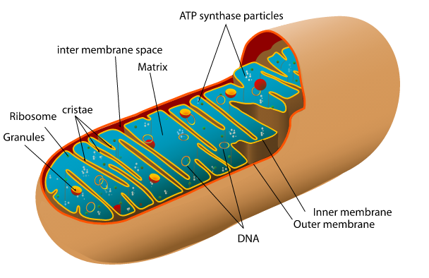
Aerobic Cellular Respiration – uses Oxygen
Word Origin: Aero-ultimately from Greek aēr air
Air, because there is Oxygen in it!
C₆H₁₂O₆ + 6 O₂ → 6 CO₂ + 6 H₂O + energy (Net: 32 ATP)
4 steps to cellular respiration:
Glycolysis – happens in cytoplasm
Pyruvate oxidation – happens in mitochondria in eukaryotes
Citric Acid Cycle – happens in mitochondria in eukaryotes
Oxidative phosphorylation via electron transport chain – happens on inner mitochondrial membrane in eukaryotes
By Mariana Ruiz Villarreal LadyofHats - the diagram I made myself using adobe illustrator, Public Domain, https://commons.wikimedia.org/w/index.php?curid=6195050

Slide 7
What happens without oxygen?
Anaerobic cellular respiration:
Prefix “An-” is used to state the opposite of what comes next (if starting with vowel)
Ex: Anhydrous = without water
Same as “A-” when what’s next starts with consonant.
Ex: Asymmetric =not symmetric
Anaerobic for Not aerobic: No air = No O₂
FERMENTATION!!

Slide 8
Respiration w/out oxygen = Fermentation
Glucose → carbon dioxide + ENERGY + organic by-product
C₆H₁₂O₆ → 2 CO₂ + 2 ATP + 2C₂H₅OH
Write this equation down on page 59!!!!!!! (ethanol, lactic acid)
2 steps to fermentation:
Glycolysis – happens in cytoplasm
Just like in aerobic respiration, this is where the 2 ATP are produced
Fermentation – happens in cytoplasm, also
Nothing happens in the mitochondria because there is no oxygen

Slide 9
Fermentation By-products
Ethanol is produced when the organism*yeast* (Saccharomyces cerevisiae) ferments
"Saccharomyces" Greek: "sugar-fungus“
Cerevisiae comes from Latin and means "of beer". Cerveza!
Lactic Acid is produced by mammalian muscle cells when not enough oxygen is available
These organic molecules are left over because there is no oxygen so the glucose molecule is not completely oxidized
Glycolysis is the only energy harvesting step that happens
These organic molecules still contain energy!!!

Slide 10
Aerobic Respiration vs. Fermentation
Glucose
Plants = sunlight/photosynthesis
Animals = food we ingest
Glycolysis
Pyruvate
O₂
O₂
Aerobic Respiration
Complete oxidation
Products: H₂O, CO₂
Net energy gained by the cell: 32 ATP per glucose molecule
Efficient/effective
Fermentation
Incomplete oxidation
Products: Organic Compound, CO₂
Net energy gained by the cell: 2 ATP per glucose molecule
Lower life forms live in low O₂ environments, higher life forms utilize as back-up method “fight or flight”

Slide 11
Cellular Respiration Experiment
We will be using peas as our *test organism*:
Germinating peas: are alive and growing, cells need usable energy
Remember plants go through Photosynthesis AND cellular respiration
Non-germinating peas: have been freeze dried
Remember plants need sunlight and water to process glucose
Glass beads: used as a “correction factor” for any change in volume due to changes in atmospheric pressure or temperature. This would affect all 3 tubes. “aka. Your constant variable”
Objective: Measuring Oxygen consumption

Slide 12
O₂
CO₂
KOH
O₂
0.5
1.0
1.5
O₂
O₂
Enclosed air will reduce its volume as its oxygen content is used for aerobic respiration by the peas. This results in water coming into the pipette
The carbon dioxide that is a product of the respiration is absorbed by potassium hydroxide (KOH)
C₆H₁₂O₆ + 6 O₂ → 6 CO₂ + 6 H₂O + energy (Net: 32 ATP)

Slide 13
Testing Aerobic Respiration via peas
Glass Beads = Not Respiring
O₂
O₂
CO₂
KOH
0.5
1.0
1.5
O₂
O₂
Freeze-dried peas = Not Respiring
O₂
O₂
CO₂
KOH
0.5
1.0
1.5
O₂
O₂
Germinating peas = Respiring!!!
O₂
O₂
CO₂
KOH
0.5
1.0
1.5
O₂
O₂

Slide 14
00:00
0.1
O₂
CO₂
KOH
O₂
0.5
1.0
1.5
O₂
O₂
10:00
0.8
O₂
CO₂
KOH
O₂
0.5
1.0
1.5
O₂
O₂

Slide 15
How to fill out the Handout table pg. 88:
Cellular Respiration Data
Tube | Content | Initial Reading | After 10 minutes | After 20 minutes | Net Change | Correct | Correct Net Change
1 | Germ.-Peas
2 | NON-Germ. Peas + Beads
3 | Beads
2.3-0.1=
2.2-0.2=
0.1
1.1
2.3
2.2
0.2
2.0
0.2
0.3
0.5-0.2=
0.2
0.1
0.5
0.3
0.3-0.2=
0.2
0.4
0.2
0.3
0.4-0.2=

Slide 16
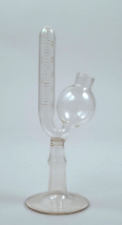
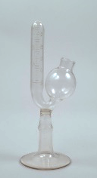
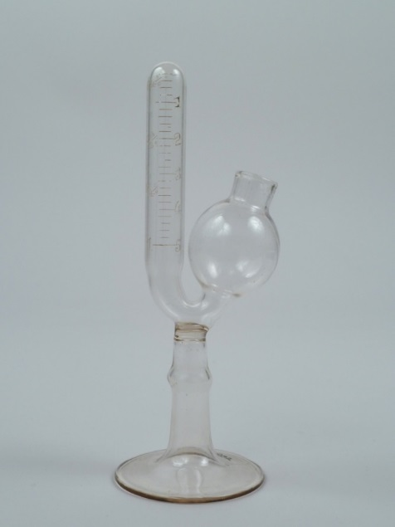
Testing Fermentation via Yeast
We will use yeast as the *test organism*
Label 4 beakers and 4 flasks (1-4)
1
2
3
4
1
2
3
4
saccharometer

Slide 17
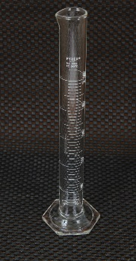
Testing Fermentation via Yeast
We will use yeast as the *test organism*
Label 3 beakers and 3 flasks (1-3)
Measure* out sugar solutions into separately
labeled beakers
Beaker 1: 12ml Glucose
Beaker 2: 12ml Sucrose
Beaker 3: 12ml distilled water
1
2
3
1
2
3
12 ml

Slide 18
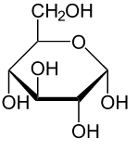
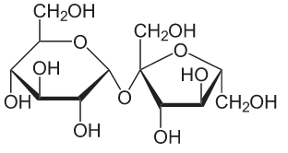
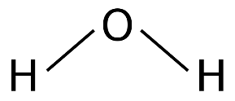
Testing Fermentation via Yeast
*
We will use yeast as the *test organism*
Label 3 beakers and 3 flasks (1-3)
Measure* out sugar solutions into separately
labeled beakers
Beaker 1: 12ml Glucose
Beaker 2: 12ml Sucrose
Beaker 3: 12ml distilled water (negative control)
1
2
3
1
2
3
Glucose
Sucrose
Water

Slide 19
Testing Fermentation via Yeast
Hypothesis?!?
Glucose
Readily enters 1st step of glycolysis
Sucrose
Must first be broken down into fructose & glucose, only then can it enter glycolysis.

Slide 20
Testing Fermentation via Yeast
Glucose
Readily enters 1st step of glycolysis
FAST
is
BEST
By NEUROtiker - Own work, Public Domain, https://commons.wikimedia.org/w/index.php?curid=2951918
Sucrose
Must first be broken down into fructose & glucose, only then can it enter glycolysis.

Slide 21
Fermentation
We will use yeast as the *test organism*
Label 3 beakers and 3 flasks (1-3)
Measure* sugar solutions into separate beakers
Beaker 1: 12ml Glucose
Beaker 2: 12ml Sucrose
Beaker 3: 12ml distilled water (negative control)
I’ll measure out yeast for you into your separately labeled beakers when you are done measuring out sugars! *TIME SENSITIVE – mix before next step*
Place in fermentation flask “aka. saccharometer” – thumb over top – tilt sideways/invert to expel air
Flask 1: Glucose (12ml + 6ml yeast)
Flask 2: Sucrose (12ml + 6ml yeast)
Flask 3: distilled water (negative control) (12ml + 6ml yeast)
CAREFULLY place all tubes in incubator = KEEP Incubator LID CLOSED!
Objective: Measure CO₂ release = fermentation has occurred (**Gas bubbles will collect at top of tube)
C₆H₁₂O₆ → 2 CO₂ + 2 ATP + 2C₂H₅OH
*
1
2
3
1
2
3
By The National Museum of American History, CC BY-NC-ND 2.0, http://americanhistory.si.edu/collections/search/object/nmah_735243

Slide 22
Exercise 7 Lab Procedures:
Groups of 4:
2 students set-up the Aerobic Respiration experiment/peas pg. 86
2 students set up Fermentation experiment/yeast pg. 89
All come back to benches while you wait
Discuss as a group how you set-up “your” part of the experiment!!!
Peas – Aerobic people tell Fermentation people about your set-up
Yeast – Anaerobic people tell Cell Resp. people about your set-up
Hypothesize what you expect to happen and why!
Peas, which vial will show resp, which will not, why?
Yeast, which flask will show fermentation best, which will not, why?
Everyone answers questions on pg. 92
Do as many as you can while waiting for the conclusion of your experiment
Read and record your results
Dismantle everything, Wash and DRY glassware, wipe up countertops
RETURN TO SEATS TO GO OVER Respiration LAB REPORT

Slide 23
Aerobic Respiration = peas = measured Oxygen* Consumption
Glucose + OXYGEN → carbon dioxide + water + ENERGY
C₆H₁₂O₆ + 6 O₂ → 6 CO₂ + 6 H₂O + 32 ATP
Anaerobic Respiration = yeast = measured Carbon Dioxide* Product
(aka. Fermentation)
Glucose → carbon dioxide + ENERGY + organic by-product
C₆H₁₂O₆ → 2 CO₂ + 2 ATP + 2C₂H₅OH

