Slide 1
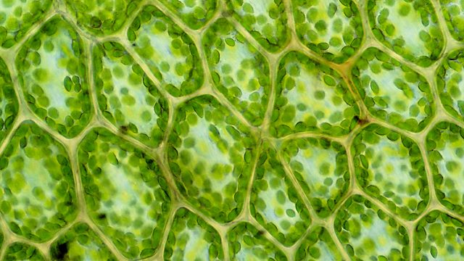
Cellular Function & osmosis
Exercise 6 pg. 67-81
BSC2010L

Slide 2
Withdrawal Date = Tues., June 4th
It is YOUR responsibility to assess your grade (always available via Blackboard) in this course at this time to determine your academic standing.
In most cases, a “W” won’t count against your overall GPA, but it will show on your transcript that you attempted the class but withdrew for any number of reasons. You will need to repay to fully retake the course.
If you have two low test scores, you need to talk with your TLS/Adjunct about the probability of your success in passing the course. If you fail to notify AND discuss this with your instructor (which he or she will document), you will NOT be considered a candidate for an Instructor Withdrawal or Incomplete if any situation arises come the final, thus the grade you have earned will be what is reported on your transcript… NO EXCEPTIONS!
There is NO Make-up Final, so make absolutely sure you will be present and ON TIME to class the week of June 17/18th!!!

Slide 3
Cell Function Exercise 6, pg. 67-81
Lab Objectives:
Define and describe the process of diffusion
Define and experiment tonicity changes in plant & animal cells
Walk through how lab book data is integrated into a Lab Report

Slide 4
Cell Function
Last lab we talked about parts of the cell and how they all must work together or the cell fails to survive. We simulated how pH stress can effect a eukaryotic cell, and how the cell has some power to compensate: cytoplasm is a buffer.
#1 Goal of Nature = balance (aka. homeostasis, equilibrium)
What happens in extremes, when the cell is unable compensate for its stressful environment???
What molecules* within the environment can do that? How? Why?

Slide 5
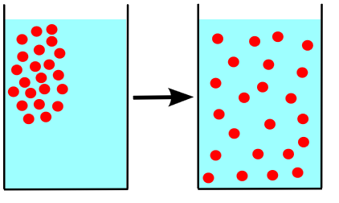
Molecule movement = Diffusion
Given lack of any barriers, movement of molecules* from a higher to a lower concentration until equilibrium is achieved.
By JrPol - Own work, CC BY 3.0, https://commons.wikimedia.org/w/index.php?curid=4586487

Slide 6
Diffusion
Say I spray perfume at the front of the lab: you could assume first row students will be able to pick up the scent before the back of the room.
WHY?
Given lack of any barriers, molecules move from a higher to a lower concentration until all are equally spaced. (think kindergarten and swinging your arms as wide as you can to “space apart from each other”)
By JrPol - Own work, CC BY 3.0, https://commons.wikimedia.org/w/index.php?curid=4586487

Slide 7
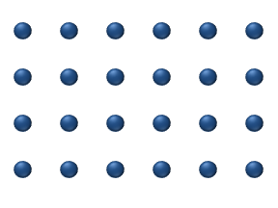
Diffusion
Molecules move to nearest free available space due to their own kinetic energy (generally always positive in nature).
Remember: Nature wants everything in homeostasis.
How fast/slow or drastic/subtle this process happens can depend on:
Temperature, Size of Molecules (solute) involved, and Type of Medium
By JrPol - Own work, CC BY 3.0, https://commons.wikimedia.org/w/index.php?curid=4586487

Slide 8
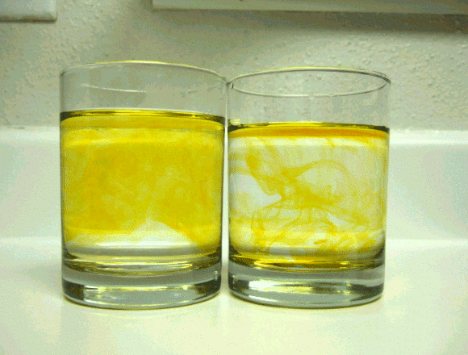
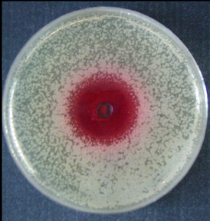
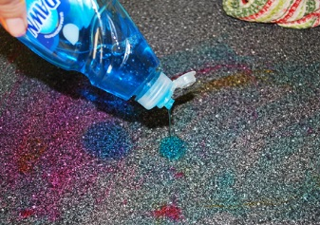
Types of Medium
* what molecules are moving through
Air (perfume) molecules far apart
Liquid (kool-aid)
Semi-solid (agar)
Solid (countertop) molecules close together
Copyrighted free use, https://commons.wikimedia.org/w/index.php?curid=1353812
By M.Mack - HS-Mannheim, Institut für technische Mikrobiologie, CC BY-SA 3.0, https://commons.wikimedia.org/w/index.php?curid=5239374
http://www.clumsycrafter.com/wp-content/uploads/2011/08/stainsoncountertopdawn.jpg
By Mike aus dem Bayerwald - Own work, CC BY-SA 3.0, https://commons.wikimedia.org/w/index.php?curid=7549241
Notes:
Here are four examples of mediums, ranging by molecule proximity.

Slide 9
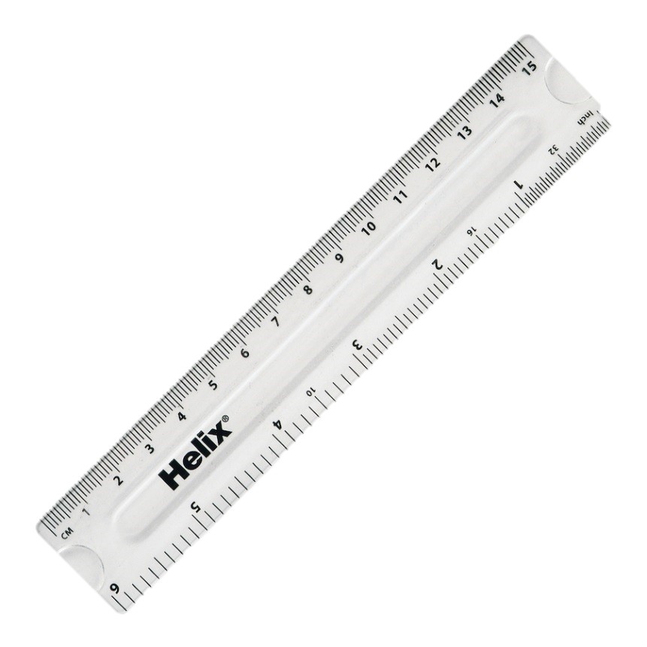
Diffusion – Liquid vs. Semi-Solid pg. 68
Switch to doc cam to demonstrate the experimental set-up and process for the student to be able to measure diffusion of semi-solid (pre-started) and water
2X

Slide 10
Diffusion – Liquid vs. Semi-Solid pg. 68
Diffusion of methylene blue in:
water (liquid) vs. agar (semi-solid)
Hypothesize: Given the same amount of time, in which medium would the dye diffuse the fastest?
© Kornelia Fillmer, CC BY-SA 3.0 https://photos.google.com/share/AF1QipNI7F0Ivn98mkVbccZHaZLZUf5g2B-0MeWxZig4RiIHK_ki4B0g4poDhu0I4mKdbg?key=R3h4N1MyMlFCRERIODBOczdrZEd5b3lVaFBJRXF3

Slide 11
Diffusion – Liquid vs. Semi-Solid pg. 68
Diffusion of methylene blue in:
water (liquid) vs. agar (semi-solid)
You will test and support your hypothesis by determining HOW FAST each of these medium’s allow a dye to travel
© Kornelia Fillmer, CC BY-SA 3.0 https://photos.google.com/share/AF1QipNI7F0Ivn98mkVbccZHaZLZUf5g2B-0MeWxZig4RiIHK_ki4B0g4poDhu0I4mKdbg?key=R3h4N1MyMlFCRERIODBOczdrZEd5b3lVaFBJRXF3

Slide 12
Calculating Rate of Diffusion (mm/h) pg. 68
Time Start: 9:00am
Time End: 12:00pm
Total Time in Hours (h): 3
Distance Traveled (mm) :
Time Start: 12:00:00pm
Time End: 12:00:20
Total Time in Hours (h):
Distance Traveled (mm) :
Total Time in Hours (h):

Slide 13
Calculating Rate of Diffusion (mm/h) pg. 36
1 hour = 60 mins = 3600 seconds
Take measurement after 20 seconds:
Need to know how to report 20 seconds AS what part of an hour?
3600 sec = 20 sec
3600 x = 20
x = 20 = 0.005 hours
1 hour ?(x)
3600 3600
3600

Slide 14
Calculating Rate of Diffusion (mm/h) pg. 68
Time Start:
Time End:
Total Time in Hours (h):
Distance Traveled (mm) :
Time Start:
Time End:
Total Time in Hours (h):
Distance Traveled (mm) :
Distance Traveled (mm) :
Distance Traveled (mm) :
8 cm to 10.5 cm = 2.5 cm =25 mm
8 cm to 9.5 cm = 1.5 cm =15 mm
Notes:
Rate of diffusion is reported in millimeters per hour mm/h Basically, if I tapped each of these mediums at the same time with dye then waited one hour, in which medium would the dye move outward the Fastest? We don’t have one hour to wait, so will need to conduct our experiment into a smaller timeframe, then convert our data into the correct units before we can compare the two mediums.

Slide 15
Types of Medium w/ barriers
Air (perfume)
Liquid
Semi-solid (agar)
Semi-permeable membrane* “Osmosis” (dialysis bag)
Copyrighted free use, https://commons.wikimedia.org/w/index.php?curid=1353812
By M.Mack - HS-Mannheim, Institut für technische Mikrobiologie, CC BY-SA 3.0, https://commons.wikimedia.org/w/index.php?curid=5239374
What else has a semipermeable “membrane”?
By Mike aus dem Bayerwald - Own work, CC BY-SA 3.0, https://commons.wikimedia.org/w/index.php?curid=7549241

Slide 16
Osmosis terms : Tonicity
Relative concentration of solute (particles) in solvent (water) side vs. side
this side VS. this side

Slide 17
Osmosis terms : Tonicity
Relative concentration of solute (particles) in solvent (water) side vs. side
Isotonic equal
Hypertonic (higher solute)
Hypotonic (lower solute)
8
8
16
8
16
16
8
*NOTE: You must have two sides – the terms mean nothing without a comparison!

Slide 18
Hypertonic, Hypotonic, Isotonic -Tonicity, it’s all relative -
Ted
Jim
Bill
By pixabay.com, CC0 Public Domain, https://pixabay.com/en/boy-happy-teen-guy-dude-teenager-154336/
Is Jim tall?

Slide 19
Diffusion of across semi-permeable membrane
Where is the concentration of the solutes (or particles) higher?
Where is the concentration of the solutes (or particles) lowest?
= Hypotonic
= Hypertonic
Semi-permeable
membrane

Slide 20
Q. What does nature want to do?

Slide 21
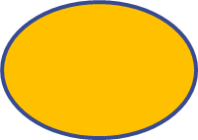
Q. What does nature want to do?
A. Move high conc. molecules to the space between the lower conc. molecules, until equilibrium is reached.

Slide 22
What if solute molecules are too large and can’t move through membrane, then…

Slide 23
What if solute molecules are too large and can’t move through membrane, then…
Water must move! Always from “o” to “er”
Think of the water diluting the high solute side
Water moves from Hypotonic to Hypertonic
The goal is Isotonicity/Equilibrium/Homeostasis!
Hypotonic
ISOTONIC
ISOTONIC
H₂O
Hypertonic

Slide 24
This is movement of water is called “Osmosis”
Isotonic!
So same concentration on both sides
Number of solute molecules on either side did not change (they did not move!)
H₂O moved, making left side smaller (shrink) and right side bigger (expand)
ISOTONIC
ISOTONIC

Slide 25
Where is the concentration of solute higher?
=> Hypertonic
=> other side = Hypotonic
Water moves from Hypotonic to Hypertonic
From ‘o’ to ‘er’
What will happen?
Cell expands
H₂O
Hypertonic
Hypotonic

Slide 26
Where is the concentration of solute higher?
=> Hypertonic
=> other side = Hypotonic
Water moves from Hypotonic to Hypertonic
From ‘o’ to ‘er’
What will happen?
Cell expands
0.5% NaCl
H₂O
0.9%
NaCl
Hypertonic
Hypotonic

Slide 27
Where is the concentration of solute higher?
=> Hypertonic
=> other side = Hypotonic
Water moves from Hypotonic to Hypertonic
From ‘o’ to ‘er’
What will happen?
Cells shrivel
1.5% NaCl
0.9%
NaCl
H₂O
Hypertonic
Hypotonic

Slide 28
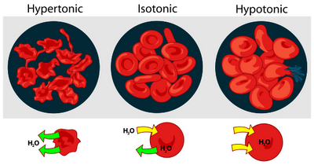
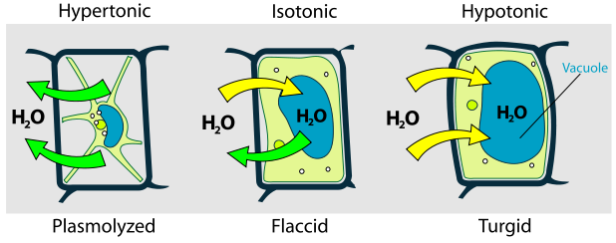
Diffusion in relation to cells = Tonicity
Relative concentration of solute (particles) or solvent (water) outside the cell compared to inside:
Isotonic – equilibrium, homeostasis…
Hypertonic
Shrivel = Crenation (animal cells), Plasmolysis (plant cells)
Hypotonic
Burst = Hemolysis (animal cells)
Swell = Turgid, or Turgor Pressure (plant cells)
By Osmotic pressure on blood cells diagram.svg: LadyofHatsderivative work: Antoni Salvà (talk)This vector image was created with Inkscape. - Osmotic pressure on blood cells diagram.svg, GFDL, https://commons.wikimedia.org/w/index.php?curid=7861851
By LadyofHats - did it myself based on [1], [2] ,[3] and [4]., Public Domain, https://commons.wikimedia.org/w/index.php?curid=1685428

Slide 29
Diffusion in relation to cells = Tonicity
Relative concentration of solute (particles) or solvent (water) outside the cell compared to inside:
Isotonic – equilibrium, homeostasis…
Hypertonic
Shrivel = Crenation (animal cells), Plasmolysis (plant cells)
Hypotonic
Burst = Hemolysis (animal cells)
Swell = Turgid, or Turgor Pressure (plant cells)
By Osmotic pressure on blood cells diagram.svg: LadyofHatsderivative work: Antoni Salvà (talk)This vector image was created with Inkscape. - Osmotic pressure on blood cells diagram.svg, GFDL, https://commons.wikimedia.org/w/index.php?curid=7861851
By LadyofHats - did it myself based on [1], [2] ,[3] and [4]., Public Domain, https://commons.wikimedia.org/w/index.php?curid=1685428

Slide 30
Diffusion in relation to cells = Tonicity
Relative concentration of solute (particles) or solvent (water) outside the cell compared to inside:
Isotonic – equilibrium, homeostasis…
Hypertonic
Shrivel = Crenation (animal cells), Plasmolysis (plant cells)
Hypotonic
Burst = Hemolysis (animal cells)
Swell = Turgid, or Turgor Pressure (plant cells)
By Osmotic pressure on blood cells diagram.svg: LadyofHatsderivative work: Antoni Salvà (talk)This vector image was created with Inkscape. - Osmotic pressure on blood cells diagram.svg, GFDL, https://commons.wikimedia.org/w/index.php?curid=7861851
By LadyofHats - did it myself based on [1], [2] ,[3] and [4]., Public Domain, https://commons.wikimedia.org/w/index.php?curid=1685428

Slide 31
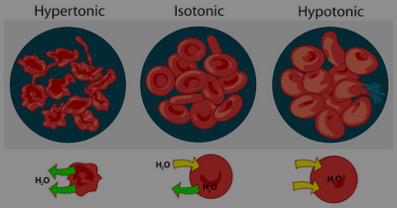
Tonicity and red blood cells pg. 75
Check out tubes of prepared red blood cell (RBC) solutions
RBCs are floating either in Hypertonic, Isotonic, or Hypotonic solution
“crenation”
“hemolysis”
By Osmotic pressure on blood cells diagram.svg: LadyofHatsderivative work: Antoni Salvà (talk)This vector image was created with Inkscape. - Osmotic pressure on blood cells diagram.svg, GFDL, https://commons.wikimedia.org/w/index.php?curid=7861851
10.0% NaCl
0.9% NaCl
DI water

Slide 32
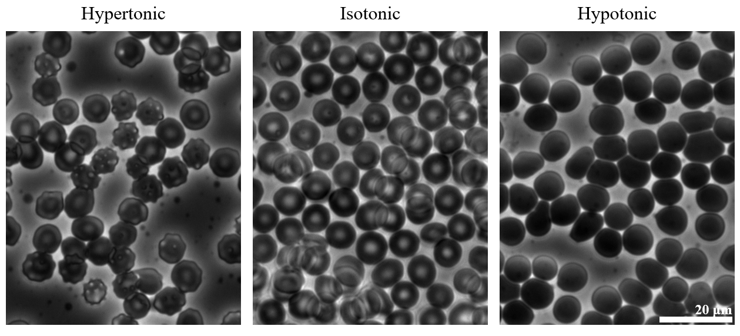
Tonicity and red blood cells pg. 75
By Zephyris - Own work, CC BY-SA 3.0, https://commons.wikimedia.org/w/index.php?curid=18401754
10.0% NaCl
0.9% NaCl
DI water

Slide 33
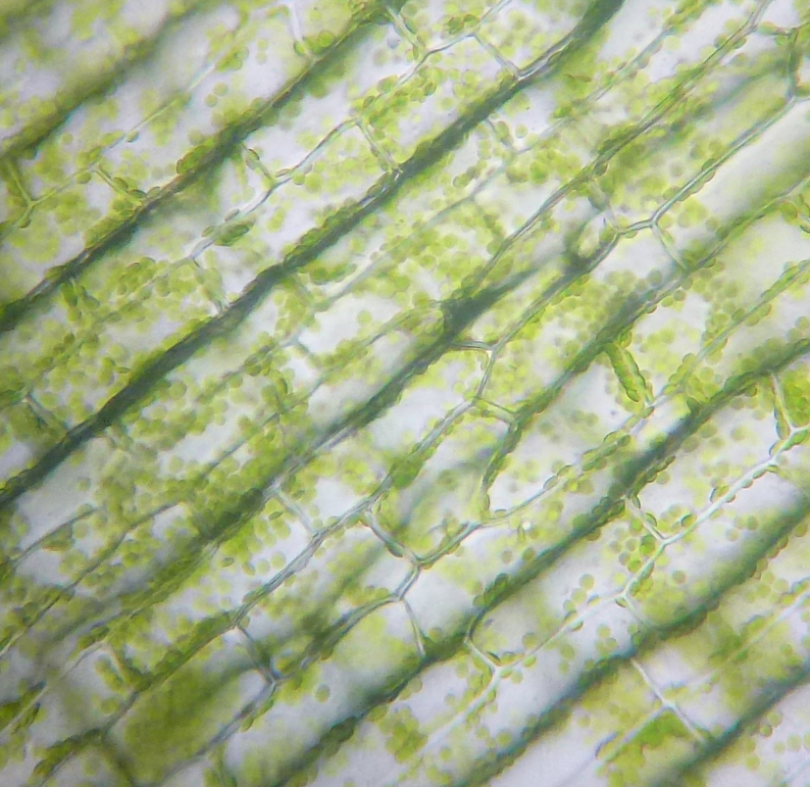
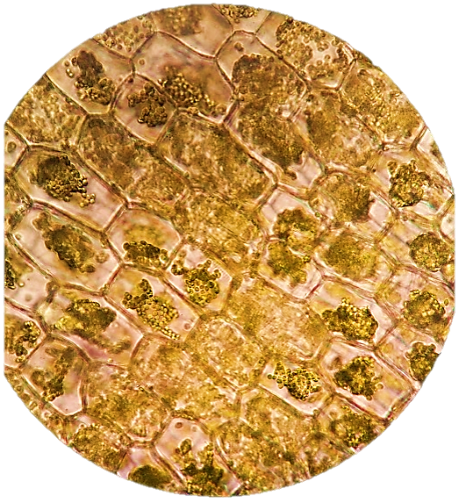
Tonicity and Elodea Cells pg. 77
Hypotonic Environment
Tap water > Cell (slightly salty)
Presses organelles up to side of cell wall (LCV swells!)
Turgid – Turgor Pressure
Hypertonic Enviornment
In 10% NaCl solution < Cell
Water leaves cell to dilute environment, LCV shrinks
Organelles clump and float wherever
Plasmolysis
By Cimice50 (Own work) [CC BY-SA 4.0 (http://creativecommons.org/licenses/by-sa/4.0)], via Wikimedia Commons https://upload.wikimedia.org/wikipedia/commons/a/a9/Cloroplasti_Elodea.jpg
© Kornelia Fillmer, CC BY-SA 3.0 https://photos.google.com/share/AF1QipNHRhg4AkNftwXMWAa7Si_lRLAjOlcWMvdtckFrv6fSCVYYXP6l70Y21yd_o47orA?key=VVV4M052OGk5R2FENWNHU0tMNjMxOWJjekFFMEtn

Slide 34
Tonicity Plant Cells pg. 77
By LadyofHats - did it myself based on [1], [2] ,[3] and [4]., Public Domain, https://commons.wikimedia.org/w/index.php?curid=1685428
10.0% NaCl
0.9% NaCl
DI water

Slide 35
Demonstration of movement across a semi-permeable membrane pg. 71
Tag water in test tube with Iodine* = amber
Add Glucose and Starch* in bag/
“cell” = cloudy white
Glucose + Starch
IODINE

Slide 36
Demonstration of movement across a semi-permeable membrane pg. 71
Tag water in test tube with Iodine* = amber
Add Glucose and Starch* in “cell”/= cloudy white
Solution inside the “cell” is what tonicity to the surrounding water?
(think our slightly salty cell is placed into DI water..)
Hypertonic
Water outside the “cell” is what tonicity to the solution inside the “cell”?
(think our slightly salty cell is placed into DI water..)
Hypotonic
Glucose + Starch

Slide 37
Demonstration of movement across a semi-permeable membrane pg. 71
Iodine + Starch = dark purple
Does inside or outside of the “cell” have smaller molecules?
Outside : (water*iodine)
What moves where, and WHY?
Water*iodine moves INTO “cell” meets Starch* and turns purple because Starch is too big to diffuse outward!
IODINE + Starch
Glucose + Starch
IODINE

Slide 38
Demonstration of movement across a semi-permeable membrane pg. 71
Tag water in test tube with Benedicts reagent (environment)
Blue Benedicts reagent detects sugar (glucose) by turning Orange.
Glucose + Starch
Starch only
Benedicts
+
Glucose
Benedicts

Slide 39
Demonstration of movement across a semi-permeable membrane pg. 71
Tag water in beaker with Benedicts reagent (environment)
Blue Benedicts reagent detects sugar (glucose) by turning Orange.
If heated for 5 minutes, What moves Where and Why?
Do things expand or contract
when heated?
The permeable membrane
stretches to allow glucose to pass
changing the blue beaker
solution to Orange

Slide 40
Today’s Lab Experiments
A: “To Do” pg. 68-70 Particle Diffusion Liquid (Water @ 60s) vs. Semisolid (Agar) vs. Solid (Tile)
B: “View & Answer” pgs. 72-73 ( view Dialysis bags)
Diffusion across Plasma membrane Demo
C: “View & Answer” pg. 75-76 Diffusion of water across animal cell membrane (view Red Blood Cells)
D: “To Do” pg. 77 Diffusion of water across plant cell wall (DO Elodea Tonicity slides)
ALL*: Finish Stations then return to seats discuss Potato Exp. Results and associated Lab Report
Station A
* Instructor” starts the potato strip for the entire class and records start time. Students skip this station until the 1 h wait time is over to record results.
Station D
Station B
Station C

