Slide 1
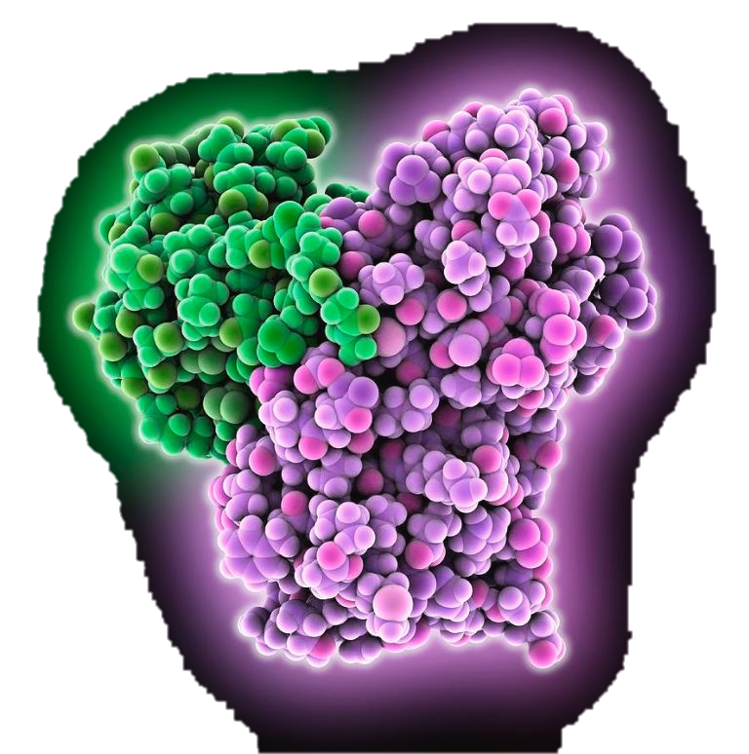
Enzymes
Exercise 5, pg. 55-66
BSC2010L

Slide 2
ENZYmes
Exercise 5, pg. 55-66
Lab Objectives:
Describe how enzymes function
Understand the role of the active site in enzyme specificity and activity
Understand the effect of temperature, concentration, and pH on enzyme activity

Slide 3
Metabolism
All the chemical reactions that occur in a cell
A + B -------------------------------------- → C + D
Reactants Products
Substrate
These reactions can take a long time, so …
an enzyme is needed to speed up the reaction and/or to lower the activation energy needed to jumpstart the reaction (police escort in the HOV lane)
A + B ------→ C + D
Reactants Products
Substrate
-------------------------------------- →

Slide 4
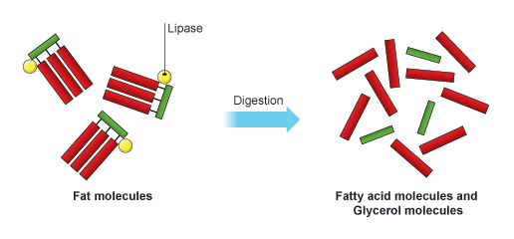
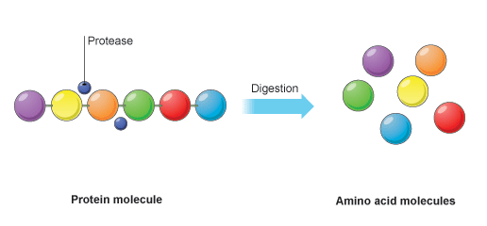
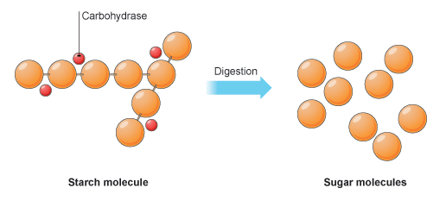
What are Enzymes?
Organic catalysts that speed up metabolic reactions
Enzymes are NOT consumed during a reaction
Reaction takes place at the ‘active site’
They are proteins
So they can be affected by environmental stress (think pH & temp)
Enzymes are specific and speed up only one type of reaction
Names for enzymes will generally end in –ase
Lipase – breaks down fats (laundry detergent)
Protease – breaks down proteins (baby formula)
Carbohydrase – breaks down carbohydrates (lactose free milk)

Slide 5
Enzymes = proteins that speed rxns
Things that can alter enzyme efficiency (rate of reaction):
Specificity: Having the (specific) substrate for the enzyme to react with (BFF)
Concentration: Having the right amount of enzyme and substrate (quantity limitations)
Temperature: Having the optimal temperature for the enzyme to work in (where did it come from)
pH: Having the optimal pH environment for the enzyme to work in (what makes it cozy)

Slide 6
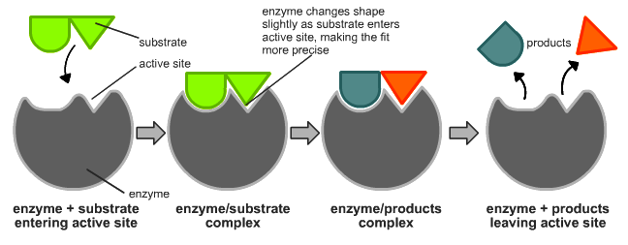
Types of Enzyme reactions:
Example of catabolic reaction (breakdown of sub) involving an enzyme;
Enzymes can also be involved in synthesis (combining subs) reactions
By TimVickers (en:Image:Induced_fit_diagram.png) [Public domain], via Wikimedia Commons https://upload.wikimedia.org/wikipedia/commons/c/c0/Induced_fit_diagram.png

Slide 7
Specificity & Enzymes
Specificity is important for enzymatic reactions because of the “ACTIVE SITE” adherence factor!
http://2.bp.blogspot.com/-_Yfec28lZKs/U-4VXAOdfpI/AAAAAAAATCE/97meLiwRvGA/s1600/lock%2Band%2Bkey.png

Slide 8
Specificity & Enzymes
Specificity is important for enzymatic reactions because of the “ACTIVE SITE” adherence factor!
If the enzyme cannot sit perfectly in the active site, the reaction will not occur (or it will but not as fast or easily as with the enzyme)
http://2.bp.blogspot.com/-_Yfec28lZKs/U-4VXAOdfpI/AAAAAAAATCE/97meLiwRvGA/s1600/lock%2Band%2Bkey.png

Slide 9
Specificity & Enzymes
Specificity is important for enzymatic reactions because of the “ACTIVE SITE” adherence factor!
If the enzyme cannot sit perfectly in the active site, the reaction will not occur (or it will but not as fast or easily as with the enzyme)
http://2.bp.blogspot.com/-_Yfec28lZKs/U-4VXAOdfpI/AAAAAAAATCE/97meLiwRvGA/s1600/lock%2Band%2Bkey.png

Slide 10
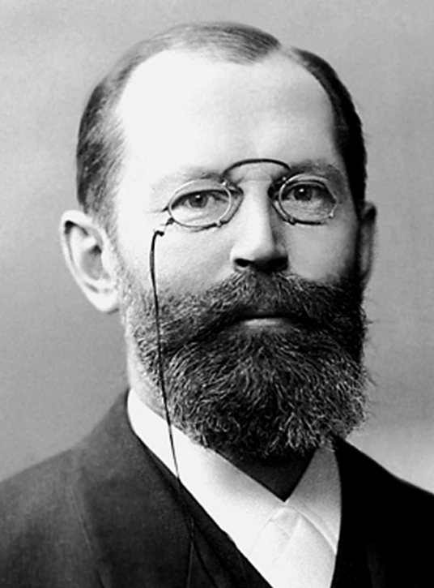
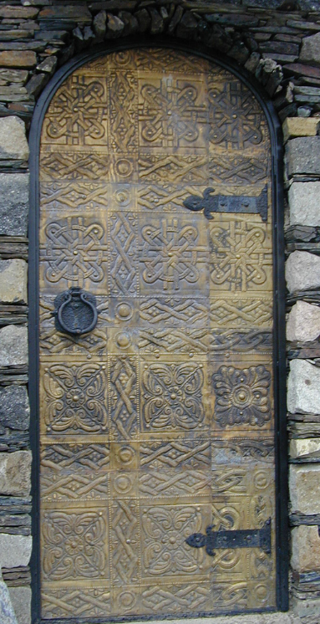
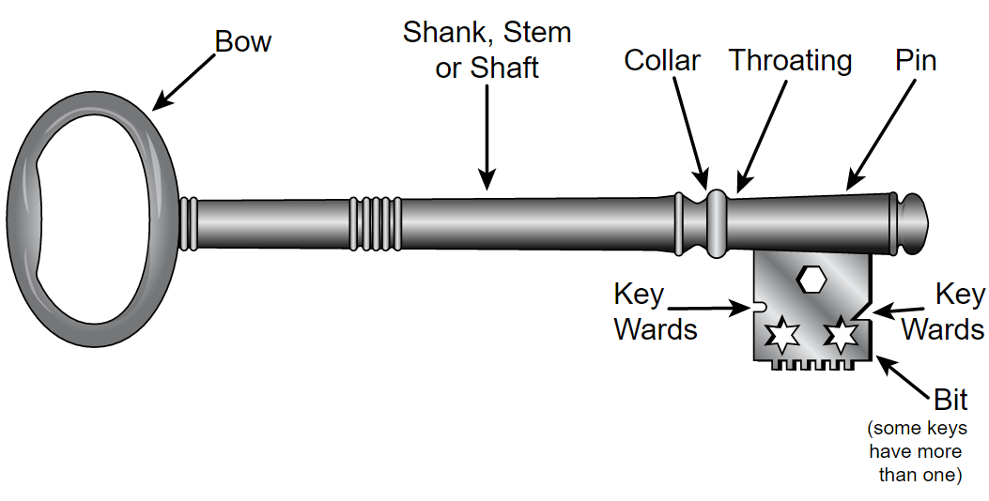
Effects of Concentration of Enzyme
In 1890 Hermann Emil Fischer proposed the following analogy:
Think of an enzyme like a key to a specific locked door
Now think of yourself in a building with 100 doors (substrate) with only 1 key (enzyme)
It would take you a while to open all the doors, although you could do it
By Atelier Victoria (Inh. Paul Gericke, gegr. 1894), Berlin http://www.znanijamira.ru/publ/nobel_laureat/ehmil_german_fisher/42-1-0-2119, Public Domain, https://commons.wikimedia.org/w/index.php?curid=35759465
By Fred the Oysteri The source code of this SVG is valid. This vector graphics image was created with Adobe Illustrator. - Own work, GFDL, https://commons.wikimedia.org/w/index.php?curid=36301608
By daduNI - Nino Narozauli - how old is this door???, CC BY-SA 2.0, https://commons.wikimedia.org/w/index.php?curid=3401686

Slide 11
Effects of Concentration of Enzyme
How about having more keys (more enzymes)?
Say I give the entire class a key and we all go together to unlock the doors…
The more keys you have, the more doors could be opened in the same amount of time!
By Atelier Victoria (Inh. Paul Gericke, gegr. 1894), Berlin http://www.znanijamira.ru/publ/nobel_laureat/ehmil_german_fisher/42-1-0-2119, Public Domain, https://commons.wikimedia.org/w/index.php?curid=35759465
By Fred the Oysteri The source code of this SVG is valid. This vector graphics image was created with Adobe Illustrator. - Own work, GFDL, https://commons.wikimedia.org/w/index.php?curid=36301608
By daduNI - Nino Narozauli - how old is this door???, CC BY-SA 2.0, https://commons.wikimedia.org/w/index.php?curid=3401686

Slide 12
‘Rate of Reaction’ influenced by Substrate Concentrations
If the substrate concentration for a given amount of enzymes is very low, the time for an enzyme to bind with the next substrate would be relatively long.
aka. doors are very far apart
Enzyme needs “to find” the next available substrate.

Slide 13
‘Rate of Reaction’ influenced by Substrate Concentrations
If the substrate concentration for a given amount of enzymes is very low, the time for an enzyme to bind with the next substrate would be relatively long.
aka. doors are very far apart
Enzyme needs “to find” the next available substrate.
Increasing the substrate concentration will decrease that ‘search time’ – thereby increasing the rate of reaction.

Slide 14
Rate of Reaction influenced by Enzyme & Substrate Concentrations
Both, Enzyme Concentration as well as Substrate Concentration influence the Rate of Reaction
also called ‘reaction velocity’

Slide 15
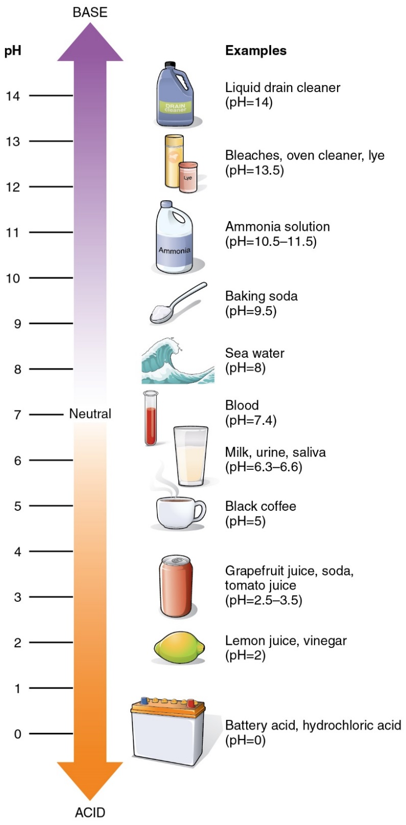
pH & Enzyme Activity
Potential of Hydrogen = pH
How acidic (excess H+) or basic (excess –OH) a solution is
1-6 #’s ACIDIC (extra H+)
Enzymes in our Stomach – work best in low pH (break down fats, proteins, carbs)
7 is NEUTRAL (equal –OH and H+)
Blood must be between 7.35-7.45
Enzymes in our blood work best at 7.4
8-14 #’s ALKALINE (extra –OH)
Enzymes in small intestine – work best in higher pH (neutralize the acid from digestion)

Slide 16
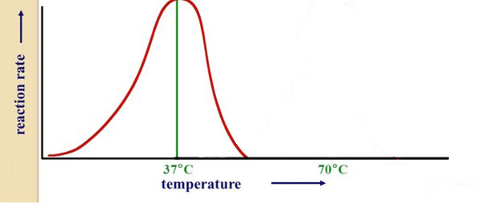
Temp & pH effects on Enzymes
Each enzyme is derived from a particular environment:
Where it’s found gives you clues to what conditions it will work best in (*optimal condition*)
Deviations away from optimal will decrease how well the enzyme functions, and at some point no longer work (*past threshold)
http://image.slidesharecdn.com/enzymesanddigestion-111011101326-phpapp02/95/enzymes-and-digestion-19-728.jpg
http://images.slideplayer.com/36/10667951/slides/slide_23.jpghttp://www.factzoo.com/sites/all/img/invertebrates/alaskan-crab-in-the-deep.jpg

Slide 17
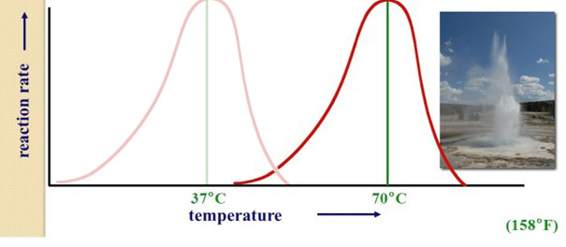
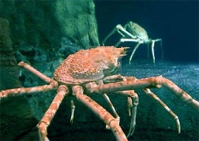
Temp & pH effects on Enzymes
Each enzyme is specific to its ‘optimal’ temp & pH:
Cold water crab digestive enzyme may have lower
‘optimal temp’/‘optimal pH’
vs. digestive enzyme found in hot springs bacteria.
Crab enzyme won’t function in Hot Springs environment and vice versa.
http://image.slidesharecdn.com/enzymesanddigestion-111011101326-phpapp02/95/enzymes-and-digestion-19-728.jpg
/pH
/pH
http://images.slideplayer.com/36/10667951/slides/slide_23.jpghttp://www.factzoo.com/sites/all/img/invertebrates/alaskan-crab-in-the-deep.jpg

Slide 18
Temp & pH effects on Enzymes
If the enzyme and substrate are exposed to a non-optimal environment, say too hot or too drastic pH change, weak bonds can be broken causing the active site of the substrate or the enzyme shape itself to change form, or become “denatured”, thus they cannot bond together to drive the reaction.
http://image.slidesharecdn.com/enzymesanddigestion-111011101326-phpapp02/95/enzymes-and-digestion-19-728.jpg

Slide 19
What does CATALASE do?
Hydrogen peroxide is a dangerous product of metabolic processes in cells
The enzyme, catalase (found in peroxisomes), is used by cells to rapidly catalyze the decomposition of hydrogen peroxide to less reactive oxygen and water
Test if these 4 things can alter enzyme efficiency (rate of reaction):
Specificity
Concentration
Temperature
pH
catalase
Substrate Product Product
2 H₂O₂ O₂ + 2 H₂O
Notes:
peroxisomes

Slide 20
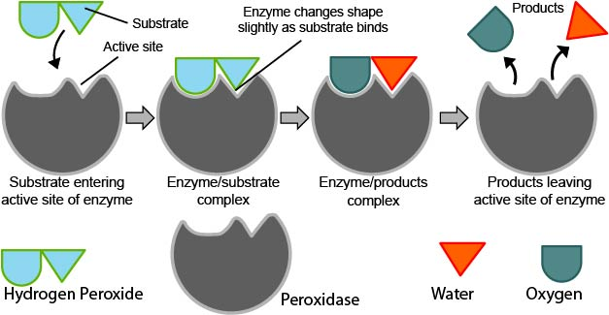
How will we see if catalase is working?
Bubbles!... But where do they come from?
catalase
Hydrogen Peroxide Oxygen Water
2 H₂O₂ O₂ + 2 H₂O
By pixabay.com, CC0 Public Domain, https://pixabay.com/en/test-tube-boiling-blue-bubbles-31062/
Catalase

Slide 21
How will we see if catalase is working?
Bubbles!... But where do they come from?
catalase
Hydrogen Peroxide Oxygen Water
2 H₂O₂ O₂ + 2 H₂O
By pixabay.com, CC0 Public Domain, https://pixabay.com/en/test-tube-boiling-blue-bubbles-31062/
Resulting from the production of oxygen (O₂ - a gas)
Remember, bubbles will only form when catalase is effectively breaking down hydrogen peroxide into water and oxygen
Catalase

Slide 22
Specificity & Enzyme Activity (pg.58)
1a. Cat + H202
1b. Water + H202
1c. Cat + Sucrose
2.5 cm
2.5 cm
2.5 cm
0.5 cm
0.5 cm
0.5 cm
Tube 1
Tube 2
Tube 3
Label, measure, and mark three tubes accordingly
Add “first reagent” to 0.5 cm mark in respective tubes
3. Add “second reagent” to 2.5 cm mark and swirl - record bubble height

Slide 23
Specificity & Enzyme Activity (pg.58)
Hypothesis?
1a. Cat + H202
1b. Water + H202
1c. Cat + Sucrose
2.5 cm
2.5 cm
2.5 cm
0.5 cm
0.5 cm
0.5 cm
Tube 1
Tube 2
Tube 3
catalase
Substrate Product Product
2 H₂O₂ O₂ + 2 H₂O
“Enzyme”

Slide 24
Concentration & Enzyme Activity (pg. 60)
1a. 0.5 cm Cat
1b. 1.0 cm Cat
1c. 1.5 cm Cat
3.5 cm
3.0 cm
2.5 cm
1.5 cm
1.0 cm
0.5 cm
Tube 1
Tube 2
Tube 3
Label, measure, and mark three tubes accordingly
Add different amounts of Catalase to specified marks in respective tubes
Add 2.0 cm of H₂O₂ to pre measured marks and swirl - record bubble height

Slide 25
Concentration & Enzyme Activity (pg. 60)
Hypothesis?
1a. 0.5 cm Cat
1b. 1.0 cm Cat
1c. 1.5 cm Cat
3.5 cm
3.0 cm
2.5 cm
1.5 cm
1.0 cm
0.5 cm
Tube 1
Tube 2
Tube 3
catalase
Substrate Product Product
2 H₂O₂ O₂ + 2 H₂O
“Enzyme”

Slide 26
Temperature & Enzyme Activity (pg.62)
1a. ICED Cat
1b. Body temp Cat
1c. Pre-Boiled Cat
2.5 cm
2.5 cm
2.5 cm
0.5 cm
0.5 cm
0.5 cm
Tube 1
Tube 2
Tube 3
Label, measure, and mark three tubes accordingly
Add different temp Catalase to 0.5 cm mark in respective tubes
3. Add H₂O₂ to 2.5 cm mark and swirl - record bubble height

Slide 27
Temperature & Enzyme Activity (pg.62)
Hypothesis?
1a. ICED Cat
1b. Body temp Cat
1c. Pre-Boiled Cat
2.5 cm
2.5 cm
2.5 cm
0.5 cm
0.5 cm
0.5 cm
Tube 1
Tube 2
Tube 3
catalase
Substrate Product Product
2 H₂O₂ O₂ + 2 H₂O
“Enzyme”

Slide 28
ph & Enzyme Activity (pg. 64)
2a. Adjust to pH 3
By adding HCl
2b. Use DI water @ pH 7
2c. Adjust to pH 11
By adding NaOH
3.5 cm
3.5 cm
3.5 cm
1.5 cm
1.5 cm
1.5 cm
1.0 cm
1.0 cm
1.0 cm
Tube 1
Tube 2
Tube 3
Label all three test tubes, then…
1. Add water to 1.0 cm mark
2. ADJUST pH!!! (see above illustration)
3. Add Catalase to 1.5 cm mark
4. Add H₂O₂ to 3.5 cm mark and swirl -record bubble height

Slide 29
ph & Enzyme Activity (pg. 64)
Hypothesis?
2a. Adjust to pH 3
By adding HCl
2b. Use DI water @ pH 7
2c. Adjust to pH 11
By adding NaOH
3.5 cm
3.5 cm
3.5 cm
1.5 cm
1.5 cm
1.5 cm
1.0 cm
1.0 cm
1.0 cm
Tube 1
Tube 2
Tube 3
catalase
Substrate Product Product
2 H₂O₂ O₂ + 2 H₂O
“Enzyme”

Slide 30
Activities
A: “To Do” page 58 Enzyme Specificity
B: “To Do” page 60 Enzyme Concentration
C: “To Do” page 62 Temperature
D: “To Do” page 64 pH
E: Return to seats:combine class data for your LAB REPORT!
Lab Manual Fix:
Do not record in mm, Measure and RECORD in
cm

