Slide 1
Enzymes
Exercise 5, pg. 45-52
BSC2010L

Slide 2
Test 2 Next week
Exercise 4 – Osmosis/Diffusion/Tonicity
Exercise 5 – Enzymes
Exercise 6 – Respiration/Fermentation
Same set up as Test 1
50 questions
25 stations
Mini versions of lab
Read & Record
Memory Recall
1.5 min per station
One rotation only – cannot go back to a station
80 point test + 20 point Lab Report* = 100 points

Slide 3
ENZYmes
Exercise 5, pg. 45-52
Lab Objectives:
Describe how enzymes function
Understand the role of the active site in enzyme specificity and activity
Understand the effect of temperature, concentration, and pH on enzyme activity

Slide 4
Metabolism
All the chemical reactions that occur in a cell
A + B -------------------------------------- → C + D
Reactants Products
Substrate
These reactions can take a long time, so …
an enzyme is needed to speed up the reaction and/or to lower the activation energy needed to jumpstart the reaction (police escort in the HOV lane)
A + B ------→ C + D
Reactants Products
Substrate
-------------------------------------- →

Slide 5
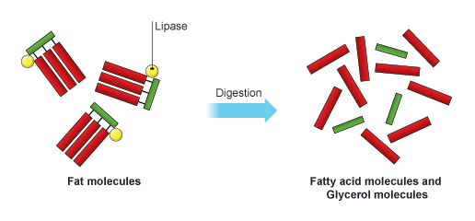
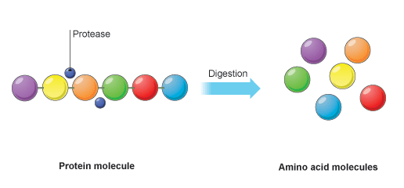
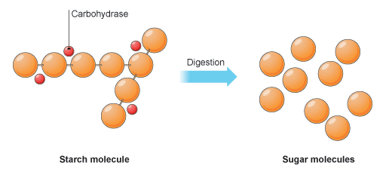
What are Enzymes?
Organic catalysts that speed up metabolic reactions
Enzymes are NOT consumed during a reaction
Reaction takes place at the ‘active site’
They are proteins
So they can be affected by environmental stress (think pH & temp)
Enzymes are specific and speed up only one type of reaction
Names for enzymes will generally end in –ase
Lipase – breaks down fats (laundry detergent, make cheese)
Protease – breaks down proteins (baby formula)
Carbohydrase – breaks down carbohydrates (performance shirts)

Slide 6
Enzymes = proteins that speed rxns
Things that can alter enzyme efficiency (rate of reaction):
Specificity: Having the (specific) substrate for the enzyme to react with (BFF)
Temperature: Having the optimal temperature for the enzyme to work in (where did it come from)
Concentration: Having the right amount of enzyme and substrate (quantity limitations)
pH: Having the optimal pH environment for the enzyme to work in (what makes it cozy)

Slide 7
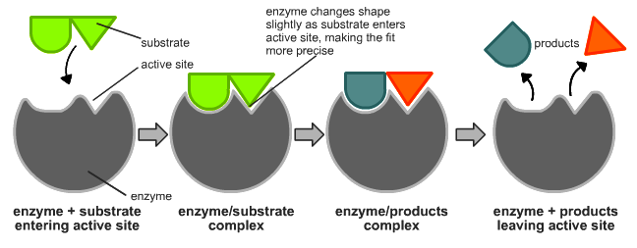
Types of Enzyme reactions:
Example of catabolic reaction (breakdown of sub) involving an enzyme;
Enzymes can also be involved in synthesis (combining subs) reactions
By TimVickers (en:Image:Induced_fit_diagram.png) [Public domain], via Wikimedia Commons https://upload.wikimedia.org/wikipedia/commons/c/c0/Induced_fit_diagram.png

Slide 8
Specificity & Enzymes
Specificity is important for enzymatic reactions because of the “ACTIVE SITE” adherence factor!
http://2.bp.blogspot.com/-_Yfec28lZKs/U-4VXAOdfpI/AAAAAAAATCE/97meLiwRvGA/s1600/lock%2Band%2Bkey.png

Slide 9
Specificity & Enzymes
Specificity is important for enzymatic reactions because of the “ACTIVE SITE” adherence factor!
If the enzyme cannot sit perfectly in the active site, the reaction will not occur (or it will but not as fast or easily as with the enzyme)
http://2.bp.blogspot.com/-_Yfec28lZKs/U-4VXAOdfpI/AAAAAAAATCE/97meLiwRvGA/s1600/lock%2Band%2Bkey.png

Slide 10
Specificity & Enzymes
Specificity is important for enzymatic reactions because of the “ACTIVE SITE” adherence factor!
If the enzyme cannot sit perfectly in the active site, the reaction will not occur (or it will but not as fast or easily as with the enzyme)
http://2.bp.blogspot.com/-_Yfec28lZKs/U-4VXAOdfpI/AAAAAAAATCE/97meLiwRvGA/s1600/lock%2Band%2Bkey.png

Slide 11
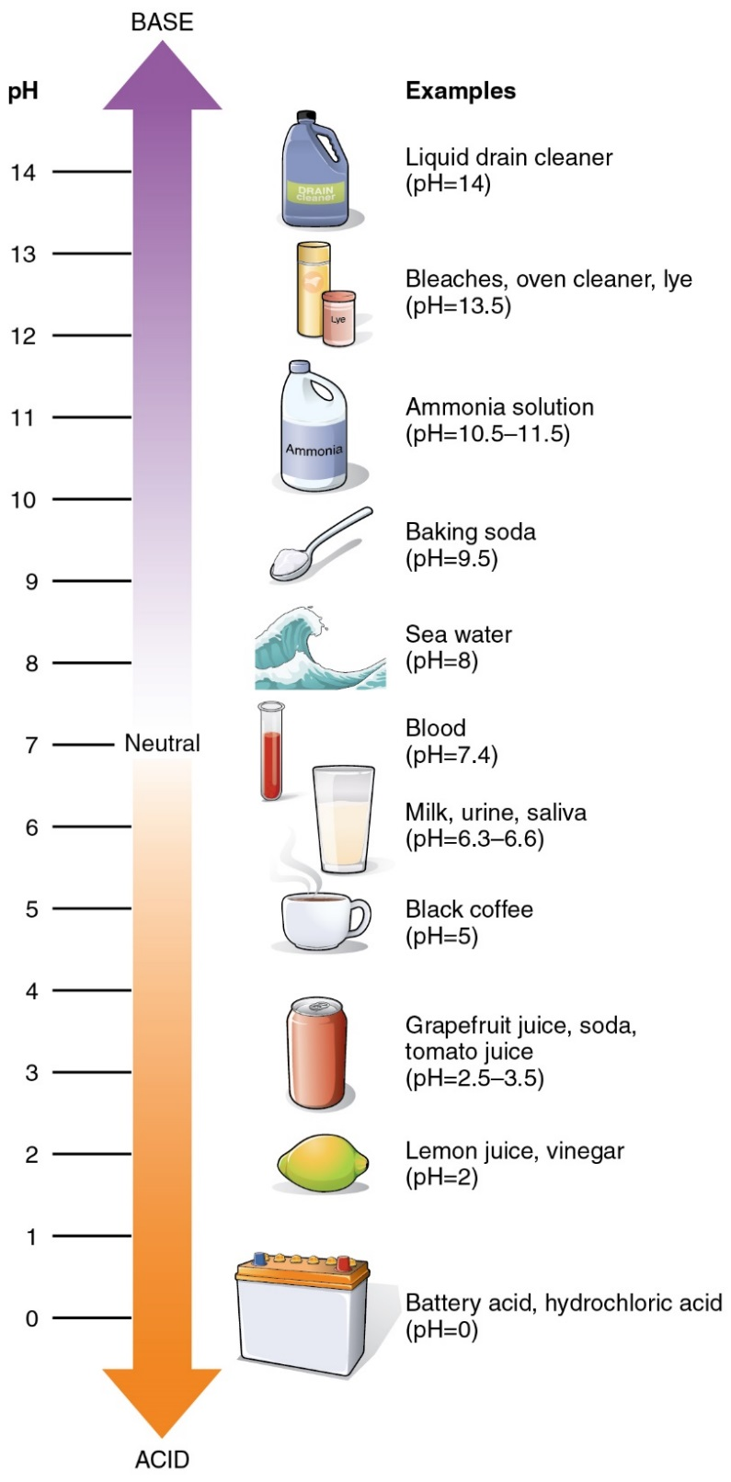
pH & Enzyme Activity
Potential of Hydrogen = pH
How acidic (excess H+) or basic (excess –OH) a solution is
1-6 #’s ACIDIC (extra H+)
Enzymes in our Stomach – work best in low pH (break down fats, proteins, carbs)
7 is NEUTRAL (equal –OH and H+)
Blood must be between 7.35-7.45
Enzymes in our blood work best at 7.4
8-14 #’s ALKALINE (extra –OH)
Enzymes in small intestine – work best in higher pH (neutralize the acid from digestion)

Slide 12
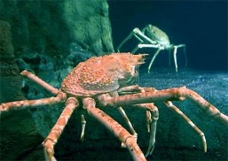
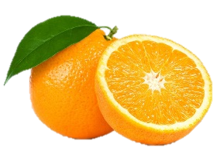
Temp & pH effects on Enzymes
In general as temperature increases, enzymatic reactions will increase as well…to a point.
(Rxns are driven from kinetic energy conversion into chemical potential energy)
Each enzyme is specific to its ‘optimal’ temp & pH:
Cold water crab digestive enzyme may have lower ‘optimal temp’ vs. digestive enzyme found in hot springs bacteria.
Same applies for pH: Citrus fruit enzyme may have low ‘optimal pH’ vs.
http://image.slidesharecdn.com/enzymesanddigestion-111011101326-phpapp02/95/enzymes-and-digestion-19-728.jpg
an oceanic plankton enzyme.
You can chart this “rate of reaction” on a simple x-y axis graph for either temp or pH.
/pH
http://images.slideplayer.com/36/10667951/slides/slide_23.jpghttp://www.factzoo.com/sites/all/img/invertebrates/alaskan-crab-in-the-deep.jpg

Slide 13
Temp & pH effects on Enzymes
If the enzyme and substrate are exposed to a non-optimal environment, say too hot or too drastic pH change, weak bonds can be broken causing the active site of the substrate or the enzyme shape itself to change form, or become “denatured”, thus they cannot bond together to drive the reaction.
http://image.slidesharecdn.com/enzymesanddigestion-111011101326-phpapp02/95/enzymes-and-digestion-19-728.jpg

Slide 14
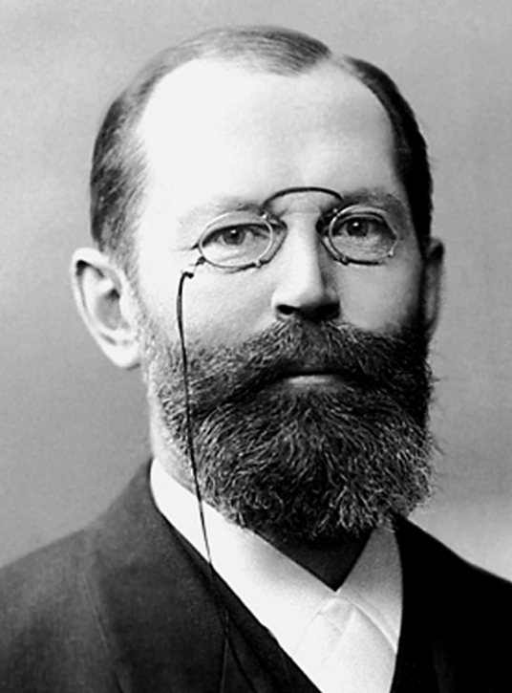
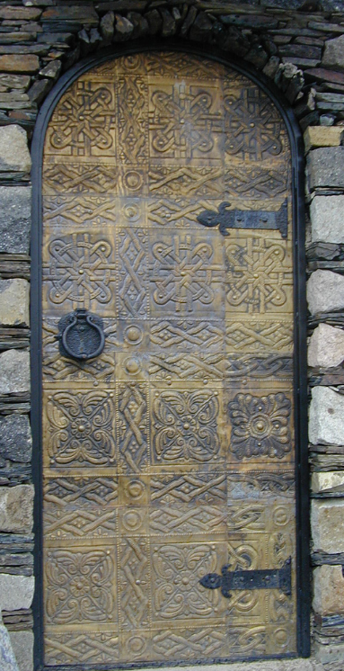
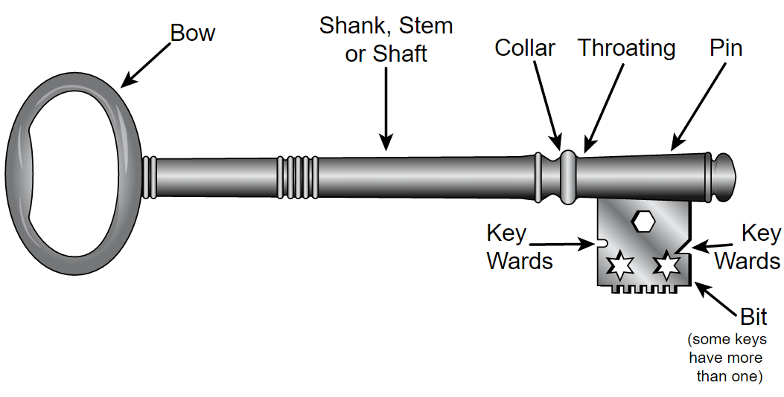
Effects of Concentration of Enzyme
In 1890 Hermann Emil Fischer proposed the following analogy:
Think of an enzyme like a key to a specific locked door
Now think of yourself in a building with 100 doors (substrate) with only 1 key (enzyme)
It would take you a while to open all the doors, although you could do it
By Atelier Victoria (Inh. Paul Gericke, gegr. 1894), Berlin http://www.znanijamira.ru/publ/nobel_laureat/ehmil_german_fisher/42-1-0-2119, Public Domain, https://commons.wikimedia.org/w/index.php?curid=35759465
By Fred the Oysteri The source code of this SVG is valid. This vector graphics image was created with Adobe Illustrator. - Own work, GFDL, https://commons.wikimedia.org/w/index.php?curid=36301608
By daduNI - Nino Narozauli - how old is this door???, CC BY-SA 2.0, https://commons.wikimedia.org/w/index.php?curid=3401686

Slide 15
Effects of Concentration of Enzyme
How about having more keys (more enzymes)?
Say I give the entire class a key and we all go together to unlock the doors…
The more keys you have, the more doors could be opened in the same amount of time!
By Atelier Victoria (Inh. Paul Gericke, gegr. 1894), Berlin http://www.znanijamira.ru/publ/nobel_laureat/ehmil_german_fisher/42-1-0-2119, Public Domain, https://commons.wikimedia.org/w/index.php?curid=35759465
By Fred the Oysteri The source code of this SVG is valid. This vector graphics image was created with Adobe Illustrator. - Own work, GFDL, https://commons.wikimedia.org/w/index.php?curid=36301608
By daduNI - Nino Narozauli - how old is this door???, CC BY-SA 2.0, https://commons.wikimedia.org/w/index.php?curid=3401686

Slide 16
Rate of Reaction
Assume: It takes 4 seconds to open 1 one door with 1 key
4 seconds =

Slide 17
Rate of Reaction
Assume: It takes 4 seconds to open 1 one door with 1 key
What is the rate of reaction (how much time will it take) if you have 10 keys and 100 doors?
How many seconds does it take to open 100 doors with 1 key?
4 sec X 100 doors = 400 sec (~6^{1/2} minutes)

Slide 18
Rate of Reaction
Assume: It takes 4 seconds to open 1 one door with 1 key
What is the rate of reaction (how much time will it take) if you have 10 keys and 100 doors?
How many seconds does it take to open 100 doors with 1 key?
4 sec X 100 doors = 400 sec (~6^{1/2} minutes)
100 doors would take 400 sec with 1 key ….
BUT…you have 10 keys! (10x faster)

Slide 19
Rate of Reaction
Assume: It takes 4 seconds to open 1 one door with 1 key
What is the rate of reaction (how much time will it take) if you have 100 doors and 10 keys ?
How many seconds does it take to open 100 doors with 1 key?
4 sec X 100 doors = 400 sec (~6^{1/2} minutes)
100 doors would take 400 sec with 1 key ….
BUT…you have 10 keys! (10x faster)
Reaction rate is 400 sec/10 keys = 40 [doors/sec]

Slide 20
‘Rate of Reaction’ influenced by Substrate Concentrations
If the substrate concentration for a given amount of enzymes is very low, the time for an enzyme to bind with the next substrate would be relatively long.
aka. doors are very far apart
Enzyme needs “to find” the next available substrate.

Slide 21
‘Rate of Reaction’ influenced by Substrate Concentrations
If the substrate concentration for a given amount of enzymes is very low, the time for an enzyme to bind with the next substrate would be relatively long.
aka. doors are very far apart
Enzyme needs “to find” the next available substrate.
Increasing the substrate concentration will decrease that ‘search time’ – thereby increasing the rate of reaction.

Slide 22
Rate of Reaction influenced by Enzyme & Substrate Concentrations
Both, Enzyme Concentration as well as Substrate Concentration influence the Rate of Reaction
also called ‘reaction velocity’

Slide 23
What does CATALASE do?
Hydrogen peroxide is a dangerous product of metabolic processes in cells
The enzyme, catalase (found in peroxisomes), is used by cells to rapidly catalyze the decomposition of hydrogen peroxide to less reactive oxygen and water
Remember, 4 things can alter enzyme efficiency (rate of reaction):
Specificity: Whether or not you have the correct (specific) substrate for the enzyme to react with.
Temperature
Concentration of enzyme and substrate
pH
catalase
Substrate Product Product
2 H₂O₂ O₂ + 2 H₂O
Notes:
peroxisomes

Slide 24
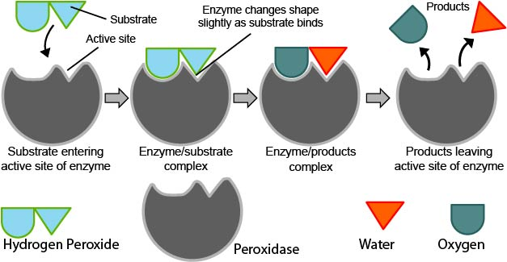
How will we see if catalase is working?
Bubbles!... But where do they come from?
catalase
Hydrogen Peroxide Oxygen Water
2 H₂O₂ O₂ + 2 H₂O
By pixabay.com, CC0 Public Domain, https://pixabay.com/en/test-tube-boiling-blue-bubbles-31062/
Catalase

Slide 25
How will we see if catalase is working?
Bubbles!... But where do they come from?
catalase
Hydrogen Peroxide Oxygen Water
2 H₂O₂ O₂ + 2 H₂O
By pixabay.com, CC0 Public Domain, https://pixabay.com/en/test-tube-boiling-blue-bubbles-31062/
Resulting from the production of oxygen (O₂ - a gas)
Remember, bubbles will only form when catalase is effectively breaking down hydrogen peroxide into water and oxygen
Catalase

Slide 26
Specificity & Enzyme Activity (pg.47)
1a. Cat + H202
1b. Water + H202
1c. Cat + Sucrose
2.5 cm
2.5 cm
2.5 cm
0.5 cm
0.5 cm
0.5 cm
Tube 1
Tube 2
Tube 3
Label, measure, and mark three tubes accordingly
Add “first reagent” to 0.5 cm mark in respective tubes
3. Add “second reagent” to 2.5 cm mark and swirl - record bubble height

Slide 27
Specificity & Enzyme Activity (pg.47)
Hypothesis?
1a. Cat + H202
1b. Water + H202
1c. Cat + Sucrose
2.5 cm
2.5 cm
2.5 cm
0.5 cm
0.5 cm
0.5 cm
Tube 1
Tube 2
Tube 3
catalase
Substrate Product Product
2 H₂O₂ O₂ + 2 H₂O
“Enzyme”

Slide 28
Temperature & Enzyme Activity (pg.48)
1a. ICED Cat
1b. Body temp Cat
1c. Pre-Boiled Cat
2.5 cm
2.5 cm
2.5 cm
0.5 cm
0.5 cm
0.5 cm
Tube 1
Tube 2
Tube 3
Label, measure, and mark three tubes accordingly
Add different temp Catalase to 0.5 cm mark in respective tubes
3. Add H₂O₂ to 2.5 cm mark and swirl - record bubble height

Slide 29
Temperature & Enzyme Activity (pg.48)
Hypothesis?
1a. ICED Cat
1b. Body temp Cat
1c. Pre-Boiled Cat
2.5 cm
2.5 cm
2.5 cm
0.5 cm
0.5 cm
0.5 cm
Tube 1
Tube 2
Tube 3
catalase
Substrate Product Product
2 H₂O₂ O₂ + 2 H₂O
“Enzyme”

Slide 30
Concentration & Enzyme Activity (pg. 50)
1a. 0.5 cm Cat
1b. 1.0 cm Cat
1c. 1.5 cm Cat
3.5 cm
3.0 cm
2.5 cm
1.5 cm
1.0 cm
0.5 cm
Tube 1
Tube 2
Tube 3
Label, measure, and mark three tubes accordingly
Add different amounts of Catalase to specified marks in respective tubes
Add 2.0 cm of H₂O₂ to pre measured marks and swirl - record bubble height

Slide 31
Concentration & Enzyme Activity (pg. 50)
Hypothesis?
1a. 0.5 cm Cat
1b. 1.0 cm Cat
1c. 1.5 cm Cat
3.5 cm
3.0 cm
2.5 cm
1.5 cm
1.0 cm
0.5 cm
Tube 1
Tube 2
Tube 3
catalase
Substrate Product Product
2 H₂O₂ O₂ + 2 H₂O
“Enzyme”

Slide 32
ph & Enzyme Activity (pg. 51)
2a. Adjust to pH 3
By adding HCl
2b. Adjust to pH 7
By adding either NaOH or HCl
2c. Adjust to pH 11
By adding NaOH
3.5 cm
3.5 cm
3.5 cm
1.5 cm
1.5 cm
1.5 cm
1.0 cm
1.0 cm
1.0 cm
Tube 1
Tube 2
Tube 3
To all three test tubes:
1. Add water to 1.0 cm mark
2. ADJUST pH!!! (see above illustration)
3. Add Catalase to 1.5 cm mark
4. Add H₂O₂ to 3.5 cm mark and swirl -record bubble height

Slide 33
ph & Enzyme Activity (pg. 51)
Hypothesis?
2a. Adjust to pH 3
By adding HCl
2b. Adjust to pH 7
By adding either NaOH or HCl
2c. Adjust to pH 11
By adding NaOH
3.5 cm
3.5 cm
3.5 cm
1.5 cm
1.5 cm
1.5 cm
1.0 cm
1.0 cm
1.0 cm
Tube 1
Tube 2
Tube 3
catalase
Substrate Product Product
2 H₂O₂ O₂ + 2 H₂O
“Enzyme”

Slide 34
Change Lab Manual 1
Page 51:
Table 5-3. Effect of pH “Conc.” on Enzyme Activity
“To Do”
**ADJUST pH water FIRST** before adding H₂0₂ and Catalase!

Slide 35
Enzyme Lab Report
Write up due day of Test 2!
If you are late to the test, you MUST wait until test is finished to still turn in your lab report. Failure to do so will be a zero (0) on your lab report!
NO EXEPTIONS - NO LATE REPORTS!
Report is 20 points of Test 2 (worth 80 points)

Slide 36
Activities
A: “To Do” page 47 Enzyme Specificity answer “Before you move on” page 48
B: “To Do” page 49 Temperature
answer “Before you move on” page 50
C: “To Do” page 50 Enzyme Concentration answer “Before you move on” page 51
D: “To Do” page 51 pH
answer “Before you go” page 52
E: Answer the 3 questions at bottom of page 46
!!!!!!!NEXT WEEK IS TEST 2 – on Ex. 4, 5, 6!!!!!!!

