Slide 1
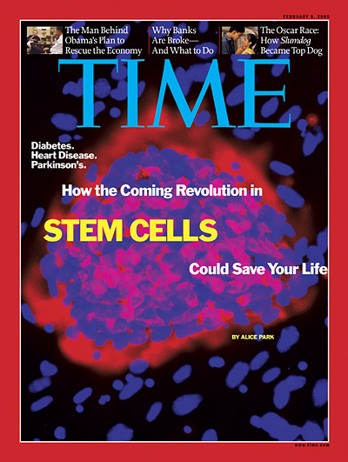
Introduction to Lab Reporting
Exercise 4, pg. 49-53
BSC2010L

Slide 2
Lab Reports Exercise 4, pg.49-56
Lab Objectives:
Why reporting findings is vital to science
How and where to report findings
What needs to be reported
What constitutes plagiarism & how to avoid

Slide 3
What is a Lab Report?
A document that reports on the outcome of an experiment you conducted
Explain who, what where, when, why, & how and prepares you for future similar ways science is distributed:
Publications
Manuscripts
Books
Notes
Symposiums
Conferences

Slide 4
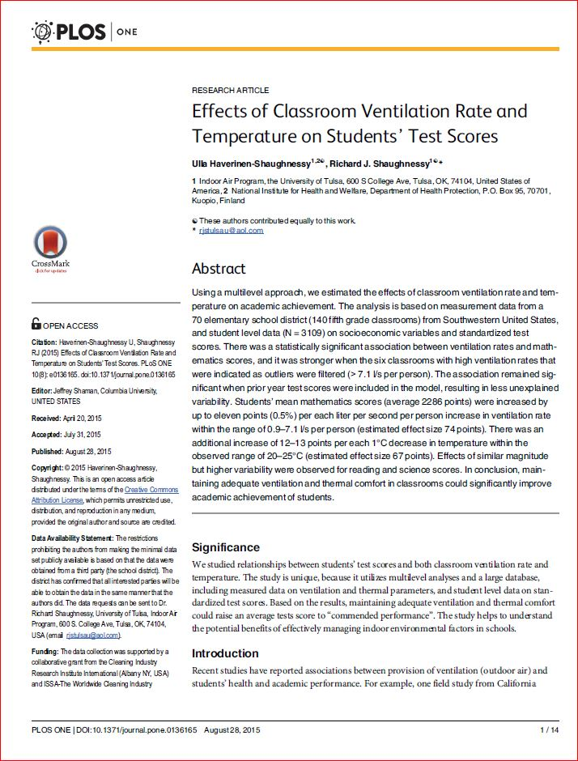
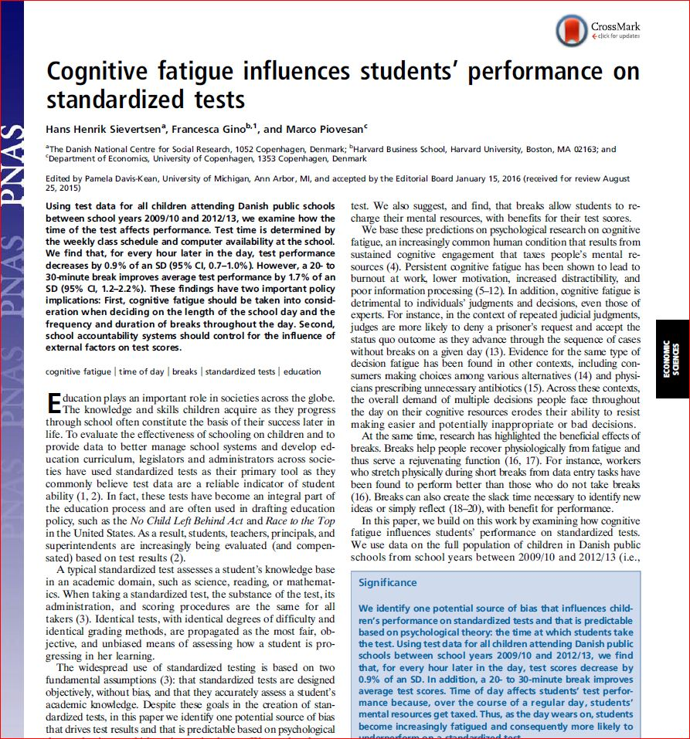
Report basics:
Title page
Abstract
Introduction
Hypotheses
Materials & Methods
Results & Data
Discussion & Conclusions
References/ Works Cited

Slide 5
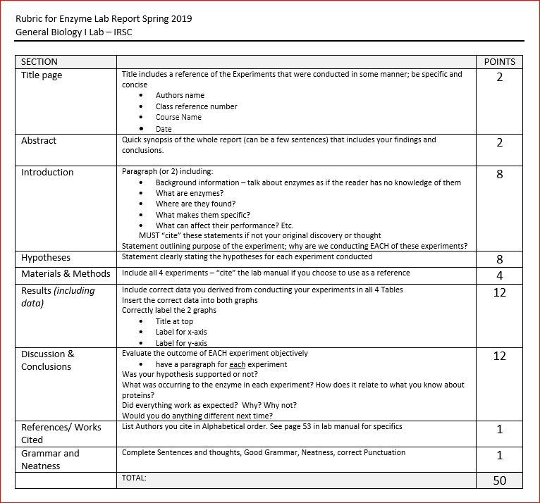
Rubric:

Slide 6
1. Title Page

Slide 7
2. Abstract

Slide 8
3. Introdution

Slide 9
4. Hypopthesis
The set up of the next until of the lab manual is to habituate formulating hypotheses, thus we have outlined these as such in your manual.
Examples would be:
We hypothesized that there would be no difference in quantity of prey eaten in relation to daylight hours during our observational experiment.
Or
We hypothesized there would be no differentiation between bird preference of sunflower seeds verses peas eaten when conducting our experiment.

Slide 10
4. Materials/Methods

Slide 11
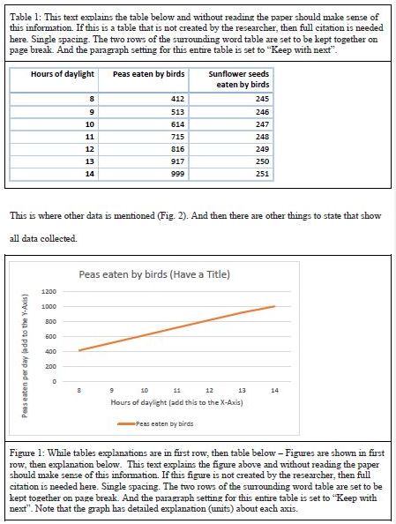
5. Results/Data

Slide 12
6. Discussion & Conclusion

Slide 13
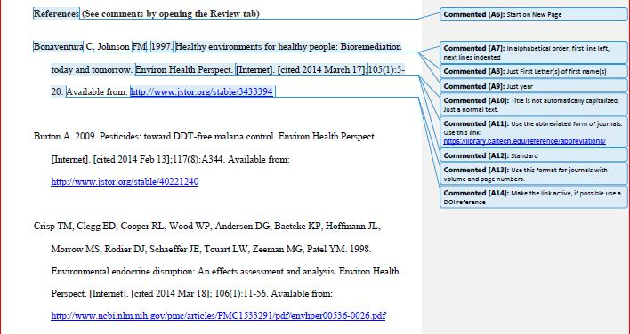
7. Works Cited/References

Slide 14
Plagiarism:

Slide 15
Example Lab Reports/Template
Weebly and Blackboard both contain Zip Files that include:
Rubric for how you will be graded
Example report for Ex.6
Example report for Ex.7
Report Template for you to complete using Ex. 5
You will need to upload your digital finished version two weeks prior to the final
WE suggest you try to upload any blank document NOW so you can work out any glitches you may encounter vs. waiting until the deadline and then having emergency uploading issues.
If you don’t get an conformation email that your document has been uploaded, you did not upload your document correctly.

Slide 16
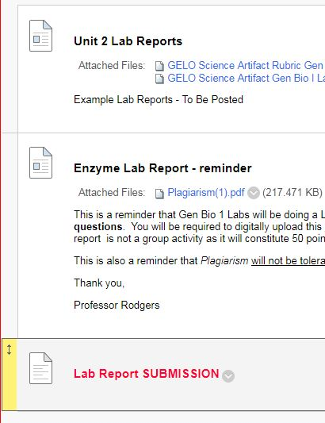
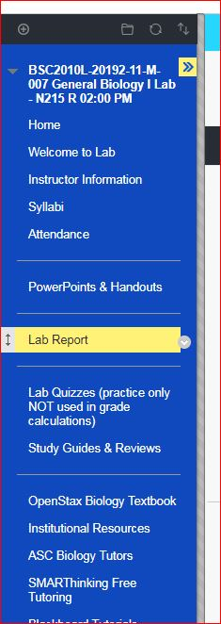
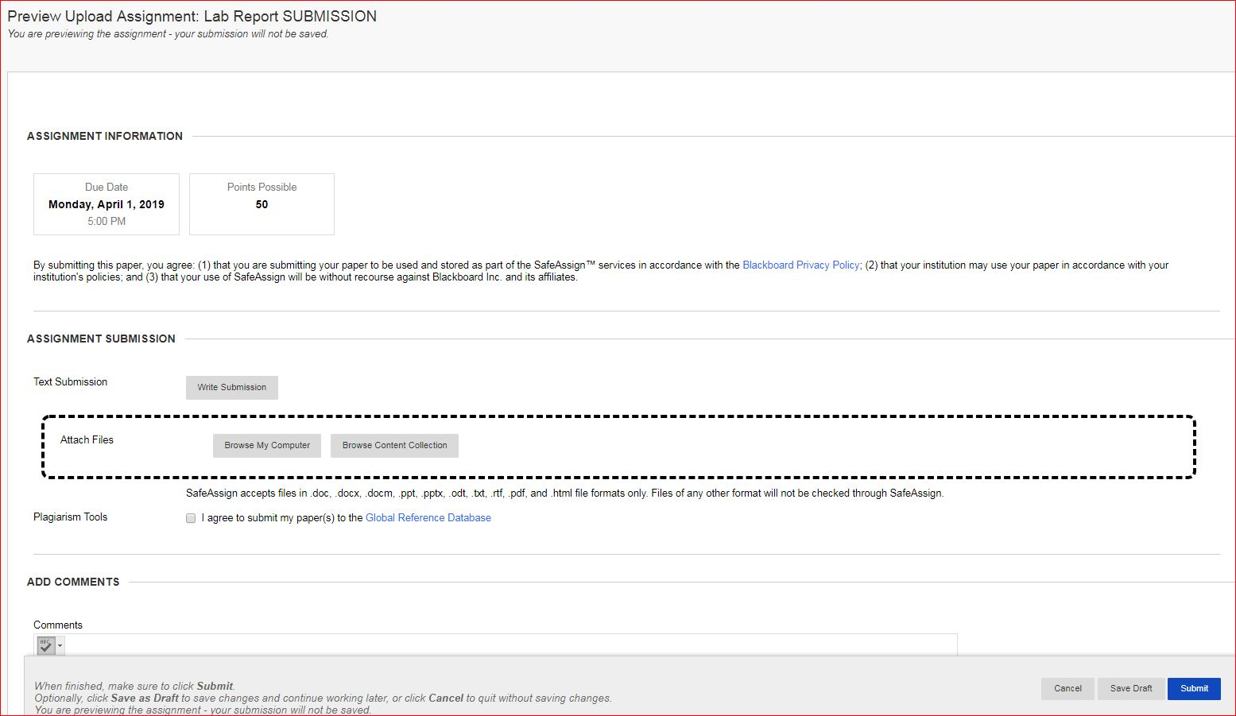
Uploading via Blackboard:
*TRY PRACTICE UPLOAD THIS WEEK
To avoid issues when you go to upload at end of semester!

Slide 17
Lab Report Help
The ASC, Academic Support Center on each campus library is aware of this assignment and can help you with any troubles you may encounter.
Remember to just follow the rubric and thoroughly complete all steps as listed.
If you miss-upload your document, just email your instructor and ask for them to “delete your attempt” so you can resubmit.
(This is a single attempt upload)
Don’t wait until the last minute
-do a little bit each week →
Title page, Intro
Hypotheses, Procedure (M&M)
Results/Data, Discussion
Abstract, References

