Slide 1
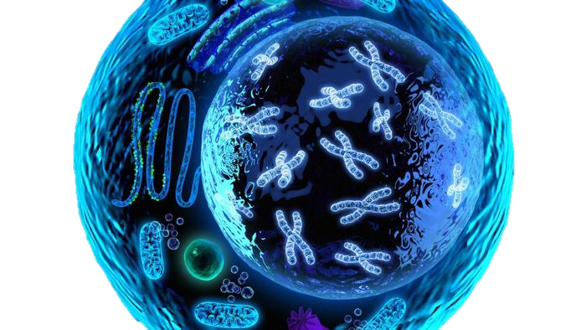
Cell Structure & pH
Exercise 3, 25-34, 43-44
BSC2010L

Slide 2
Exam Details
Be on time - door stays closed after lecture start time (=Your one Zero)
No Cell Phones/ no smart watches
No Food or Beverages
No baggy clothing/hoodies
No paper – Bring several pencils or pens.
Closed Toe shoes – or you wear “Booties of Shame”
Visits per station: Once
Know your TLS’s actual NAME
Know your Class Reference number
Ex. BSC2010L -11-002

Slide 3
Testing Strategies
Pen to Paper
This helps when you don’t know the answer – write question down on back of paper and if might come to you through muscle memory
Speak and Describe
Reading your notes out loud, even to yourself, involves two of your senses at once = visuable & audible
Study in groups
Forces you to talk (see above)
ASC – Free Individual/Group Tutors
8am-8pm M-Sat, don’t tell me you they weren’t available!
Flash Cards
Online quizzes
Kahoot, Quizzlets, BB quizzes

Slide 4
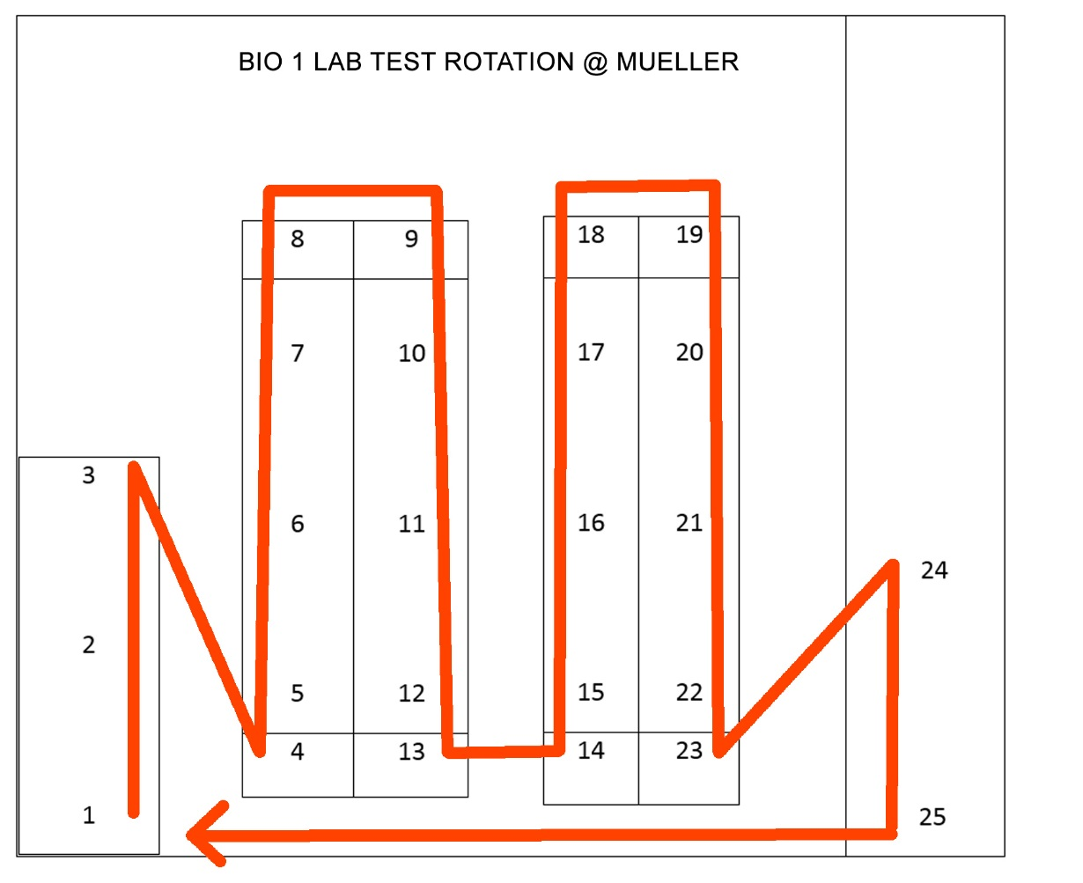
Exam Details
50 questions
25 stations
2 questions per station
1 ½ minutes at each station
All questions are either one term or a short answer

Slide 5
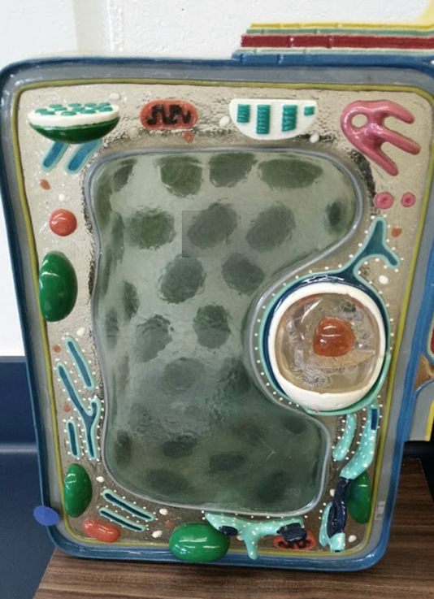
Exam Example:
Cell wall
plant

Slide 6
Exam Details
Missed exam = is dropped exam grade
Lab attire
Once you leave the lab – no reentry until we start the Next Lab Chapter.
See me now after class or email me if you have ANY special needs! It is my responsibility to ask, it is yours to come talk to me about it.
Do Exercise 5 Enzymes AFTER TEST

Slide 7
Cellular Structure Exercise 3, pg. 25-34
Lab Objectives:
Define Prokaryotic from Eukaryotic cells
Describe basic components of cells
Compare/contrast plant and animal cell structures & functions
Experiment with how cells handle pH stress

Slide 8
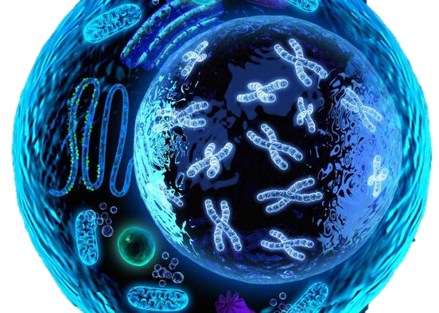
Cells
Cells are the basic unit of life
Cell Theory:
All living things are composed of cells
Cells come only from other cells

Slide 9
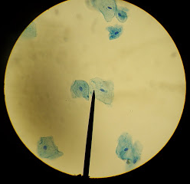
What we can see with a microscope
This is a view while looking through the eyepiece.
The pointer is placed as a reference for other viewers to see what you are interested in.

Slide 10
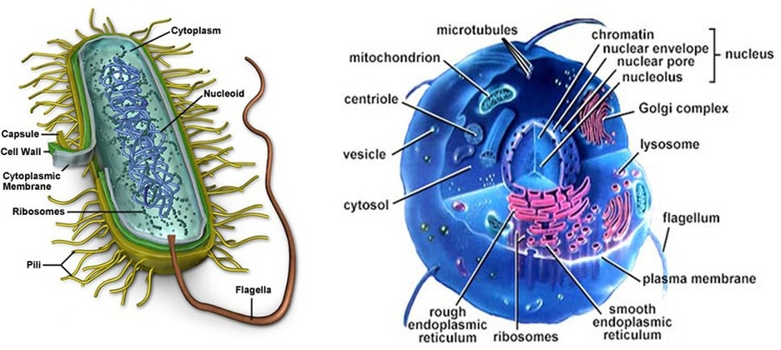
Eukaryotes vs. Prokaryotes
Protists, fungi, plants, animals
Bacteria

Slide 11
Eukaryotes vs. Prokaryotes
Larger
Smaller
Plasma Membrane
Chromosomes
Ribosomes
Cytoplasm
Have Nucleolus
NO Nucleolus
Unbound Nucleus
Membrane bound Nucleus
NO Membrane bound Organelles
Have Membrane bound Organelles
NO Cytoskeleton
Have Cytoskeleton

Slide 12
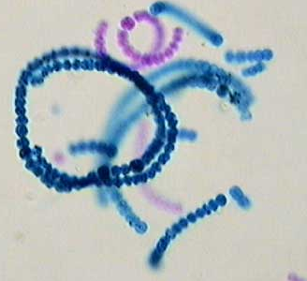
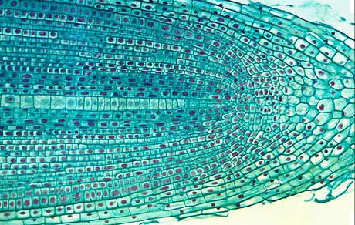
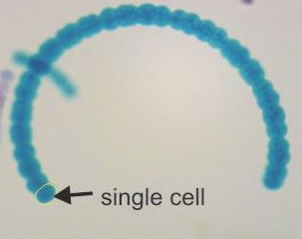
Eukaryotes vs. Prokaryotes Plant cell vs. Cyanobacterium
Genus: Allium
Domain: Eukarya
*note arrangement of
multiple blocks of cells
Genus: Anabaena
Domain: Bacteria
*note arrangement of single chain

Slide 13
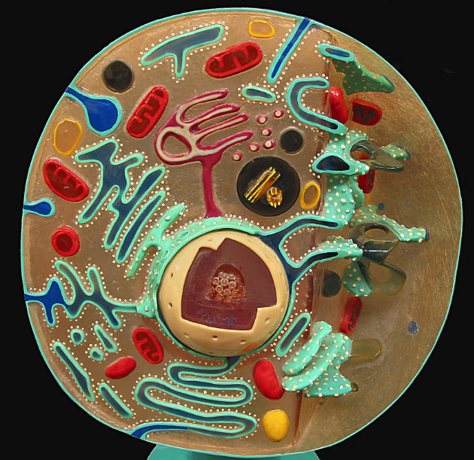
Eukaryotic Cell: Animal Cell
a) Revolving door
Cell membrane
Mitochondria
b) Powerhouse ATP prod.
c) FedEx/UPS
Golgi apparatus
d) assem. RNA/proteins
Nucleolus
Nucleus
e) Control = DNA house
By Divinemercy (Own work) [CC BY-SA 3.0 (http://creativecommons.org/licenses/by-sa/3.0) or GFDL (http://www.gnu.org/copyleft/fdl.html)], via Wikimedia Commons https://upload.wikimedia.org/wikipedia/commons/5/5f/Animal_Cell_Cross_Section_Model.jpg
f) Vip door; keeps cyto out
Nuclear Membrane
g) scaffold
Cytoplasm
Endoplasmic reticulum
h) Subway/ lipid synthesis
i) Janitors; digestion via enzymes
Lysosome

Slide 14
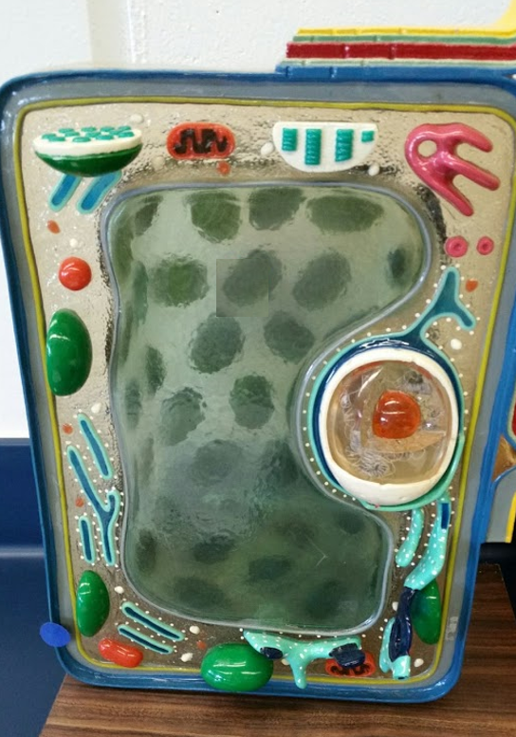
Eukaryotic Cell: Plant Cell
Know the name and function of organelles found in eukaryotic plant cells
a) Support & protect (plants only)
Cell wall
b) Revolving door
Cell membrane
Mitochondrion
c) Powerhouse/ATP
d) FedEx/UPS
Golgi apparatus
Nucleolus
e) Assembles RNA/proteins
© Kornelia Fillmer, CC BY-SA 3.0 https://photos.google.com/share/AF1QipN07w2MVbOkY1hNX55T6HF-k7ab1lO6gNOLMKjICmjl1PLBeSHy1uTuaisGMWJzvg/photo/AF1QipMPjNAnq-0k_A1os3jxfSa2DHqr3CepILIVnYus?key=M09OZm9fc3dYU3p4QXhzUVIzMzhFZmJEMy1sckV3
f) Control cntr/DNA
Nucleus
g) Vip Door
Nuclear Envelope/Memb
h) Subway/ lipid synthesis
Endoplasmic reticulum
i) Airplane cabin (plants only)
Large central vacuole
j) Photosynthesis loc (plants only)
Chloroplast

Slide 15
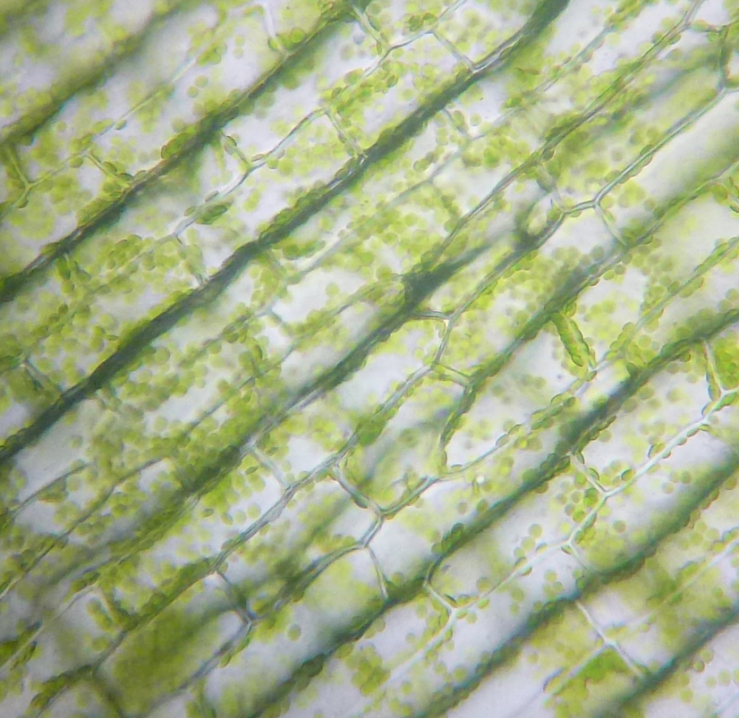
Plant Cell – Elodea Leaf
Cell Wall
By Cimice50 (Own work) [CC BY-SA 4.0 (http://creativecommons.org/licenses/by-sa/4.0)], via Wikimedia Commons https://upload.wikimedia.org/wikipedia/commons/a/a9/Cloroplasti_Elodea.jpg
choroplasts

Slide 16
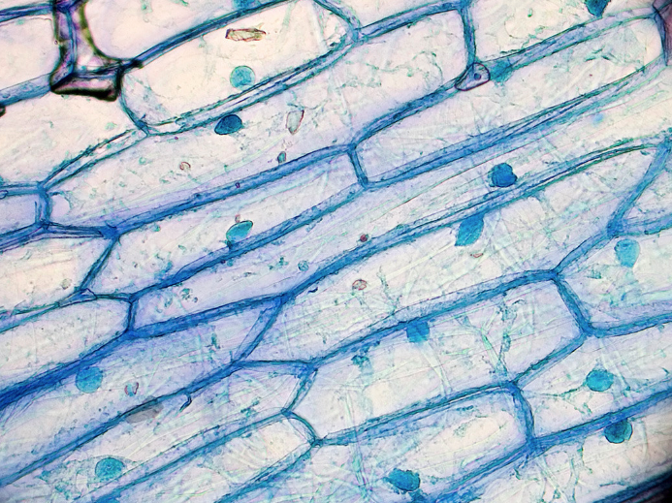
Plant Cell – Onion
Cell Wall
By kaibara87 [CC BY 2.0 (http://creativecommons.org/licenses/by/2.0)], via Wikimedia Commons https://upload.wikimedia.org/wikipedia/commons/e/ef/Onion_Cells.jpg
Nucleus (plural: Nuclei)

Slide 17
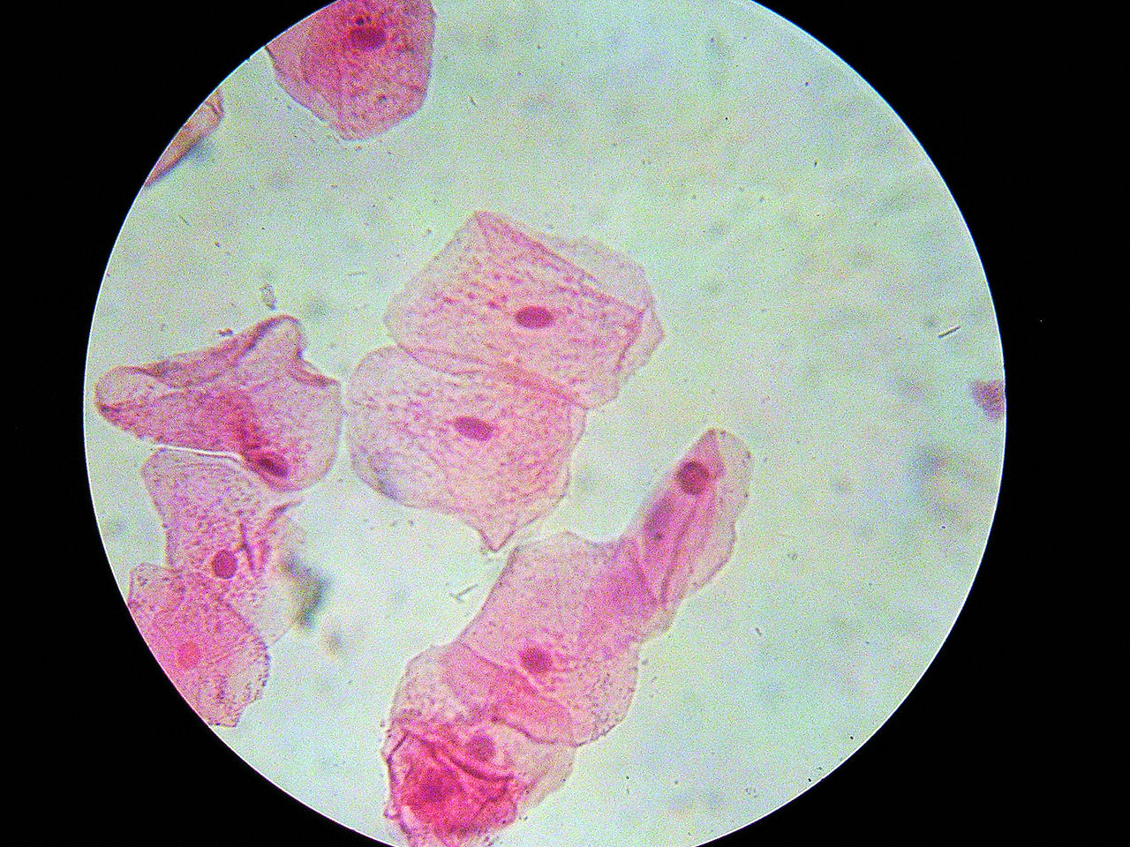
Animal Cells – Cheek Epithelial Cells
Nucleus (plural: Nuclei)
By Mulletsrokk - Own work, CC BY-SA 3.0, https://commons.wikimedia.org/w/index.php?curid=10270500
Cell Membrane

Slide 18
Human Epithelial Cells
With toothpick scrape gently inside your cheek
Place scraping on washed and dry slide
Place used toothpick in orange/red ‘biohazard bag’
add one drop of methylene blue
cover with cover slip (careful!)
Take slide to your workstation
When done, drop slide with cover slip in ‘beaker with bleach’

Slide 19
Eukaryotic Cells
What are the three differences between animal and plant cells?
Plant Cells only:
Cell wall
Large Central Vacuole
Chloroplasts
Animal Cells only:
Centrioles in Centrosome

Slide 20
How cells thrive:
All these organelles work optimally in unison.
Changes in the environment can cause disruptions in this fluid process.
Hydrogen Ions play a central role in the lives of cells
Change in ionic gradients can effect the cells ongoing processes

Slide 21
pH
pH of a solution tells its hydrogen ion concentration - H⁺
Buffer – system of chemicals that takes up excess H⁺ ions or hydroxide ions (OH⁻)
Maintaining pH is VERY important in biological systems
i.e. – human blood pH must be maintained at 7.4
You will test the buffering capacity of 3 solutions (page 43)
Water, buffer, and simulated cytoplasm *Albumin
Which one do you think will be able to hold its pH the longest as drops of HCl are added?

Slide 22
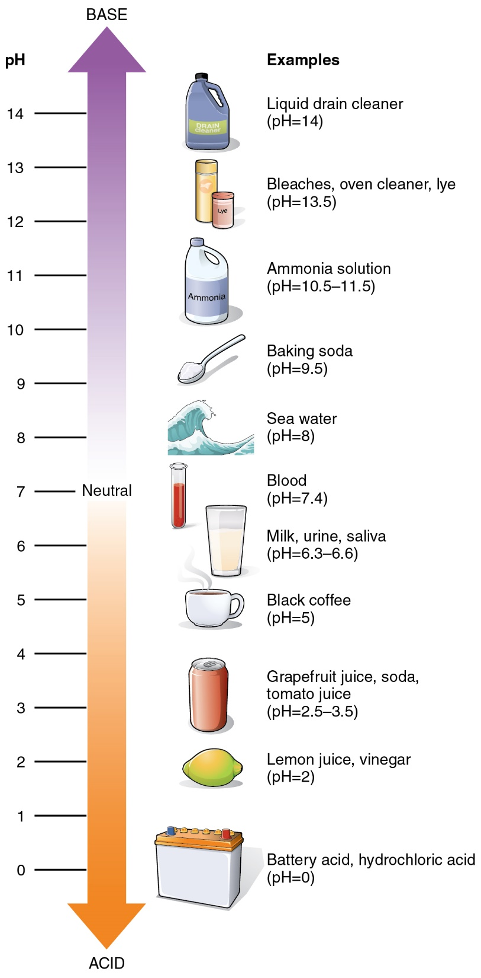
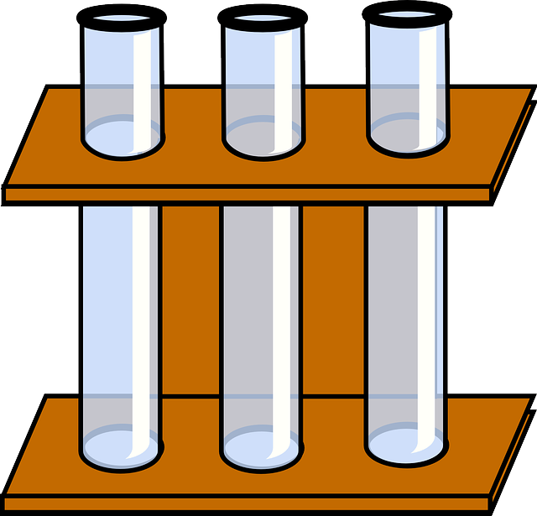
pH
By Clker-Free-Vector-Images / 29620 images CC 0 https://pixabay.com/p-297716
Water
Buffer
Simulated Cytoplasm
By OpenStax College - Anatomy & Physiology, Connexions Web site. http://cnx.org/content/col11496/1.6/, Jun 19, 2013., CC BY 3.0, https://commons.wikimedia.org/w/index.php?curid=30131151
Alkaline 14-8
Neutral around 7
Acidic 6-0

Slide 23
Activities
A: “To Do” page 27 (Draw on Page 31)
B: “To Do” page 28 1. Onion Cells “To Do” page 28 2. Elodea Cells “To Do” page 30 1. Human Cheek Cells (Draw all three on page 33)
C: Label the models on page 32
D: “To Do” pH page 43 (1. – 5.)
When done:
Switch lens to lowest power (use nosepiece to turn first) !!
Stage down, then take slide off, put in your slide box (in order!)
Place back in cabinet in the correct place
Return mat to your cabinet

