Slide 1
Microscopy
Exercise 2, pg. 15-30 & pg. 37-38; 47
BSC2010L

Slide 2
Intro to Microscopes Exercise 2, pg. 15-30
Lab Objectives:
Work with a microscope and adjust it to maximum resolution
Locate and define the parts of the microscope
View Fixed Slides to Practice for Microscope Exam test next week pg. 37-38; 47

Slide 3
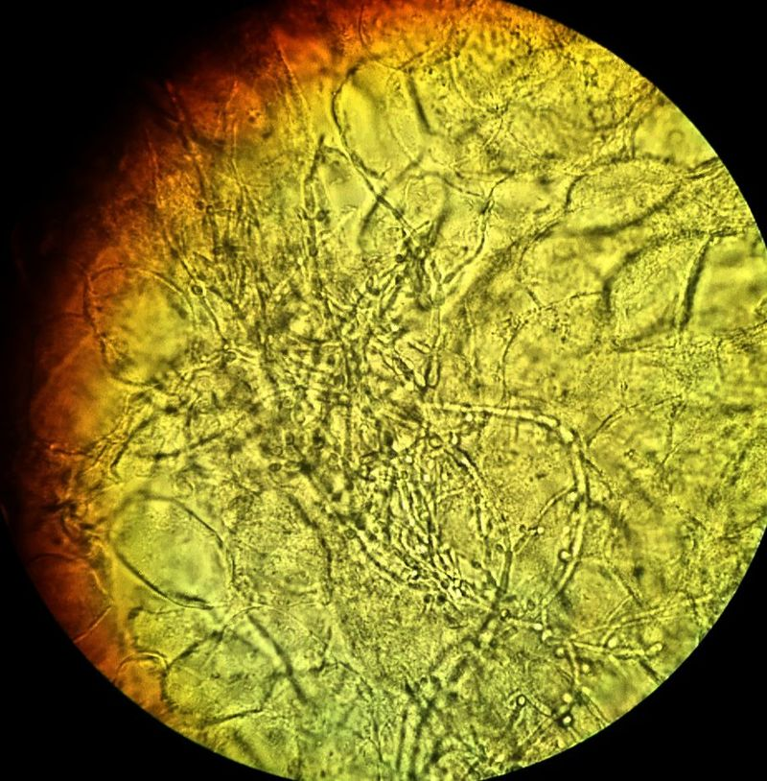
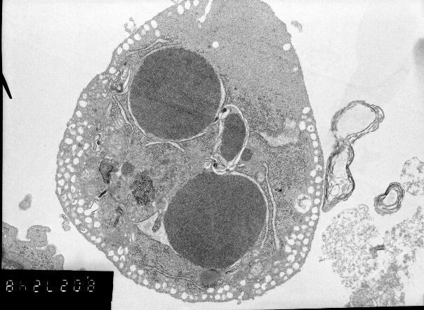
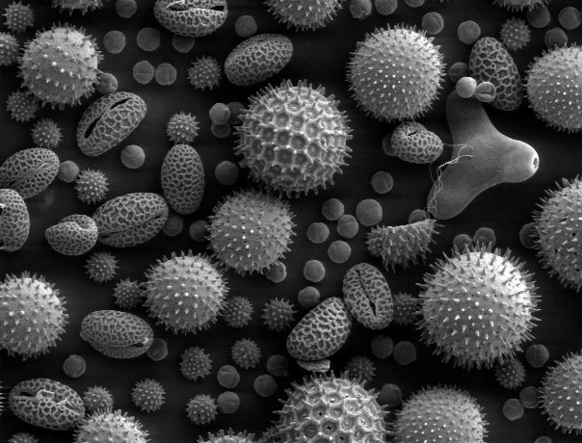
Microscopy – using microscopes to view objects that cannot be seen with the naked eye
By Mikael Häggström. "Medical gallery of Mikael Häggström 2014". Wikiversity Journal of Medicine 1 (2). DOI:10.15347/wjm/2014.008. ISSN 20018762. - Own work, CC0, https://commons.wikimedia.org/w/index.php?curid=34138383
Light Microscope
Binocular dissecting microscope
View: whole to cells
Compound light microscope***
View: inside cell structure
Electron Microscope
Transmission Electron Microscope
View: inside organelles to molecule = DNA
Thin slices of specimen
Scanning Electron Microscope
View: surface of bacteria/virus’
Image of surface of specimen
By Ltumanovskaya V. Nagibin - Own work, CC BY-SA 4.0, https://commons.wikimedia.org/w/index.php?curid=44661206
By Dartmouth College Electron Microscope Facility - Source and public domain notice at Dartmouth College Electron Microscope Facility ([1], [2]), Public Domain, https://commons.wikimedia.org/w/index.php?curid=24407

Slide 4
The Compound Scope
+
Two sets of lenses = compound
Oculars + Objectives
Two focusing knobs
Course + Fine
Four objective lenses
4x, 10x, 40x, 100x
1
2

Slide 5
The Objective Lenses
Scanning Objective (4x)
Red color band, smallest one
Low-power objective (10x)
Yellow color band
High-power objective (40x)
Blue color band
Oil Immersion objective (100x)
Gray color band
Only use with oil! Have to carefully clean oil off afterwards!!!!!

Slide 6
Magnification
oculars
X
objectives
Total magnification =
Examples:
Under 4x objective – magnification of specimen is 40 x
Under 10x objective – magnification of specimen is 100x
Under 40x objective – magnification of specimen is 400x
Question:
What is the total magnification under a 36x objective lens?
360x

Slide 7
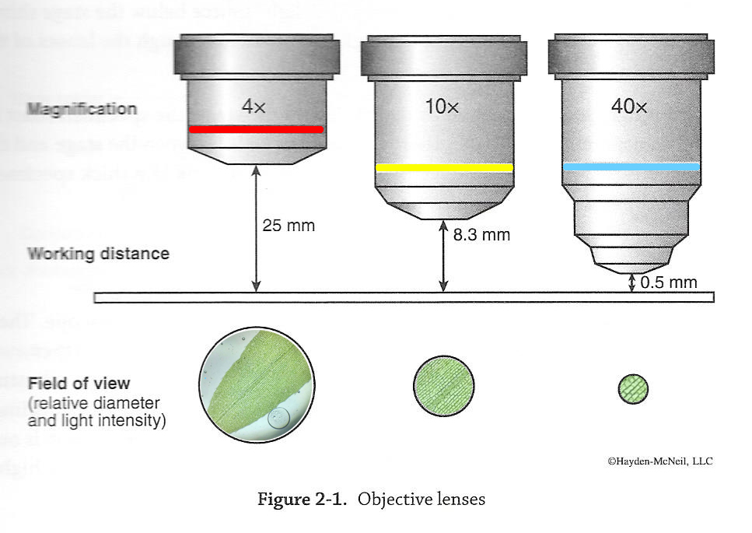
The Objective Lenses – Focus & Field of View
Field of View

Slide 8
The Objective Lenses – Focus & Field of View

Slide 9
Microscopy Procedure pg. 21
CLEAR YOUR WORKSPACE!
Put mat on Workstation (in your cabinet)
Find the microscope # assigned to you in the storage cabinet
Reach UNDER the storage bag
Carry the microscope with BOTH hands back to the lab bench by ‘ARM’ and ‘BASE’
Place scope on mat with power cord facing you.
DO NOT PLUG IN YOUR SCOPE!
Turn to page 21

Slide 10
Meet your Microscope: locate the parts while the instructor points them out
Nose piece
© Moisey - File:Optical microscope nikon alphaphot.jpg, CC BY-SA 3.0, https://commons.wikimedia.org/w/index.php?curid=7011479
Coarse adjustment knob
Condenser
Notes:
Have students get out scopes

Slide 11
Microscopy Procedure pg. 22
Plug it in, turn on light
Dimmer switch
Iris Open
Condenser Up
Objective on 4x
Stage down
Set Oculars
Pull apart or together
Find one bright circle, not 2!
Dim slightly to comfort
May see Pointer or Ruler
Take out fly or threads slide:
*switch to doc cam: go through how to take out and observe slide, note orientation,
stage clip placement, slide centering with manipulation knobs, rotate stage up.
all BEFORE ever viewing specimen/subject through oculars!

Slide 12
Focus Specimen (pg. 47)
Use Nosepiece and set to Scanning Objective (4x Red color band)
Place slide on stage
Use coarse adjustment knob to raise stage all the way up.
Focus (both: fine and coarse adjustment knobs) and center
Use Nosepiece and set to Low-power objective (10x Yellow color band)
Focus (only fine adjustment knob)
Use Nosepiece and set to Low-power objective (40x Blue color band)
Focus (only fine adjustment knob)
Rotate Nosepiece “backwards” (not THROUGH OIL lense!!) and set to Scanning Objective (4x Red color band)
Now, you can lower the stage

Slide 13
Microscopy Procedure
e
Take out ‘e’ slide
Turn to Page 21-24 and we do all steps of “TO DO” together. (drawings on page 24)
e
e
e
The Letter ‘e’
e

Slide 14
Microscopy Procedure
e
Take out ‘e’ slide
Turn to Page 21-24 and we do all steps of “TO DO” together. (drawings on page 24)
e
e
e
The Letter ‘e’
e

Slide 15
Practice Focusing on your own pgs. 37-38; 47
Flip to page 47
These are the steps you need to do every time you look at a slide
You may tear this page out now or wait until next week when your instructor will use it to conduct your Microscope Exam. YOU WILL NOT BE ABLE TO LOOK AT THIS SHEET WHILE TESTED, so today is to practice until you have it memorized.

Slide 16
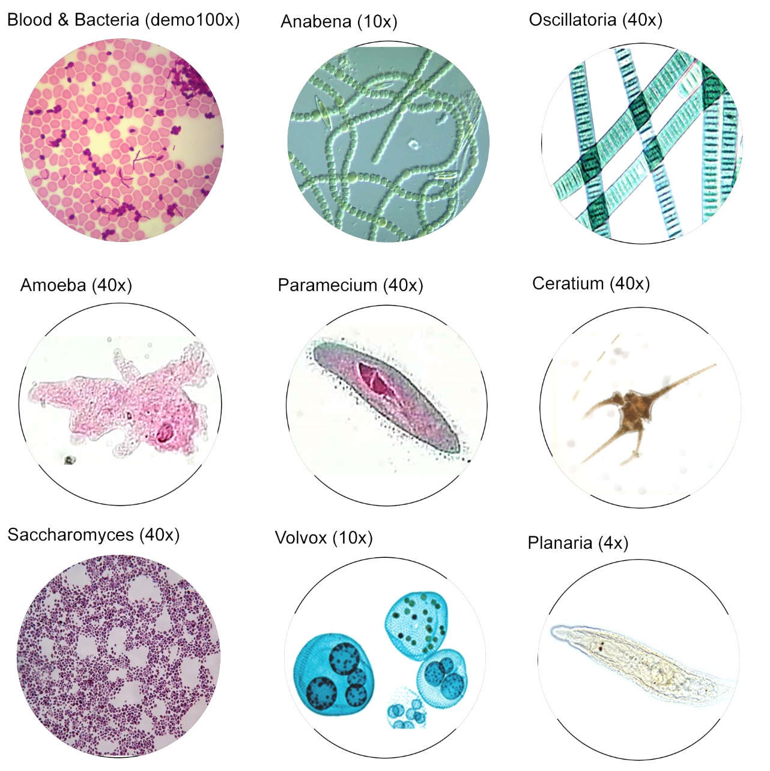
Practice Focusing on your own pgs. 37-38; 47
To prepare for this exam, please turn to page 37 and practice these steps for each slide listed. Sketch what you see at the power listed for each organism on page 38.
If time is limited, you may continue this exercise next week but know you will be tested on the steps listed on pg. 47 using the slide Paramecium* so make sure you practice at minimum with this slide this week!)
*
If you want more time, you may come to open lab any day this week @ Main campus where there is not a class being conducted (check the schedule on Weebly <link>

Slide 17
Today’s Lab pgs. 15-30; 37-38
Read and complete all TO DO’s :
p. 20: Calculate total mag. chart
p. 25: Measure field of view with ruler
p. 27: View/Sketch Fixed mount of elodea leaf
(we will do wet mount next week)
p. 29: Fill in microscope parts
p. 37-38: View/Sketch Fixed Mount organisms
p. 30: Complete Before you go questions
NOTE: Next week is your Microscope Exam!!!! Make sure you are using your lab time wisely today to practice using your microscope in the order listed on pg. 47!
x

Slide 18
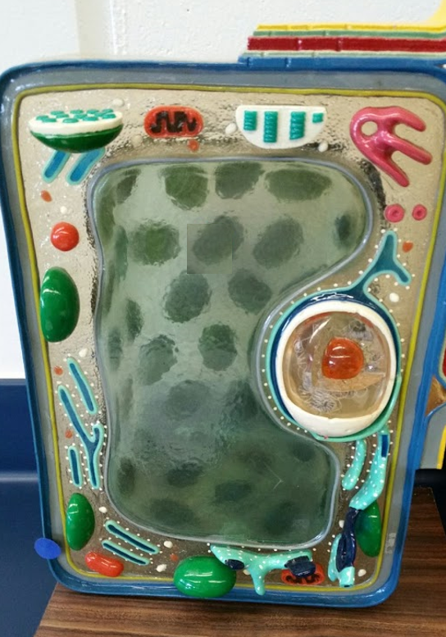
Know this for next Lab!
Know the name and function of organelles found in plant and animal cells.
Know differences between them!
Cell wall
Cell membrane
Mitochondrion
Golgi apparatus
Nucleolus
Nucleus
© Kornelia Fillmer, CC BY-SA 3.0 https://photos.google.com/share/AF1QipN07w2MVbOkY1hNX55T6HF-k7ab1lO6gNOLMKjICmjl1PLBeSHy1uTuaisGMWJzvg/photo/AF1QipMPjNAnq-0k_A1os3jxfSa2DHqr3CepILIVnYus?key=M09OZm9fc3dYU3p4QXhzUVIzMzhFZmJEMy1sckV3
Endoplasmic reticulum
Large central vacuole
Chloroplast

Slide 19
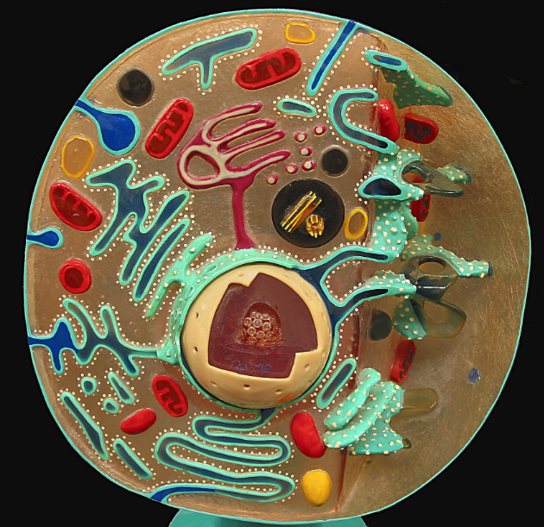
Know this for next Lab!
Know the name and function of organelles found in plant and animal cells.
Know differences between them!
Cell membrane
Mitochondria
Golgi apparatus
Nucleolus
Nucleus
By Divinemercy (Own work) [CC BY-SA 3.0 (http://creativecommons.org/licenses/by-sa/3.0) or GFDL (http://www.gnu.org/copyleft/fdl.html)], via Wikimedia Commons https://upload.wikimedia.org/wikipedia/commons/5/5f/Animal_Cell_Cross_Section_Model.jpg
Cytoplasm
Endoplasmic reticulum
Lysosome

Slide 20
Focus Specimen pg. 47
Use Nosepiece and set to Scanning Objective (4x Red color band)
Place slide on stage
Use coarse adjustment knob to raise stage all the way up.
Focus (both: fine and coarse adjustment knobs) and center
Use Nosepiece and set to Low-power objective (10x Yellow color band)
Focus (only fine adjustment knob)
Use Nosepiece and set to Low-power objective (40x Blue color band)
Focus (only fine adjustment knob)
Rotate Nosepiece “backwards” (not THROUGH OIL lense!!) and set to Scanning Objective (4x Red color band)
Now, you can lower the stage

