Slide 1
Microscopy
Exercise 2, pg. 13-24
BSC2010L

Slide 2
Intro to Microscopes Exercise 2, pg. 13-24
Lab Objectives:
Work with a microscope and adjust it to maximum resolution
Locate and define the parts of the microscope
View Fixed Slides
Make and View Wet mount slide of living cells

Slide 3
Test your knowledge from Ex. 1
3 questions – 4 minutes
123456 µm = __________ dm
0.00123456km = __________ cm
What is the volume in cm³ of a wooden block with these measurements: length = 2cm, height = 3cm, depth = 4cm

Slide 4
Metric System
KiloU
(km)
HectoU
(hm)
“Point” to the right
DekaU
(dam)
End
U
(m)
DeciU
(dm)
CentiU
(cm)
MilliU
“Point” to the left
(mm)
Start
MicroU
(µm)
NanoU
1.23456
(nm)
123456 µm = __________ dm
123456 = 0000123456.00000
123456 = 00001.2345600000
Start µm (micro m) = End dm (deci m)
Five steps to the left = 5 steps for decimal point to the left

Slide 5
Metric System
Start
KiloU
(km)
HectoU
(hm)
“Point” to the right
DekaU
(dam)
U
(m)
End
DeciU
(dm)
CentiU
(cm)
MilliU
“Point” to the left
(mm)
MicroU
(µm)
NanoU
123.456
(nm)
0.00123456 km = __________ cm
0.00123456 = 00.0012345600000
0.00123456 = 0000123.45600000
Start km (kilo m) = End cm (centi m)
Five steps to the right = 5 steps for decimal point to the right

Slide 6
Test your knowledge
Volume formula is length x width x height(depth)
2 x 3 x 4 = 24 => volume is 24 cm³
If you submerge this block in water, how many ml of water would be displaced?
By definition: 1 ml = 1 cm³ => 24 ml

Slide 7
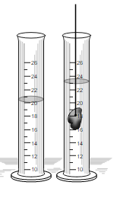
Important Equations to Know
Volume of a block = Length x width x height
1cm³ (cc) = 1ml
Displacement volume =
Total volume (after object) – Original volume (before object)
Freezing point of water: ______ ºC________ºF
Boiling point of water: ______ ºC________ºF
0
32
100
212
By Submerged-and-Displacing.png: Michael Malak derivative work: Malyszkz (Submerged-and-Displacing.png) [Public domain], via Wikimedia Commons https://upload.wikimedia.org/wikipedia/commons/6/6a/Submerged-and-Displacing.svg

Slide 8
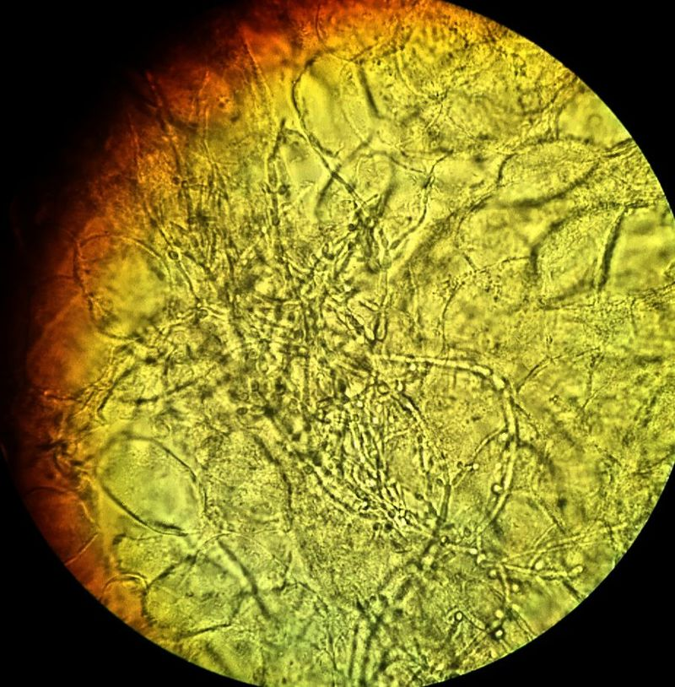
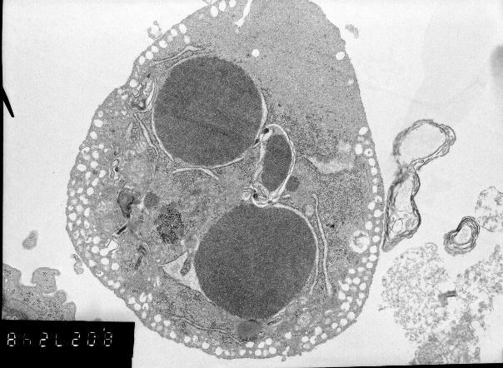
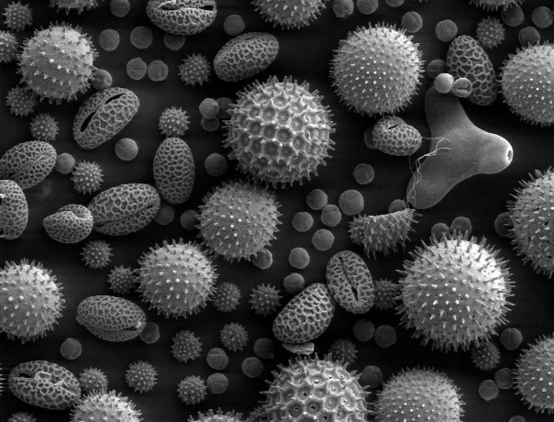
Microscopy – using microscopes to view objects that cannot be seen with the naked eye
By Mikael Häggström. "Medical gallery of Mikael Häggström 2014". Wikiversity Journal of Medicine 1 (2). DOI:10.15347/wjm/2014.008. ISSN 20018762. - Own work, CC0, https://commons.wikimedia.org/w/index.php?curid=34138383
Light Microscope
Binocular dissecting microscope
View: whole to cells
Compound light microscope***
View: inside cell structure
Electron Microscope
Transmission Electron Microscope
View: inside organelles to molecule = DNA
Thin slices of specimen
Scanning Electron Microscope
View: surface of bacteria/virus’
Image of surface of specimen
By Ltumanovskaya V. Nagibin - Own work, CC BY-SA 4.0, https://commons.wikimedia.org/w/index.php?curid=44661206
By Dartmouth College Electron Microscope Facility - Source and public domain notice at Dartmouth College Electron Microscope Facility ([1], [2]), Public Domain, https://commons.wikimedia.org/w/index.php?curid=24407

Slide 9
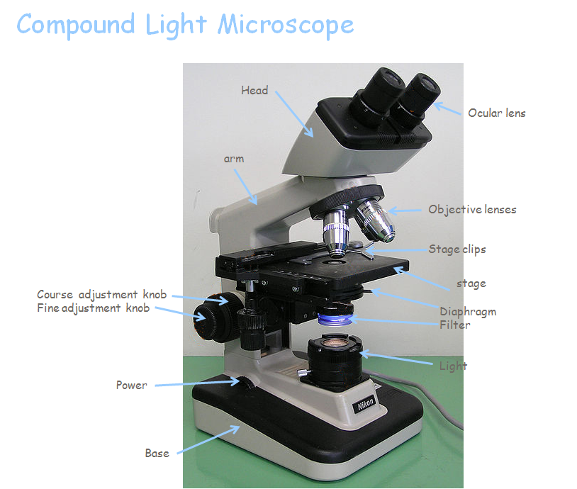
The Compound Light Microscope
Nose piece
© Moisey - File:Optical microscope nikon alphaphot.jpg, CC BY-SA 3.0, https://commons.wikimedia.org/w/index.php?curid=7011479
Coarse adjustment knob
Condenser
Notes:
Have students get out scopes

Slide 10
The Compound Scope
+
Two sets of lenses = compound
Oculars + Objectives
Oculars with Diopter ring
Vision correction
Two focusing knobs
Course + Fine
Four objective lenses
4x, 10x, 40x, 100x
1
2

Slide 11
The Objective Lenses
Scanning Objective (4x)
Red color band, smallest one
Low-power objective (10x)
Yellow color band
High-power objective (40x)
Blue color band
Oil Immersion objective (100x)
Gray color band
Only use with oil! Have to carefully clean oil off afterwards!!!!!

Slide 12
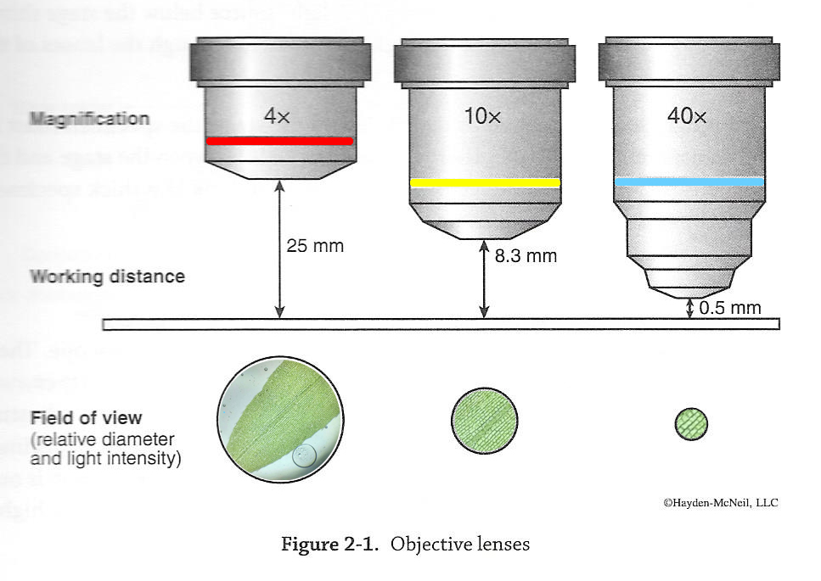
The Objective Lenses – Focus & Field of View
Field of View

Slide 13
Microscopy Procedure
Put mat on Workstation (in your cabinet)
Find the microscope # assigned to you in the storage cabinet
Carry the microscope with BOTH hands back to the lab bench
Plug it in, turn on light
Turn to Page 18 and we do all steps of “TO DO” together. (drawings on page 23)

Slide 14
Focus Specimen
Use Nosepiece and set to Scanning Objective (4x Red color band)
Place slide on stage
Use coarse adjustment knob to raise stage all the way up.
Focus (both: fine and coarse adjustment knobs) and center
Use Nosepiece and set to Low-power objective (10x Yellow color band)
Focus (only fine adjustment knob)
Use Nosepiece and set to Low-power objective (40x Blue color band)
Focus (only fine adjustment knob)
Rotate Nosepiece “backwards” (not THROUGH OIL lense!!) and set to Scanning Objective (4x Red color band)
Now, you can lower the stage

Slide 15
Magnification
Total magnification = ocular x objective
Ocular lens is usually 10x
Examples:
Under 4x objective – magnification of specimen is 40 x
Under 10x objective – magnification of specimen is 100x
Under 40x objective – magnification of specimen is 400x
Question:
What is the total magnification under a 36x objective lens?
360x

Slide 16
Things to Remember
Be careful with Microscope
Never turn head around!
Always clean lenses with lens paper only
In your drawer
You can clean slides with Kim wipes
Always put slides back in slide box in numerical order
Get slide box out and count them (12)

Slide 17
Video Elodea leaf wet mount Link
Microscopy of Elodea leaf 4x, 10x and 40x

Slide 18
Today’s Lab pgs. 13-24
Read and complete all TO DO’s (pgs. 16, 20, 21, 24)
We already did page 18 together
Review Lab Exercise 3 for next week pgs.25-34
NOTE: Next week is the last lab BEFORE your FIRST TEST!!!! Make sure you are using your lab time wisely to review/study!
Use Nosepiece and set to Scanning Objective (4x Red color band)
Place slide on stage
Use coarse adjustment knob to raise stage all the way up.
Focus (both: fine and coarse adjustment knobs) and center
Use Nosepiece and set to Low-power objective (10x Yellow color band)
Focus (only fine adjustment knob)
Use Nosepiece and set to Low-power objective (40x Blue color band)
Focus (only fine adjustment knob)
Rotate Nosepiece “backwards” (not THROUGH OIL lense!!) and set to Scanning Objective (4x Red color band)
Now, you can lower the stage

Slide 19
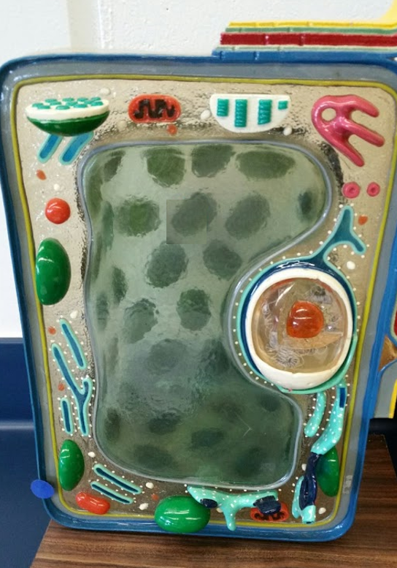
Know this for next Lab!
Know the name and function of organelles found in plant and animal cells.
Know differences between them!
Cell wall
Cell membrane
Mitochondrion
Golgi apparatus
Nucleolus
Nucleus
© Kornelia Fillmer, CC BY-SA 3.0 https://photos.google.com/share/AF1QipN07w2MVbOkY1hNX55T6HF-k7ab1lO6gNOLMKjICmjl1PLBeSHy1uTuaisGMWJzvg/photo/AF1QipMPjNAnq-0k_A1os3jxfSa2DHqr3CepILIVnYus?key=M09OZm9fc3dYU3p4QXhzUVIzMzhFZmJEMy1sckV3
Endoplasmic reticulum
Large central vacuole
Chloroplast

Slide 20
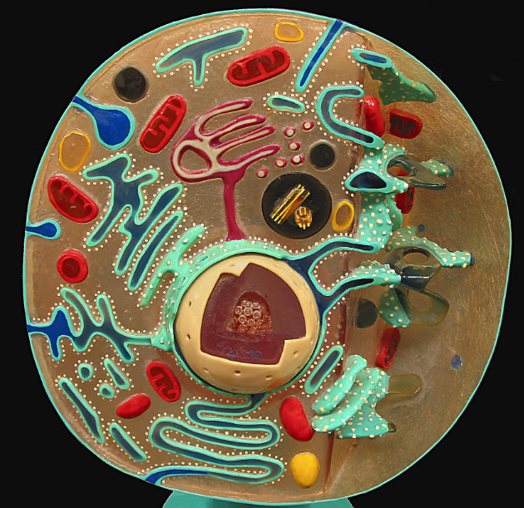
Know this for next Lab!
Know the name and function of organelles found in plant and animal cells.
Know differences between them!
Cell membrane
Mitochondria
Golgi apparatus
Nucleolus
Nucleus
By Divinemercy (Own work) [CC BY-SA 3.0 (http://creativecommons.org/licenses/by-sa/3.0) or GFDL (http://www.gnu.org/copyleft/fdl.html)], via Wikimedia Commons https://upload.wikimedia.org/wikipedia/commons/5/5f/Animal_Cell_Cross_Section_Model.jpg
Cytoplasm
Endoplasmic reticulum
Lysosome

Slide 21
Focus Specimen
Use Nosepiece and set to Scanning Objective (4x Red color band)
Place slide on stage
Use coarse adjustment knob to raise stage all the way up.
Focus (both: fine and coarse adjustment knobs) and center
Use Nosepiece and set to Low-power objective (10x Yellow color band)
Focus (only fine adjustment knob)
Use Nosepiece and set to Low-power objective (40x Blue color band)
Focus (only fine adjustment knob)
Rotate Nosepiece “backwards” (not THROUGH OIL lense!!) and set to Scanning Objective (4x Red color band)
Now, you can lower the stage

