Slide 1
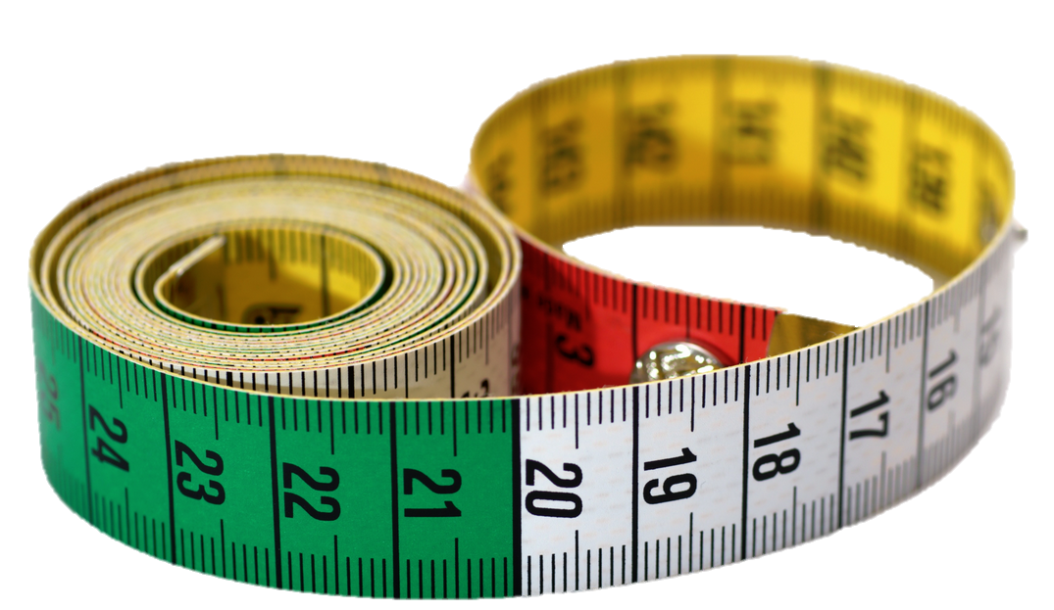
General Biology I Lab BSC 2010L
Welcome/Safety, pg. v-viii
Measurement Metric, Exercise 1, pg. 1-12
BSC2010L

Slide 2
Instructor info – Summer A
TLS – Technical Laboratory Specialist
#237885-BSC2010L 1-Main N215 11:00- 1:45PM TR Anthony Cruz acruz@irsc.edu
#237886-BSC2010L 1-Main N215 2:05- 4:50PM TR Grace Dodillet gdodille@irsc.edu***
#237887-BSC2010L 2-Vero D204 2:45- 5:15PM MW Sarah Rodgers srodgers@irsc.edu
#238063-BSC2010L 2-Vero D204 5:30- 8:15PM MW Allison Wright awright@irsc.edu
#237983-BSC2010L 5-Pruitt E113 2:00- 4:45PM MW Brian Lenhart blenhart@irsc.edu
#237889-BSC2010L 5-Pruitt E113 5:30- 8:15PM TR Allison Wright awright@irsc.edu
#238013-BSC2010L 3-Chastain C209 11:15- 2:00PM TR Adam Muckenfuss amuckenf@irsc.edu
#238137-BSC2010L 5-Pruitt E113 5:30- 8:15PM MW Adam Muckenfuss amuckenf@irsc.edu
IOR – Instructor Of Record
Sarah Rodgers srodgers@irsc.edu
772-462-7149
Office N-124 (Call or email to make appointment)
EMAILS or CALLS without REF # MAY NOT BE ANSWERED!!!!!!

Slide 3
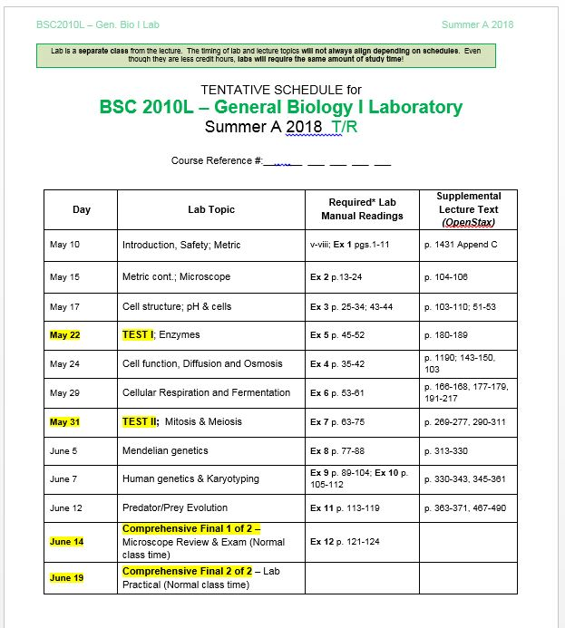
Welcome to Bio I Lab!
Read Syllabus:
It’s YOUR contract!

Slide 4
Welcome to Lab!
Did you get my email?
In case you forward your RiverMail to your private account, pls verify
Lab Material on Weebly
http://biology-irsc.weebly.com/bsc2010l-general-biology-i-lab.html
Attendance (mandatory to finish each lab)
1 emergency absence is ‘free’ – then 3% points off FINAL GRADE
Inform BEFORE the lab that you might miss!!
Make-up lab exercises
http://biology-irsc.weebly.com/laboratory-schedules-click-here.html

Slide 5
Lab Rules:
Lab Attire (see syllabus)
Shoes: closed-toe and closed-heel
Recommendation: Shoes in car!
Long pants
Not dressed properly = NOT allowed in lab! (including Exam days = a ZERO on the test)
Cheating:
Zero Tolerance
Both students will be reported – protect your test!

Slide 6
Lab Rules:
Makeup-Policy
Labs-find another lab, contact instructor to attend
http://biology-irsc.weebly.com/laboratory-schedules-click-here.html
One free, subsequent -3% of final grade
Exam 1 -> No make up, will be your dropped grade
Exam 2 -> No make up, will be your dropped grade
Final -> No make up, ‘I’ = incomplete, if passing grade, 0% x 2 = two zero’s, if not currently passing

Slide 7
Lab Rules:
Cell Phone Policy - no video
Disruptive Behavior - will be asked to leave
Follow directions – main part of “LAB”
Help your fellow students
=> Teamwork
No exam grades will be curved
Ask questions
In class, email me, drop by my office or call me.
If you require additional services, see me after class. (need note-taker, testing accommodations etc.)

Slide 8
Grading
100
100
100
100
Exam 1 100%
Exam 2 100%
Final 100% x 2 = 200
drop 1 of 4
average
best 3
*NOTICE* : YOUR GRADE IS MADE UP ENTIRELY from the points YOU EARN from your THREE TESTS!
= No Homework, No extra credit, No lab book points, No Blackboard Quiz points
HOWEVER, Attendance can negatively influence your final grade -3% for each missed class!

Slide 9
Grading Example 1
Exam 1 86/100 86 drop 1 of 4
Exam 2 71/100 71 average
best 3
Final 82/100 x 2 = 164 82
82
(86+82+82)
3
= 83 = B

Slide 10
Grading Example 2
Exam 1 86/100 86
Exam 2 abs. 0
Final 81/100 x 2 = 162 81
81
(86+81+81)
3
= 82.6 = B…
***Missed 2 classes =
one freebee, other -3%
-3.0
79.6 = C

Slide 11
Grading Example 3
Exam 1 86/100 86
Exam 2 71/100 71
Final 65/100 x 2 = 130 65
65
(86+71+65)
3
= 74 = C

Slide 12
Taking attendance:
I am required to track attendance in every Lab.
*YOU* are required to sign in at the door with first and last name as well as your workstation number. Failure to do this will result in being counted ABSENT that day. Instructors are NOT responsible to remember whom was or was not present each class period.
You will be automatically dropped from this class if I do not record your attendance.

Slide 13
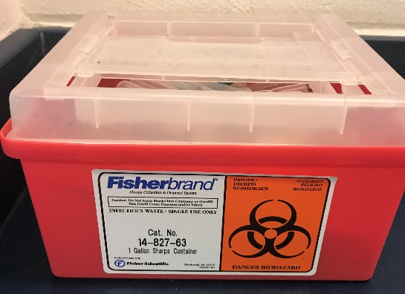
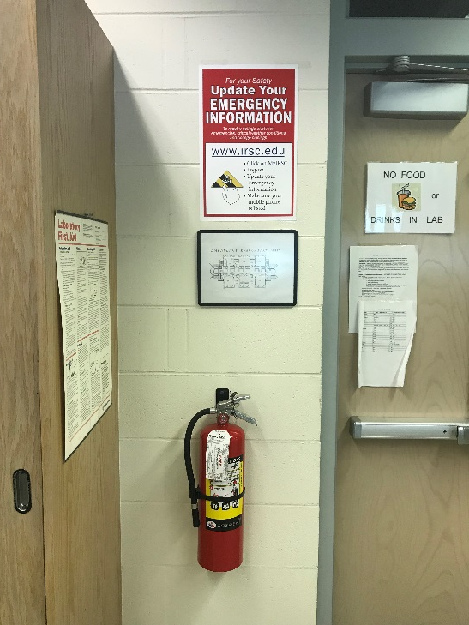
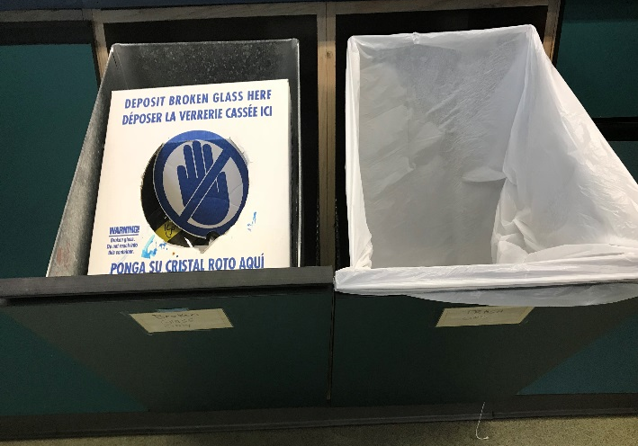
Safety
Biohazard
Be sure to familiarize yourself with safety procedures
Where does broken glass go?
What goes in the biohazard?
Eye wash station
Chemical Shower
Fire Blanket
Fire Extinguisher
Fire
Broken Glass vs. Trash

Slide 14
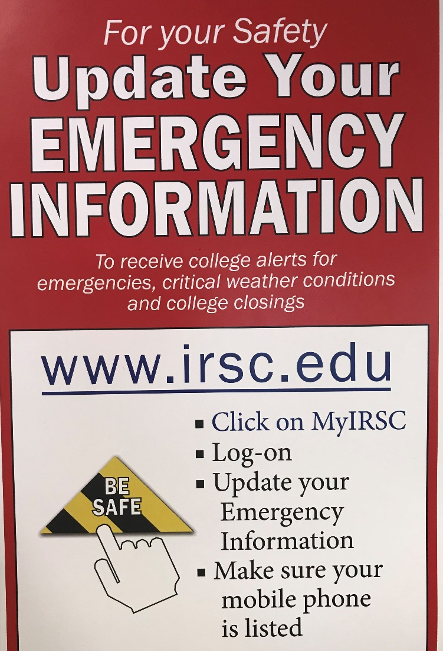
Safety
Evacuation Map and Emergency Info
Evacuation from GB1L – Main Campus

Slide 15
What to Expect from a LAB:
Labs become increasingly difficult
Missing a Lab is detrimental to Exams
Summer is tough – keep up
Just a 1 credit hour course, yet
Pre-Lab reading and preparation
2½ hour long Lab
Final is comprehensive!
Use of specific terms (like a new language)
NO extra credit
NOT an easy course!

Slide 16
Steps to ‘complete’ a lab:
On Time
No Food no Beverages
Sign in at door
Complete and Understand entire exercise
Clear Workstation
Review next weeks exercise
Clean up before you leave

Slide 17
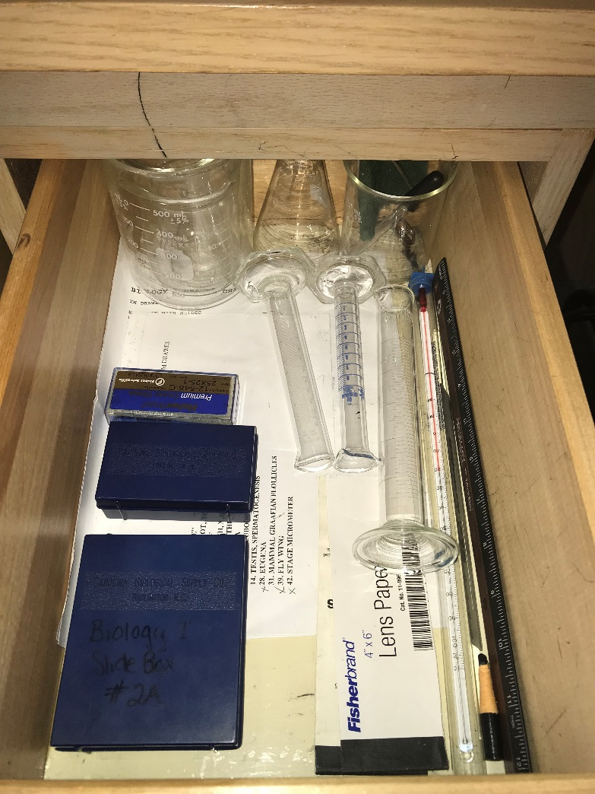
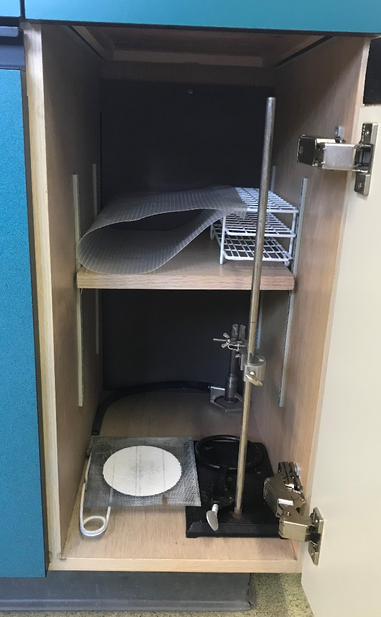
Your Workstation Supplies:

Slide 18
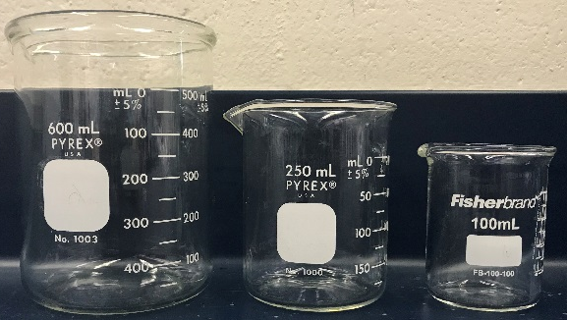
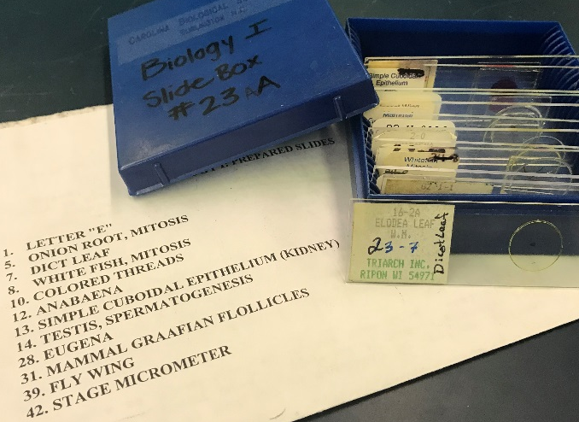
Lab Equipment (in your Drawer):

Slide 19
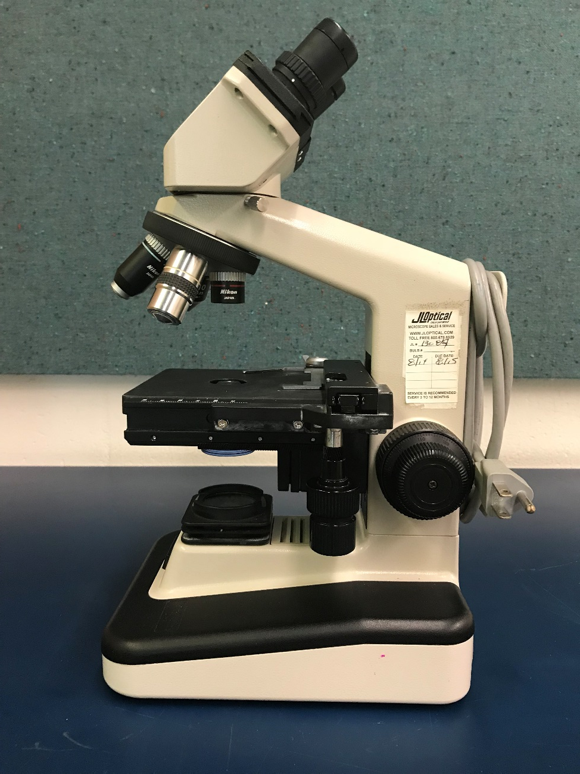
Lab Equipment (on benchtop & cabinet):

Slide 20
Lab Contract
By not dropping the course, the student agrees to these terms of the Lab Contract:
Shoe attire
Food and beverages stored away
Cell Phone use for pictures of stations ONLY
Be on time for all Labs and Exams
Inform Instructor when unable to attend – then make up the lab.
Setup the email forwarding system by next lab period
Follow instructions during Lab
Clean up!

Slide 21
The Metric System Exercise 1, pg. 1-12
“Lab” Objectives:
Understanding the Metric System
Mass (g) grams
Length (m) meters
Volume (l) liters
Learning to convert to different units
i.e. the same measurement recorded different ways
Conduct accurate measurements using laboratory equipment

Slide 22
What is a “Laboratory”
Word origin 1595-1605: Medieval Latin labōrātōrium workshop,
Latinlabōrā(re) to labor
Definition:
A building or room equipped for conducting scientific research or for teaching practical science

Slide 23
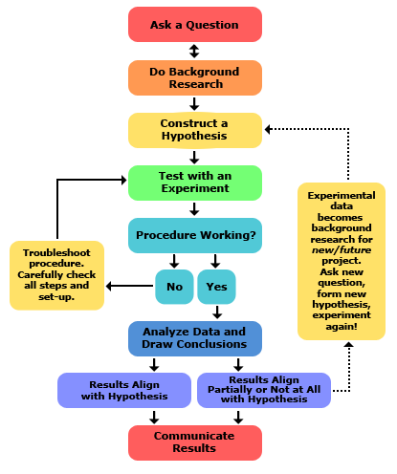
SCIENCE:
Answering questions
&
solving problems
via
The Scientific Method
http://www-cdn.sciencebuddies.org/Files/5084/7/2013-updated_scientific-method-steps_v6_noheader.png

Slide 24
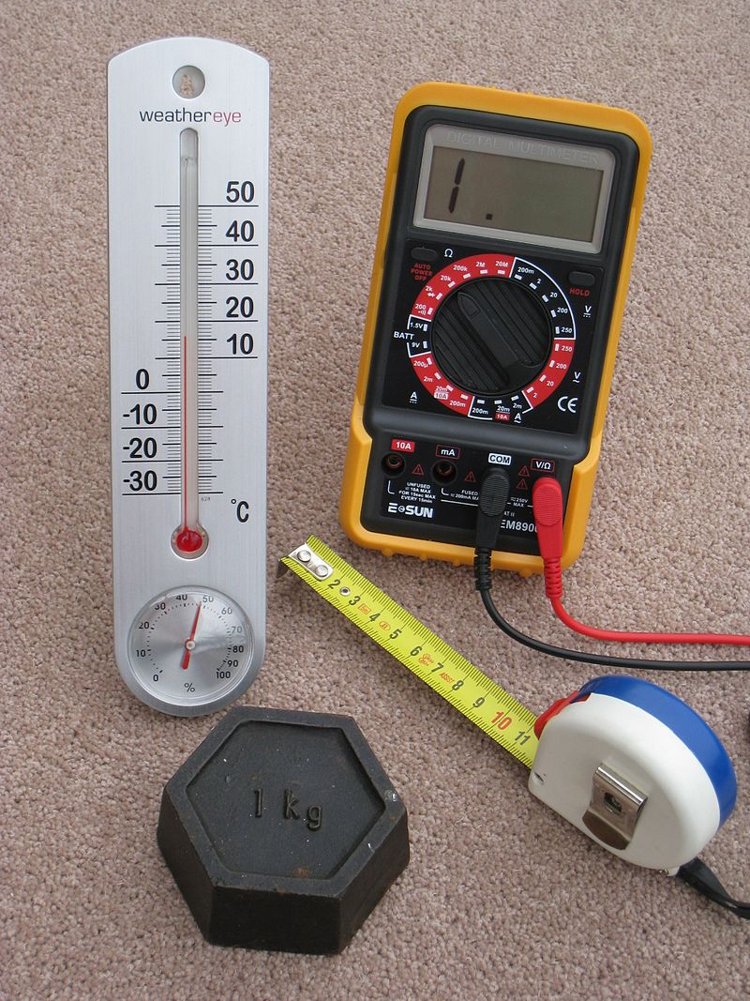
SCIENCE: making observations & comparing to others
Metric system Units of Measure
Length or Distance – Meter
100 meter dash
Mass – Gram
15 grams of salt
Volume – Liter
2 liter bottle of soda
Temperature – Celsius
Store at 4 degrees Celsius

Slide 25
How to make comparing across time and space easier:
Converting measurements to appropriate units increases accuracy & precision
Why is accuracy important – who cares!??
Accuracy represents how close a measurement comes to a true value. This is important because bad equipment, bad data processing or human error can lead to inaccurate results, meaning they are not very close to the truth.
Example: Put*******************************************************************************************************

Slide 26
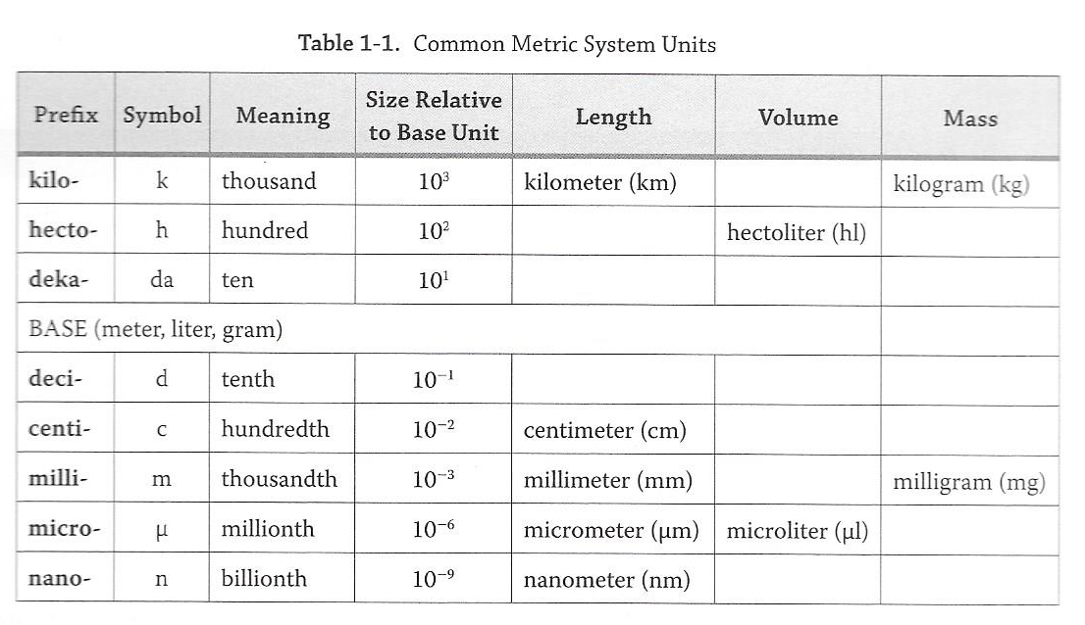
Metric System
KiloU
(k*)
HectoU
Meter, Gram, Liter
(h*)
DekaU
(da*)
U
m,l,g
DeciU
(d*)
CentiU
(c*)
MilliU
(m*)
MicroU
(µ *)
NanoU
(n*)

Slide 27
Metric System
0.001 kg
KiloU
0.01 hg
(k*)
HectoU
0.1 dag
(h*)
DekaU
1 g
(da*)
U
10 dg
m,l,g
DeciU
100 cg
(d*)
CentiU
1000 mg
(c*)
MilliU
(m*)
1,000,000 µg
MicroU
(µ *)
1,000,000,000 ng
NanoU
(n*)

Slide 28
Metric System (pgs. 2 &3)
0.0025 km
0.0025 km
KiloU
0.025 hm
(k*)
0.025 hm
HectoU
0.25 dam
Meter, Gram, Liter
How long is my desk?
2.5 meters
0.25 dam
2.5 m
(h*)
DekaU
2.5 m
(da*)
U
25 dm
m,l,g
DeciU
250 cm
“Decimal Point” to the right
(d*)
CentiU
2,500 mm
(c*)
MilliU
(m*)
“Decimal Point” to the left
THEY ARE ALL CORRECT
because they all equal each other!
However, it’s more accurate and easier to comprehend the
desk length in meters (m) in reference to the desk size!
Q. Would you use meters (m) to measure a stamp???
A. NO, you would use a smaller unit to report the stamp size for the same reasons.
2,500,000 µm
MicroU
(µ *)
2,500,000,000 nm
NanoU
(n*)

Slide 29
Metric System (pgs. 2 &3)
End
KiloU
(km)
HectoU
(hm)
“Decimal Point” to the right
DekaU
(dam)
U
m,l,g
DeciU
(dm)
CentiU
Start
(cm)
MilliU
(mm)
“Decimal Point” to the left
MicroU
(µm)
NanoU
0.000005
(nm)
5 mm = ____________ km
5 = 5.0 = 0000000005.000000000
5 = 5.0 = 0000.000005000000000
Start mm (milli m) = End km (kilo m)
Six steps to the left = 6 steps for decimal point to the left

Slide 30
Metric System (pgs. 2 &3)
KiloU
(kg)
HectoU
(hg)
“Point” to the right
DekaU
(dag)
U
Start
m,l,g
DeciU
(dg)
CentiU
End
(cg)
MilliU
“Point” to the left
(mg)
MicroU
(µg)
NanoU
1275
12.75 dg =________mg
12.75 = 000000012.7500000000
(ng)
12.75 = 00000001275.00000000
Start dg (deci) = End mg (milli g)
2 steps to the right = 2 steps for decimal point to the right

Slide 31
Metric System (pgs. 2 &3)
KiloU
Start
(kl)
HectoU
(hl)
“Point” to the right
DekaU
(dal)
U
m,l,g
DeciU
End
(dl)
CentiU
(cl)
MilliU
“Point” to the left
(ml)
MicroU
(µl)
NanoU
143
0.0143 hecto l = _____cl
0.0143 = 00000000.014300000000
(nl)
0.0143 = 000000000143.00000000
Start hecto = End cl (centi l)
4 steps to the right = 4 steps for decimal point to the right

Slide 32
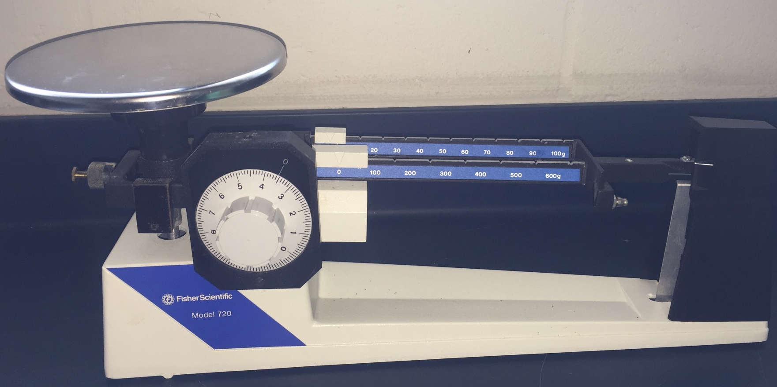
How to measure Mass?
tens
hundreds
© OHAUS CORPORATION, Parsippany, NJ 07054 http://www.directindustry.com/prod/ohaus/product-5711-1559328.html
ones

Slide 33
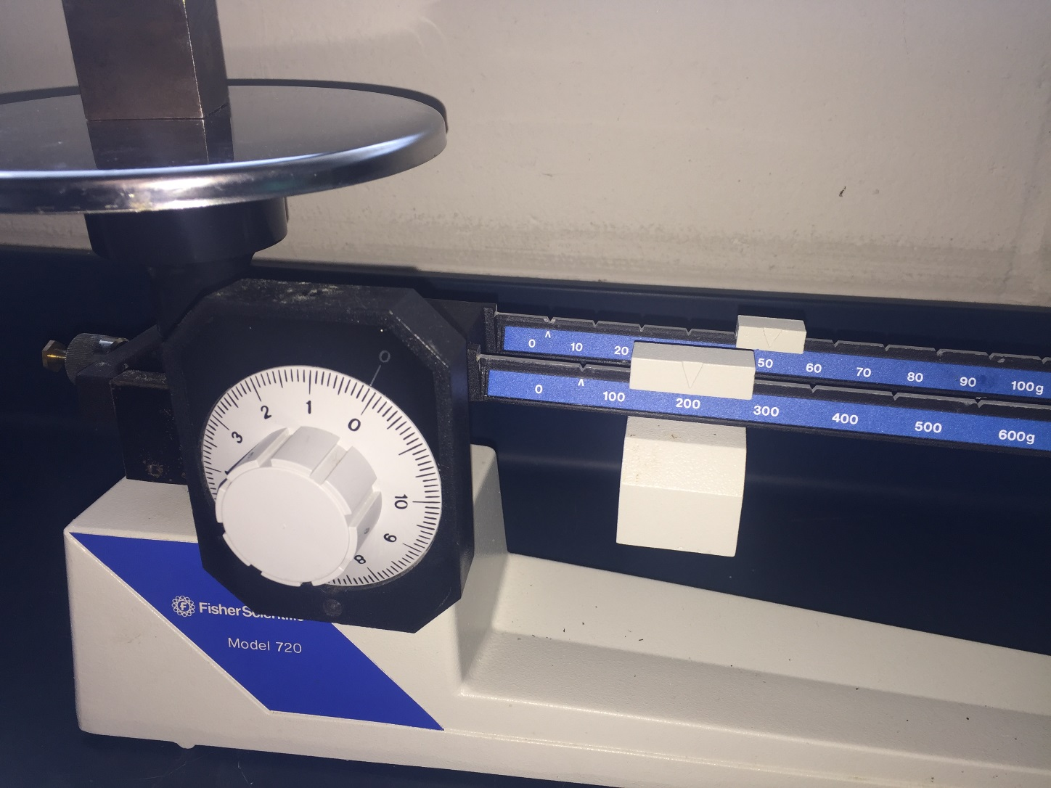
How to measure Mass?
tens
hundreds
ones

Slide 34
How to measure Mass?
hundreds
tens
ones
200 g
+
40 g
+
1.4 g
=
241.4 g

Slide 35
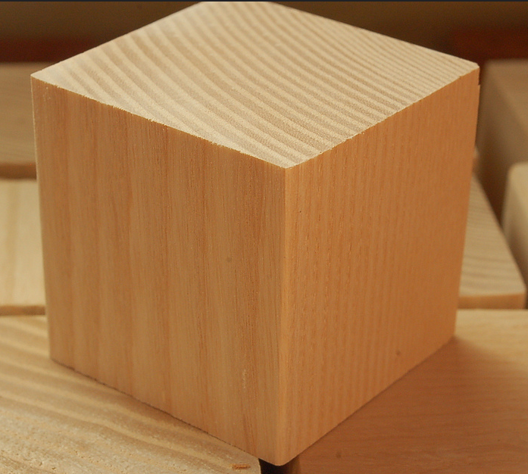
How to measure Length?
7.9 cm
By Luigi Chiesa - Photo taken by Luigi Chiesa, CC BY-SA 3.0, https://commons.wikimedia.org/w/index.php?curid=1137573
© Ash Blocks, CC BY-SA 2.0, https://www.flickr.com/photos/artdrauglis/4192499051

Slide 36
How to measure volume?
Pick ONE vertex
And measure the
three different
edges that meet at this vertex
By Luigi Chiesa - Photo taken by Luigi Chiesa, CC BY-SA 3.0, https://commons.wikimedia.org/w/index.php?curid=1137573
© Ash Blocks, CC BY-SA 2.0, https://www.flickr.com/photos/artdrauglis/4192499051

Slide 37
How to measure volume (solid)?
Volume = length x width x height(depth)
Length = 7.9 cm
Width = 8.5 cm
Height(depth) = 6.2 cm
=> Volume = 7.9 x 8.5 x 6.2 = 416.33 cm³

Slide 38
How to measure volume: solid to liquid
416.33 cm³ in ml?
How much water (liquids reported in liters) would fit into that block you just measured at 416.33 cm^{3 ?}
Remember, by definition, 1 cm³ = 1 ml
=> 416.33 cm³ =
416.33 ml

Slide 39
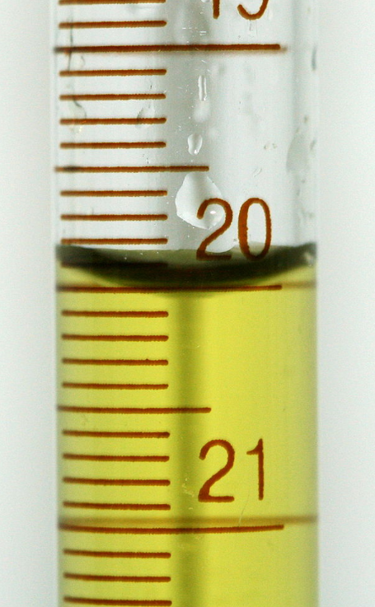
How to measure volume (liquid)?
Always use graduated cylinder to measure volume:
Do not use a beaker (not accurate)!!!
View meniscus at eye level !
wrong
© PRHaney - Own work, CC BY-SA 3.0, https://commons.wikimedia.org/w/index.php?curid=9472731
By AnyFile (Own work) [Public domain], via Wikimedia Commons https://commons.wikimedia.org/wiki/File%3AEye_symbol_lateral.svg

Slide 40
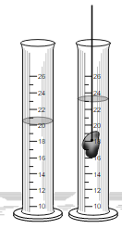
How to measure volume: solid to liquid
Can measure volume of an odd shaped object with Displacement volume =
Record measurement at meniscus
Total volume (after object)
- Original volume (before object)
23 ml
-20 ml
3 ml

Slide 41
How to measure temperature?
Thermometer display in Celsius
Read measurement where the grey/black line stops climbing up the glass rod
This will take time to change if measuring different temperatures, be patient for an accurate reading
Report in either Celsius or convert to Fahrenheit
°C = (°F – 32°)/1.8 °F = °C x 1.8 + 32
Boiling Point of Water 100 °C or 212 °F
Freezing Point: 0 °C or 32 °F
*hint – in a conversion, C will always be a smaller number than F
(c comes before f in alphabet)

Slide 42
Lab Procedure and Stations
Pg 4 ‘To Do’ Length
Pg 7, 8 ‘To Do’ Mass
Pg 10 ‘To Do’ Temperature
Pg 9 ‘To Do’ Volume
Length (Bones/meter stick) *take to desk
Volume
Marble/grad cylinder (*grad cyl in drawer)
Mass
(blocks/scale) *take carefully to desk
Temp
(Water, Air, Ice to view movement) *measure here*

Slide 43
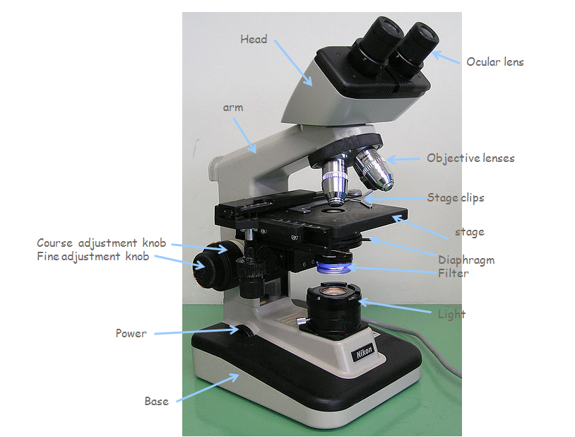
Next Week: Compound Microscope
Learning all parts of the Microscope and how to utilize them!
Nose piece
Coarse adjustment knob
Condenser
Slide Manipulation Knobs

Slide 44
Exam Study Guide
Metric System
Be comfortable with measurements and know how to do conversions!
Be comfortable measuring anything placed in front of you
ASC Library for extra tutoring and help
Form study groups now
Sample Quiz on Blackboard

