Slide 1
Lab Contract
By not dropping the course, the student agrees to these terms of the Lab Contract:
Shoe attire
Food and beverages stored away
Cell Phone use for pictures of stations ONLY
Be on time for all Labs and Exams
Inform Instructor when unable to attend – then make up the lab.
Setup the email forwarding system by next lab period
Follow instructions during Lab
Clean up!

Slide 2
The Metric System Exercise 1, pg. 1-14
“Lab” Objectives:
Understanding the Metric System
Mass (g) grams
Length (m) meters
Volume (l) liters
Learning to convert to different units
i.e. the same measurement recorded different ways
Conduct accurate measurements using laboratory equipment

Slide 3
What is a “Laboratory”
Word origin 1595-1605: Medieval Latin labōrātōrium workshop,
Latinlabōrā(re) to labor
Definition:
A building or room equipped for conducting scientific research or for teaching practical science

Slide 4
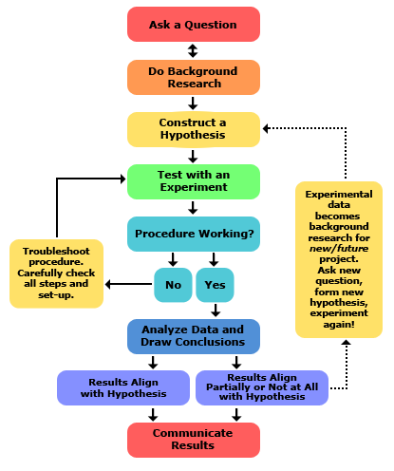
SCIENCE:
Answering questions
&
solving problems
via
The Scientific Method
http://www-cdn.sciencebuddies.org/Files/5084/7/2013-updated_scientific-method-steps_v6_noheader.png

Slide 5
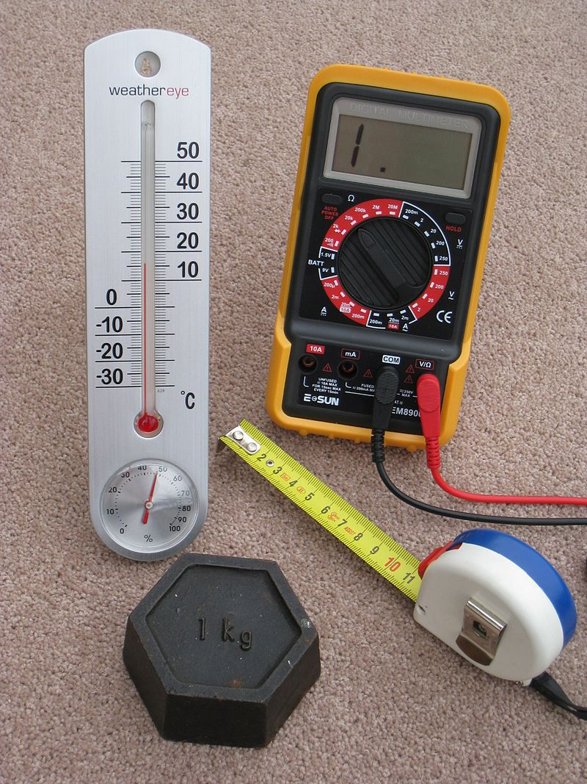
SCIENCE: making observations & comparing to others
Metric system Units of Measure
Length or Distance – Meter
100 meter dash
Mass – Gram
15 grams of salt
Volume – Liter
2 liter bottle of soda
Temperature – Celsius
Store at 4 degrees Celsius

Slide 6
How to make comparing across time and space easier:
= Converting measurements to appropriate units increases accuracy & precision
Accuracy represents how close a measurement comes to a true value.
Example: What if I tell you to run “a couple of miles”…
Could mean 2 miles to some or 10 miles for a trained runner = BIG DIFFERENCE!
Example: The recipe calls for a “few teaspoons of salt”…
Could mean the difference between a good cake and mush
Precision represents to what degree you can report your measurement accurately (=without guessing)

Slide 7
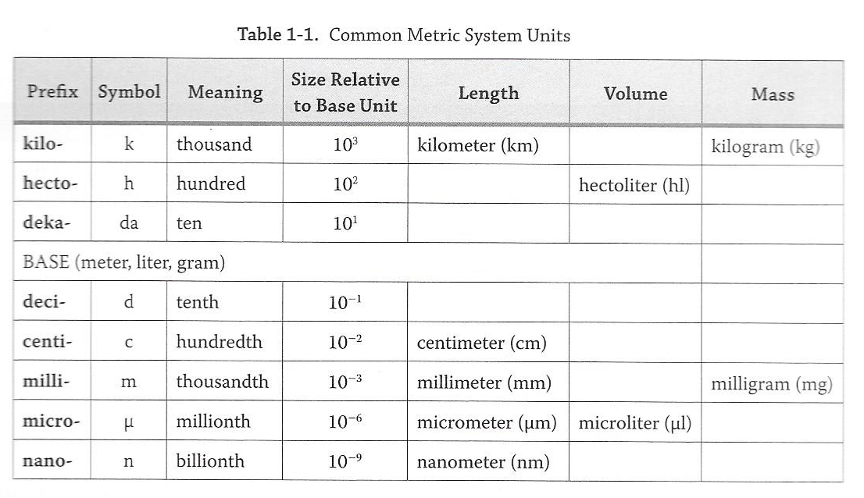
Metric System
KiloU
(k*)
HectoU
Meter, Gram, Liter
(h*)
DekaU
(da*)
U
m,l,g
DeciU
(d*)
CentiU
(c*)
MilliU
(m*)
MicroU
(µ *)
NanoU
(n*)

Slide 8
Metric System
0.001 kg
KiloU
0.01 hg
(k*)
HectoU
0.1 dag
(h*)
DekaU
1 g
(da*)
U
10 dg
m,l,g
DeciU
100 cg
(d*)
CentiU
1000 mg
(c*)
MilliU
(m*)
1,000,000 µg
MicroU
(µ *)
1,000,000,000 ng
NanoU
(n*)

Slide 9
Metric System (pgs. 2 &3)
0.0025 km
0.0025 km
KiloU
0.025 hm
(k*)
0.025 hm
HectoU
0.25 dam
How long is my desk?
~2.5 meters
0.25 dam
(h*)
DekaU
2.5 m
Is that precise? NO,
you would have to say 2-3 meters
(da*)
25 dm
U
m,l,g
DeciU
250 cm
“Decimal Point” to the right
(d*)
CentiU
2,500 mm
(c*)
MilliU
(m*)
“Decimal Point” to the left
THEY ARE ALL CORRECT
because they all equal each other!
However, it’s more accurate and easier to comprehend the
desk length in meters (m) in reference to the desk size!
2,500,000 µm
MicroU
(µ *)
2,500,000,000 nm
NanoU
(n*)

Slide 10
Metric System (pgs. 2 &3)
Q. Would you use meters (m) to measure a stamp???
KiloU
(k*)
HectoU
(h*)
~0.03 meters
DekaU
0.03 m
(da*)
U
Is that precise?
0.3 dm
m,l,g
DeciU
3.0 cm
“Decimal Point” to the right
(d*)
CentiU
30 mm
(c*)
MilliU
(m*)
“Decimal Point” to the left
MicroU
(µ *)
NanoU
(n*)

Slide 11
Metric System (pgs. 2 &3)
End
KiloU
(km)
HectoU
(hm)
“Decimal Point” to the right
DekaU
(dam)
U
m,l,g
DeciU
(dm)
CentiU
Start
(cm)
MilliU
(mm)
“Decimal Point” to the left
MicroU
(µm)
NanoU
0.000005
(nm)
5 mm = ____________ km
5 = 5.0 = 0000000005.000000000
5 = 5.0 = 0000.000005000000000
Start mm (milli m) = End km (kilo m)
Six steps to the left = 6 steps for decimal point to the left

Slide 12
Metric System (pgs. 2 &3)
KiloU
(kg)
HectoU
(hg)
“Point” to the right
DekaU
(dag)
U
Start
m,l,g
DeciU
(dg)
CentiU
End
(cg)
MilliU
“Point” to the left
(mg)
MicroU
(µg)
NanoU
1275
12.75 dg =________mg
12.75 = 000000012.7500000000
(ng)
12.75 = 00000001275.00000000
Start dg (deci) = End mg (milli g)
2 steps to the right = 2 steps for decimal point to the right

Slide 13
Metric System (pgs. 2 &3)
KiloU
Start
(kl)
HectoU
(hl)
“Point” to the right
DekaU
(dal)
U
m,l,g
DeciU
End
(dl)
CentiU
(cl)
MilliU
“Point” to the left
(ml)
MicroU
(µl)
NanoU
143
0.0143 hecto l = _____cl
0.0143 = 00000000.014300000000
(nl)
0.0143 = 000000000143.00000000
Start hecto = End cl (centi l)
4 steps to the right = 4 steps for decimal point to the right

Slide 14
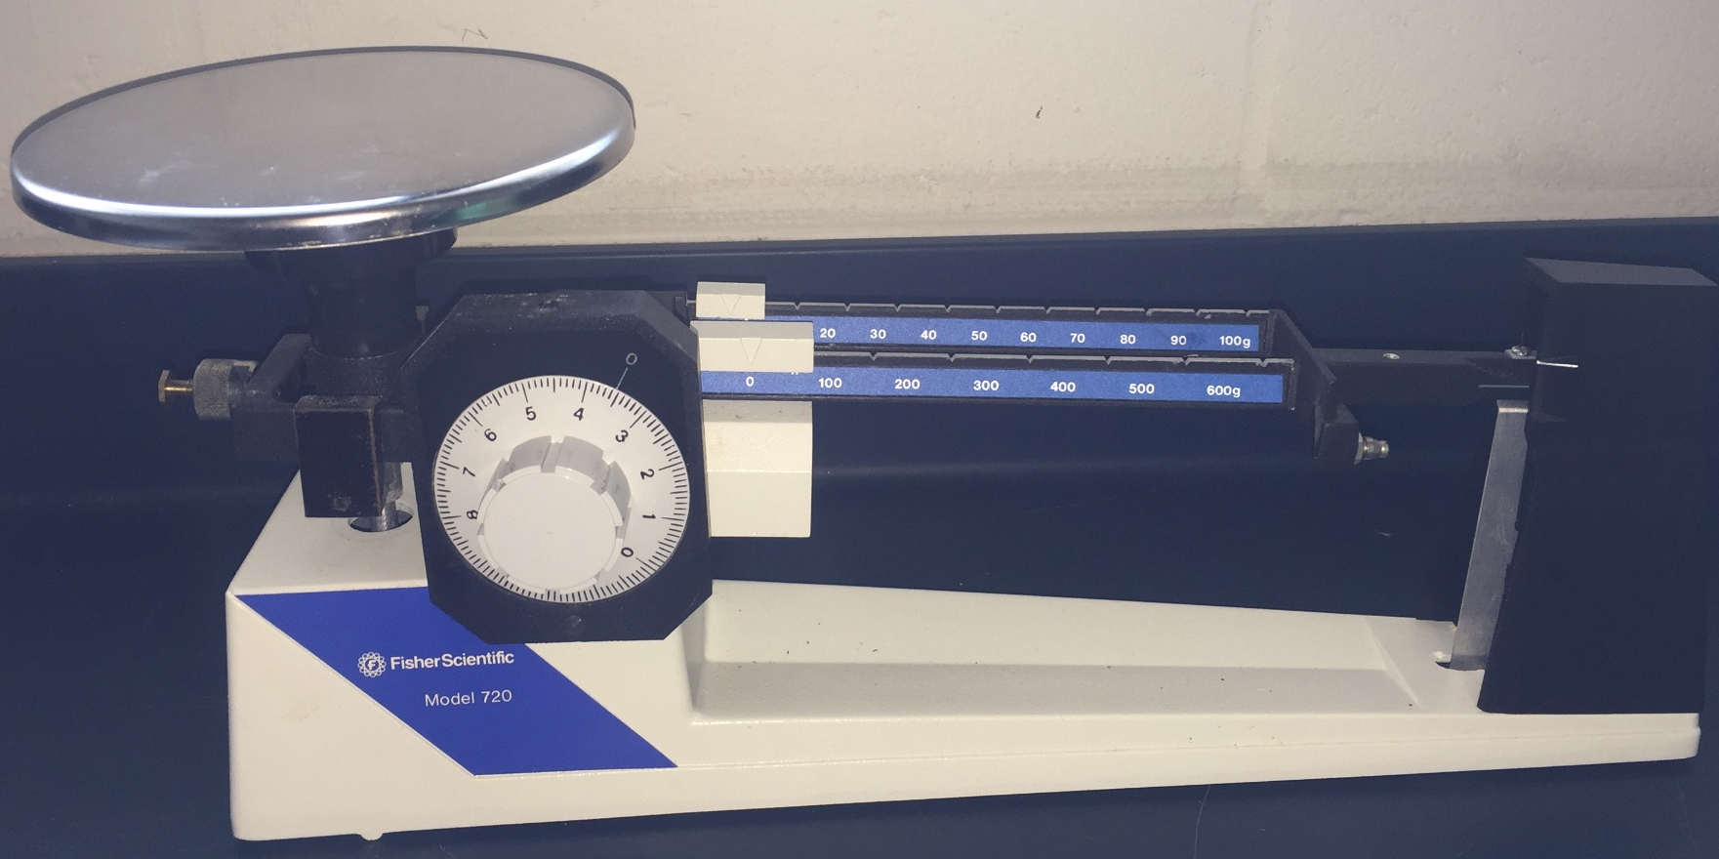
How to measure Mass?
tens
hundreds
© OHAUS CORPORATION, Parsippany, NJ 07054 http://www.directindustry.com/prod/ohaus/product-5711-1559328.html
ones

Slide 15
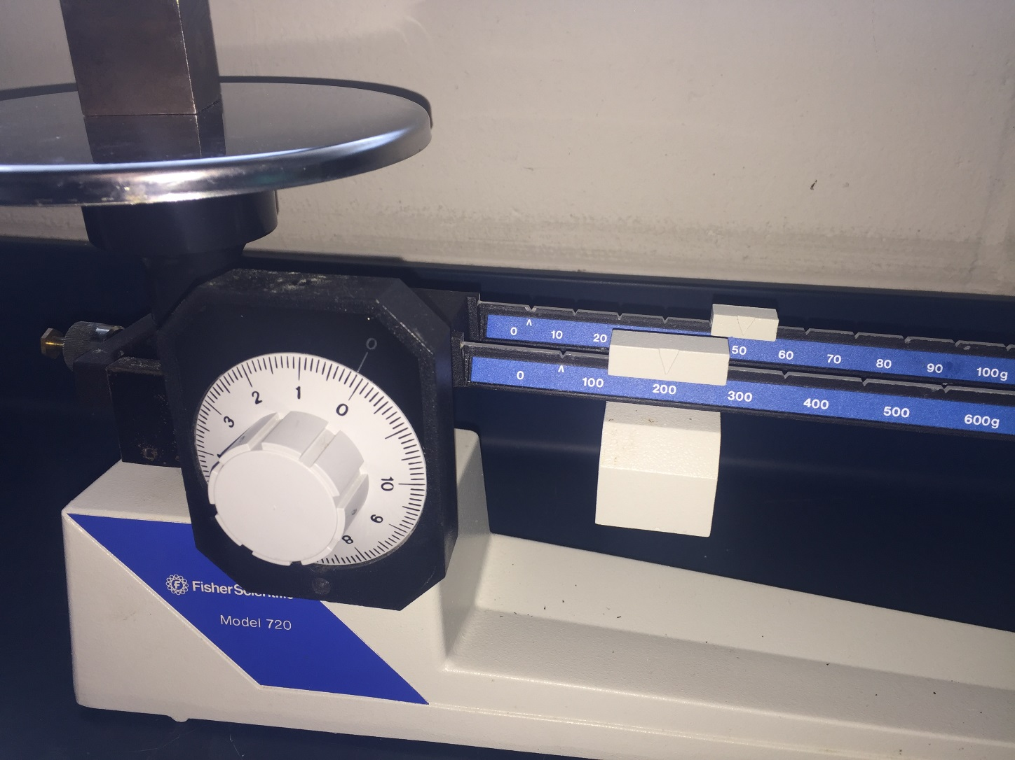
How to measure Mass?
tens
hundreds
ones

Slide 16
How to measure Mass?
hundreds
tens
ones
200 g
+
40 g
+
1.4 g
=
241.4 g

Slide 17
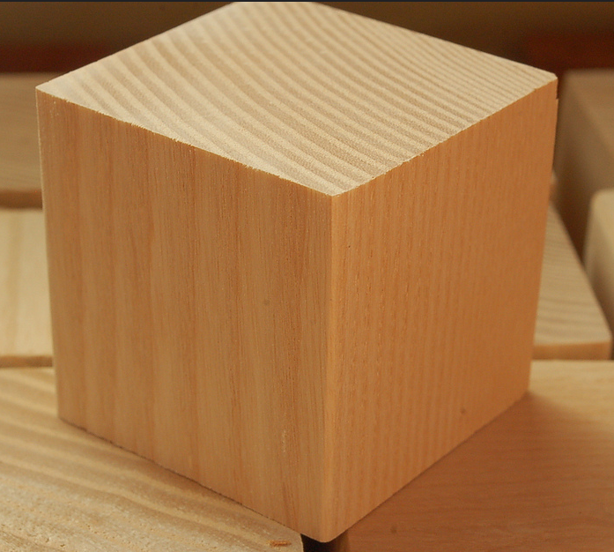
How to measure Length?
7.9 cm
By Luigi Chiesa - Photo taken by Luigi Chiesa, CC BY-SA 3.0, https://commons.wikimedia.org/w/index.php?curid=1137573
© Ash Blocks, CC BY-SA 2.0, https://www.flickr.com/photos/artdrauglis/4192499051

Slide 18
How to measure volume?
Pick ONE vertex
And measure the
three different
edges that meet at this vertex
By Luigi Chiesa - Photo taken by Luigi Chiesa, CC BY-SA 3.0, https://commons.wikimedia.org/w/index.php?curid=1137573
© Ash Blocks, CC BY-SA 2.0, https://www.flickr.com/photos/artdrauglis/4192499051

Slide 19
How to measure volume (solid)?
Volume = length x width x height(depth)
Length = 7.9 cm
Width = 8.5 cm
Height(depth) = 6.2 cm
=> Volume = 7.9 x 8.5 x 6.2 = 416.33 cm³

Slide 20
How to measure volume: solid to liquid
416.33 cm³ in ml?
How much water (liquids reported in liters) would fit into that block you just measured at 416.33 cm^{3 ?}
Remember, by definition, 1 cm³ = 1 ml
=> 416.33 cm³ =
416.33 ml

Slide 21
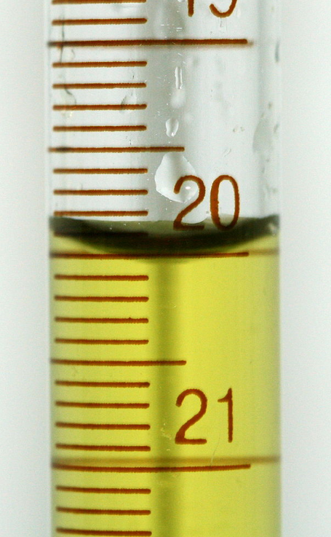
How to measure volume (liquid)?
Always use graduated cylinder to measure volume:
Do not use a beaker (not accurate)!!!
View meniscus at eye level !
wrong
© PRHaney - Own work, CC BY-SA 3.0, https://commons.wikimedia.org/w/index.php?curid=9472731
By AnyFile (Own work) [Public domain], via Wikimedia Commons https://commons.wikimedia.org/wiki/File%3AEye_symbol_lateral.svg

Slide 22
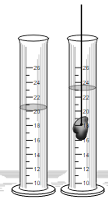
How to measure volume: solid to liquid
Can measure volume of an odd shaped object with Displacement volume =
Record measurement at meniscus
Total volume (after object)
- Original volume (before object)
23 ml
-20 ml
3 ml

Slide 23
How to measure temperature?
Thermometer display in Celsius
Read measurement where the grey/black line stops climbing up the glass rod
This will take time to change if measuring different temperatures, be patient for an accurate reading
Report in either Celsius or convert to Fahrenheit
°C = (°F – 32°)/1.8 °F = °C x 1.8 + 32
Boiling Point of Water 100 °C or 212 °F
Freezing Point: 0 °C or 32 °F
*hint – in a conversion, C will always be a smaller number than F
(c comes before f in alphabet)

Slide 24
Lab Procedure and Tools
Pg x "Before you Proceed" Questions
Pg 5 – Conversion Questions
Pg 6-7 ‘To Do’ Length
Pg 7-10 ‘To Do’ Mass
Pg 10-12 ‘To Do’ Volume
Pg 13-14 ‘To Do’ Temperature
Volume
LxWxH; grad cylinder
Length (Bones/meter stick)
Mass
(blocks/scale) *take carefully to desk
Temp
(Water, Air, Ice...)
*measure where set up*

Slide 25
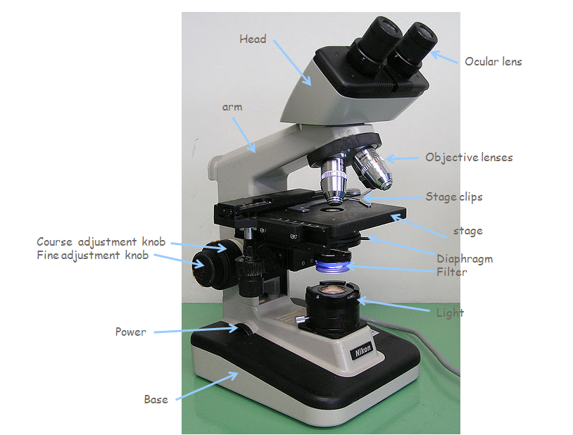
Next Week: Compound Microscope
Learning all parts of the Microscope and how to utilize them!
Nose piece
Coarse adjustment knob
Condenser
Slide Manipulation Knobs

Slide 26
Exam Study Guide
Metric System
Be comfortable with measurements and know how to do conversions!
Be comfortable measuring anything placed in front of you
Supplemental Packet = extra problems!
ASC Library for extra tutoring and help
Form study groups now
Sample Quiz on Blackboard

