Slide 1
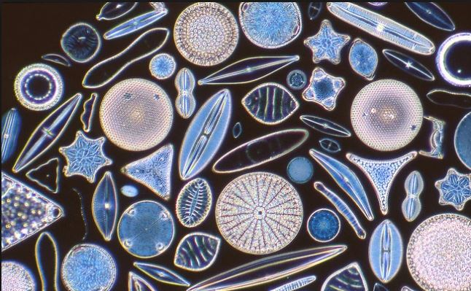
Microscope Review: Prokayrotes & Simple Eukaryotes
Exercise 12. pg. 121-124
BSC2010L

Slide 2
Microscope Use & Test Exercise 12, pg. 123-126
Lab Objectives:
- Examine Slides of key stages in Earth’s evolution
- Practice & Test Microscope skills
- Prepare for subsequent lab courses (Bio2, AP1, Micro)

Slide 3
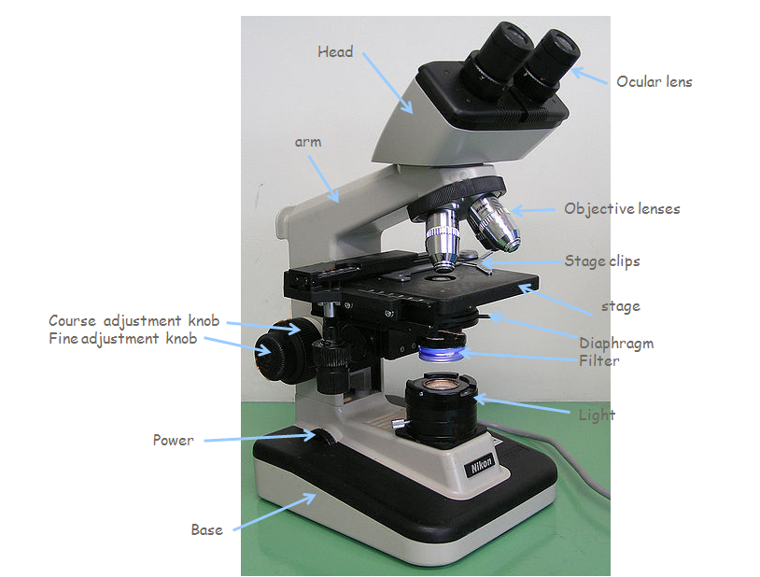
Compound Microscope
Nose piece
© Moisey - File:Optical microscope nikon alphaphot.jpg, CC BY-SA 3.0, https://commons.wikimedia.org/w/index.php?curid=7011479
Coarse adjustment knob
Condenser

Slide 4
The Objective Lenses
Scanning Objective (4x)
Red color band, smallest one
Low-power objective (10x)
Yellow color band
High-power objective (40x)
Blue color band
Oil Immersion objective (100x)
Gray color band
Only use with oil! Have to carefully clean oil off afterwards!!!!!

Slide 5
Focus Specimen
Use Nosepiece and set to Scanning Objective (4x Red color band)
Place slide on stage
Use coarse adjustment knob to raise stage all the way up.
Focus (both: fine and coarse adjustment knobs) and center
Use Nosepiece and set to Low-power objective (10x Yellow color band)
Focus (only fine adjustment knob)
Use Nosepiece and set to Low-power objective (40x Blue color band)
Focus (only fine adjustment knob)
Use Nosepiece and set to Scanning Objective (4x Red color band) – Now, you can lower the stage

Slide 6
The Domains
Domain Bacteria – unicellular prokaryotes
Bacteria
Cyanobacteria
Domain Archaea – unicellular prokaryotes
Includes “extremophiles”
We won’t be looking at any of these in this lab
Domain Eukarya – eukaryotes
Kingdom Protista
Kingdom Fungi
Kingdom Plantae
Kingdom Animalia

Slide 7
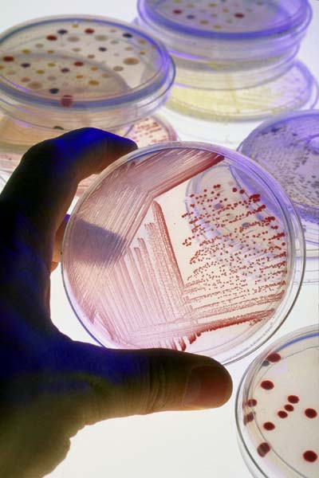
Domain Bacteria
This is what bacteria looks like growing in culture, you have to look at it under the microscope to see individual cells

Slide 9
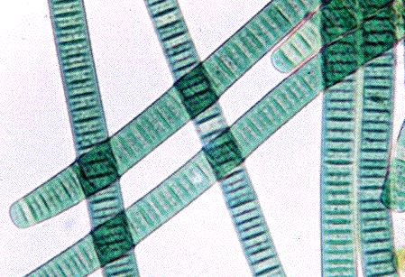
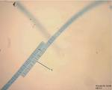
Domain Bacteria Cyanobacteria- photosynthetic bacteria
Oscillatoria

Slide 10
Domain Eukarya
Includes all organisms made of eukaryotic cells
Includes:
Protists
“Protozoa” – heterotrophic, “animal-like”
“Algae” – autotrophic
Microscopic – phytoplankton
Macroscopic - seaweed
Fungi
Plants
Animals
As discussed in lecture, the phylogeny and taxonomy are changing and moving away from the 5 Kingdom system as better molecular techniques allow us to relook at the relationships of organisms

Slide 11
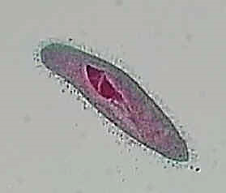
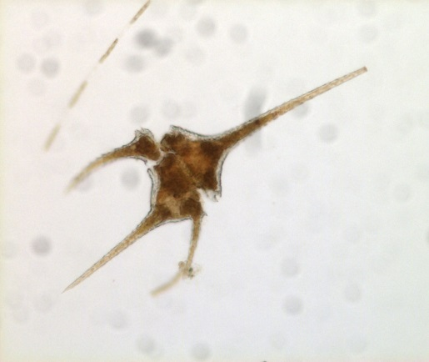
Simple Eukaryotes
Amoeba proteus –
move by pseudopodia
Paramecium –
Moves by cilia
Flagellated Eukaryote
Ceratium
All modes of locomotion:
Flagellated, Ciliary, Amoeboid
Colonial Eukaryote
Volvox

Slide 12
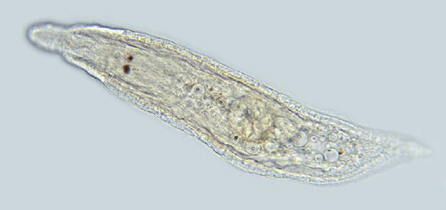
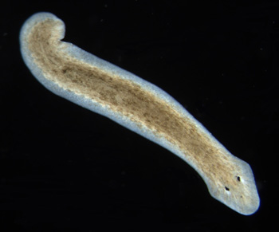
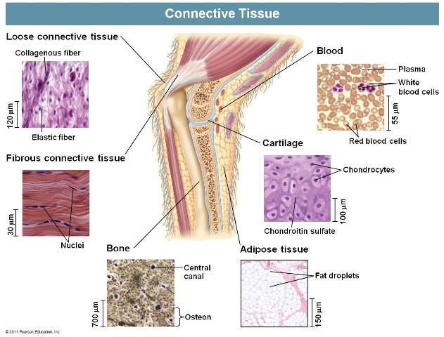
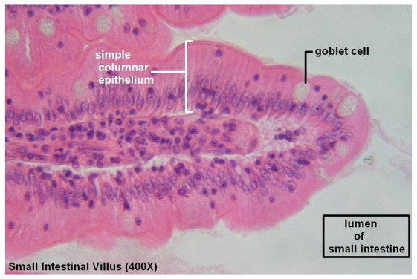
Multicellular Eukaryote
Planaria
Has specialized cells to preform
different functions
Simple Eukaryote – no major organ systems
Tissues = many specialized cells
Specialized cells together form Organs
Organs together form Systems (cardiovascular, respiratory…)
Epithelia Tissue – Simple Columnar

Slide 13
Preview of Microscope Proficiency Test
Checklist for microscope test (failure to demonstrate any of the items listed below
will result in a failed microscope test and 20points off your final exam grade):
Slide is placed on stage between stage clips (not under the clips)
Slide is focused at 4X
Uses nosepiece to change objective
Does NOT use coarse adjustment knob once you have switched to a higher objective than the 4x (ONLY FINE adjustment knob for 10X and 40X).
Slide is focused at 10X
Slide is focused at 40X
At the end, change objective lens to 4X (use nosepiece)
Stage down
Hand slide back.

Slide 14
FINAL EXAM
DO NOT BE LATE – there is NO MAKE-UP
Counts twice – if it’s your worst test grade, then it counts only once.
Cumulative, but weighted toward last half of semester
Exam 1* 86/100 86 *drop 1 of 4
Exam 2* abs. 0 average
best 3
Final** 82/100 x 2 = 164
(86+82+82)
3
= 83 = B

