Slide 1
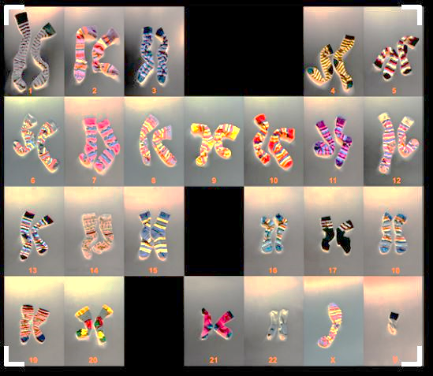

Human Genetics & Karyotyping
Exercise 10, pg. 127-147
BSC2010L

Slide 2
Human Genetics Exercise 10, pg. 127-147
Lab Objectives:
Determine Genotypes
Investigate Inheritance Patterns
Identify Non-disjunction results
Predict Autosomal & Sex Chromosome Abnormalities
Construct Pedigrees

Slide 3
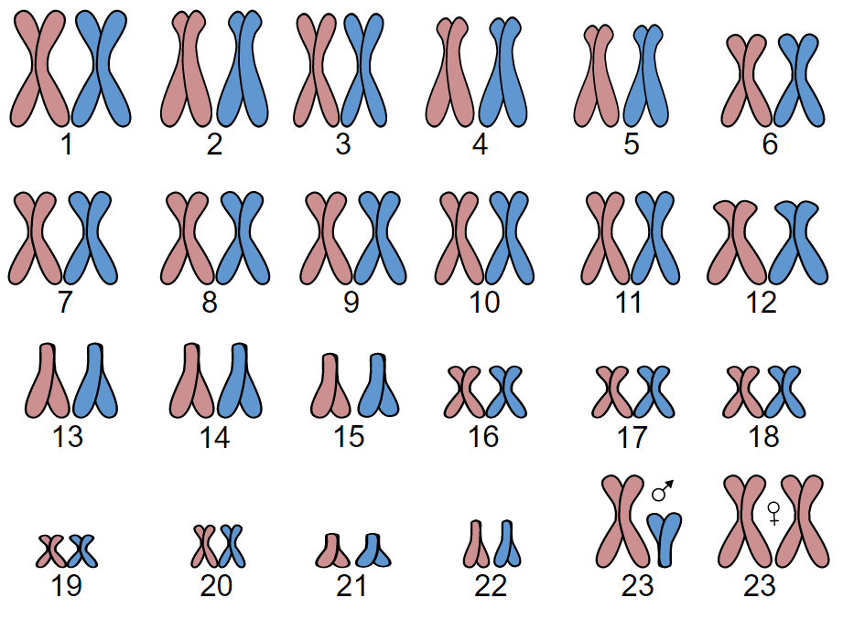

Human Karyotype
Shown here is the karyotype of a human during S phase. All 23 homologous pairs of different length and functions are shown
  22 pairs Autosomal, 1 pair Sex
Note the shape arrangement of Pair #23, the sex chromosomes
XX = Female
By AGeremia - Own work, CC BY-SA 3.0,
https://commons.wikimedia.org/w/index.php?curid=37184677
XY = Male
♀

Slide 4
Dom vs. Rec Trait Review:
Each pair of the 22 autosomal chromosomes have the same genes
For each gene there can be 2 alleles (different forms) (G or g)
A human with two different alleles for a trait is heterozygous for that trait (Gg)
Heterozygous (Gg) will show the dominant trait and carry* the recessive
A human with two of the same alleles is homozygous (GG or gg)
Homozygous Dominate (GG) will show the dominant trait
Homozygous recessive(gg) will not show the dominate trait
***(no “G” instructions for it!)***

Slide 5
Autosomal Traits
Some autosomal DOMINANT traits in Humans:
  Widow’s peak
  Unattached earlobes
  Freckles
Some autosomal recessive traits in Humans:
  No hair on back of hand
  Not able to roll tongue
  Joined eyebrows

Slide 6
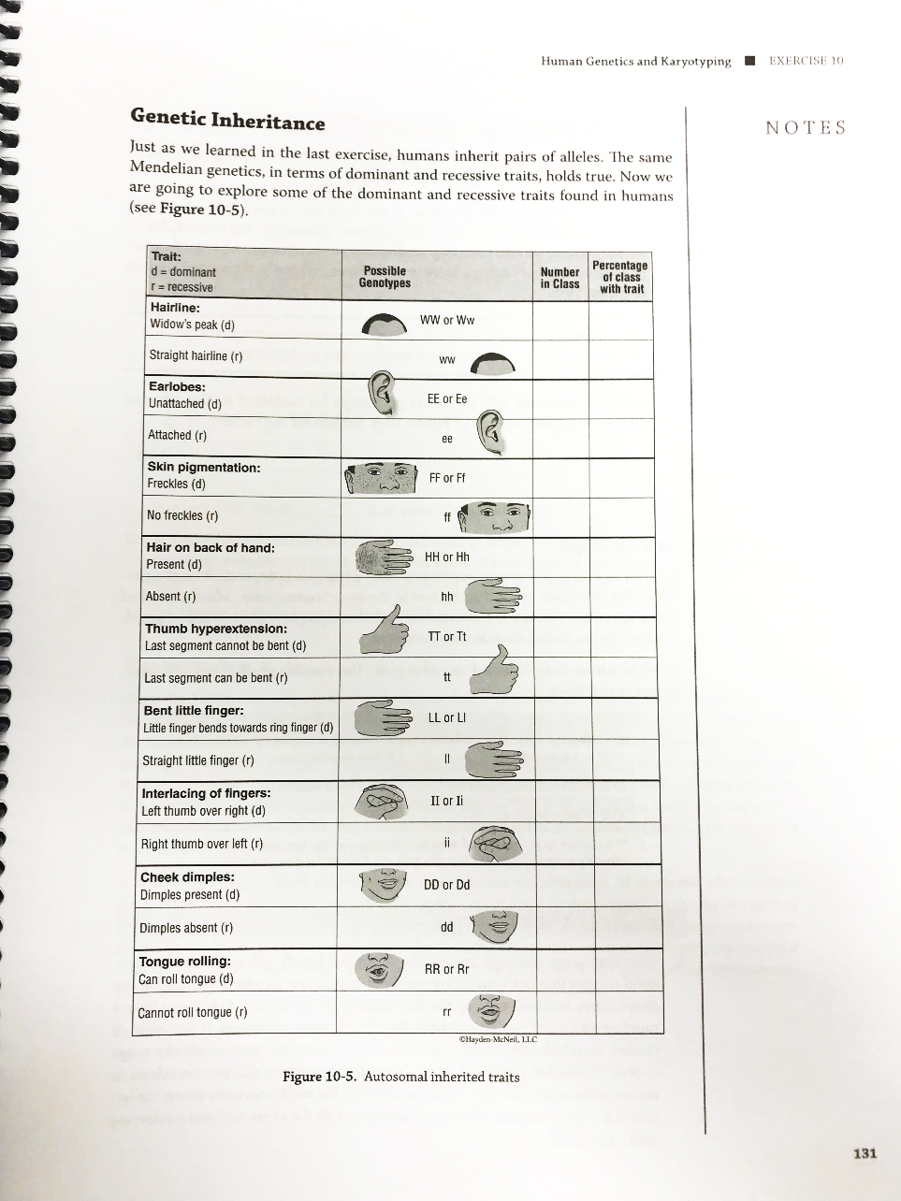
Autosomal Traits
Turn to page 131 in Lab book:
*turn on projector to do class tally together

Slide 7
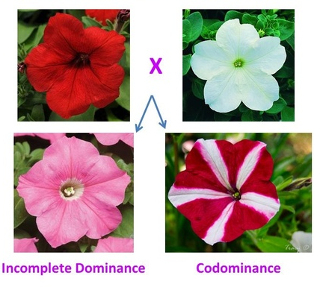
Non Mendelian Inheritance
Incomplete Dominance
  Form of inheritance where heterozygous alleles are both expressed => combined phenotype
    Example: white flowers + red flowers = pink flowers
Codominant
  Both alleles are expressed
    Example: Example: white flowers + red flowers = mixed white & red flowers
    Example: Blood types in humans
        If a person has the A allele and the B allele, then both A and B are expressed on the surface of the red blood cell (RBC) as AB.

Slide 8
X-linked crosses
Chromosomal pair #23 (Sex Chromosomes):
XX (so, one chromosome is X,
the other is also X) => results in female
XY (so, one chromosome is X, the other is Y)
=> results in male

Slide 9
X-linked crosses
Possible gametes of a sperm: X or Y
male female | X | Y
X | XX (female) | XY (male)
X | XX (female) | XY (male)
Possible gametes of an ovum: X (only X)

Slide 10
X-linked crosses
When we mark a dominant or recessive trait that is located on chromosome 23, we need to indicate if the trait is on the ‘Y’ or the ‘X’ chromosome.
In this course we will analyze recessive diseases that are expressed X-linked recessive.
Here is the notation for an X-linked mutations:
  X^{b} = recessive mutation
  X^{B} = dominant; not affected

Slide 11
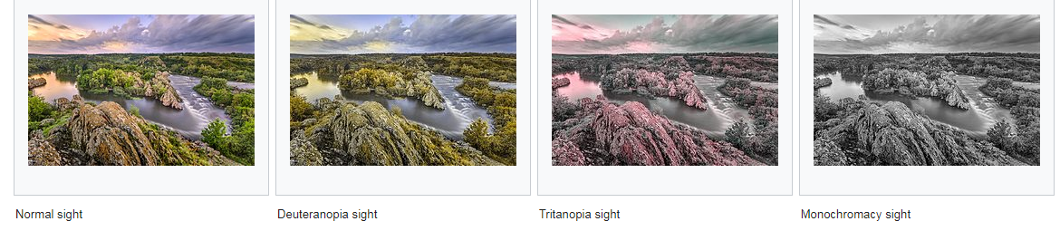
Color Blindness – X-linked
Color blindness is an X-linked recessive disorder (X^{b} X^{b}), thus:

Slide 12

X-linked crosses
Color blindness is an X-linked recessive disorder (X^{b} X^{b}), thus:
X^{b} X^{b} = female expressing colorblind
X^{B} X^{b} = female carrying (non-colorblind)
X^{B} X^{B} = female non-expressing/not carrier
X^{b} Y = male expressing colorblind
X^{B} Y = male non-expressing/not carrier

Slide 13
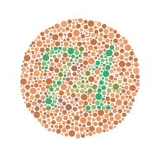
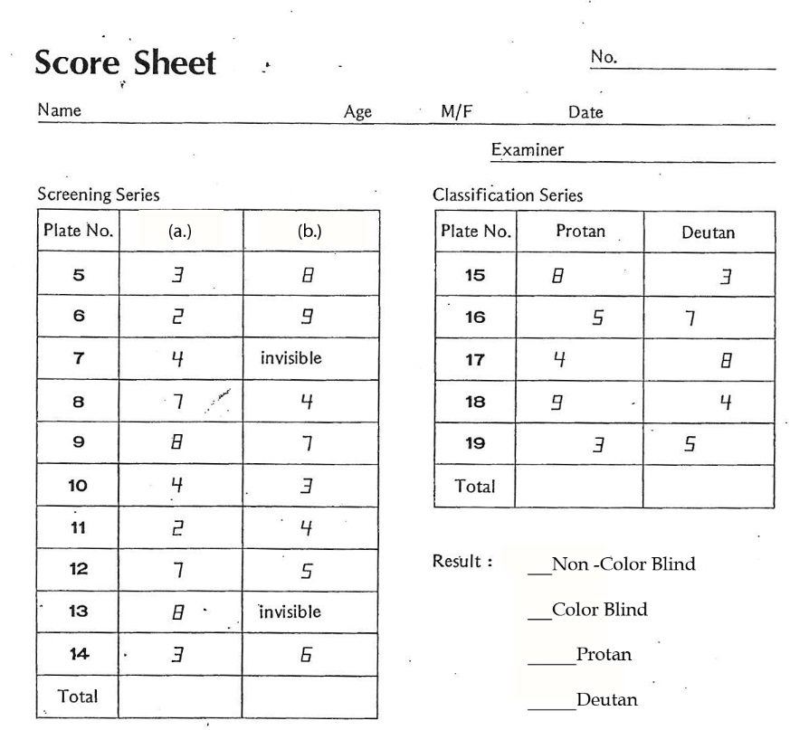
Color Blindness – experiment
Class Activity – pg.132
  Pull out Score Sheets
  I will walk around room slowly holding book of “plates” one at a time (#5-19)
    View approx. 10 sec and >10ft from eyes
    Students: circle what number(s) you see

Slide 14
Color Blindness – experiment
  Total Columns
    Non-colorblind > 8
    Color Blind < 8
      Protan – sensitive to reds
      Deutan – sensitive to greens

Slide 15
Color Blindness – X-linked
X^{b} Y = male expressing colorblind
X^{B} Y = male non-expressing/not carrier
NOTE: MALES CANNOT CARRY COLORBLINDESS!

Slide 16
Color Blindness – X-linked
X^{b} Y = male expressing colorblind
If you are a colorblind male
your mom is also colorblind OR she is a carrier !!!!
 | X^{b} | Y
X^{b}
X^{b}
 | X^{b} | Y
X^{b} | X^{b}X^{b}
X^{B}
X^{b}X^{b}
X^{b}Y
X^{b}Y
X^{b}X^{b}
X^{b}Y
X^{B} X^{b}
X^{B}Y

Slide 17
Color Blindness – X-linked
X^{b} X^{b} = female expressing colorblind
If you are a colorblind female,
Dad MUST be colorblind &
 | X^{b} | Y
X^{b}
X^{b}
 | X^{b} | Y
X^{b} | X^{b}X^{b}
X^{B}
X^{b}X^{b}
X^{b}Y
X^{b}Y
X^{b}X^{b}
X^{b}Y
X^{B} X^{b}
X^{B}Y
mom is at minimum a carrier!

Slide 18
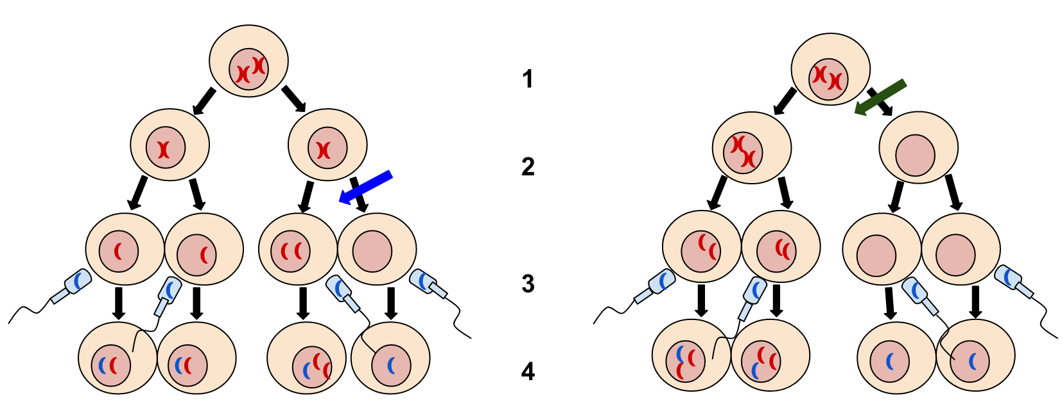
Chromosomal Abnormalities resulting from non-disjunction during Meiosis
Meiosis II
Meiosis I
?
FATAL
?
FATAL
By Tweety207 - Own work, CC BY-SA 3.0,
https://commons.wikimedia.org/w/index.php?curid=26233546
Non-disjunction in Meiosis II – 50% chance gametes may be unaffected
Non-disjunction in Meiosis I – ALL gametes affected

Slide 19
Chromosomal Abnormalities resulting from non-disjunction during Meiosis
Autosomal
    Patau syndrome (Trisomy 13)
      severe intellectual disability and physical defects, fatal first week of life
    Edwards syndrome (Trisomy 18)
      extreme developmental delays, usually fatal first year of life,
    Down Syndrome (Trisomy 21)
      intellectual disability, weak muscle tone (hypotonia) in infancy, cognitive delays
Sex linked
    Turner Syndrome – 45, XO
    Female missing one X = Never reaches puberty
    *Only known survivable Monosomy in humans
    Poly-X Syndrome - 47, XXX
        Female – taller, Tend to have learning disabilities
    Klinefelter Syndrome – 47, XXY
        Male - Testes underdeveloped, long limbs, poor muscle growth
    Jacob Syndrome – 47, XYY
        Male - Taller, speech and reading problems
FATAL
FATAL

Slide 20
Pedigrees
Method that allows tracking of a genetic disorder within a family
  Circles – Females
  Squares – Males
  Affected individuals – filled in
  Carriers – half filled in (sometimes…)

Slide 21
Pedigrees Example
bb
BB
 | B | B
b | Bb | Bb
b | Bb | Bb
Bb
Bb
Bb
Bb
A new type of representation of our Punnett Square, but now we can trace traits through generations!

Slide 22
Pedigrees Examples how to draw a pedigree
John’s parents are one
generation level up.
They are connect to their
children.
John’s sister is on the
same generation level
and has the same
parents.
John’s sister is on the
same generation level
and has the same
parents.
John is male = square
Bill next generation
connected to John and
Anna
Anna = same generation
level as John and
connected but not to
John’s siblings.
  John does not show disease.
  His sister Jill does not show disease either.
  His sister Mary shows disease.
  His mother shows disease while his father does not.
  John is married to Anna who does not show disease.
  John and Anna have a child (Bill) who shows disease.

Slide 23
Pedigrees Examples how to draw a pedigree
 | C | c
c | Cc | cc
c | Cc | cc
cc
Cc
Cc
Cc
cc
cc
Cc
Cc
cc
cc
Cc
 | c | c
C | Cc | Cc
c | cc | cc

Slide 24
Pedigrees Example
bb
BB
What’s this Pattern Look like? Remember Mendel’s Petals??? 2 homozygous parents = 4:0 phenotype ratio
 | B | B
b | Bb | Bb
b | Bb | Bb
Bb
Bb
Bb
Bb
Super recessive Mary & Super Dominate Jim have 4 normal heterozygous children, 50% being a girl or a boy, but all possessing one dominate allele and one recessive allele.
Let’s say “B” represents dominance of how the kids look.
They all look like Jim – he’s proud … but poor Mary, her kids will never express her recessive-recessive traits.

Slide 25
Pedigrees Example
What’s this Pattern Look like?
Remember Mendel’s Petals??? 2 heterozygous parents = 3:1 phenotype ratio
bb
BB
Heterozygous normal Bill has kids with heterozygous normal Sally (kid of Mary/Jim)
Bb
Bb
Bb
Bb
Bb
BB
Bb
Bb
bb
Sally has 4 kids with Bill, one of her grandkids looks just like Mary! So how is that possible if Sally looks like her dad and married Bill who also looks like her dad?!?
 | B | b
B | BB | Bb
b | Bb | bb
All Jim/Mary’s kids carried one recessive allele – and Bill supplied the other!

Slide 26
Pedigrees Example
bb
BB
Is this a Dominate or a recessive inheritance pattern?
Bb
Bb
Bb
Bb
Bb
BB
Bb
Bb
bb
How could you tell if this recessive gene was located on an autosomal chromosome or a sex chromosome?

Slide 27
Find inheritance from pedigrees
Patterns of inheritance | Pedigrees shows Carriers | Pedigrees without showing Carriers
Autosomal Dominant | Impossible to be a carrier. | If at least one child is “bb” => neither parent can be “BB”
Autosomal Recessive | If parents “Bb”& “BB” => No child can be “bb | Can skip a generation.
X-linked recessive | No male can be a carrier. | All sons of an affected mother (X^{b}X^{b}) WILL also show disease (X^{b}Y).
X-linked dominant | Impossible to be a carrier. | All children of an affected mother (X^{B}X^{B}) will also show disease either (X^{B}Y), (X^{B}X^{B}), or (X^{B}X^{b}).

Slide 28
Pedigrees Example
bb
BB
Bb
Bb
Bb
Bb
Bb
BB
Bb
Bb
bb
Autosomal Dominant | Impossible to be a carrier. | If at least one child is “bb” => neither parent can be “BB”
Autosomal Recessive | If parents “Bb”& “BB” => No child can be “bb | Can skip a generation.
X-linked recessive | No male can be a carrier. | All sons of an affected mother (X^{b}X^{b}) WILL also show the trait (X^{b}Y).
X-linked dominant | Impossible to be a carrier. | All children of an affected mother (X^{B}X^{B}) will also show the trait (X^{B}Y), (X^{B}X^{B}), or (X^{B}X^{b}).

Slide 29
Find inheritance from pedigrees
Patterns of inheritance | Pedigrees shows Carriers | Pedigrees without showing Carriers
Autosomal Dominant | Impossible to be a carrier. | If at least one child shows no disease (“bb”), neither parent can be homozygous dominant (“BB”)
Autosomal Recessive | One parent carrier (“Bb”) other parent homozygous dominant (“BB”) => No child can be showing the disease (“bb”) | Can skip a generation.
X-linked recessive | No male can be a carrier. | All sons of an affected mother (X^{b}X^{b}) will also show disease (X^{b}Y).
X-linked dominant | Impossible to be a carrier. | All children of an affected mother (X^{B}X^{B}) will also show disease either (X^{B}Y), (X^{B}X^{B}), or (X^{B}X^{b}).
If Carriers Present, can’t be Dominant
If Male Carriers are seen, can’t be X-linked
If Carriers Present, can’t be Dominant

Slide 30
What is the Inheritance Pattern?
Autosomal Dominant
Autosomal Recessive
X-linked Dominant
X-linked Recessive
Step 1: We see carriers which means this inheritance pattern cannot be Dominate

Slide 31
What is the Inheritance Pattern?
Autosomal Recessive
X-linked Recessive
Step 2: We see MALE carriers which means this inheritance pattern cannot be X-linked

Slide 32
What is the Inheritance Pattern?
Autosomal Recessive

Slide 33
What is the Inheritance Pattern?
Autosomal Dominant
Autosomal Recessive
X-linked Dominant
X-linked Recessive

Slide 34
What is the Inheritance Pattern?
Autosomal Dominant
Autosomal Recessive
X-linked Dominant
X-linked Recessive
Step 1: We see carriers which means this inheritance pattern cannot be dominate
We don’t see any Male carriers, so we can’t eliminate X-linked recessive yet

Slide 35
What is the Inheritance Pattern?
x^{B}x^{b}
x^{B}y
Autosomal Recessive
X-linked Recessive
x^{B}x^{B}
BB
x^{B}x^{B}
x^{B}x^{b}
?
x^{B}y
x^{b}y
bb
?
x^{b}y
x^{b}y
x^{B}y
  Step 2: Assume a pattern, Say Autosomal Recessive…What would this genotype have to be?
  And His father, what would his genotype have to be? *hint he isn’t a carrier*
  Impossible for a father to be BB and son to be bb…soooo….
  This is X-linked recessive.

Slide 36
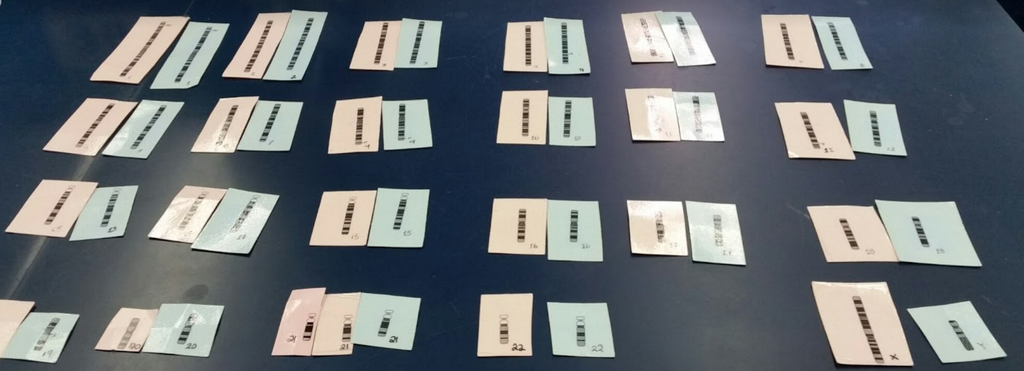
Karyotyping Babies
Karyotyping is used to detect genetic abnormalities
Now you and a partner are going to determine inheritance patterns through Karyotyping a developing fetus!

Slide 37
Karyotyping Babies pg. 135-138
Each group (2 students) gets one bag (Ex: child #4)
Contains 1 blue set and 1 pink set each containing 23 chromosomes
Each set represents a haploid gamete (1n=23) (egg + sperm)
These two fuse to form a diploid zygote (2n=46; full set of chromosomes in humans)
Pair each of the 23 chromosomes up with its homologue.
Order 1 to 22 autosomal pairs plus the sex chromosomes.
Use KEYS to decode babies sex, genetic disease(expressed), carrier of any disease, blood type, hair color, and eye color.

Slide 38
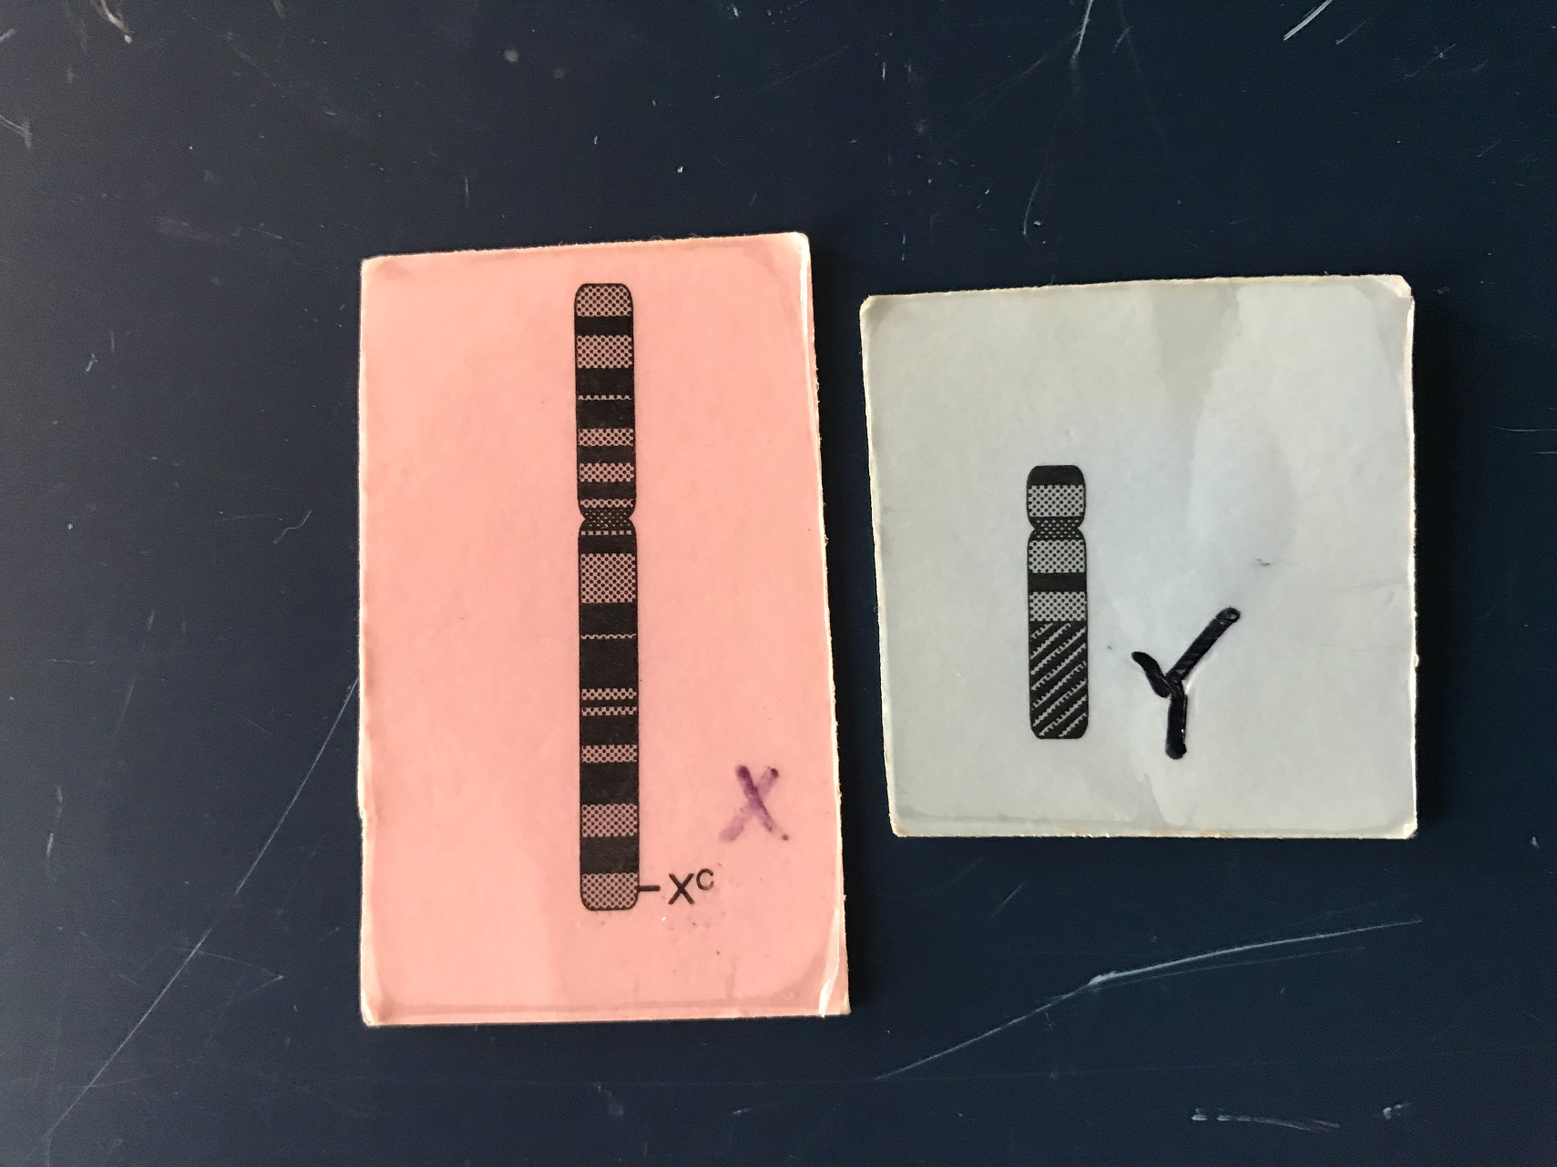
Karyotyping Babies
You “made” Baby #4…Congrats!!
Start by looking at his or her sex chromosomes…
Is your baby a male (XY) or female (XX)?

Slide 39
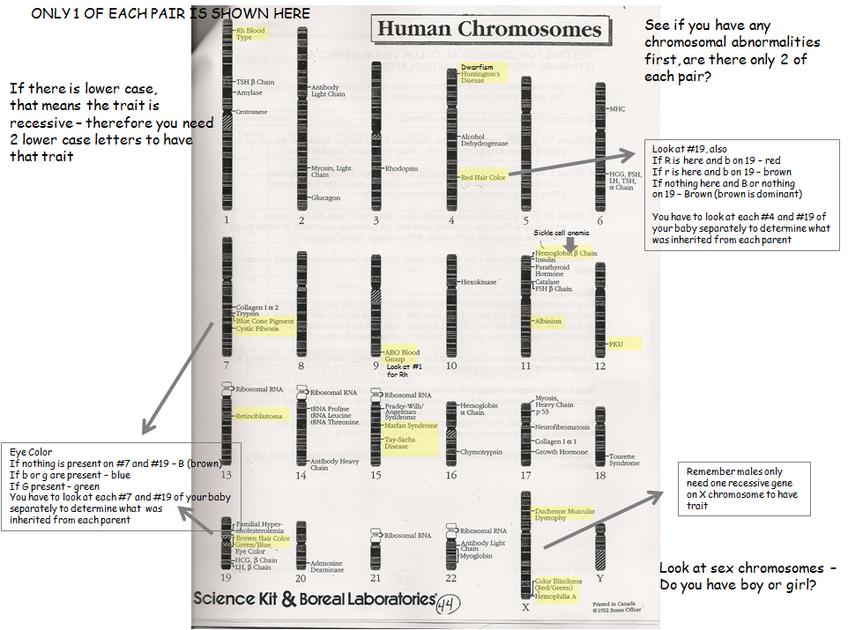
Karyotyping Babies

Slide 40
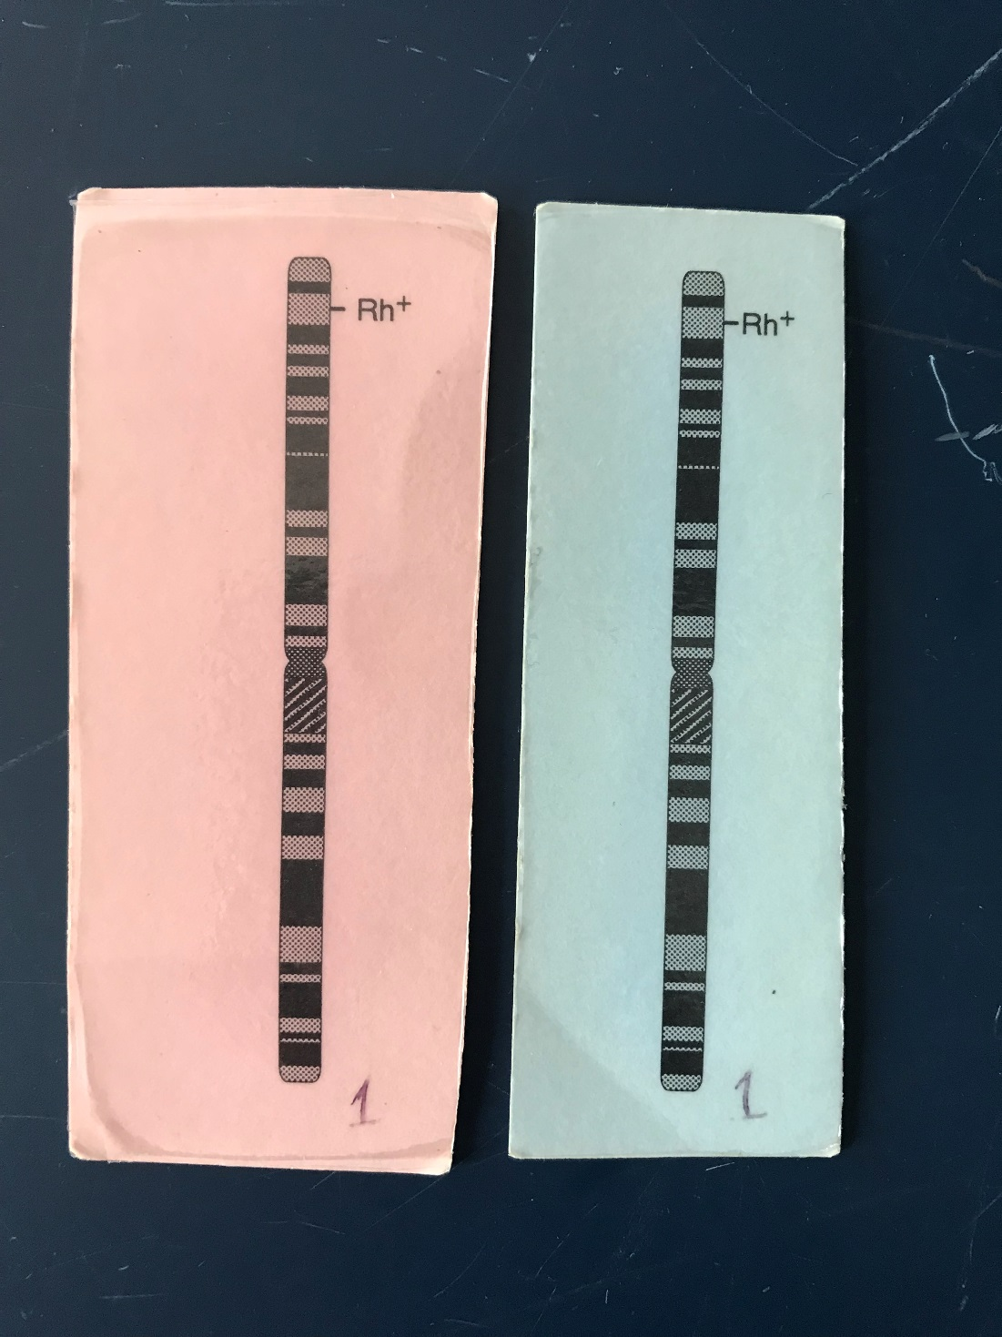
Karyotyping Babies
Chromosome #1

Slide 41
Dominant vs. Recessive Traits
Given that Huntington’s Disease is dominant ‘H’ :
What type of chromosome is this trait found?
  Autosomal or Sex Linked?
Would a human who is heterozygous (Hh) express Huntington’s? Yes or No?
A human who is homozygous dominant (HH) _________ show the disease.
A human who is homozygous recessive (hh) ___________ show the disease.
will
will not
*BECAUSE the genetic info for ‘G’ is not present.
This inheritance pattern is called Autosomal Dominant

Slide 42
Dominant vs. Recessive Traits
Given that an Cystic Fibrosis is recessive ‘c’:
A human who is heterozygous (Cc) _________ express the disease.
  However, this human (Cc) is a carrier for the disease and 50% of its gametes will have the ‘c’ trait.
A human who is homozygous dominant (CC) _________ express the disease.
A human who is homozygous recessive (gg) _________ express the disease.
will not
will not
will
This inheritance pattern is called Autosomal Recessive

Slide 43
Today’s Lab
Review Genetic Inheritance we did as class pg. 131
Review Color Blindness we did as class pgs. 132-133
“To Do” Karyotyping Babies pgs. 135-138 - set up your own baby, then walk around and identify ALL OTHERS
Work on “To Do” & Genetics Pedigree problems pgs. 141 – 147 (answers are in back of lab book)

