Slide 1
Chapter 10
Meiosis and sexual reproduction

Slide 2
Chapter outlines
11.1 The Process of Meiosis
11.2 Sexual Reproduction

Slide 3
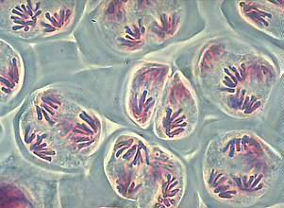
introduction
Mitosis create many genetically identical cells
Asexual reproduction of unicellular organisms.
Growth, development, repair and regeneration in multicellular organisms.
Meiosis produces gametes for sexual reproduction resulting in offspring that are genetically different from parents and each other.
http://www.biologie.uni-hamburg.de/b-online/fo09/mei07.jpg

Slide 4
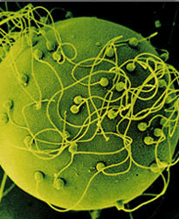
introduction
Sexual reproduction contributes to genetic variation
Gametes from each parent contain one set of chromosome
Gametes fuse to produce a single cell, the zygote (fertilized egg) with two sets of chromosomes
Offspring are genetically different from parents and each other, even before mutations
http://www.jour.sc.edu/pages/wigginsweb/Cyberhemiapage1fall2005_files/fertilization.gif

Slide 5
Sperm + Ovum = Zygote
haploid (1n) sperm
diploid (2n) zygote
haploid (1n) ovum

Slide 6
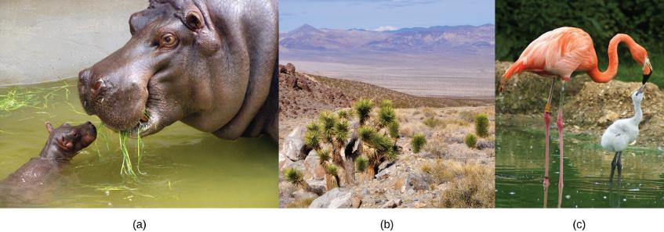
introduction
Each of us, like these other large multicellular organisms, begins life as a fertilized egg. After trillions of cell divisions, each of us develops into a complex, multicellular organism.

Slide 7
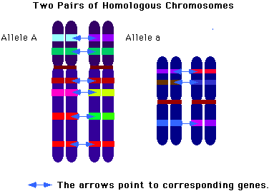
11.1 the process of meiosis
In diploid (2n) multicellular organisms, somatic cells (non-gametes) each contain two sets of chromosomes = homologous chromosomes
For each pair of chromosomes, each parent contributes one homolog
Have corresponding but not identical genetic information
http://staff.jccc.net/PDECELL/celldivision/homolg.gif

Slide 8
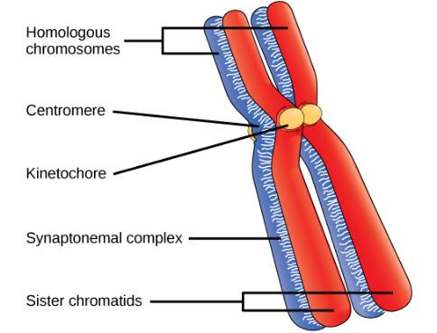
11.1 the process of meiosis
Early in prophase I, homologous chromosomes come together to form a synapse. The chromosomes are bound tightly together and in perfect alignment by a protein lattice called a synaptonemal complex and by cohesin proteins at the centromere.

Slide 9
11.1 the process of meiosis
Functions of meiosis:
produce gametes
reduce chromosome number from in half (2n to n)
ensure each gamete gets a complete set of chromosomes (one of each pair)
promote genetic diversity of products
http:/www.luc.edu/depts/biology/dev/meioanm.htm

Slide 10
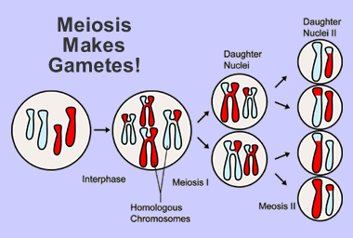
11.1 the process of meiosis
Meiosis consists of two nuclear divisions (Meiosis I and II)
DNA is replicated once in S-phase before meiosis
➔ chromosome number is reduced by half, from diploid to haploid, ensuring each haploid has complete chromosome set
Products differ from parent cell, and each other
http://www.windows.ucar.edu/earth/Life/images/genetics_meiosis_sm.gif

Slide 11
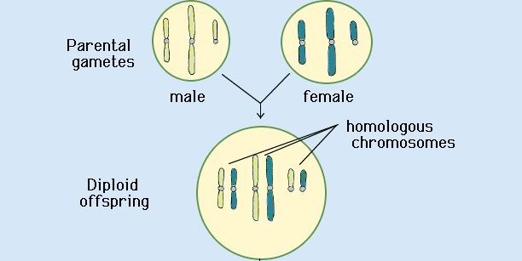
11.1 the process of meiosis
Fertilization is the process that gametes from two parents unite.
Gametes (haploid cells) contain one homolog of each pair (n)
When haploid gametes fuse in fertilization, they create diploid (2n) zygote
http://faculty.abe.ufl.edu/~chyn/age2062/lect/lect_08/12_25.GIF

Slide 12
11.1 the process of meiosis
The cell divide twice (Meiosis I and Meiosis II)
In Meiosis I, the homologous chromosomes are separated. The number of chromosomes are reduced in half.
In Meiosis II, the sister chromatids are separated. The final products are four haploid gametes (n).

Slide 13
11.1 the process of meiosis
Meiosis I
Prophase I – homologous pair, crossing over
Metaphase I – line up in pairs
Anaphase I – homologous chromosomes separate
Telophase I – 2 haploid cells (reduction of chromosomes)
Meiosis II (similar to mitosis except it starts with two haploid cells)
Prophase II – only one set of chromosomes
Metaphase II – line up in the middle of the cell
Anaphase II – sister chromatids separate
Telophase II – 4 haploid cells

Slide 14
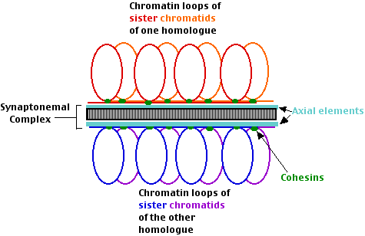
11.1 the process of meiosis
In Prophase I, synapsis occurs:
Two homologs join together, held together by protein complex
Resulting tetrad consists of two homologous chromosomes, each with two sister chromatids
http://users.rcn.com/jkimball.ma.ultranet/BiologyPages/S/SC_schematic.gif

Slide 15
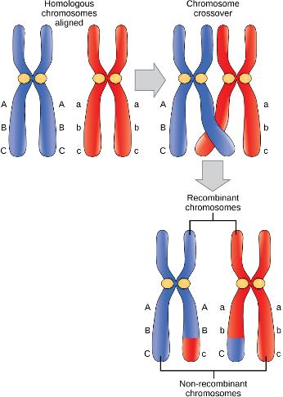
Prophase I
Crossover occurs between non-sister chromatids of homologous chromosomes. The result is an exchange of genetic material between homologous chromosomes.

Slide 16
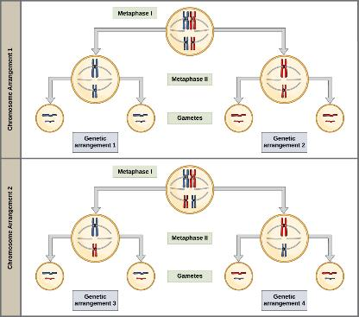
Metaphase I
Random, independent assortment during metaphase I can be demonstrated by considering a cell with a set of two chromosomes (n = 2). In this case, there are two possible arrangements at the equatorial plane in metaphase I. The total possible number of different gametes is 2n, where n equals the number of chromosomes in a set. In this example, there are four possible genetic combinations for the gametes. With n = 23 in human cells, there are over 8 million possible combinations of paternal and maternal chromosomes

Slide 17
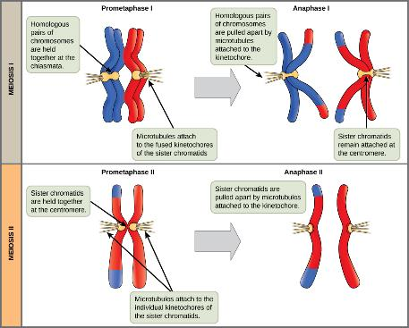
Anaphase I and II
The process of chromosome alignment differs between meiosis I and meiosis II. In prometaphase I, microtubules attach to the fused kinetochores of homologous chromosomes, and the homologous chromosomes are arranged at the midpoint of the cell in metaphase I. In anaphase I, the homologous chromosomes are separated. In prometaphase II, microtubules attach to the kinetochores of sister chromatids, and the sister chromatids are arranged at the midpoint of the cells in metaphase II. In anaphase II, the sister chromatids are separated.

Slide 18
11.1 the process of meiosis (revisit)
Meiosis I
Prophase I – homologous pair, crossing over
Metaphase I – line up in pairs
Anaphase I – homologous chromosomes separate
Telophase I – 2 haploid cells (reduction of chromosomes)
Meiosis II (similar to mitosis except it starts with two haploid cells)
Prophase II
Metaphase II – line up in the middle of the cell
Anaphase II – sister chromatids separate
Telophase II – 4 haploid cells

Slide 19
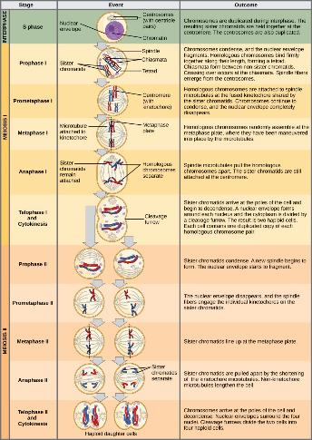
11.1 the process of meiosis
An animal cell with a diploid number of four (2n = 4) proceeds through the stages of meiosis to form four haploid daughter cells.

Slide 20
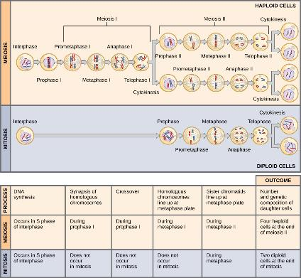
Meiosis vs mitosis
Meiosis and mitosis are both preceded by one round of DNA replication; however, meiosis includes two nuclear divisions. The four daughter cells resulting from meiosis are haploid and genetically distinct. The daughter cells resulting from mitosis are diploid and identical to the parent cell.

Slide 21
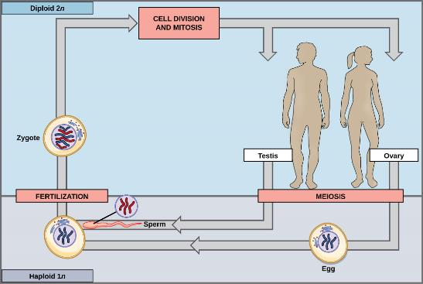
11.2 sexual reproduction
In animals, sexually reproducing adults form haploid gametes from diploid germ cells. Fusion of the gametes gives rise to a fertilized egg cell, or zygote. The zygote will undergo multiple rounds of mitosis to produce a multicellular offspring. The germ cells are generated early in the development of the zygote.

Slide 22
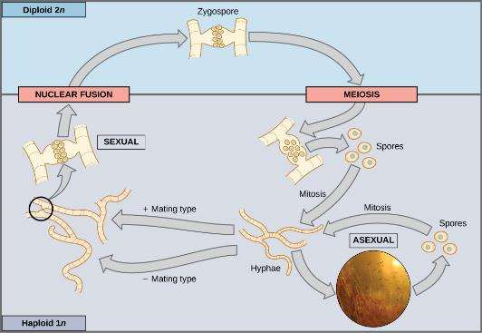
11.2 sexual reproduction
Fungi, such as black bread mold (Rhizopus nigricans), have haploid-dominant life cycles. The haploid multicellular stage produces specialized haploid cells by mitosis that fuse to form a diploid zygote. The zygote undergoes meiosis to produce haploid spores. Each spore gives rise to a multicellular haploid organism by mitosis.

Slide 23
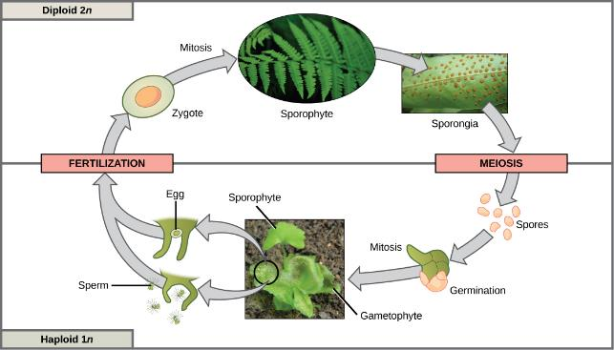
11.2 sexual reproduction
Plants have a life cycle that alternates between a multicellular haploid organism and a multicellular diploid organism. In some plants, such as ferns, both the haploid and diploid plant stages are free-living. The diploid plant is called a sporophyte because it produces haploid spores by meiosis. The spores develop into multicellular, haploid plants called gametophytes because they produce gametes. The gametes of two individuals will fuse to form a diploid zygote that becomes the sporophyte.

