Slide 1
Basic anatomy of the heart
Indian River State College
Week 3

Slide 2
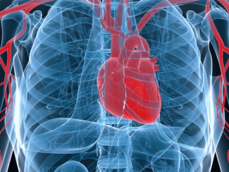
Location
Apex
Left fifth intercostal space, slightly medical to the midclavicular line
Base
Formed by the left atrium and by part of the posterior right atrium
Right Border
Superior vena cava, Right atrium, and inferior vena cava
Left Border
Left Ventricle

Slide 3
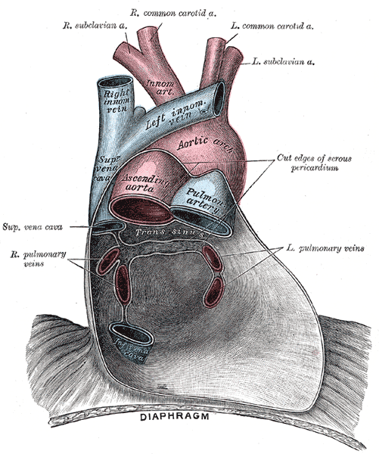
Pericardial layers
Pericardium
Fibroserous sac that encloses the heart and the roots of the great vessels
Layers of the Pericardium
Fibrous
Serous
Pericardial Cavity

Slide 4
Myocardium Muscle Layers

Slide 5
Anterior Surface

Slide 6
Coronary Arteries

Slide 7
Posterior Surface

Slide 8
Internal Anatomy

Slide 9
Conduction System

Slide 10
Blood Flow: Right Atrium into Right Ventricle

Slide 11
Blood Flow: Pulmonary Artery and back to the Left Atrium

Slide 12
Blood Flow: Left Ventricle to Aorta

Slide 13
Blood Flow Animations
Animated Blood Flow
YouTube animation (anything wrong with this)
Great YouTube Animation
Another Good One (no sound)
Surgical Anatomy of the Heart 1
Surgical Anatomy of the Heart 2

