Slide 1
The Spinal Cord & The Brain
A&P I Lab

Slide 2
Spinal Cord
•White matter-myelinated axons
•Gray matter-unmyelinated axons
•Ventral (anterior)
horn-contain cell bodies of motor neurons
•Dorsal (posterior)
horn- contain cell bodies
of sensory neurons

Slide 3
Spinal Cord
•Gray commissure with central canal- central canal circulates CSF and the gray commissure connects the 2 sides of the spinal cord
•Dorsal (posterior) root –sensory neurons
–Dorsal root ganglion: contain a collection of sensory neuron cell bodies
•Ventral (anterior) root –motor neurons

Slide 4
Gray Commissure With Central Canal
Denticulate Ligament
Dorsal horn
Lateral horn
Ventral root
Spinal nerve
Dorsal Ganglion
Ventral horn
Dura Matter
Pia Matter
Arachnoid layer

Slide 6
Spinal Cord
•Pia matter
–Dentate ligament
•Arachnoid mater
•Dura mater
•Spinal nerve

Slide 7
Reflexes
•Reflexes are rapid, predictable, involuntary motor responses to stimuli. Usually unaware of them.
Autonomic reflexes: Mediated through autonomic nervous system
– Visceral: Activate smooth muscle, cardiac muscle, glands
– Somatic reflexes: Skeletal muscle
•Examples:
– Patellar reflex
– Achilles reflex
– Plantar reflex

Slide 8
Reflexes
Components of reflex arc
–5 components:
•Receptor–site of stimulus action
•Sensory neuron transmits afferent impulses to CNS
•Integration center consists of 1 or more neurons in CNS
•Motor neuron conduct efferent impulses to effector organ
•Effector (muscle fibers or glands) respond to efferent impulse

Slide 10
Brain- 3 Main Regions of the brain
•Cerebrum–“cerebral cortex” –outer most part of brain. Squiggly. Higher brain functions such as sight, emotion, memory, etc.
•Diencephalon–deep to the cortex.
–Comprised of thalamus, hypothalamus and pituitary gland (Responsible for hormone production such as GH, LH, FSH, etc.)
•Brain Stem –just what it sounds like
–Comprised of the midbrain, pons and medulla oblongata (Responsible for heart rate and blood pressure, respiratory rate and reflexes)

Slide 11
Brain- The diencephalon
•Thalamus–part of the diencephalon
-Major sensory integration area; regulates consciousness and sleep
•Hypothalamus–also part of the diencephalon
-Controls the base autonomic functions of life such as thirst, hunger, temperature regulation, etc.
•Pituitary gland –connected to hypothalamus
-Controls a wide variety of hormones in the body
Pineal body/gland- located in the epithalamus of the diencephalon
-Produces melatonin and regulates the circadian cycle

Slide 12
Brain- The Brain Stem
Midbrain- Responsible for vision, hearing, temperature regulation
Pons- Relays messages to the cerebrum and cerebellum
Medulla oblongata- Controls involuntary functions such as regulating blood pressure, heart rate and respiratory rate

Slide 14
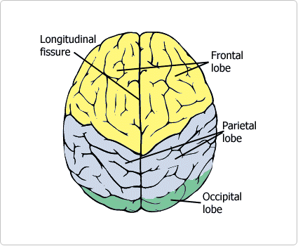
Brain
•Gyrus– (gyri) ridges of brain tissue in cerebral hemispheres
•Sulcus– (sulci) –grooves between the gyri
•Longitudinal fissure –between right and left cerebral hemispheres

Slide 15
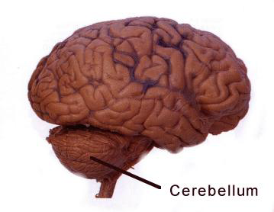
Brain
•Cerebellum–inferior to posterior cerebral hemispheres. Responsible for motor functions such as balance, posture and coordination of movement

Slide 16
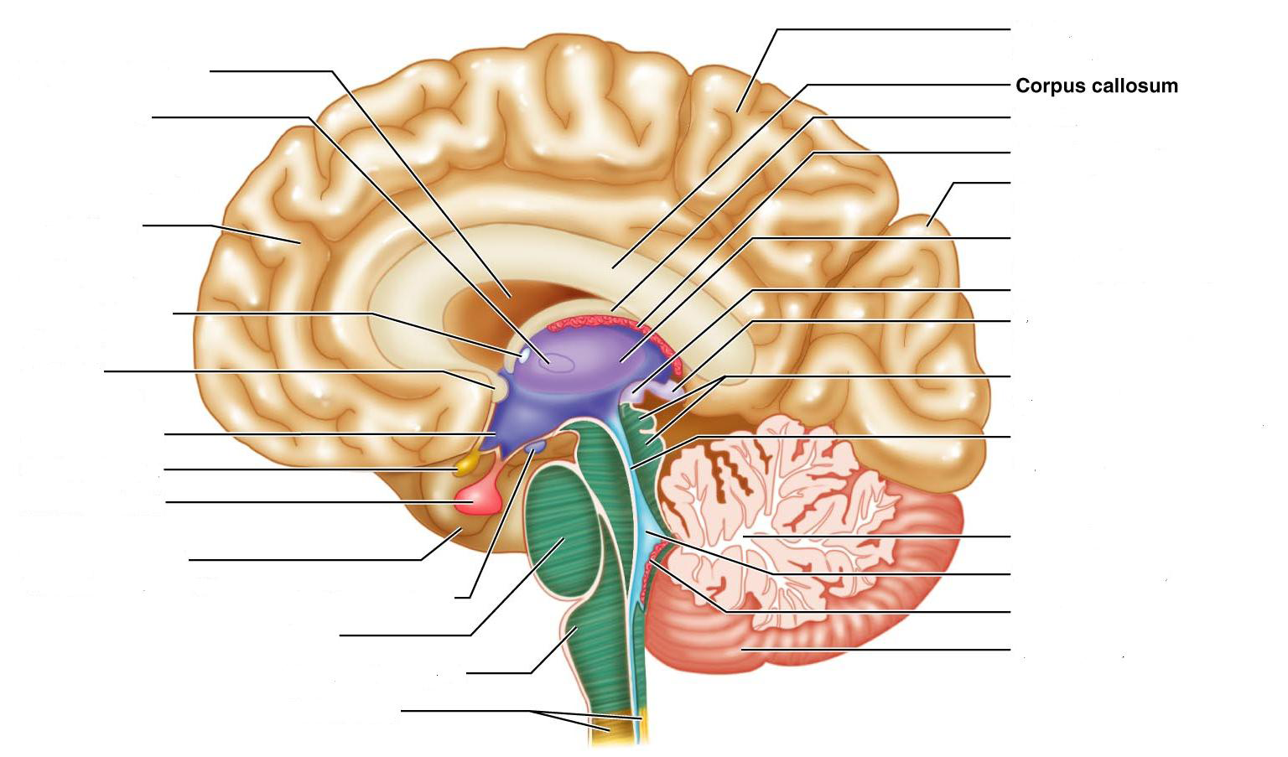
Brain
•Corpus callosum –band of commissural neurons connecting the right and left hemispheres

Slide 17
Brain

Slide 18
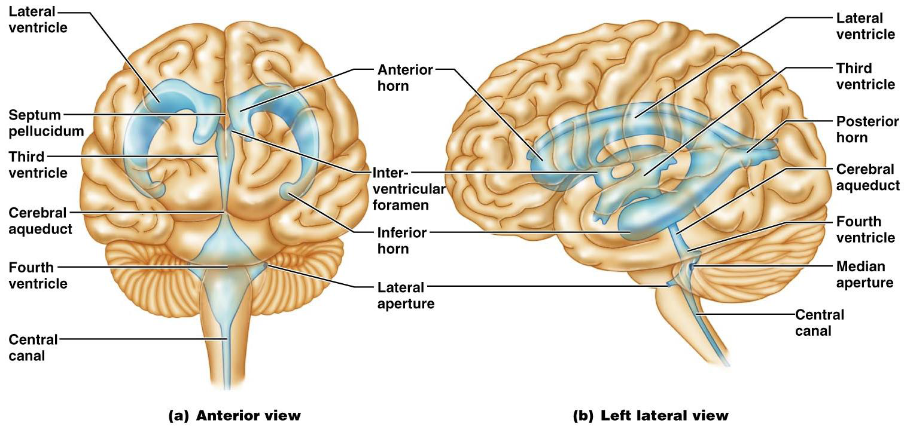
Brain
•Ventricles:
–Lateral, Third, Fourth (Responsible for circulation CSF)

Slide 19
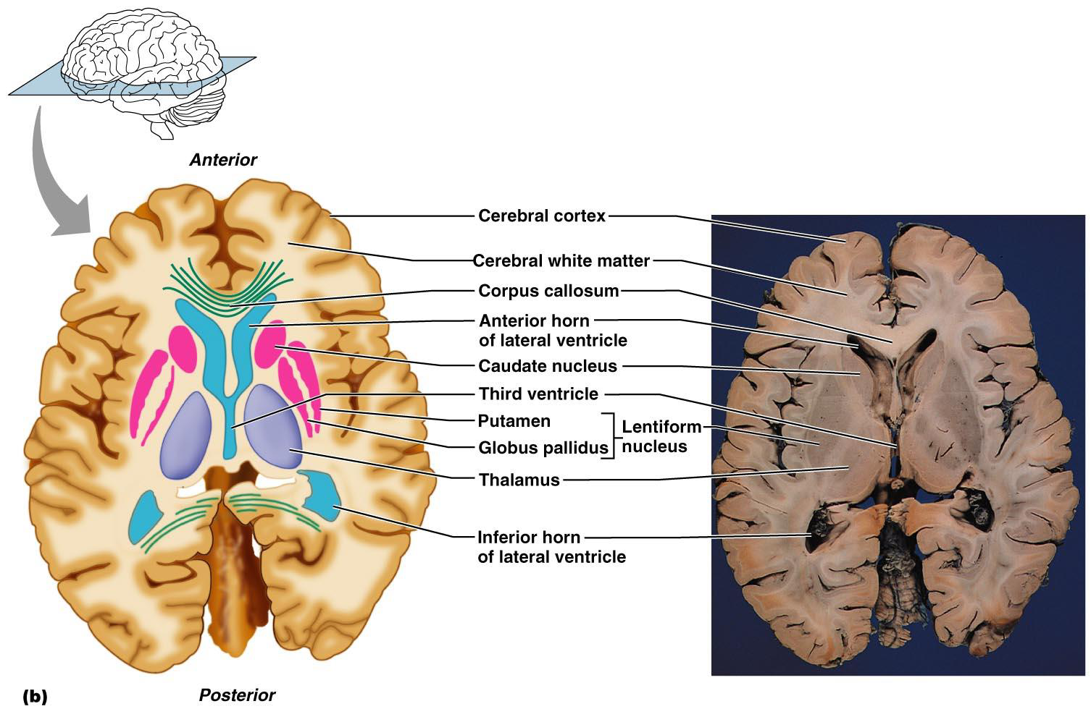
Brain
•Gray/White matter–gray outside, white inside
Gray
White

Slide 20
Cranial Nerves
I. Olfactory– Sensory: smell
II. Optic—Sensory: vision
III. Oculomotor–Motor to eye muscles
IV. Trochlear–Motor to eye muscles
V. Trigeminal–Sensory to face for pain, touch and temperature; Motor-involved in mastication
VI. Abducens–Motor to eye muscles
VII. Facial–Motor to face for facial expression and stimulation of salivary gland and lacrimal glands; Sensory-taste buds
VIII. Vestibulocochlear(acoustic) –Sensory: hearing/balance
IX. Glossopharangeal–Motor: control swallowing using muscles in the pharynx; Sensory: carries impulses from chemoreceptors and pressure receptors of carotid (monitors blood pressure, levels of oxygen and carbon dioxide in the blood)
X. Vagus– Sensory: Monitors blood pressure and O2 and CO2 levels, sensation from organs in thorax and abdomen; Motor: slows heartrate and contraction of smooth muscle of GI tract
XI. Accessory nerve (spinal accessory) –Motor to trapezius, soft palate, pharynx, larynx for swallowing and moving of head
XII. Hypoglossal–Motor to tongue for swallowing and speech

Slide 21
Cranial Nerves
• I. Olfactory
• II. Optic
• III. Oculomoter
• IV. Trochlear
• V. Trigeminal
• VI. Abducens
• VII. Facial
• VIII. Vestibulocochlear
• IX. Glossopharyngeal
• X. Vagus
• XI. Accessory
• XII. Hypoglossal
Optic
chiasmatic

