Slide 1
The Axial Skeleton
Spine and Thoracic Cage

Slide 2
Spine
Vertebral column extends from skull to pelvis
Forms major axial support mechanism of body
Protects spinal cord and allows for passage of spinal nerves from between adjacent vertebrae
Composed of 24 individual vertebrae
Plus two composite bones (sacrum and coccyx)

Slide 3
Spine
Of the 24 vertebrae:
- 7 are cervical
- 12 are thoracic
- 5 are lumbar
Vertebrae are separated by pads of fibrocartilage called Intervertebral Discs
Discs are composed of:
- Central, fluid-like nucleus propulsus
- Outer ring of collagen fibers calls annulus fibrosis

Slide 4
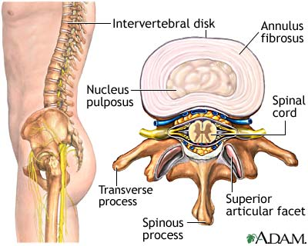
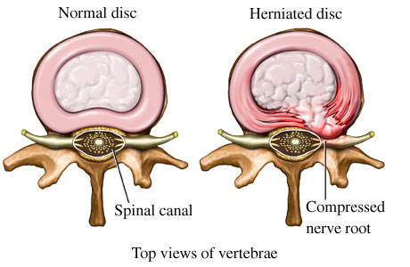
Spine
As a person ages, the water content of their discs decreases
Discs become harder and less pliable
Leads to “ruptured” or “herniated” discs

Slide 5
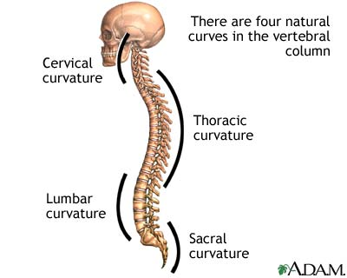
Spine
The discs and the spine’s natural curves make it a good shock absorber
Thoracic and pelvic curves present at birth
Cervical and lumbar curves develop later

Slide 6
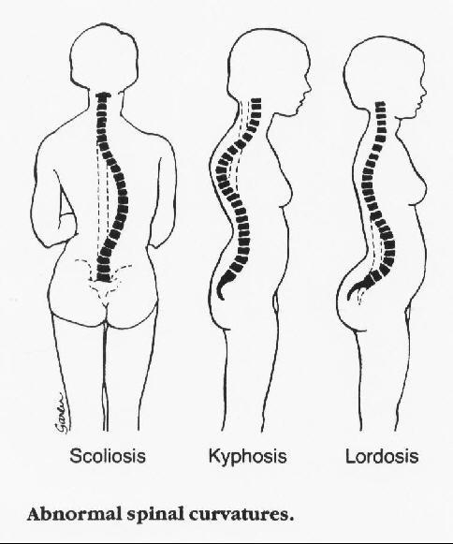
Spine
Abnormal curvature

Slide 8
Vertebral Structure
Body
Vertebral arch
Vertebral foramen
Transverse process
Pedicle
Lamina
Spinous process
Superior and inferior articular processes
Interveretbral foramina

Slide 9
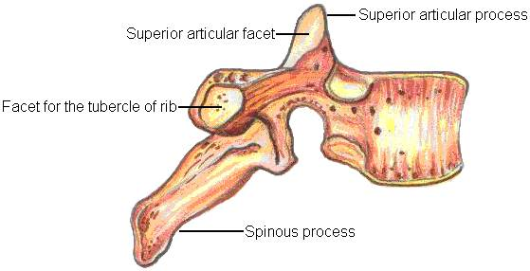
Cervical Vertebrae
C1-C7
C1 & C2 atypical
C3-C7 typical
Short, bifurcated SPs
Except C7 (vertebral prominens)
TPs of cervical vertebrae are short and have foramen for vertebral artery(only cervicals have this)

Slide 10
Cervical Vertebrae
C1 & C2 are atypical
AKA “Atlas and Axis”

Slide 11
Atlas
C1
No vertebral body
Anterior and posterior arches
Lateral processes have large articular surfaces to receive occipital condyles of skull
Allows person to nod “yes”

Slide 12
Axis
C2
Has large vertical process called densor odontoid process
Dens articulates w/ atlas to allow for “no” motion of shaking head

Slide 14
Thoracic Vertebrae
T1 –T12
Bigger than cervical verts
Body has two small articular facets on each side to articulate w/ ribs
Long SPs w/ downward hook
Articular facets on TP articulate w/ tubercles of ribs
Form posterior aspect of rib cage (only vertebrae to articulate w/ ribs)

Slide 15
Lumbar vertebrae
L1-L5
Large, block-like bodies
Short, thick SPs
Received most stress, so must be strong
Spinal cord ends at L2, but outer covering of cord extends beyond.

Slide 16
Sacrum and Coccyx
Composite of 5 fused vertebrae
Articulates w/ L5 superiorly and the coccyx inferiorly
4 or 5 fused vertebrae
Remnants of tail

Slide 17
Thorax
Composed of sternum, ribs and thoracic vertebrae
With costal cartilage it’s known as the thoracic cage

Slide 18
Sternum
Composed of three fused bones
Manubrium
Body
Xiphoid process

Slide 19
Ribs
12 ribs
All ribs articulate w/ thoracic vertebrae posteriorly
Most have costal cartilage connection to sternum
Ribs 1-7 are true ribs
8-12 are false ribs
11 & 12 are floating ribs

Slide 20
Rib Structure
Flat blade called a shaft
Inferior margin has costal groove for nerves & vessels
Proximal head & tubercle are connected by neck
Articulation
Head with body of vertebrae
Tubercle with transverse process

