Slide 1
The Axial Sekelton
Skull

Slide 2
Divisions of the Skeleton
The skeleton is divided in 2 parts: axial skeleton and appendicular skeleton.
The axial skeleton consists of:
1. Skull
2. Vertebral column
2. Thoracic cage
The appendicular skeleton consists of
1. Pectoral girdle
2. Upper limbs
3. Pelvic girdles
4. Lower limbs

Slide 3
Shapes of Bones

Slide 4
Bone Terms
Please be familiar with the terms on pg. 64. We will be reviewing the skeleton and you will be responsible for identifying bones but also different bony landmarks that contain these terms.

Slide 5
Skull- Anterior

Slide 6
Skull- Right Lateral

Slide 7
Skull- Posterior

Slide 8
Skull- Inferior Superficial (mandible removed)

Slide 9
Skull- Internal view of inferior portion

Slide 10
The Skull
Composed of two sets of bones:
-Cranial bones: encloses the brain
-Facial bones: forms the face, eye sockets, etc.
Most skull bones are joined together by sutures
(immovable joints).
ONLY the mandible is attached by a movable joint

Slide 11
Cranium
8 bones form the cranium
All bones are single, except for two paired bones: the parietal and temporal

Slide 12
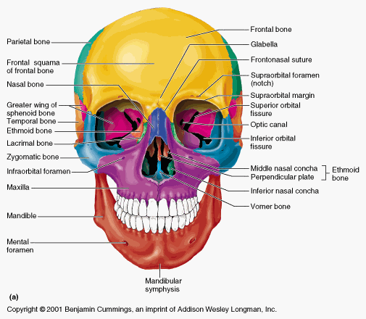
Cranium
1. Frontal bone- anterior portion of the cranium
-Forms the forehead, superior orbit, floor of the anterior cranial fossa
Features to note:
-Supraorbital foramen

Slide 13
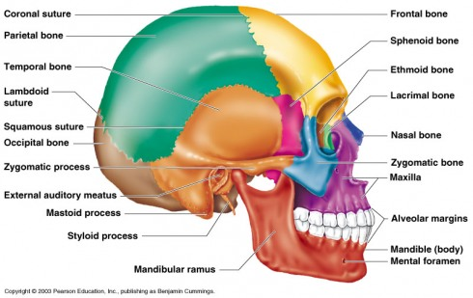
Cranium
2. Parietal bone (paired)
-Posterolateral to frontal bone
Features to note:
- Sagittal suture: midline articulation point of two parietal bones
-Coronal suture: articulation of parietal bones w/ frontal bone

Slide 14
Cranium
3. Temporal bone (paired)
- Inferior to parietal bone in lateral view
Features of note:
- Squamous suture –articulation w/ parietal bone
- Zygomatic process –projection that joins the zygomatic bone (facial) to form zygomatic arch
- Mandibular fossa–depression on inferior surface of zygomatic process that forms socket for mandibular condyle
- External auditory meatus (EAM)
- Styloid process –needlelike projection inferior to EAM, serves as attachment point for muscles/ligaments of neck

Slide 15
Cranium
Temporal bone features (cont.)
- Mastoid process –rough projection inferior and posterior to EAM, serves as attachment point for muscles
- Close to inner ear –infection can spread to here (mastoiditis)
- Infection can also spread to brain from here due to thin bony separation (meningitis)

Slide 16
Cranium
Temporal bone

Slide 17
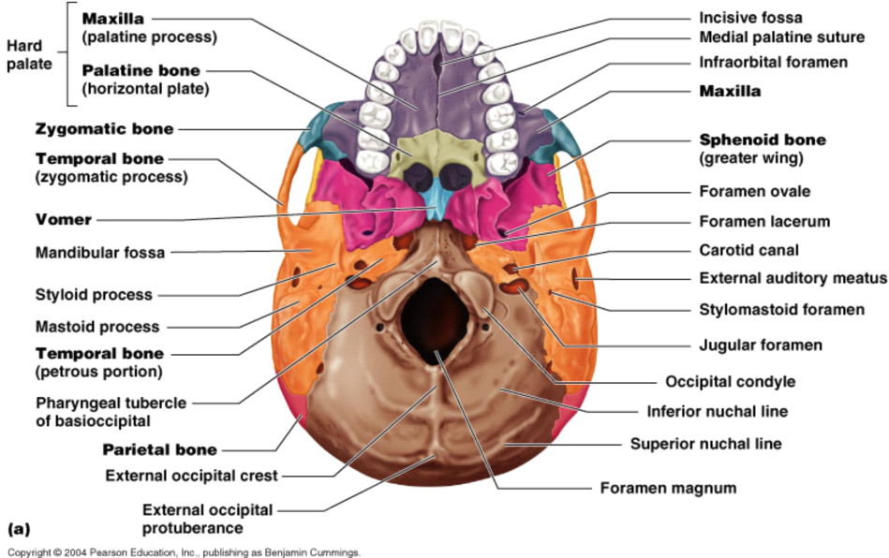
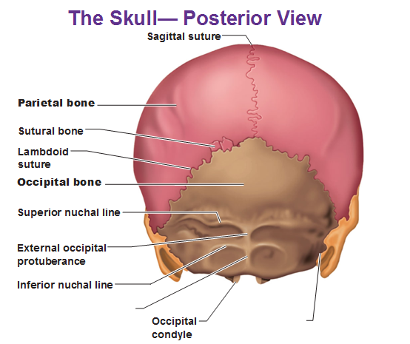
Cranium
4. Occipital bone
- Most posterior bone of cranium
- Forms posterior cranial fossa and back wall of cranial vault
Features to note:
- Lamboid suture –articulation w/ parietal bones
- Foramen magnum –large opening for passage of spinal cord to brain
- Occipital condyles –rounded projections lateral to foramen magnum for articulation w/ C1
- Carotid canal- passage way for the carotid artery to supply blood to the cerebral hemispheres

Slide 18
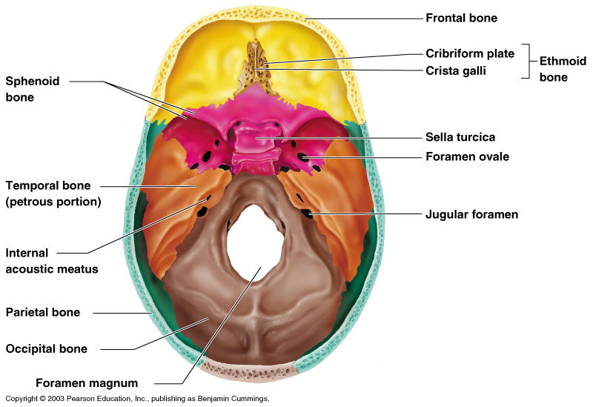
Cranium
5. Sphenoid bone: Bat-shaped bone forming anterior plateau of middle cranial fossa
Features of note:
-Optic foramen of sphenoid: jagged opening into orbits to allow passage of nerves associated w/ eye
- Hypophyseal fossa of the sella turcia- Holds the pituitary gland

Slide 19
Cranium
6. Ethmoid bone: Irregular-shaped bone anterior to sphenoid
Forms roof of nasal cavity, upper nasal septum and part of medial orbital wall
Feature of note:
-Portion of CN1 (smell) pass through cribiform plate in ethmoid to allow for sense of smell

Slide 20
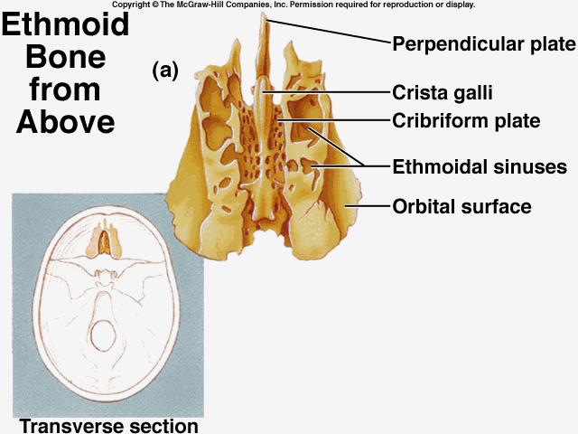
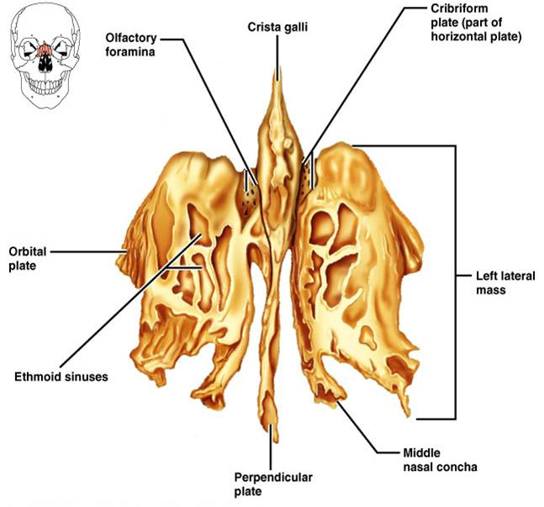
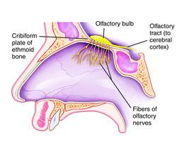
Cranium
Ethmoid bone cont.

Slide 21
Facial bones
14 bones composing face
12 are paired bones (only mandible and vomer are single)

Slide 22
Facial Bones
Mandible- aka “jawbone”
- Articulates w/ temporal bone via moveable joint
Features of note:
- Mental foramen –openings in body of mandible lateral to midline that allow for passage of nerves and blood vessles
-Mandibular condyle –process that articulates w/ mandibular fossa of temporal bone

Slide 23
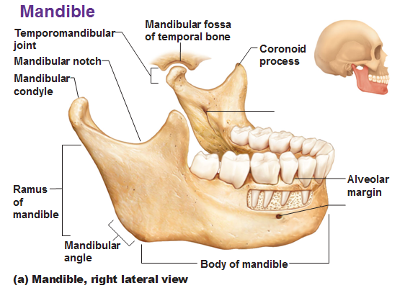
Facial bones
Mandible bone cont.

Slide 24
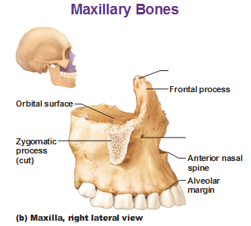
Facial bones
2. Maxillae- Two bones fused in median suture
- Form upper part of jaw and lower portion of orbits
- All facial bones except for mandible join maxillae (keystone of face)

Slide 25
Facial bones
Maxillae bones cont.
Features of note:
- Infraorbital foramen –convey nerves and blood vessels to nasal region of face

Slide 26
Facial bones
3. Lacrimal bone- Small bones forming part of medial orbital walls between maxilla and ethmoid

Slide 27
Facial bones
4. Palantine bone- Paired bones posterior to palantine process of maxillae
- Form posterior hard palate and part of inferior orbit

Slide 28
Facial bones
5. Zygomatic bone- Lateral to maxilla, forms portion of “cheekbones” and portion of lateral orbit

Slide 29
Facial bones
6. Nasal bone- Small, rectangular bones that forms bridge of nose

Slide 30
Facial bones
7. Vomer- Blade-shaped bone in median plane of nasal cavity that forms posterior and inferior portions of nasal septum

Slide 32
Quiz Yourself!

