Slide 1
Muscles: Extremities
A&P I Lab

Slide 2
Muscles of shoulder girdle
Pectoralis major
–Prime mover of arm
Pectoralis minor
–Moves scapula anterior
Serratus anterior
–Moves scapula anterior

Slide 3
Muscles of shoulder girdle
Trapezius
–Extends head
–Raises scapula (sup)
–Depresses scaupla (inf)
Levator scapulae
–Elevates scaupla
-ADDUCTION
Rhomboid major
–Pulls scapula medial
-- Stabilizes the scapula
Rhomboid minor
–Same as above

Slide 4
SITS Muscles
Supraspinatus- abduct; laterally rotate upper arm
Infraspinatus- laterally rotate upper arm
Teres minor- laterally rotate upper arm
Subscapularis- medially rotate upper arm

Slide 5
Muscles that move the arm
Pectoralis major
–Prime mover of arm flexion
Deltoid
–ABDUCTION of arm

Slide 6
Muscles that move the arm
Latissiums dorsi
–Arm EXTENSION and ADDUCTION
Teres major
–Works synergistically w/ above
Teres minor
–Same as above

Slide 7
Muscles that move forearm
Biceps brachii
–FLEXION of forearm
–Supination of forearm (Palm faces up)
-Origin: short head: coracoid process of the scapula; long head: supraglenoid tubercle of the scapula
-Insertion: tuberosity of the
radius
Brachialis
–FLEXION of forearm
Brachioradialis
–Forearm FLEXION

Slide 8
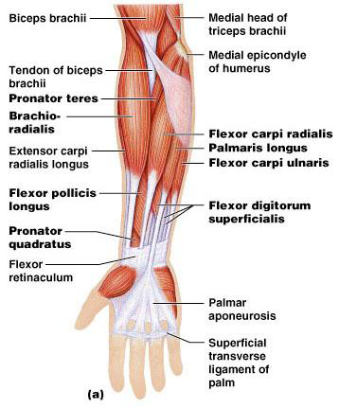
Muscles that move forearm
Triceps brachii
–Forearm EXTENSION
Pronator teres
–Pronates and FLEXION forearm

Slide 9
Muscles that move wrist and fingers
Flexor carpi radialis
–FLEXES wrist, ABDUCTS hand
Flexor carpi ulnaris
–FLEXES wrist, ADDUCTS hand

Slide 10
Muscles that move wrist and fingers
Extensor carpi ulnaris
–Extends, adducts wrist
Extensor carpi radialis longus
–Extends, abducts wrist
Extensor digitorum
–Extends digits, wrist

Slide 11
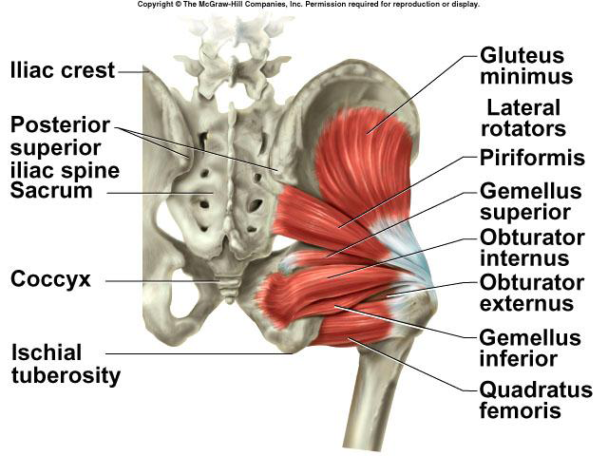
Muscles that move thigh
Gluteus maxiums
–Thigh EXTENSOR
Gluteus medius
–ABDUCTS and medially rotates thigh
Piriformis
–ABDUCTS and laterally rotates thigh

Slide 12
Muscles that move thigh
Tensor faciae latae
–FLEXES, ABDUCTS and medially rotates thigh
Adductus longus
–ADDUCTS, medially rotates, FLEXES thigh

Slide 13
Muscles that move leg
Quadriceps femoris
Rectus femoris: EXTENDS knee, FLEXES thigh
-Origin: the anterior inferior iliac spine and the the rim of the acetabulum
-Insertion: the base of the patella
Vastus lateralis: EXTENDS knee
Vastus medialis: EXTENDS knee
Vastus intermedius: EXTENDS knee

Slide 14
Muscles that move leg
Hamstring mm:
–Biceps femoris: EXTENDS thigh, laterally rotates leg, FLEXES knee
-Origin: ischial tuberosity
-Insertion: head of fibula
–Semitendinous: EXTENDS thigh, medially rotates leg, FLEXES knee
–Semimembranosus: same as above

Slide 15
Muscles that move leg
Gracilis
–ADDUCTS thigh, FLEXES and medially rotates leg
Sartorius
–FLEXES, ABDUCTS and laterally rotates thigh; FLEXES knee
–Aka “tailor’s muscle”

Slide 16
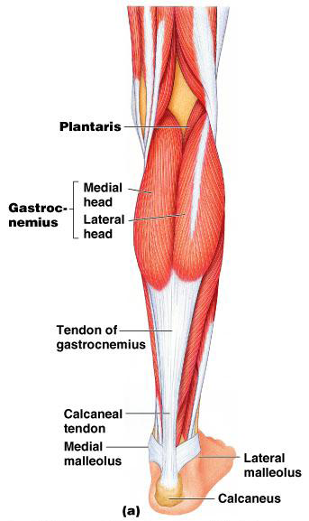
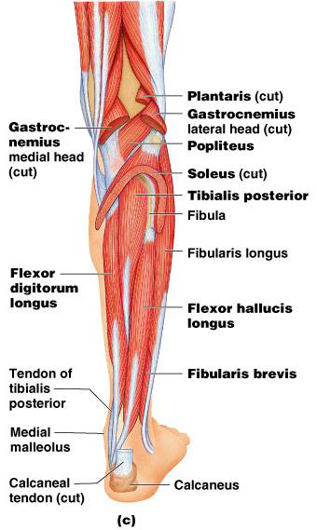
Muscles of feet and toes
Gastrocnemius–Plantar FLEXES foot
-Origin: femur
-Insertion: calcaneous
Soleus
–Plantar FLEXES foot
Tibialis posterior
–Inverts foot, plantar FLEXES
Flexor digitorum longus
–FLEXES toes, plantar FLEXES, inverts foot

Slide 17
Muscles of feet and toes
Peroneus (fibularis) longus
–Plantar FLEXES, everts foot
Tibialis anterior
–Dorsiflexes, inverts foot
Extensor digitorum longus
–EXTENDS toes, dorsiflexes foot

