Slide 1
Nervous Tissue & Neuron Anatomy
A&P I Lab

Slide 2
Nervous Tissue
The Nervous System s divided up into 2 parts: the Central Nervous System (CNS) and the Peripheral Nervous System (PNS).
The CNS contains the brain and spinal cord.
The PNS contains peripheral nerves that innervate skin, muscle, visceral organs, etc.
All of these structures contain nervous tissue.

Slide 3
Nervous Tissue
Two major cell types
- Neruoglia: support, protect and insulate neurons
- Neurons: Receive stimuli (irritability)
: Conduct impulses (conductivity)

Slide 4
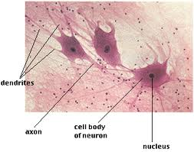
Nervous Tissue
Neuroglial

Slide 5
Neuroglia (support cells)
Types of Neuroglia cells:
-Astrocytes: regulate the transmission of electrical impulses within the brain and provide neurons with nutrients. Also, form scar tissue when damage occurs.
- Oligodendrocytes: produce myelin in CNS
- Ependymal cells: line the ventricles in the brain. They manufacture CSF and circulate it through the empty ventricles and into the rest of the CNS.
-Microglia: act as macrophages and remove damaged or invading cells.
-Schwann cells –produce myelin in PNS (forming myelin sheaths)

Slide 6
Neuron Anatomy
Common neuron components:
–Cell body (aka Perikaryon)–usually found in CNS in clusters called nuclei. They can be found in PNS in ganglia
•Make up gray matter in CNS (myelinated processes make up white matter tracts in CNS, and spinal nerves in PNS)
•Cell bodies contain:
–Nucleus: house DNA and makes ribosomes
–Neuroplasm: cytoplasm
–Neurofibrils: the cytoskeleton of the cell
–Nissl bodies: rER (rough endoplasmic reticulum). Synthesize proteins
–Smooth ER: detoxifies, stores Ca+ and
Produce lipids
–Mitochondria: synthesize ATP
- Lysosomes: contain digestive enzymes to break
down food particles.

Slide 7
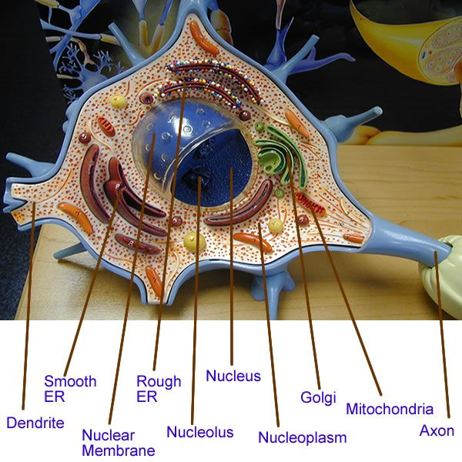
Neuron Anatomy

Slide 8
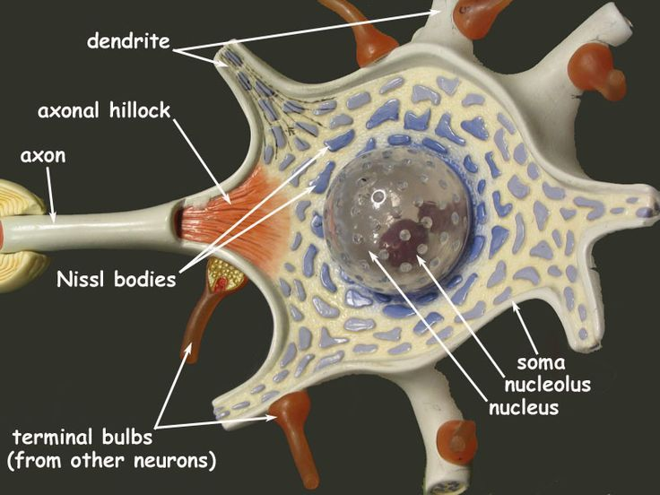
Neuron Anatomy
Dendrites–receptor regions of neuron
Axon–generate and conduct nerve impulses
•Axon hillock –part just distal to neuron body (site where APs are generated)
•Axon terminal –distal part of axon just before synapse where neurotransmitters are stored

Slide 9
Neuron Anatomy
Myelin–fatty protein covering most long neuron fibers (myelinated fibers)
Neurilemma–peripheral part of Schwann cell where its nucleus, etc are pushed out
Nodes of Ranvier –gaps in myelin sheath along axon
Endoneurium-protective covering around the axon

Slide 10
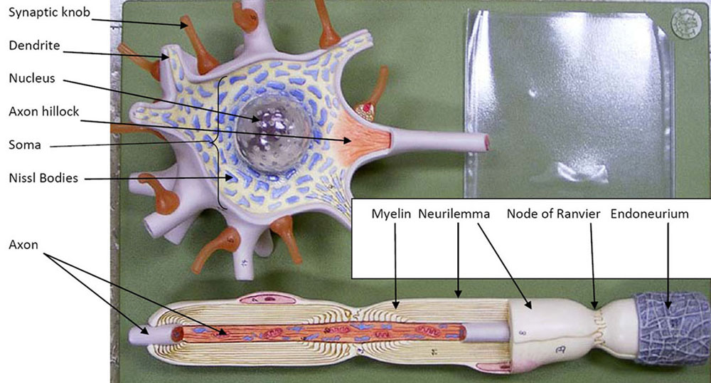
Neuron Anatomy

Slide 11
