Slide 1
Appendicular Skeleton
A & P I Lab

Slide 2
Appendicular Skeleton
126 bones (mostly paired)
Consists of pectoral and pelvic girdles, as well as bones of limbs

Slide 3
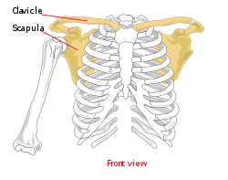
Pectoral Girdle
Two major bones:
- Clavicle
- Scapula

Slide 4
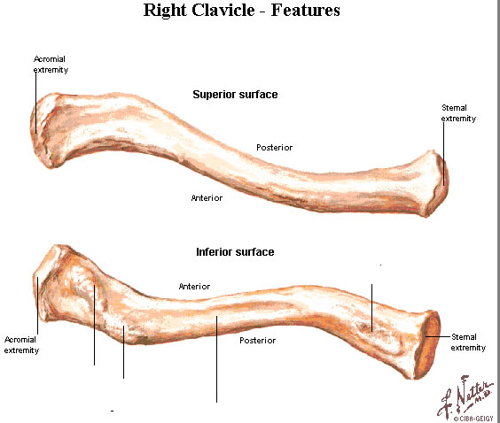
Pectoral Girdle
Clavicle
- Anterior to scapula
- Articulates w/ sternum medially and scapula laterally
Right clavicle

Slide 5
Pectoral Girdle
Scapula
Articulates w/ clavicle medially and humerus laterally
Flattened body w/ 2 important processes:
- Acromion –articulates w/ clavicle
- Coracoid –attachment point for muscles
Glenoid fossa (cavity) –attachment point for humerus
- Allows for freedom of movement
- Makes shoulder unstable joint

Slide 6
Pectoral Girdle

Slide 7
Brachial
Humerus –long bone
- Has proximal rounded head that articulates w/ glenoid of scapula
- Greater tubercle is lateral to head –attachment point for muscles
- Distal end has the trochlea medially –articulates w/ ulna; and capitulum laterally –articulates w/ radius
- Flanking these structures are the medial and lateral epicondyles, respectively

Slide 8
Brachial

Slide 9
Brachial (humerus)
Distal, posterior surface has olecranon fossa –allows corresponding process on ulna to move freely when arm is flexed/extended
Distal, anterior, lateral surface has radial fossa –receives head of radius when arm is flexed

Slide 10
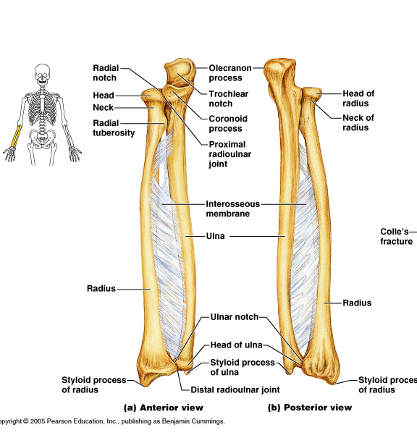
Antebrachial
Two bones:
- Ulna medially
- Radius laterally

Slide 11
Hand and wrist
Some Lovers Try Positions That They Can’t Handle
Carpal bones –short bones that form wrist
- Eight bones in all
- Scaphoid
- Lunate
- Triquetral
- Pisiform
- Trapezium
- Trapezoid
- Capitate
- Hamate

Slide 13
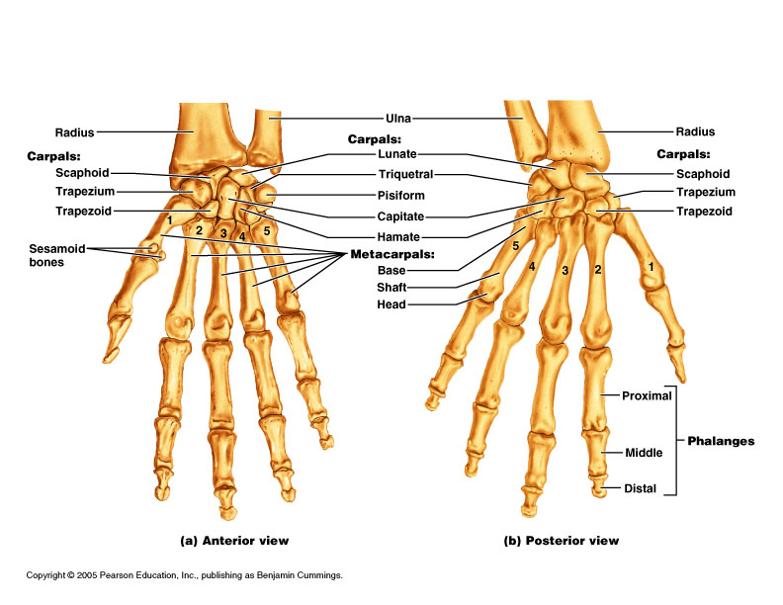
Hand and wrist
Hand:
- Proximal hand is composed of metacarpals
- Numbered 1 –5 starting w/ thumb

Slide 14
Hand and wrist
Fingers
- Composed of mini-long bones called phalanges
- Numbered the same way as metacarpals
- All except thumb have proximal, middle and distal phalanges
- Thumb only has proximal and distal phalanges
- Thumb also know as pollex anatomically

Slide 15
Hand and wrist

Slide 16
Pelvic Girdle
At birth, the pelvic girdle is three separate bones:
- Ilium, ischium and pubis
- These bones fuse by adolescence and become one bone
Note:
- Ilium
- Ischium
- Pubis

Slide 17
Pelvic girdle
Structures to note:
- Iliac crest
- Pubic symphysis
- Ischial tuberosity
- Acetabulum
- Obturator foramen
- Sacroiliac joint

Slide 18
Comparison of Male vs. Female Pelvic Structures

Slide 19
Characteristic | Male | Female
Bone thickness | Heavier, thicker, and more prominent markings | Lighter, thinner, and smoother
Pubic arch/angle | 50˚–60˚ | 80˚–90˚
Acetabula | Large; closer together | Small; farther apart
Sacrum | Narrow, longer; sacral promontory more ventral | Wider, shorter; sacral curvature is accentuated
Coccyx | Less movable; curves ventrally | More movable; straighter

Slide 20
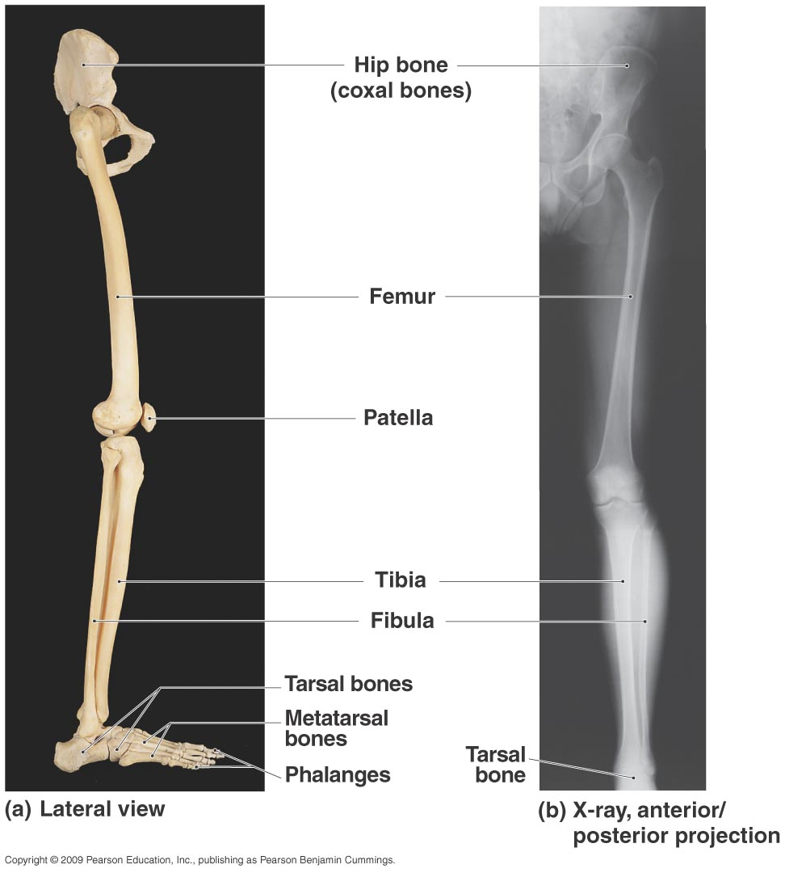
Leg
Composed of four bones:
- Femur
- Patella
- Tibia
- Fibula

Slide 21
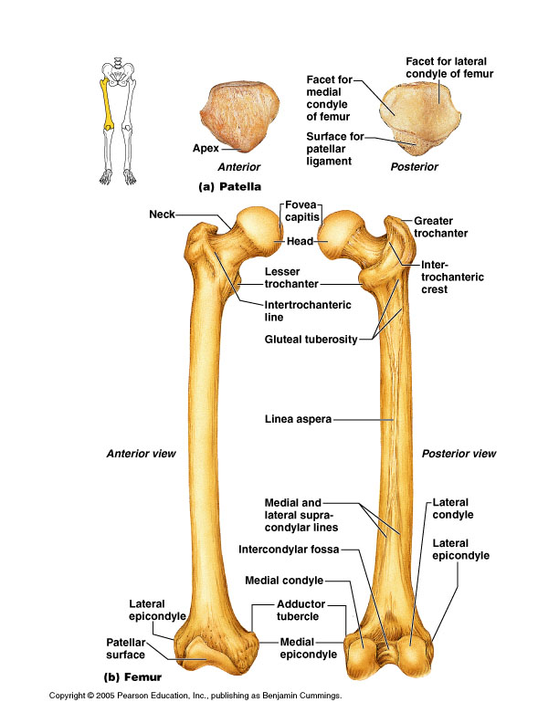
Thigh
Femur
- Head articulates w/ acetabulum in os cox
- Inferior and lateral to head is greater trochanter –attachment site for muscles

Slide 22
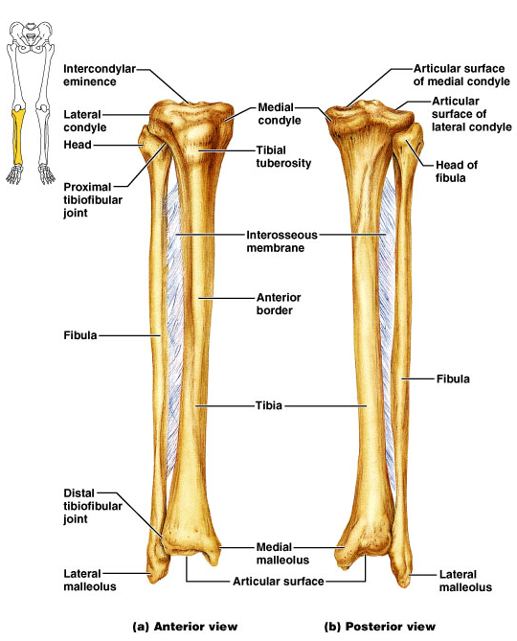
Leg
Two bones:
Tibia- Articulates w/ femur, fibula and tarsal bones
Fibula-Articulates w/ tibia and tarsal bones.
Distal process is called lateral malleolus.

Slide 23
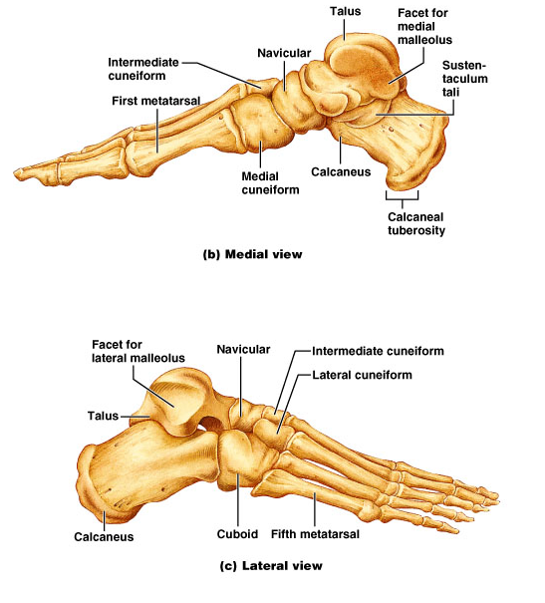
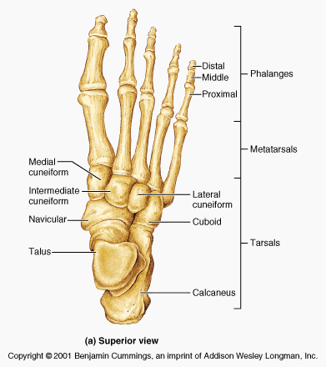
Foot
7 tarsal bones
5 metatarsal bones
14 phalanges bones

Slide 24
Foot
The Circus Needs More Interesting Little Clowns
Tarsal bones:
- Talus –articulates w/ tibia/fibula
- Calcaneous
- Navicular
- Medial Cuniform
- Intermediate Cuniform
- Lateral Cuniform
-Cuboid

Slide 25
Foot
Metatarsals
- Numbers same way as metacarpals
- 1 –5 starting w/ big toe
Phalanges
-Numbered same way as metatarsals / phalanges of fingers

Slide 26
Joints
Fibrous Joints
- No joint cavity
- Most have no movement
- Example: Sutures of the skull
Cartilaginous Joints
- Articulating bone ends are connected by plate or pad of cartilage
- No joint cavity
- Example: intervertabral discs, pubic symphysis
Synovial Joints
- Articulating bone ends are separated by joint cavity containing synovial fluid
- We will talk about these in the slides to come

Slide 27
Joints
Most moveable joints in body are called synovial joints
Six types of synovial joints in body classified by structure/movement
1. Plane(gliding) –flat articular surfaces allow bones to move in one or two planes
-intercarpal joints, intertarsal joints
2. Hinge–rounded process of one bone fits into a concavity on second bone to allow movement in one plane
-ulna/humerus joint (elbow)
3. Pivot–rounded surface of one bone fits into depression of second bone to allow for uniaxial motion
-proximal radioulnar joint

Slide 28
Joints
4. Condyloid–oval condyloid of one bone fits into ellipsoid depression on second bone allowing for biaxial movement
-metacarpophalangeal joints (knuckles) and radiocarpal (wrist)
5. Saddle–articulating surfaces are saddle shaped to allow for biaxial movement
-thumb/metacarpal joint
6. Ball and socket –ball-shaped head of one bone fits into cuplike depression in second bone
-shoulder and hip joints

