Slide 1
Eye and Ear
AP I Lab

Slide 2
Eye
•Outer most layer of eye:
–Sclera–white part or external eye, supports the eye
–Cornea–most anterior, clear part of eye, protective
•Middle layer of eye:
–Choroid–darkly pigmented, highly vascular layer that nourishes eye and prevents light scattering
–Ciliary body–composed of:
•Ora serrata –outermost ring of ciliary muscles
•Ciliary process –secrete aqueous humor
–Iris–pigmented smooth muscle that dilates and constricts to control amount of light entering eye
–Pupil–hole in iris that allows light to enter eye

Slide 4
Eye
•Inner most layer of eye (sensory layer):
–Retina–double-layered membrane that contains rods and cones, which transduce light energy into nerve impulses, this is how you see
–Macula lutea –Yellowish area of high cone density (color vision) on retina
•Fovea centralis –a small depression in the macula lutea, produce sharpest image
–Optic disc –spot where optic nerve leaves eye (blind spot)

Slide 5
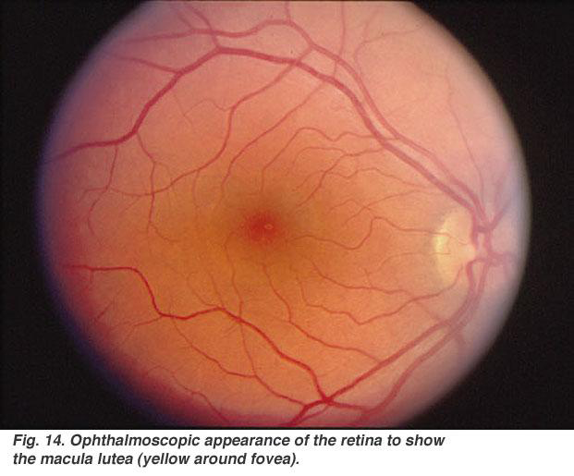

Slide 6
Eye
•Lens–clear, flexible structure that focuses light on retina. Action of ciliary muscles in ciliary body changes shape of lens to refocus light
•Anterior segment:
–Anterior chamber –between cornea and iris
–Posterior chamber –between iris and lens
–Aqueous humor –liquid in anterior segment, keeps eye lubricated
•Posterior segment–from lens to back of eye
–Vitreous humor –gel-like fluid filling posterior chamber, supports shape of eye

Slide 7
Posterior segment

Slide 8
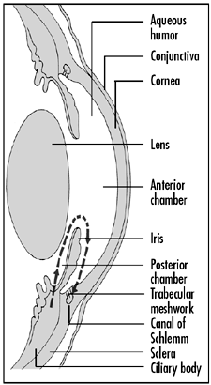
Eye
•Canal of Schlemm –duct at iris/cornea boarder that reabsorbs aqueous humor

Slide 9
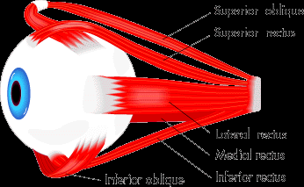
Extrinsic Eye Muscles
•Superior rectus
•Inferior rectus
•Medial rectus
•Lateral rectus
•Superior oblique
•Inferior oblique
Superior oblique
Superior rectus
Lateral rectus
Medial rectus
Inferior oblique
Inferior rectus

Slide 10
Iris
Sclera
Cornea (clear covering)
Pupil (opening in iris)

Slide 11
Sclera
Choroid
Optic nerve

Slide 12
Ciliary muscle (Gray dots)
Canal of Schlemm (black dot)
Cornea
Lens
Ciliary body
Ciliary process
Ora Serrata
Sclera
Choroid
Retina

Slide 13
Macula Lutea (area around central fovea)
Central Fovea
Blind spot
Posterior segment (Vitreous)
Anterior segment
Sclera
Choroid
Retina

Slide 14
Ear
•Pinna/Auricle –outer most part of ear
•External auditory meatus (EAM) –the tube
•Ceruminous glands –secrete cerumen (ear wax)
•Tympanic membrane –separates external ear from middle ear; aka ear drum
•Middle ear –chamber between tympanic membrane and inner ear; contains ossicles
•Eustachian tube –connects middle ear to nasopharynx

Slide 16
Ear
•Ossicles:
–Malleus
–Incus
–Stapes
•Oval window –Stapes articulates here to send vibrations into inner ear
•Round window –just inferior and medial to oval window

Slide 17
Ear
•Inner ear –composed of a membrane-filled bony labyrinth
•Vestibular apparatus –part of inner ear associated w/ balance:
–Utricle
–Saccule
–Semicircular canals
•Ampula–receptor at the base of each semicircular canal

Slide 19
Ear
•Cochlea–snail-shaped bony cavity that contains the mechanism of hearing
•Cochlear duct –spiral membrane that fills cochlea
–Has two levels:
1. Scala vestibuli –upper part of cochlear duct
2. Scala tympani –lower part of cochlear duct
•Spiral Organ of Corti –contiguous w/ cochlear duct → contains receptors for hearing (CN VIII)
•Tectorial membrane –part of SOC

Slide 21
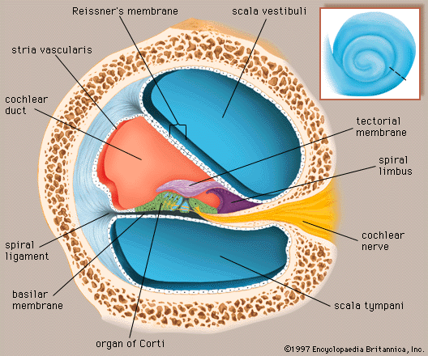

Slide 22
Pinna (Auricle)
Auditory ossicles
EAM
Tympanic membrane
Ceruminous gland
Auditory tube

Slide 24
Inner Ear Labyrinth

Slide 25
Inner ear Labyrinth
Round window

Slide 26
Cross Section of the Cochlea
Scala vestibuli
Cochlear duct
Tectorial membrane
Organ of corti
Scala tympani

Slide 27
Cross Section of the Cochlea
Enlarged Organ of Corti
Tectorial membrane
Organ of Corti

