Slide 1
Use this PowerPoint to Quiz yourself to see where you are at
Remember – you need to also be able to identify the structures on the animal models as well

Slide 2
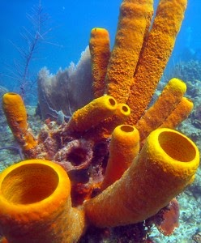
What type of symmetry do these animals have?
Do these animals have true tissues?
What does it mean to be sessile? Do the larvae have motility?

Slide 3
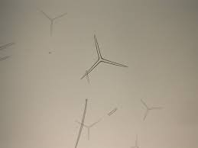
Identify
In what animals do you find these?

Slide 4
What are the 3 embryonic tissues layers?
What animals only have ectoderm and endoderm during embryological development?

Slide 5
What are the types of symmetry?
Phylum _____________ and Phylum _______________ have radial symmetry.

Slide 6
Identify Phylum
Do these animals have radial or bilateral symmetry?

Slide 7
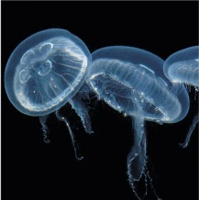
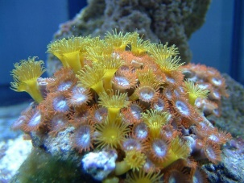
Identify Phylum
What type of symmetry?
How many embryonic tissues do these animals have?
What classes are found in this Phylum?
What are their specialized stinging cells called?
What is a gastrovascular cavity?
Do these animals have nerves?

Slide 8
Name Class

Slide 9
Name Class
Is this a polyp or medusa?

Slide 10
Identify Class

Slide 11
Is this a polyp or medusa?

Slide 12
What Phylum are flatworms in?
What classes are found in this Phylum?
Are flatworms acoelomates or coelomates?

Slide 13
Identify Phylum
Identify Class

Slide 14
This is a fluke (flatworm). What Class are flukes in?

Slide 15
Name Phylum
Name Class

Slide 16
What is a protostome?
What is a deuterostome?

Slide 17
Identify Phylum
Identify Class
Does this animal have a closed circulatory system?
Does this animal have a complete digestive system?
Is this animal hermaphroditic?

Slide 18
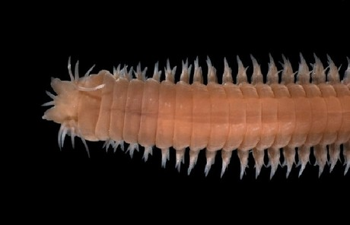
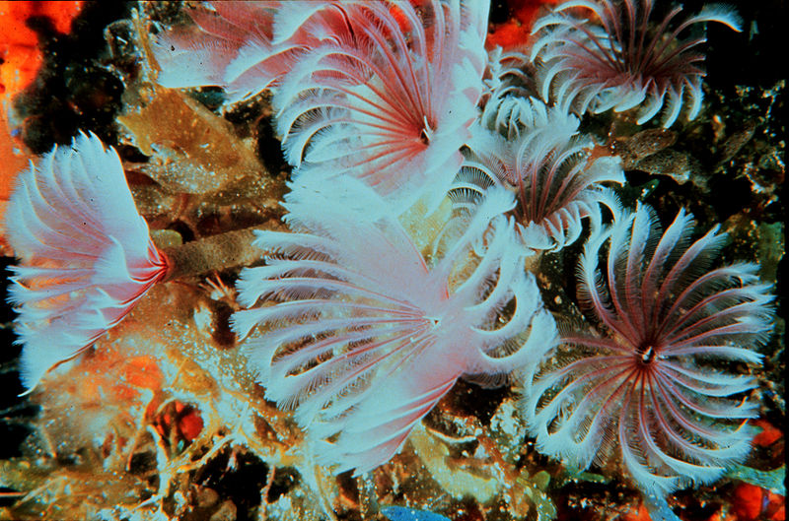
Identify Class

Slide 19
Name Class

Slide 20
Are animals in Phylum Mollusca protostomes or deuterostomes?
What are the Classes in Phylum Mollusca?
Which Classes have an open circulatory system?
Do Molluscs use gills or lungs?
What is the 3 part body plan of the Mollusc?
What makes Cephalopods different from the other Classes?

Slide 21
Name Phylum
Name Class

Slide 22
Name Class

Slide 23
Name Class

Slide 24
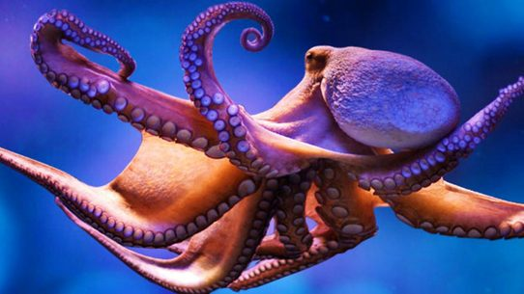
Name Class

Slide 25
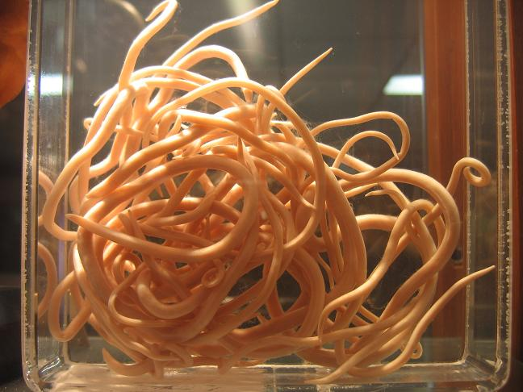
Name the Phylum?
Are these coelomates or pseudocoelomates?
Do they have a cuticle?

Slide 26
Are Arthropods protostomes or deuterostomes?
Do arthropods have jointed appendages?
What are the subphylums of Arthropoda that we looked at?
What is the exoskeleton of arthropods made of?

Slide 27
Name the Phylum?
Name the subphylum?
Name the Class
What is a cephalothorax?

Slide 28
Name the Phylum
Name the subphylum
Name the Class

Slide 29
Name Phylum
Name Subphylum
Do these animals have open or closed circulatory system?
Do they have gills or lungs?

Slide 30
Name Phylum
Name Subphylum

Slide 31
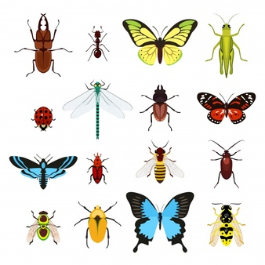
Name Phylum
Name subphylum
Name Class
What 3 body regions do they have?
How do they breathe?
How many legs do they have?

Slide 32
What is complete metamorphosis?
What is incomplete metamorphosis?

Slide 33
What does it mean to be a Deuterostome?
Name the 2 Phyla that are Deuterostomes?

Slide 34
Name the Phylum
What type of symmetry to the adults in this Phylum have?
What type of symmetry do the larvae have?
Do these animals have an endoskeleton?

Slide 35
Name Phylum
Name Class

Slide 36
Name Phylum
Name Class

Slide 37
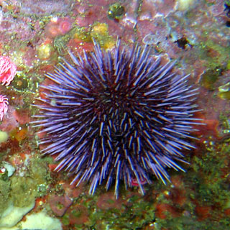
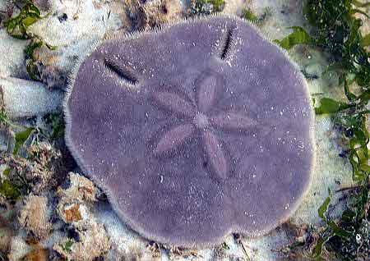
Name Phylum
Name Class

Slide 38
Name Phylum
Name Class

Slide 39
Hint: Echinoderm
Name Class

Slide 40
What are the characteristics of Phylum Chordata? (4)
What subPhylum are tunicates?
What subphylum are lancelets?
What subphylum are vertebrates?

Slide 41
In Subphylum Vertebrata, what Superclass are jawless fish in?

Slide 42
In Subphylum Vertebrata, what Superclass are the jawed vertebrates in?

Slide 43
Name the Classes of the following:
Cartilaginous fish
Bony fish
Amphibians
Reptiles
Birds
mammals
What does it mean to be a tetrapod?
Which Classes are tetrapods?
What does it mean to be an amniote?
Which classes are amniotes?

